Slide 1

Object orientated Programming with javascript
Object oriented design, how it helps, and how to use it.
Breakout example:
Https://github.Com/seanyoung247/breakout

Slide 2

What is object oriented programming?
Breaks code down to simpler units
These units are called objects
Objects are self-contained and reusable
Object orientation has four primary principles:
Encapsulation
Abstraction
Inheritance
Polymorphism

Slide 3
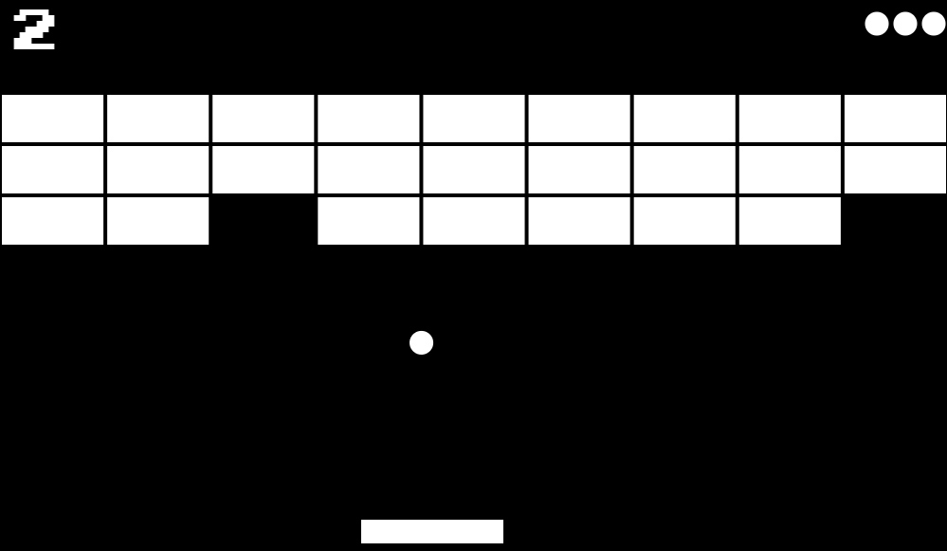
Encapsulation
An object’s internal data is private
Objects interact using a public interface
Breakout has three main game objects:
A Ball
A Paddle
Blocks
A Paddle has:
A position
A size
A movement speed
A Paddle can:
Move
Collide

Slide 4
Abstraction
This:
Hides implementation details
Helps break down complexity
Makes code more readable
vector.rotate(angle);
Is probably more readable
(and easier to maintain) than this:
const radians = angle * Math.PI / 180;
const x = Math.cos(radians);
const y = Math.sin(radians);
const tX = vectorX * x - vectorY * y;
const tY = vectorX * y + vectorY * x;
vectorX = tX;
vectorY = tY;
A Ball can:
Move - The game doesn’t care how, just that it moves.
Collide - Blocks don’t care how collision is decided, just that it collides.
Bounce - The Paddle doesn’t care how it bounces, just that it does.

Slide 5
Inheritance
GameObject
position
size
draw()
collide()
Aids code reuse
Helps in defining interfaces
In breakout all game objects have:
A position
A size
And they can:
Draw
Collide
Ball
Paddle
Block
Ball.collide();
Paddle.draw();

Slide 6
Polymorphism
Objects can redefine functionality
GameObject
Ball.draw()
Position
Size
Draw()
Collide()
Block.draw()
Paddle.draw()
Block
Ball
Collide() {
if (base.Collide()) {
ball.isAlive = false;
}
}
Draw() {
draw_a_circle();
}

Slide 7
Object Oriented Javascript
You create new objects with the ‘new’ keyword:
let myObject1 = new Object(); let myObject2 = new Object();
Object properties and methods are accessed through dot notation:
object.property = 1; object.method(12);
Or bracket notation:
object[‘property’] = 1; object[‘method’](12);
The ‘this’ keyword gives us access to the object’s fields:
object.method(12);
class Object {
method(x) {
this.property = x;
}
}

Slide 8
JavaScript Classes
class GameObject {
}
constructor(game, boundingBox) {
this._game = game;
this._box = boundingBox;
}
let gameObj = new GameObject(game, new BoundingBox(x, y, w, h));
Constructor: Creates a new instance of an object
get dimensions() {
return this._box;
}
set dimensions(val) {
this._box = val;
}
gameObj.dimensions = new BoundingBox(x, y, w, h); //set
let dimensions = gameObj.dimensions; //get
Get/Set: lets class users get object property values without exposing the properties themselves.
collision(object) {
return this._box.collision(object._box);
}
let colliding = gameObj.collision(anotherObj);
Methods: Operate on the class data

Slide 9
Javascript Inheritance
class Block extends GameObject {
}
constructor(game, boundingBox) {
super(game, boundingBox);
this._alive = true;
}
let block = new Block(game, new BoundingBox(x, y, w, h));
Constructor: Must call base class constructor
get isAlive() {
return this._box;
}
let alive = block.isAlive; // get works
Block.isAlive = false; // set does nothing
collision(object) {
let colliding = false;
if (this._alive) {
colliding = super.collision(object);
this._alive = !collision;
}
return colliding;
}
class GameObject {
collision(object) {
return this._box.collision(object._box);
}
}

Slide 10
Abstract classes
Can define a category of objects
Can’t be created, can only be extended
Used to define a basic interface for derived classes
Can ‘force’ derived classes to implement interfaces through static methods
class AbstractClass {
constructor() {
if (this.constructor === AbstractClass) {
throw new TypeError('Abstract class cannot be instantiated directly');
}
}
AbstractMethod() {
throw new TypeError('Abstract method not overridden by derived class.');
}
}

Slide 11
Bringing it together: Breakout
Game
-canvas
-thisFrameTime
-lastFrameTime
-actionMap
-keyMap
-lives
-score
-won
-bounds
-paddle
-ball
-blocks
-startFrame()
-checkVictory()
-update()
-drawFrame()
-endFrame()
+loseALife()
+increaseScore()
+loop()
+keyDown()
+keyUp()
+mouseMove()
Block
-alive
+draw()
+collision()
AbstractClass
-baseClass
+AbstractMethod()
Point2D
-x
-y
+distanceTo()
Paddle
-speed
+draw()
+collision()
+moveLeft()
+moveRight()
+setPos()
BoundingBox
-width
-height
+inbounds()
+collides()
+contains
GameObject
-game
-boundingBox
+draw()
+collision()
Ball
-vector
+draw()
+collision()
+move()
Vector2D
+normalize()
+magnitude()
+radian()
+rotate()

Slide 12
Questions
Further reading
Object Orientation in JavaScript (MDN):
https://developer.mozilla.org/en-US/docs/Learn/JavaScript/Objects/Basics
Classes (javascript.info):
https://javascript.info/classes

