Slide 1

La conjugaison
Le sablier des verbes

Slide 2

Les temps - Tenses
Tenses are what tells you when something happens

Slide 3

Fun: a conjugating dog

Slide 4
For example:
Past: I was at the store. Sometimes the verb "to have" is used to convey the past tense: I have been there before.
Present: I am at the store. In English you can also have a tense called the continuous present: Now, I am going to the store
Future: I will go to the store. In English, sometimes the verb "to go" is used to convey the future tense: I'm going to go to the store.

Slide 5
Infinitives ( full forms of verbs)
In English infinitives start with TO – to walk – to be – to have
In French the endings tell you if the verb is in its infinitive form:
Stem+ER / Stem+IR / Stem+RE
Jouer / finir / vendre

Slide 6
Personal pronouns
je –I /tu- you singular /elle,il,on - she,he, one /nous-we /vous-you plural /elles,ils-they fem,masc)
In French verb endings change to agree with the subject (here the personal pronoun)

Slide 7
Le présent
There is only one present in French
( No continuous presents!)
To conjugate the verbs in the present take the ER or IR or RE off and replace by:
ER verbs
Je – e
Tu –es
Elle,il,on –e
Nous –ons
Vous –ez
Elles,ils -ent
IR verbs
Je – is
Tu –is
Elle,il,on –it
Nous –issons
Vous –issez
Elles,ils -issent
RE verbs
Je – s
Tu –s
Elle,il,on –
Nous –ons
Vous –ez
Elles,ils -ent

Slide 8
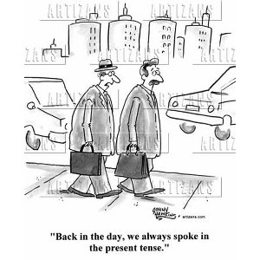
The past tenses

Slide 9
Let’s focus on two different Past tenses
Past tense 1, is called:
the PERFECT tense / Le Passé-composé
It is used to describe an action with a clear beginning and an end in the past
Past tense 2, is called:
The IMPERFECT / l’Imparfait
It is used when in English you can say – USED TO…
When you are describing something in the past ( The weather was good) & when you want to say: IT WAS (C’était)

Slide 10
The Perfect / le passé-composé
Is built in 2 parts: The Auxiliary and the Past Participle
The Auxiliary: avoir or être in the present
The PP: -é/-i/-u ( + many irregular PPs)
e.g: Tu as mangé // Il est parti

Slide 11


When to use avoir or être as an auxiliary (first part)?
Reflexive verbs take être as well as DR.Mrs.vandertramp

Slide 12
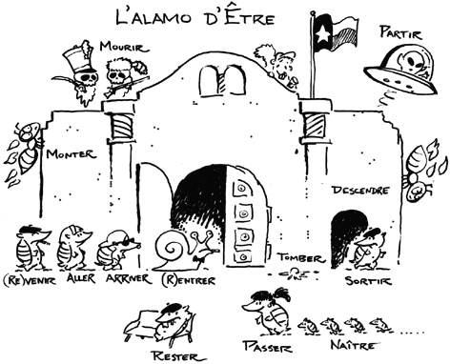

Slide 13


Another fun thing about être verbs
The PP (second part) agrees with the subject
Add an when the subject is feminine
Add an when the subject is plural
Add an & an when the subject is feminine plural
e.g; Elle est allée au cinéma /elles sont allées au cinéma

Slide 14
The Imperfect/l’imparfait
To build it you need to take the stem of Present tense verb in the NOUS form
E.g: Nous mangeons take off the ONS
and add:
Je mangeais
Tu –ais
Elle,il,on –ait
Nous -ions
Vous –iez
Elles,ils -aient

Slide 15
The simple future
In English: I WILL run 10 miles
In French keep the whole infinitive for ER and IR verbs (For RE verbs just take off the E) There Must always be an R!!!
and add:
Je mangerai
Tu finiras
Elle,il,on vendra
Nous – ons
Vous –ez
Elles,ils -ont

Slide 16
The Near future / le future proche
Use the present tense of the verb to go . Aller and add your infinitive
Je vais parler
Tu vas finir
Elle,il,on va apprendre
Nous allons chanter
Vous allez partir
Elles,ils vont attendre

Slide 17

Good luck with your

