Slide 1
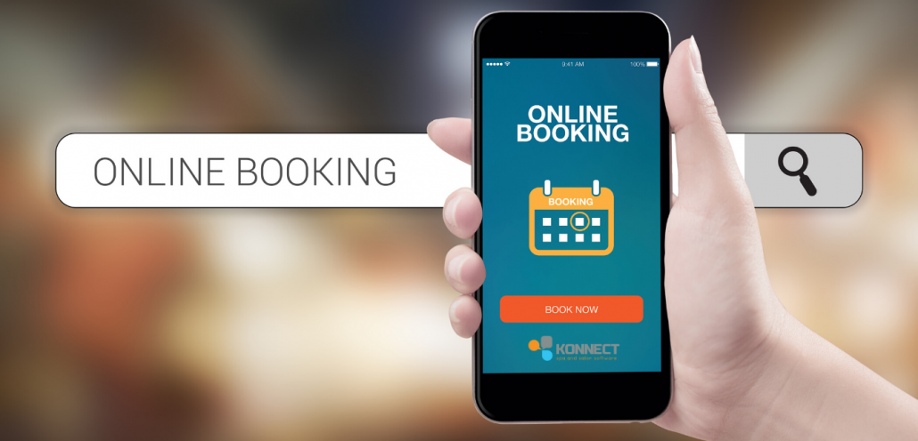
Problem Statement
How can I design an application that allows Users to book a table?
What functionality will the User require?
What functionality will the Administrator require?
What functionality will be used by both Admin and the User?

Slide 2
As a User / Admin I can arrive at the home page and see the main image and a navbar with options so that I can:
register
login
view menu
view contact details
make a reservation
Home
Page
User / Admin
Story
All Roles

Slide 3
As an admin I can click on the navbar and select “Login" so that I can access the admin environment
Create HTML and CSS
Admin Story
Admin Login
Create Models
Acceptance Criteria:
Identify navbar
Select Login
View Login form
Admin
Environment
EPIC
Admin Login
Admin
Admin Story
Admin Login
As an admin I can insert my admin credentials on the login form to access the admin environment
Create HTML and CSS
Create Models
Acceptance Criteria:
View Login form
Insert username
Insert PW

Slide 4
As an admin I can view pending customer bookings so that I can approve / reject reservation requests
Create HTML and CSS
Admin Story
User Approvals
Create Models
Acceptance Criteria:
View pending booking requests
Accept booking requests
Admin
Environment
EPIC
Admin functions
Admin Story
User Contacts
As an admin I can view User contact details so that I can reach out to them for any reasons pertinent to their booking
Create HTML and CSS
Admin
Create Models
Acceptance Criteria:
View customer contact details
Admin Story
Booking system
As an admin I can access the booking system so that I can amend / Cancel User Bookings
Create HTML and CSS
Create Models
Acceptance Criteria:
Amend / cancel bookings
Admin Story
Menu
As an admin I can access the menu feature so that I can amend the menu
Create HTML and CSS
Create Models
Acceptance Criteria:
Upload new PDF

Slide 5
EPIC
View Menu
User Story
Menu
As a User I can click on the navbar and select “Menu" so that I can see the day’s menu
Create HTML and CSS
Create Models
Acceptance Criteria:
Identify navbar
Select menu
View menu in PDF
User
Home
Page
As a User I can click on the navbar and select “Contacts" so that I can see the restaurant’s contact details
Create HTML and CSS
EPIC
View Contacts
User Story
Contacts
Create Models
Acceptance Criteria:
Identify navbar
Select contacts
View contacts

Slide 6
User Story
Register
As a User I can click on the navbar and select "Register" so that I can create an account
Create HTML and CSS
Acceptance Criteria:
Identify navbar
Select Register
View register form
Create Models
Non
Signed-in
User
Home
Page
EPIC
Register
As a User I can Register by providing a Email, create a Password and confirm Password so that I can obtain access to my account
Create HTML and CSS
User Story
Register
Create Models
Acceptance Criteria:
Insert email
Create PW
Confirm PW
Contact number (optional)

Slide 7
User Story
Login
As a Registered User I can click on the navbar and select "Login" so that I can access my account
Create HTML and CSS
Create Models
Acceptance Criteria:
Identify navbar
Select Login
View Login form
As a User I can login by using my Email and Password so that I can access the site’s contents and book a table
Create HTML and CSS
Registered
User
Home
Page
EPIC
Login
User Story
Login
Create Models
Acceptance Criteria:
View Login form
Insert email
Insert PW
User Story
Login
As a Registered User I can click on the "forgot password" feature so that I can reset my password
Create HTML and CSS
Create Models
Acceptance Criteria:
Select forgot PW feature to reset PW

Slide 8
User Story
booking
As a Registered User I can click on the navbar and select “make a reservation" so that I can book a table for dinner
Create HTML and CSS
Create Models
Acceptance Criteria:
Identify navbar
Select make reservation
View calendar and time
Set number of seats
Registered
User
Home
Page
EPIC
Bookings
User Story
booking
Create HTML and CSS
As a User I can login into my account so that I can cancel my bookings
Create Models
Acceptance Criteria:
View profile
View current bookings
Cancel bookings
User Story
booking
Create HTML and CSS
As a User I can login into my account so that I can amend my bookings
Create Models
Acceptance Criteria:
View profile
View current bookings
Amend bookings times / No. of seats

Slide 9
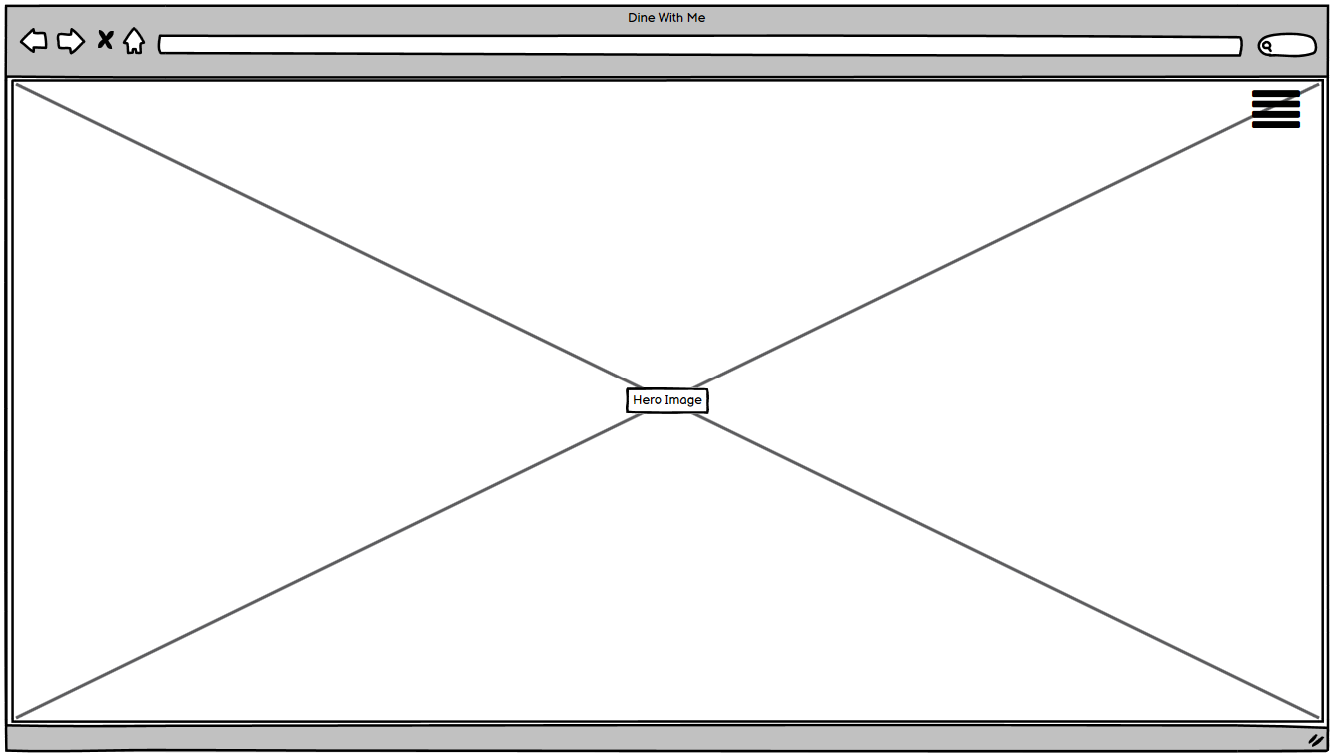
Database requirement assessment
Home Page – No db required(Just HTML & CSS)

Slide 10
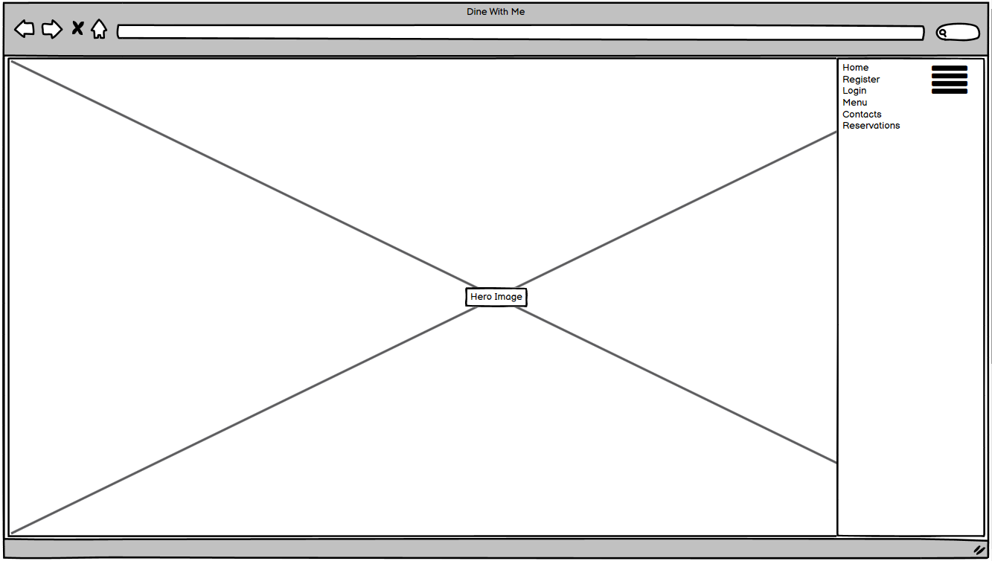
Database requirement assessment
Navbar – No db required(Just HTML & CSS & JQuery)

Slide 11
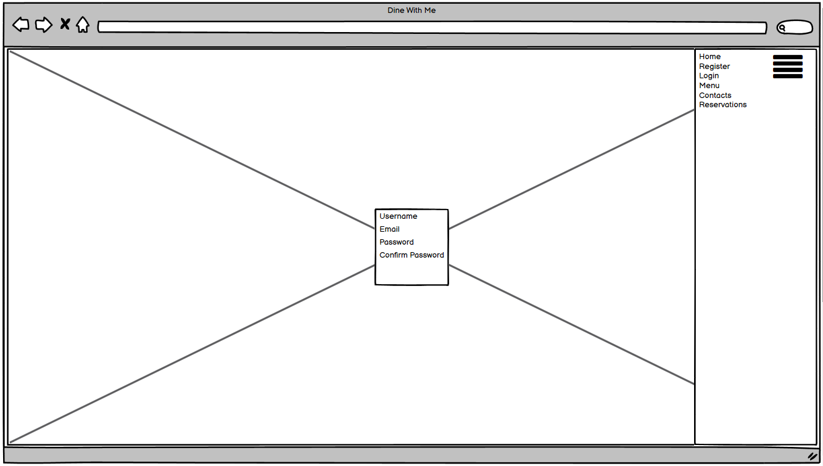
Database requirement assessment
Registration Page – DB required
Key | Name | Type
ForeignKey | Username | User Model
 | First Name | CharField (max 80)
 | Last Name | CharField (max 80)
 | Email(Unique) | EmailField()
 | Contact(Unique) | IntField
 | Slug(Unique) | SlugField

Slide 12
Table – 2 seats per table
Database requirement assessment
Key | Name | Type
ForeignKey | Table | IntegerField()
Booking model
User model
Key | Name | Type
ForeignKey | Restaurant | Booking model
 | No.of.atendees | PositiveIntegerField()
 | table | ManyToManyField(Table)
 | Date | DateField()
 | Time | TimeField()
 | length | DurationField()
 | End_time | TimeField()
Key | Name | Type
ForeignKey | Username | User Model
 | First Name | CharField (max 80)
 | Last Name | CharField (max 80)
 | Email(Unique) | EmailField()
 | Contact(Unique) | IntField
 | Slug(Unique) | SlugField

Slide 13
Database requirement assessment
Navbar – No db required(Just HTML & CSS & JQuery)

Slide 14
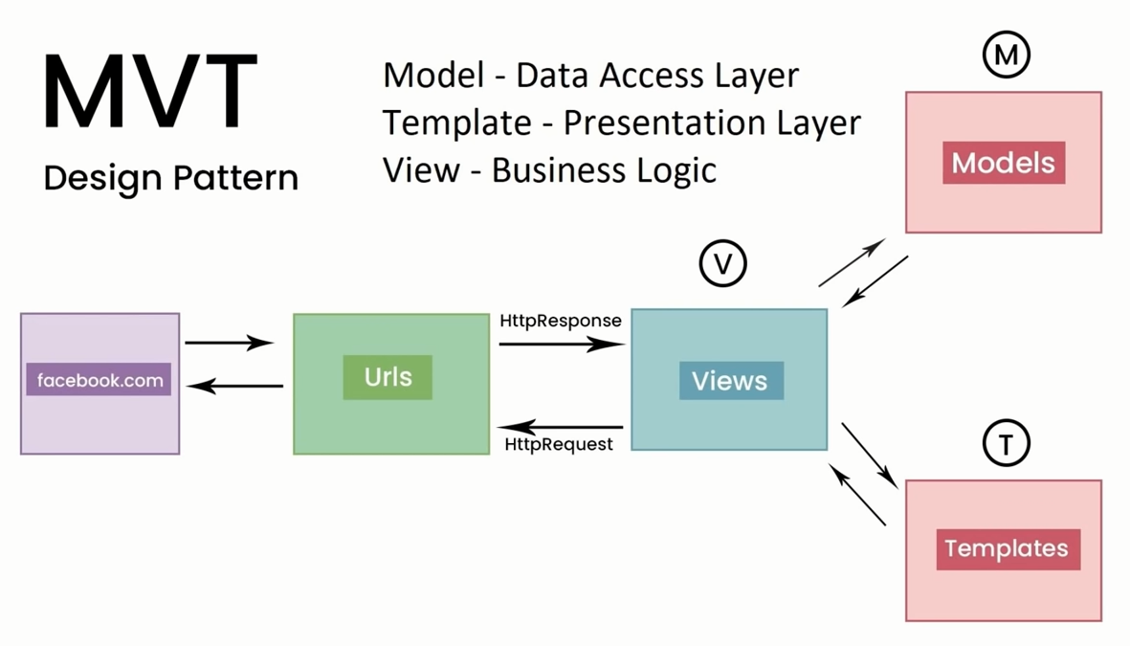

Slide 15
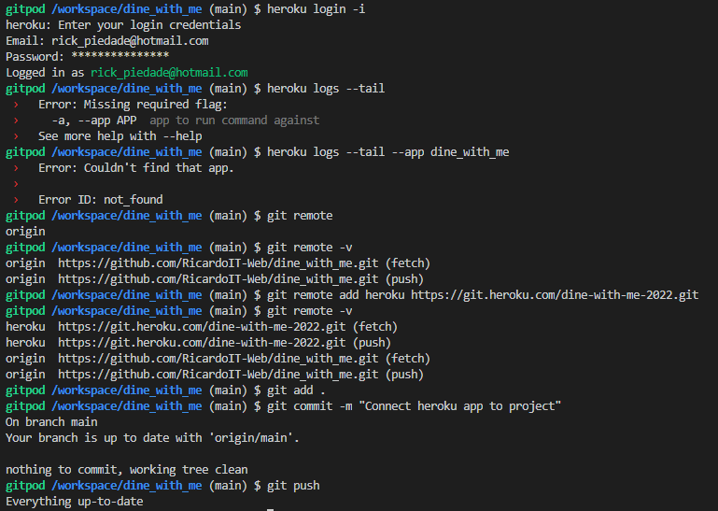
Managing H10 errors on Keroku

Slide 16

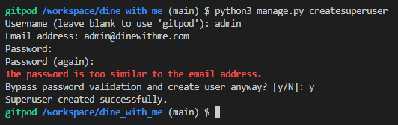
Create superuser
Pw: dinewithme

