Slide 1
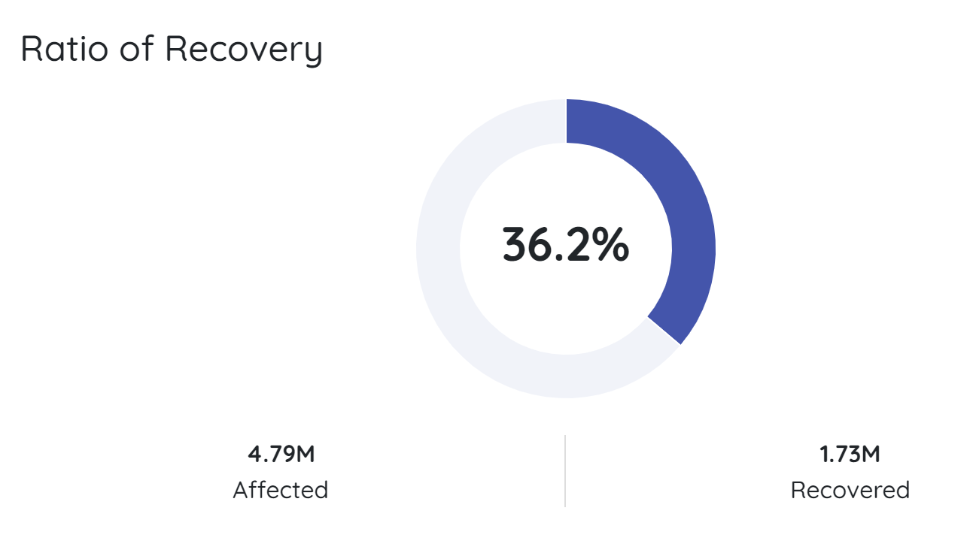
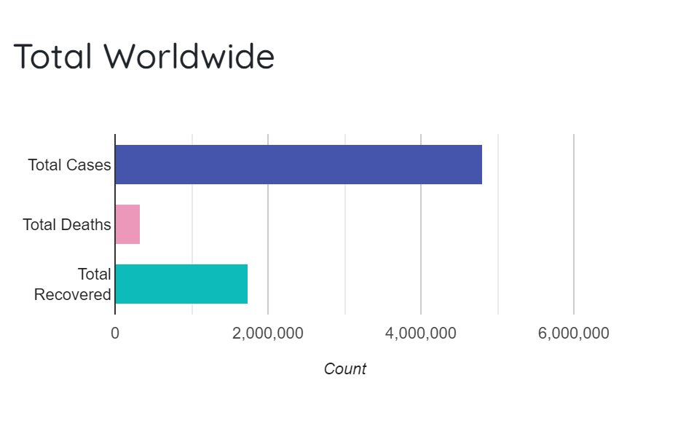
WORLD
COUNTRY
SYMPTOMS
RESOURCES
SUPPORT
#UNITEDTOGETHER
Global crisis
{{API – GLOBAL}}
Top 5 table
{{table}}
Map
By countries
{{search-function}}
{{API – Country}}
Symptoms
Preventions
Fixed info
Fixed info
Recent news
{{Scrape for news on covid19}}
Wall of Fame
{{Total amount collected}}
Top 3 donors based on ‘fake donation data’
SUPPORT & DONATE TODAY
(External link to donation field)

Slide 2
Full Name: Contact Number: Email Address: Amount Pledged (SGD): Anonymised Donation: Yes/No
SUPPORT & DONATE TODAY

