Slide 1


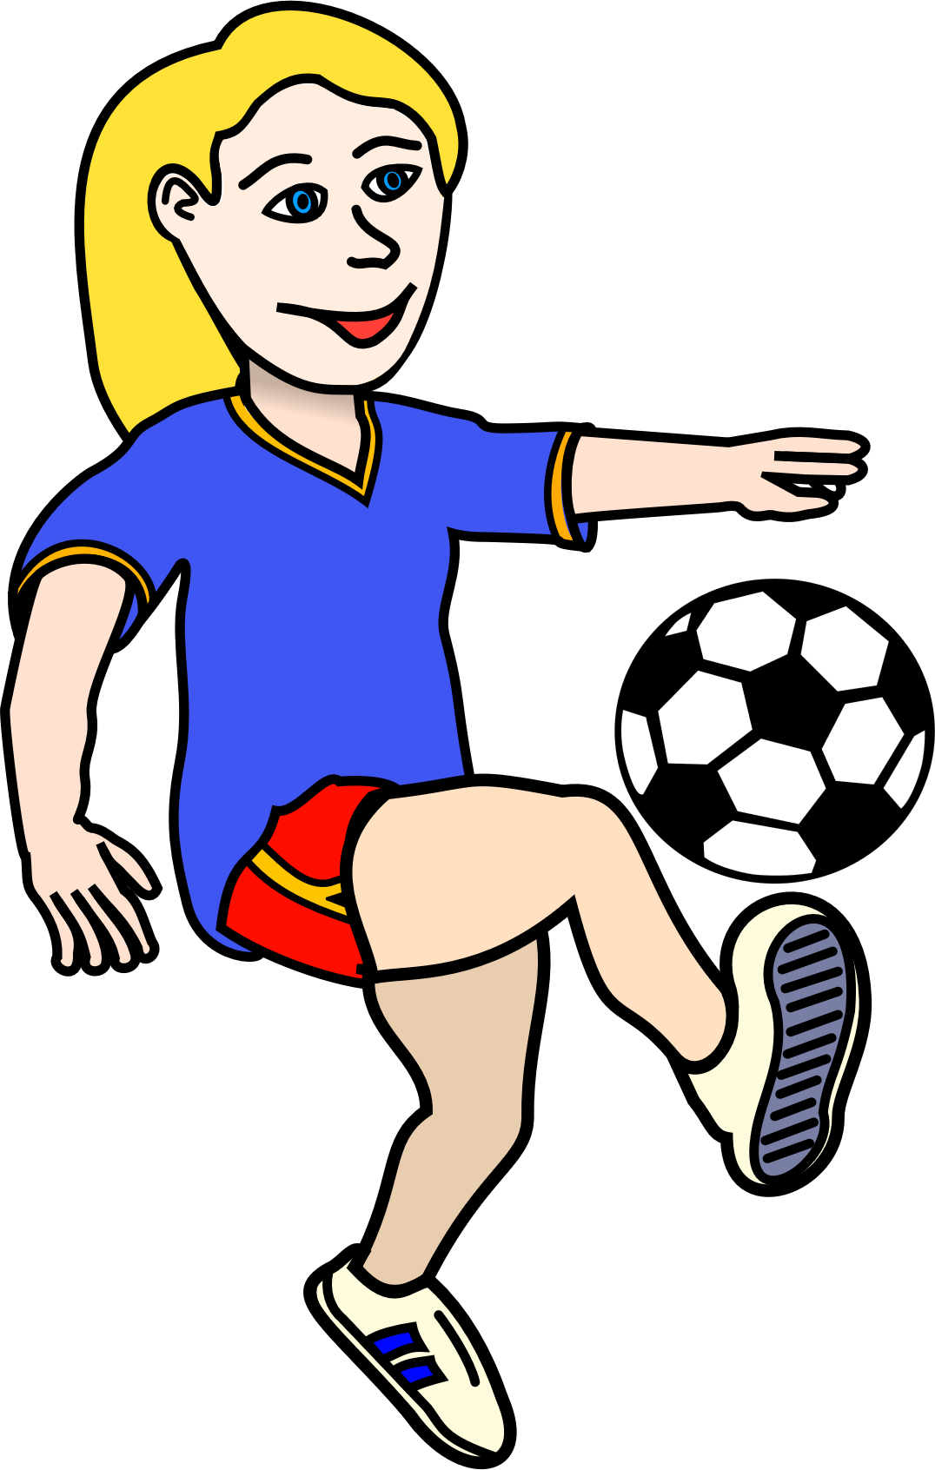
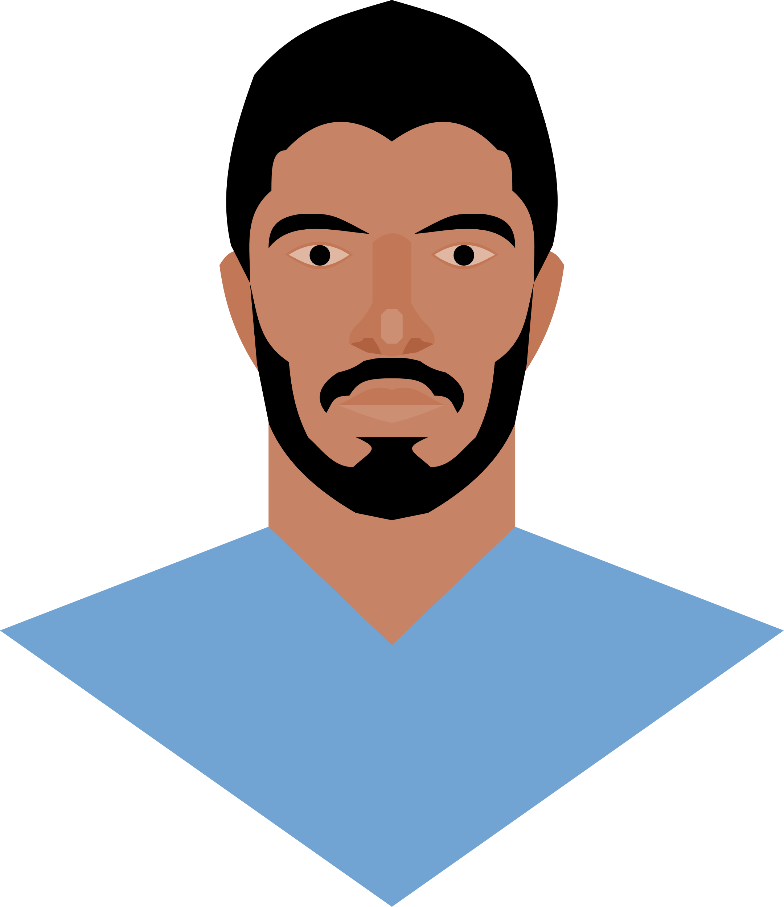
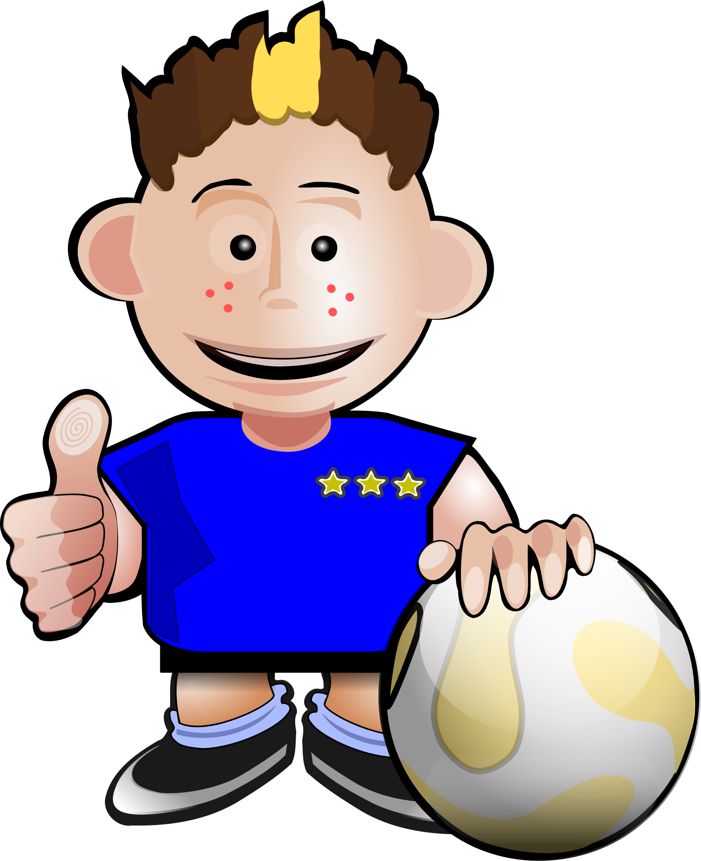
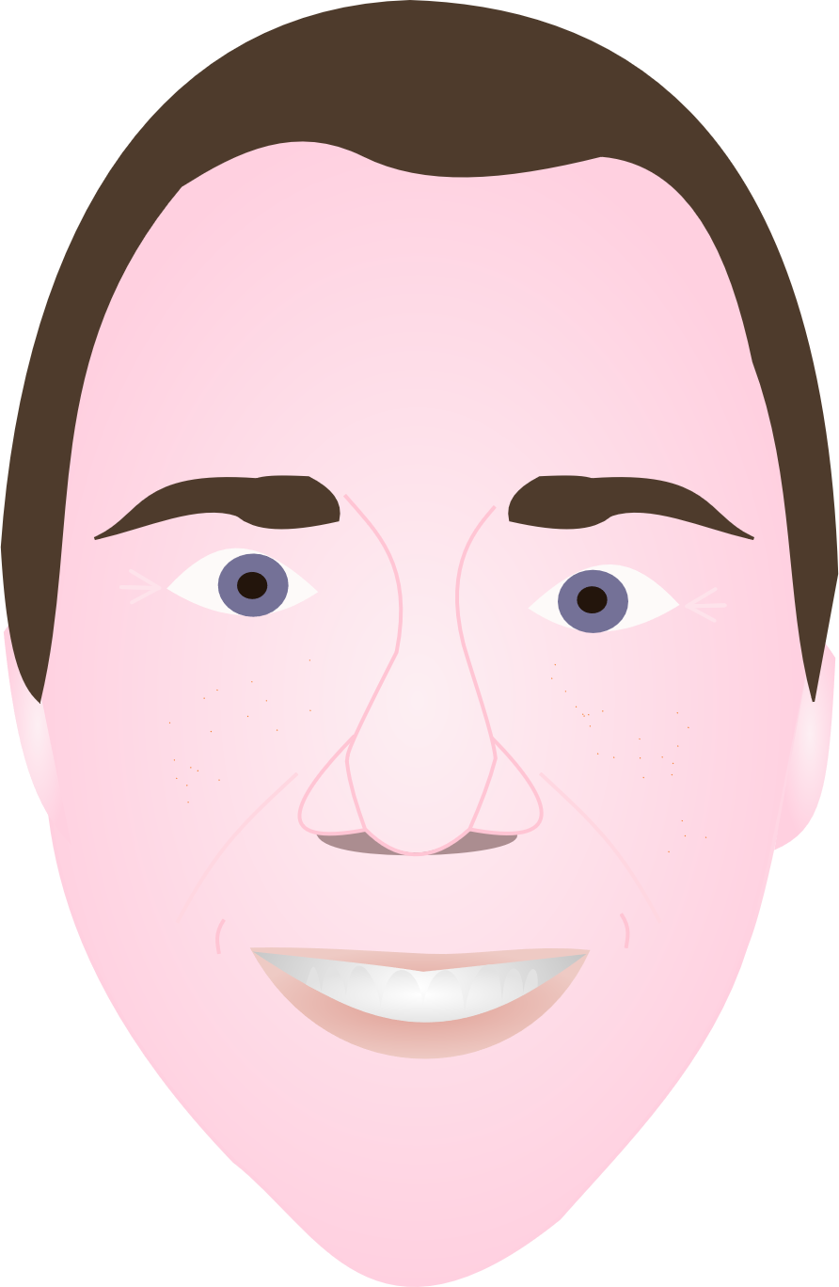
Personas
Football Fans
Journalist
John Johnson
Middle age father of two with little online experience. John is looking to buy some tickets for him and his children but also wants some information on the venue. John is cautious about shopping online and doesn’t do it often. He will not ne a regular visitor to the site and will only use it to purchase tickets. John has a laptop and mobile phone but doesn’t use it to go online.
May Little
Jack Horner
Young adult who is online often across many devises. Not a club fan but likes to visit other team sites for local news and also venue information. Jack would not visit the site often but when he does he will be looking for news or possibly travel information.
Teenager / young adult fan of the clue who goes online often vie her mobile and tablet. Loves football and loves watching highlights on the go. Owns a laptop computer but prefers to go online via portable devices. Will want to watch videos, get news and fixture updates on the go. Would look to get regular updates from the club and has keen interest in social media. Would like to connect to the players and follow players on social media. Buys online often and uses paypal / other service. Will be a regular visitor to the site and expect lots of updates. Mary likes to customise her device with the team colours so would look to get this from site.
Amy Lawrence
Adult who is not a fan but is a sports journalist. Online often especially on portable devices and always on the go. However, bulk of work is done on a laptop computer. Amy would visit the site in order to collect information for his articles so would expect to have up to date information on the go. Amy would also look to get info while working so may visit site on his laptop. Amy would also be interested in club and players social media accounts for news updates
Player
Mesut Ozil
Young adult who plays for the club. Uses social media a lot and is competent online, mainly on his portable device. Would use website sparingly, would only use website to get social media info for other players. May use site to check fixture list and see where they are travelling in future.
Tony Adams
Older player, doesn’t use social media but owns portable devices as well as laptop. Would like to be able to check fixtures online and get news updates from club. Will not visit site often

