Slide 1
Applied Data Science with R Capstone project
Felipe de Oliveira
13/07/2024

Slide 2

Outline
Executive Summary
Introduction
Methodology
Results
Conclusion
Appendix

Slide 3

Executive Summary
Data contextualization and analysis goal
Methodology description
Data gathering
Data analysis
Data visualizations
Results presentation supported with graphs and trends
Discussion of overall findings and implications regarding the results previously exposed
Final conclusions of the carried out research

Slide 4

Introduction
Analyzing how weather affects demand for bike sharing in urban areas
Collecting and processing data related to weather and bike share demand from multiple sources
Rental bikes are available in many cities around the world. It is important that each of these cities provides a reliable supply of rental bicycles to optimize availability and accessibility to the public at all times.
Understanding the influence of weather on demand for bicycles rentals

Slide 5
Methodology

Slide 6
Data collection
Web scraping was used to extract the table from Wiki Global Bike-Sharing Systems and related techniques to store the table in csv format. The second set of data was selected through the OpenWeather API, creating a call and converting the API data into a csv table
Web scraping
Extract the HTML table
Convert from HTML to Data frame
Exporting to CSV
Getting current weather data
Creating dataframe
Getting 5-day weather forecasts
Exporting to CSV

Slide 7
Data wrangling
First with the help of regex, column names were standardized for all collected data sets. We then remove the unwanted reference links from the scraped bike-sharing systems dataset, and finish by extracting only the numerical value of unwanted text annotations. With the dplyr package, we detect and manipulate missing values, create indicator (dummy) variables for categorical variables, and normalize the data.
Standardize column names for all collected datasets
Remove undesired reference links
Extract only the numeric value from undesired text annotations
Detect and handle missing values
Create indicator (dummy) variables
Normalize data

Slide 8
EDA with SQL
Using SQL queries with the RSQLite R package
Record Count
Operational Hours
Weather Outlook
Seasons
Total Bike Count and City Info for Seoul
Hourly popularity and temperature by season
Rental Seasonality

Slide 9
EDA with data visualization
Recast the date column as a date
Cast hours as a categorical variable
Dataset Summary
Calculating how many holidays there are
Calculating the percentage of records that fall on a holiday
Given the observations for the 'FUNCTIONING_DAY' how many records must there be?

Slide 10
Predictive analysis
I started by splitting data into training and testing datasets, then built a linear regression model using only the weather variables. With this, I created a linear regression model using climate and date variables, and evaluated the models for the important variables. I decided to refine the model, adding polynomial terms, interaction terms, regularization terms and experimented to look for improved models.
Split data into training and testing datasets
Build a linear regression model using only the weather variables
Build a linear regression model
Add polynomial terms
Add interactions terms
Add regularizations terms

Slide 11
Build a R Shiny dashboard
I added a base map of cycling maximum forecast overview
I added a selection entry (dropdown) to select a specific city
I added a static temperature trendline
Added an interactive bike share demand forecast trendline
I added a static humidity demand forecast correlation chart and bike sharing

Slide 12

Results
Exploratory data analysis results
Predictive analysis results
A dashboard demo in screenshots

Slide 13
EDA with SQL

Slide 14
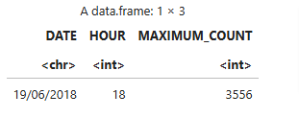
Busiest bike rental times
By creating a subquery, we were able to determine that on 06/19/2018, for 18 hours there were 3556 bicycle rentals.

Slide 15
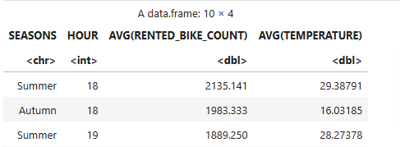
Hourly popularity and temperature by seasons
With the analysis, we noticed a preference for summer, with very high numbers. Autumn is not far behind in second place with numbers very close

Slide 16
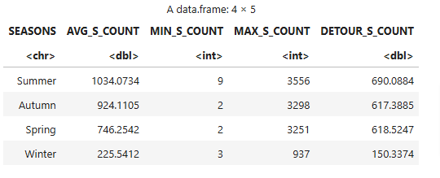
Rental Seasonality
As mentioned previously, the numbers in summer are very high compared to other seasons. Indicating a greater willingness to rent bicycles in high temperatures.

Slide 17
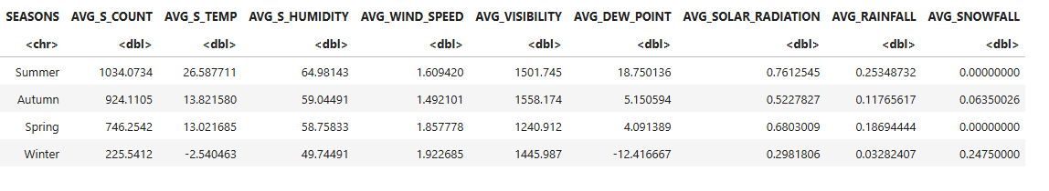
Weather Seasonality
With the help of the image, we can observe in more detail how the weather affects people's willingness to rent bicycles. With an average temperature of 26 in summer and relatively high humidity

Slide 18
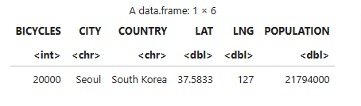
Bike-sharing info in Seoul
We can see that 20k bicycles available to more than 20 million people in Seoul is a very low number. We can assume here that demand is not high, perhaps the rainy weather could be one of the factors behind the low demand for bicycle rentals

Slide 19
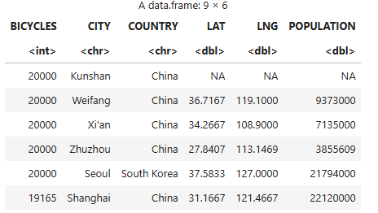
Cities similar to Seoul
We can observe that the number of bicycles available is a preference adopted by East Asia.

Slide 20
EDA with Visualization

Slide 21
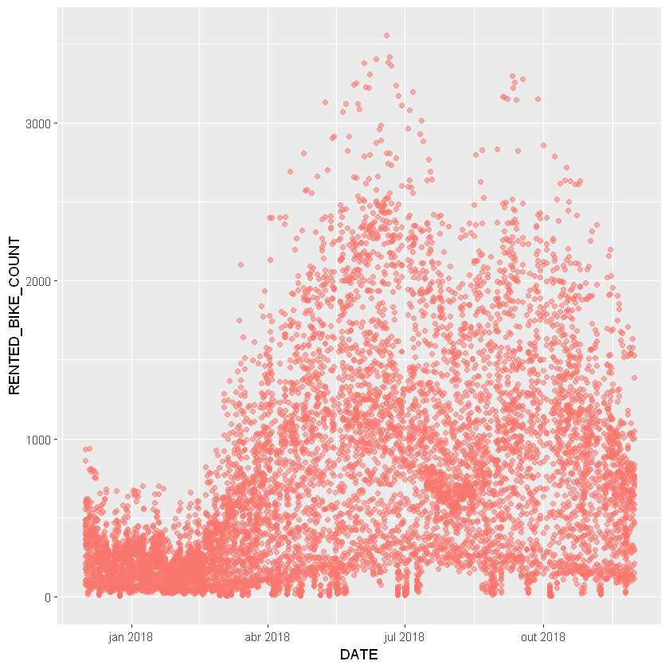
Bike rental vs. Date
We can observe an increase that started around February and March, with a peak between May and July. A considerable drop can be observed starting in August, increasing again in September and decreasing at the end of the year.

Slide 22
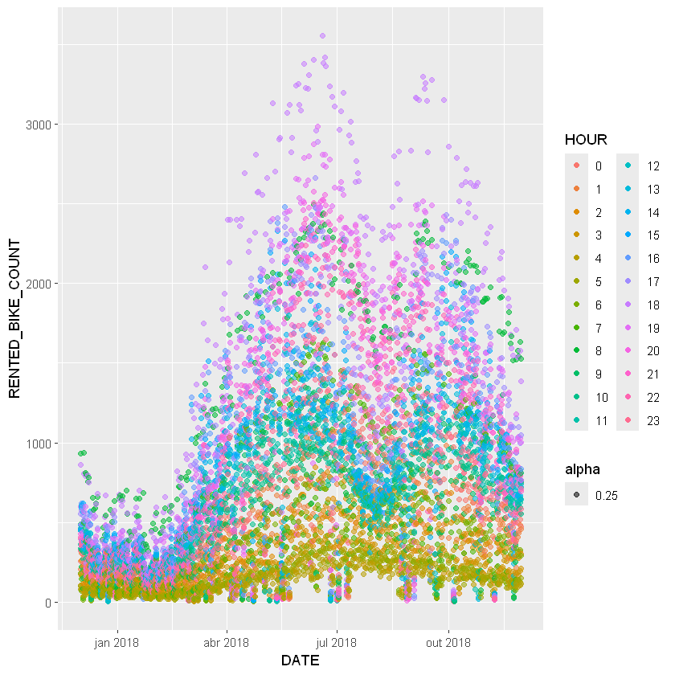
Bike rental vs. Datetime
We can observe a very low preference for renting bikes in the early hours of the morning. Now, a considerable increase begins to emerge throughout the day, with its maximum at dusk between 6 and 7.

Slide 23
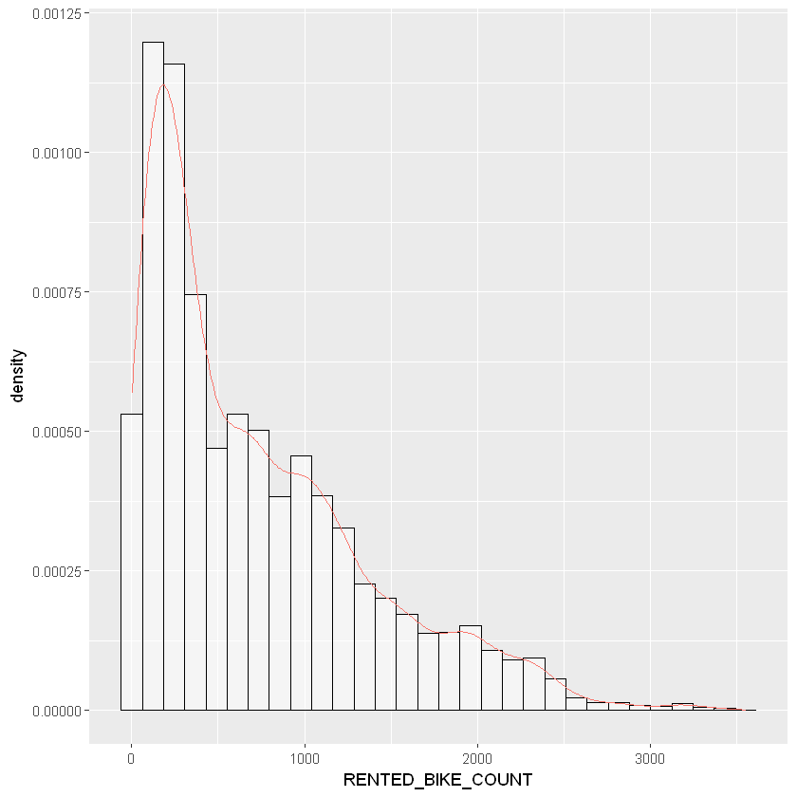
Bike rental histogram
Consider what it's shape tells you, and keep your findings for your presentation in the final project.
We can see from the histogram that there are relatively few rented bikes. The highest frequency of rented bicycles is about 250.
Judging by the "bumps" in about 700 to 3200 bikes, there may be hidden factors that are influencing the data.
It is interesting to analyze that judging by the distribution tail, on rare occasions there are many more rented bicycles than usual.

Slide 24
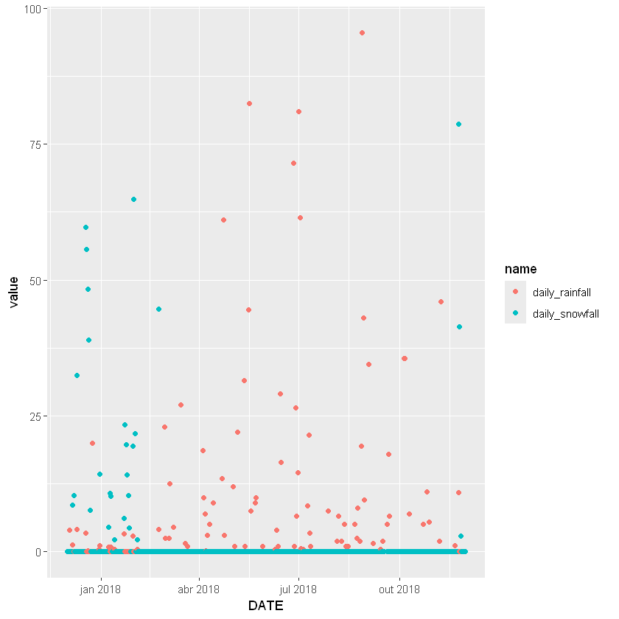
Daily total rainfall and snowfall
We can observe that between January and February there was a concentration of rain and snow. We can use it as a correlation parameter with the numbers of rented bicycles.

Slide 25
Predictive analysis

Slide 26
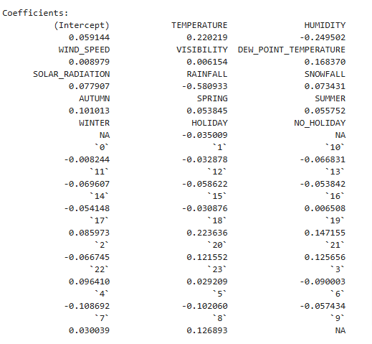
Ranked coefficients
As you can imagine, weather conditions can affect people's bike rental decisions. For example, on a cold and rainy day, you can choose alternative transportation, such as a bus or taxi. While on a nice bright day, you may want to rent a bike for a short distance trip. So, can we predict a city's bike share demand based on its local weather information? We tried to build a regression model to do this.

Slide 27
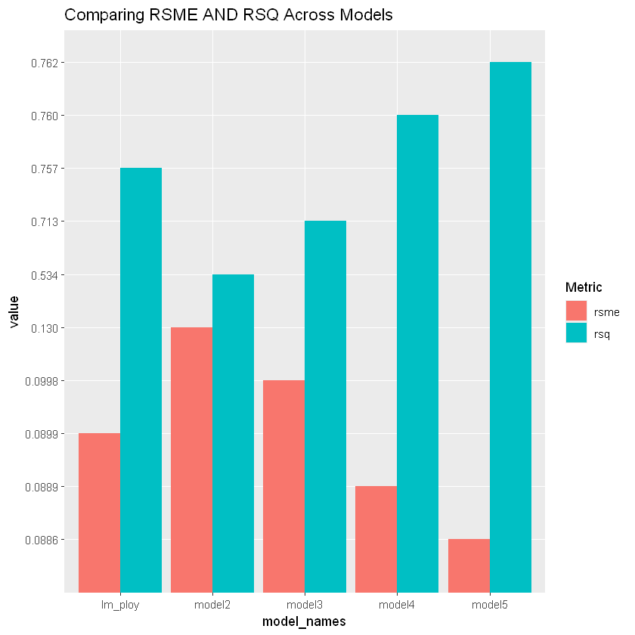
Model evaluation
Built at least 5 different models using polynomial terms, interaction terms, and regularizations
Visualize the refined models’ RMSE and R-squared using grouped bar chart

Slide 28
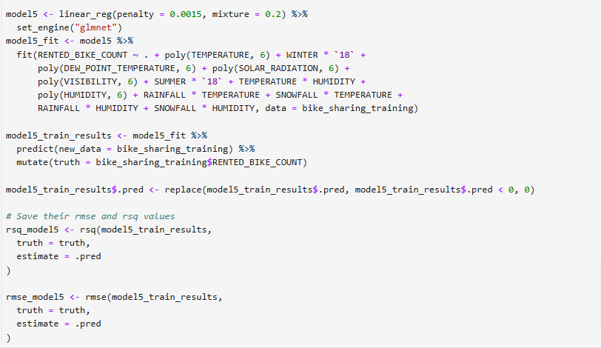
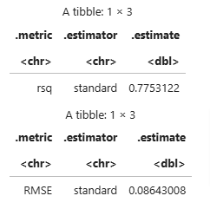
Find the best performing model
Select the best performing model with:
RMSE must be less than 330
R-squared must be larger than 0.72

Slide 29
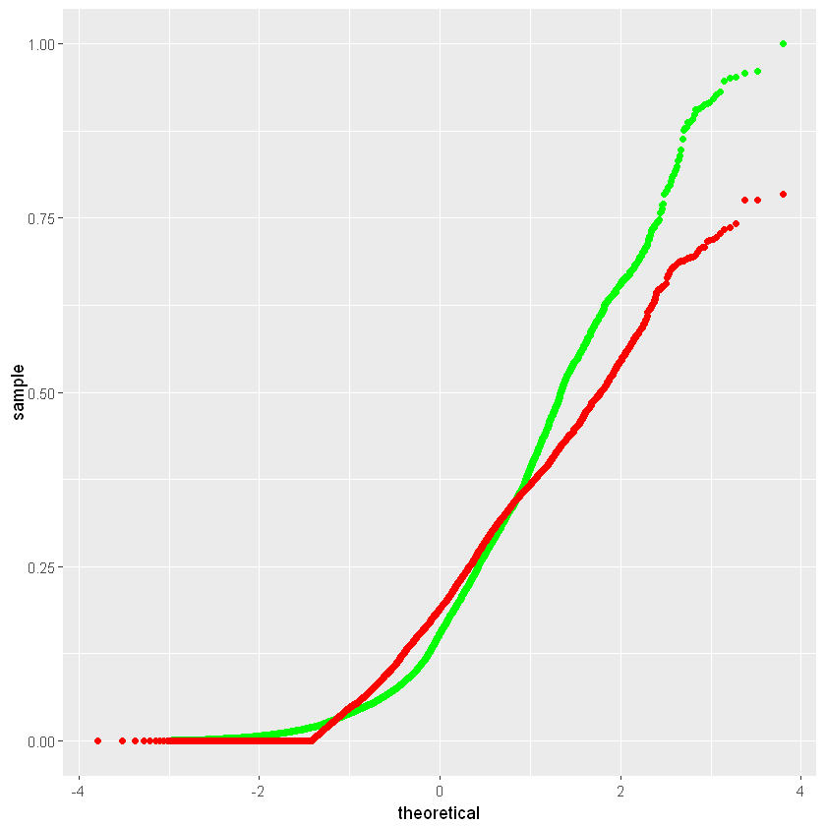
Q-Q plot of the best model
Plot the Q-Q plot of the best model’s test results vs the truths

Slide 30
Dashboard

Slide 31
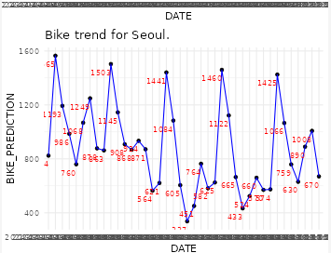
Dashboard: Max bike-sharing prediction
We can see from the daily 'ripples' that people are probably alternating between using cars and bicycles for transportation

Slide 32
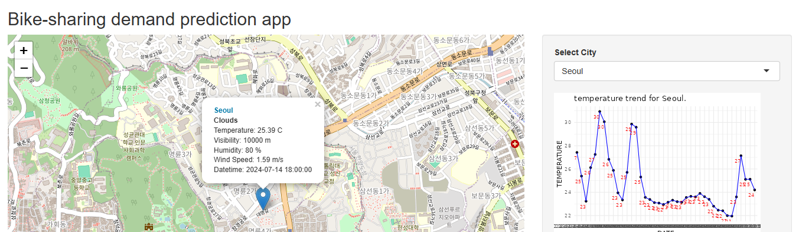
Dashboard: City is selected
With the city selected we can have a summary of statistics related to it.

Slide 33
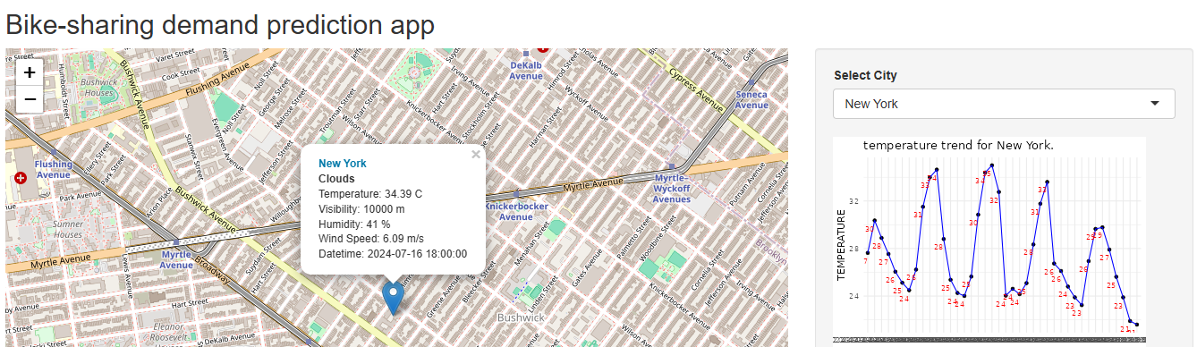
Dashboard screenshot 3
Selecting New York and getting some statistics

Slide 34

CONCLUSION
Climatic factors affect people's willingness to use bicycles.
There is a low number of bicycles available compared to the population. Perhaps a health or environmental awareness campaign is necessary.
The seasons have a certain preference in people's search for bicycles. We can observe a large concentration in the summer and autumn periods.
We can see that people are probably alternating between using automobiles and bicycles for transportation. Perhaps a greater concentration of bicycles in urban areas all the way to commercial areas would be a good move.

Slide 35

APPENDIX
Include any relevant assets like R code snippets, SQL queries, charts, Notebook outputs, or data sets that you may have created during this project

Slide 36
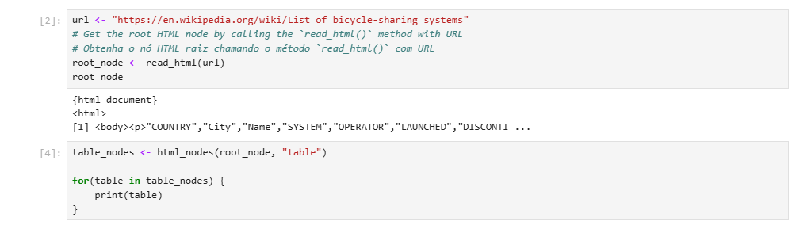
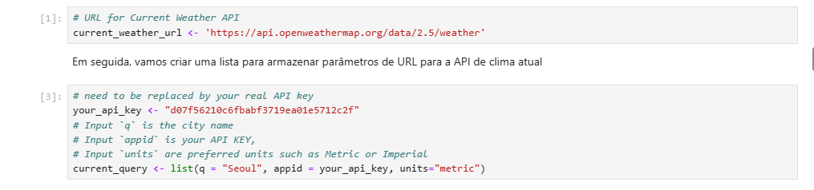
OpenWeatherAPI and Webscrping

Slide 37
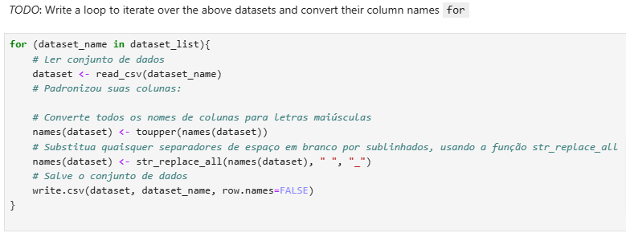
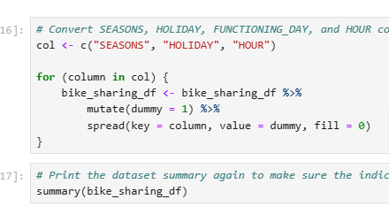
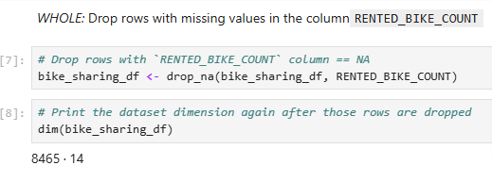
Regular expressions, missing values ​​handling and generating indicator columns

Slide 38
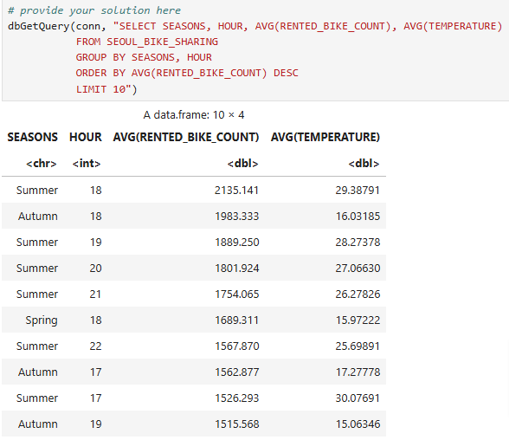
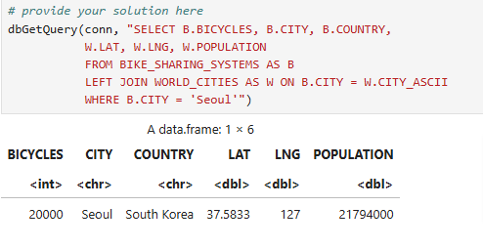
Screenshots of all required SQL queries
Total Bike Count and City Info for Seoul
Hourly popularity and temperature by season

Slide 39
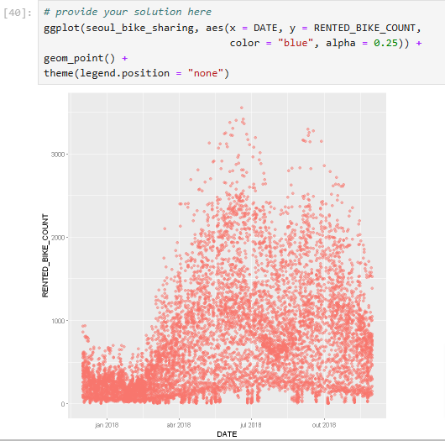
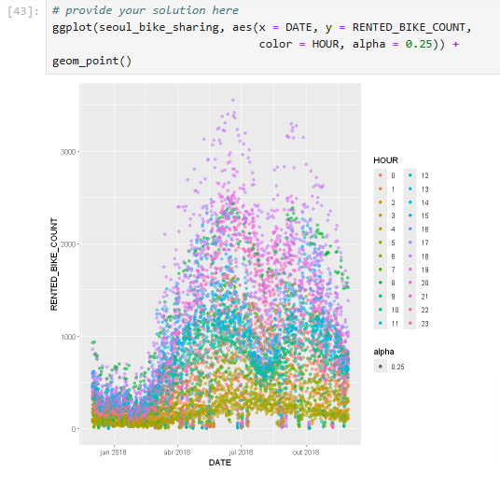
Adding screenshots of your ggplot code snippets

