Slide 1

Junior Game Development Academy
Welcome, developers! May your bugs be few and your compiles be fast.

Slide 2
Academy Structure
Week 1: Setting Up the Development Environment
Installation and setup of Unity Engine and Visual Studio 2022/VS Code.
Introduction to the Unity interface, including the Scene, Game, Hierarchy, and Inspector panels.
Understanding the Unity workflow and project structure.
Basic navigation and object manipulation within Unity.

Slide 3
Academy Structure
Week 2 : Introduction to C# Programming in Unity
Basics of C# coding language, syntax, and structure.
Writing simple scripts to control GameObjects in Unity.
Introduction to variables, functions, and conditionals in C#.
Hands-on interactive coding exercises to reinforce concepts.

Slide 4
Academy Structure
Week 3: Asset Collection & Game Design Essentials
Understanding 3D models, animations, sprites, and textures.
Introduction to Unity’s Asset Store and free/open-source resources.
Importing and organizing assets within a Unity project.
Creating a game concept and defining key gameplay elements.

Slide 5
Academy Structure
Week 4: Building a 3D Game Environment
Creating a platform for the player to run on.
Setting up a skybox, terrain, and environmental elements.
Placing initial obstacles to shape the game world.
Introduction to lighting and materials for enhanced visual appeal.

Slide 6
Academy Structure
Week 5: Implementing Character Controls
Adding a character model into the game.
Implementing Character Controller and Rigidbody mechanics.
Writing scripts to enable movement, jumping and physics interaction.
Testing character movement and refining controls.

Slide 7
Academy Structure
Week 6: Adding Obstacles & Gameplay Challenges
Designing and implementing various obstacles.
Understanding collision detection and triggers in Unity.
Implementing logic to increase difficulty dynamically.
Debugging and optimizing game elements.

Slide 8
Academy Structure
Week 7: Implementing Game Mechanics - Win & Lose Conditions
Defining winning and losing conditions.
Implementing scorekeeping.
Adding effects such as restarts, and game over screens.
Enhancing player experience with sound effects and UI feedback.

Slide 9
Academy Structure
Week 8: Game Polishing & Menu System
Refining game mechanics and fixing bugs.
Implementing a main menu, pause menu, and restart system.
Finalizing UI/UX elements for an intuitive player experience.
Playtesting and gathering feedback for improvements.

Slide 10




Different Game Engines
Note: Choose Wisely or Suffer Eternally
“The Jack-of-All-Trades Engine”
“The Graphics Flexer”
“Wait, People Still Use This?”
The Underdog with a Cult Following”
Description : Versatile engine for 2D, 3D, mobile, and VR games.
Description : AAA engine for stunning graphics and high-performance gameplay.
Description : Simple engine for 2D games with drag-and-drop ease.
Description : Open-Source engine for indie-developers who hate licenses.
Famous Games
Among Us
Genshin Impact
Hollow Knight
Famous Games
Fortnite
PUBG
Rocket League
Famous Games
Hotline Miami
Undertale
Famous Games
Haiku, The Robot
Deer Portal

Slide 11
Unity Engine - Our Weapon of Choice
Why Unity?
Versatile: 2D, 3D, Mobile, VR/AR—Unity does it all.
User-Friendly: Intuitive UI with drag-and-drop features.
Massive Asset Store: For when you’d rather buy than build.
Cross-Platform: Publish to consoles, mobile, PC, and even smart toasters (probably).
Key Unity Resources
Unity Learn: Tutorials for when you have no clue.
Unity Documentation: Where dreams go to die.
Unity Asset Store: Credit card’s worst nightmare.
Unity Community Forum: Stack Overflow, but friendlier.
Unity Answers: Because error messages are written in hieroglyphs.

Slide 12



Let’s Install The Softwares

Slide 13
Feedback Time
https://forms.gle/mtqwmi5oEHpmvVX99

Slide 14
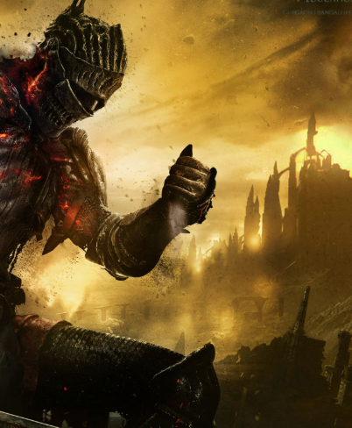
Congrats, You Survived Week 1
Level 1 Complete But the Boss Battles are yet to come…

