Slide 1

int main() {
header_slide.cpp
table_of_contents.cpp
#include <MathWord>
cout << “BotGap”;
}
C++

Slide 2
Table Of ‘Contents’ {
01
02
03
table_of_contents.cpp
team.cpp
Our Team
/* Who are we and our roles. */
About the Project
/* What is our project about. */
Used Software
/* What software we have used. */
}
C++

Slide 3
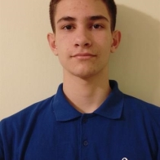

void team {
Our Team
team.cpp
about_the_game.cpp
}
Lazar Apostolov;
Front-End Developer;
Kristian Gaidov;
Back-End Developer;
C++

Slide 4
char about_the_project{
about_the_game.cpp
game_map.cpp
The main purpose of this program is to inform you about different places and the natural anomalies that have happened there and the chances of new ones.
}
C++

Slide 5






void software {
software.cpp
final.cpp
Software which we have used:
}
C++

Slide 6
void final {
final.cpp
Thank you and now let’s jump into the project!
}
C++

