Slide 1
GreenBurgas
Explorer

Slide 2
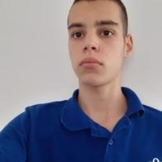
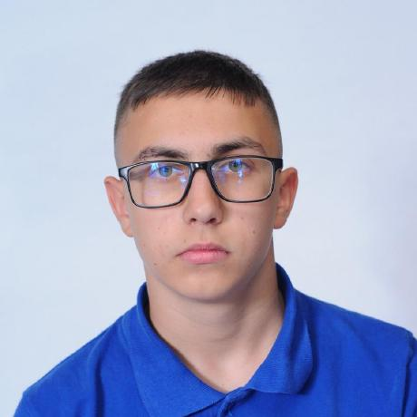
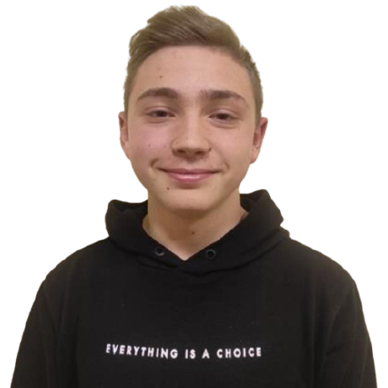
Our team
Yordan Zhechev
Georgi Kotakov
Designer
Back-end & Front-end
Developer
Denislav Bratoevski
Scrum trainer, Back-end & Front-end Developer

Slide 3
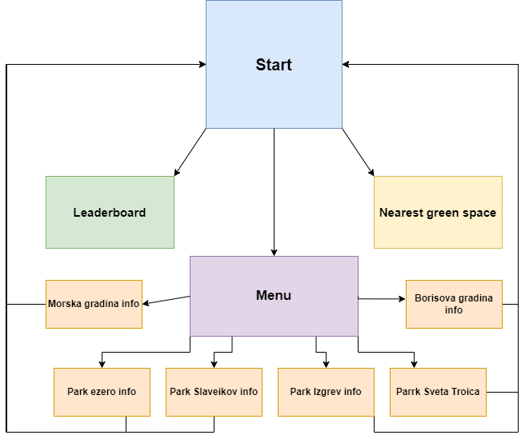
Our project
Our project is an app suitable for mobile devices and laptops and pcs.

Slide 4
Table of contents
01
Our project
Business plan
03
Used technologies
Demonstration
02
04
What is it?
How can we sell our product
Apps and websites used.
How the project works

Slide 5







Used technologies

Slide 6
Business plan

Slide 7
Lets continue to the repo

