Slide 1
Serilog: Logging All Grown Up
Brian Korzynski

Slide 2
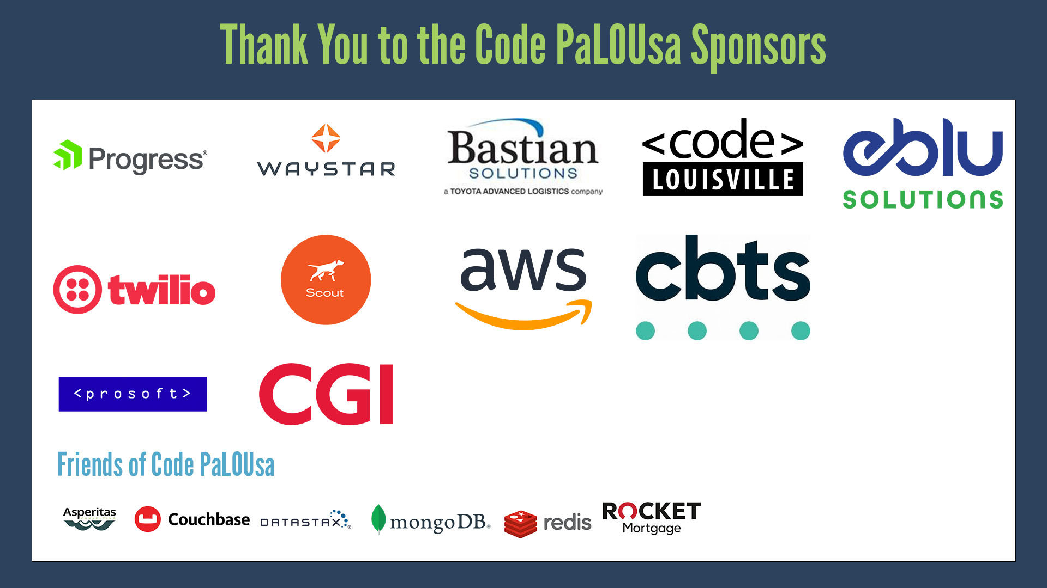

Slide 3
About Me
Principal Architect – Iron Mountain
Owner of Korzynski L.L.C.
Professional Developer for 14+ years
Windows Forms
Web
Mobile
SQL Optimization
Data Analysis
Mathematics
Big Data
Cloud
Machine Learning

Slide 4
What is Serilog?
A diagnostic logging framework that is:
Easy to use
Easy to configure
Extensible
Lightweight

Slide 5
Why Serilog?
Built from the ground up in .NET, not a port
Can write to several sources at once
Much less configuration than other frameworks
You can take as much or as little of it as you like
Extensible (can create your own sinks)
Open Source with an active community
Structured logging not just basic logging (more on this in a second)
Just gets out of your way

Slide 6
Basic Logging VS Structured Logging
Basic Logging
logger.Log(“some message”);
Structured
logger.Information(“some information”);
logger.Debug(“some information”);
logger.Warning(“some information”);
logger.Error(exception, “some information”);

Slide 7
More Structured Logging
logger.Information(“Customer {CustomerName} has been updated”, customer.Name);
logger.Information(“Customer {CustomerId} - {CustomerName} has been updated”, customer.Id, customer.Name);

Slide 8
Logging methods Explained
The method you use tells Serilog how to prioritize your events.
Fatal – show critical failures that crash the app
Error – show failures and their associated metadata
Warning – show possible issues
Information – anything contextual you want to show the person consuming the logs (e.g. got into MethodA)
Debug – meant for when you are debugging to pinpoint problems
Verbose – shows everything including tracing and debugging

Slide 9
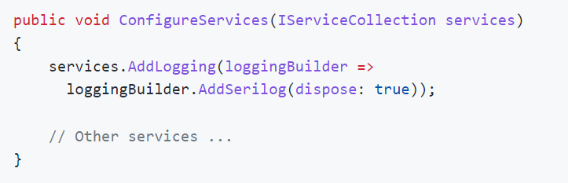
Comparison to Microsoft.Extensions.Logging
Microsoft.Extensions.Logging was loosely based on Serilog
It is not an either or, but both
Microsoft.Extensions.Logging offers the abstractions, and only some of the providers
So you can use Microsoft.Extensions.Logging for the logging abstractions and Serilog for the Sinking
Check out https://github.com/serilog/serilog-extensions-logging for more

Slide 10
SINKS
A library for writing events to a source
Common Ones
File
Literate (Console)
There is a complete list on their GitHub page
Ones I use
Application Insights
Azure Table Storage
File/RollingFile
Literate Console
LogEntries
RabbitMQ
SQL Server
SEQ

Slide 11
How Do I Get Started?
DEMO
Notes:
Getting Started
Multiple Sinks
Settings

Slide 12
Take Only What You Need
Just add sinks and configuration for the sources that you care about, which makes it very lightweight
E.g. not forcing me to download the Azure libraries if I just want to write to a file

Slide 13
Customize Log Output
You can change the format of the messages if you want
.WriteTo.RollingFile(“log-{Date}.txt”, outputTemplate: “{Timestamp:yyyy-MM-dd HH:mm:ss.fff zzz} [{Level}] {Message}{NewLine}{Exception}”)

Slide 14
Enrichers
Allows you to add contextual metadata with each log entry
Add the Machine Name to the entry line
Log.Logger = new LoggerConfiguration().ReadFrom.AppSettings()
.Enrich.WithMachineName().CreateLogger();
Add custom properties (will show in a bit)
Log.Logger = new LoggerConfiguration().ReadFrom.AppSettings()
.Enrich.WithProperty("Version", "1.0.0").CreateLogger();
DEMO

Slide 15
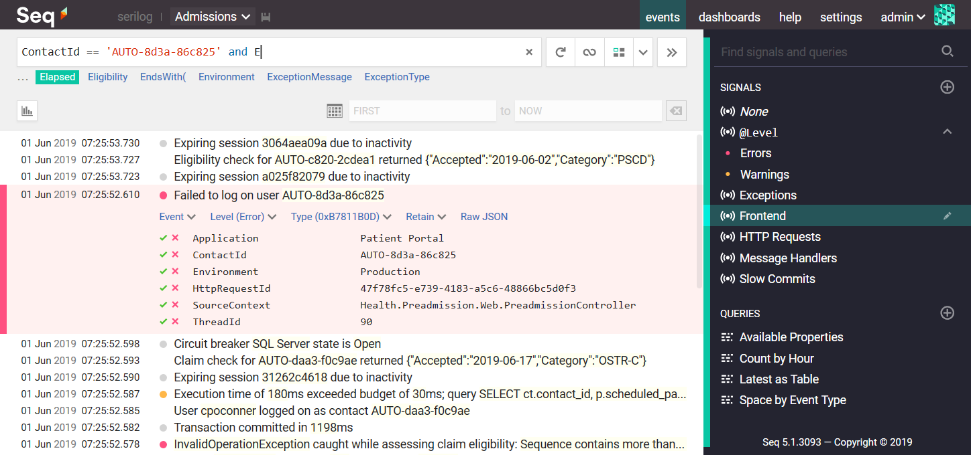
SEQ
https://github.com/serilog/serilog-sinks-seq

Slide 16
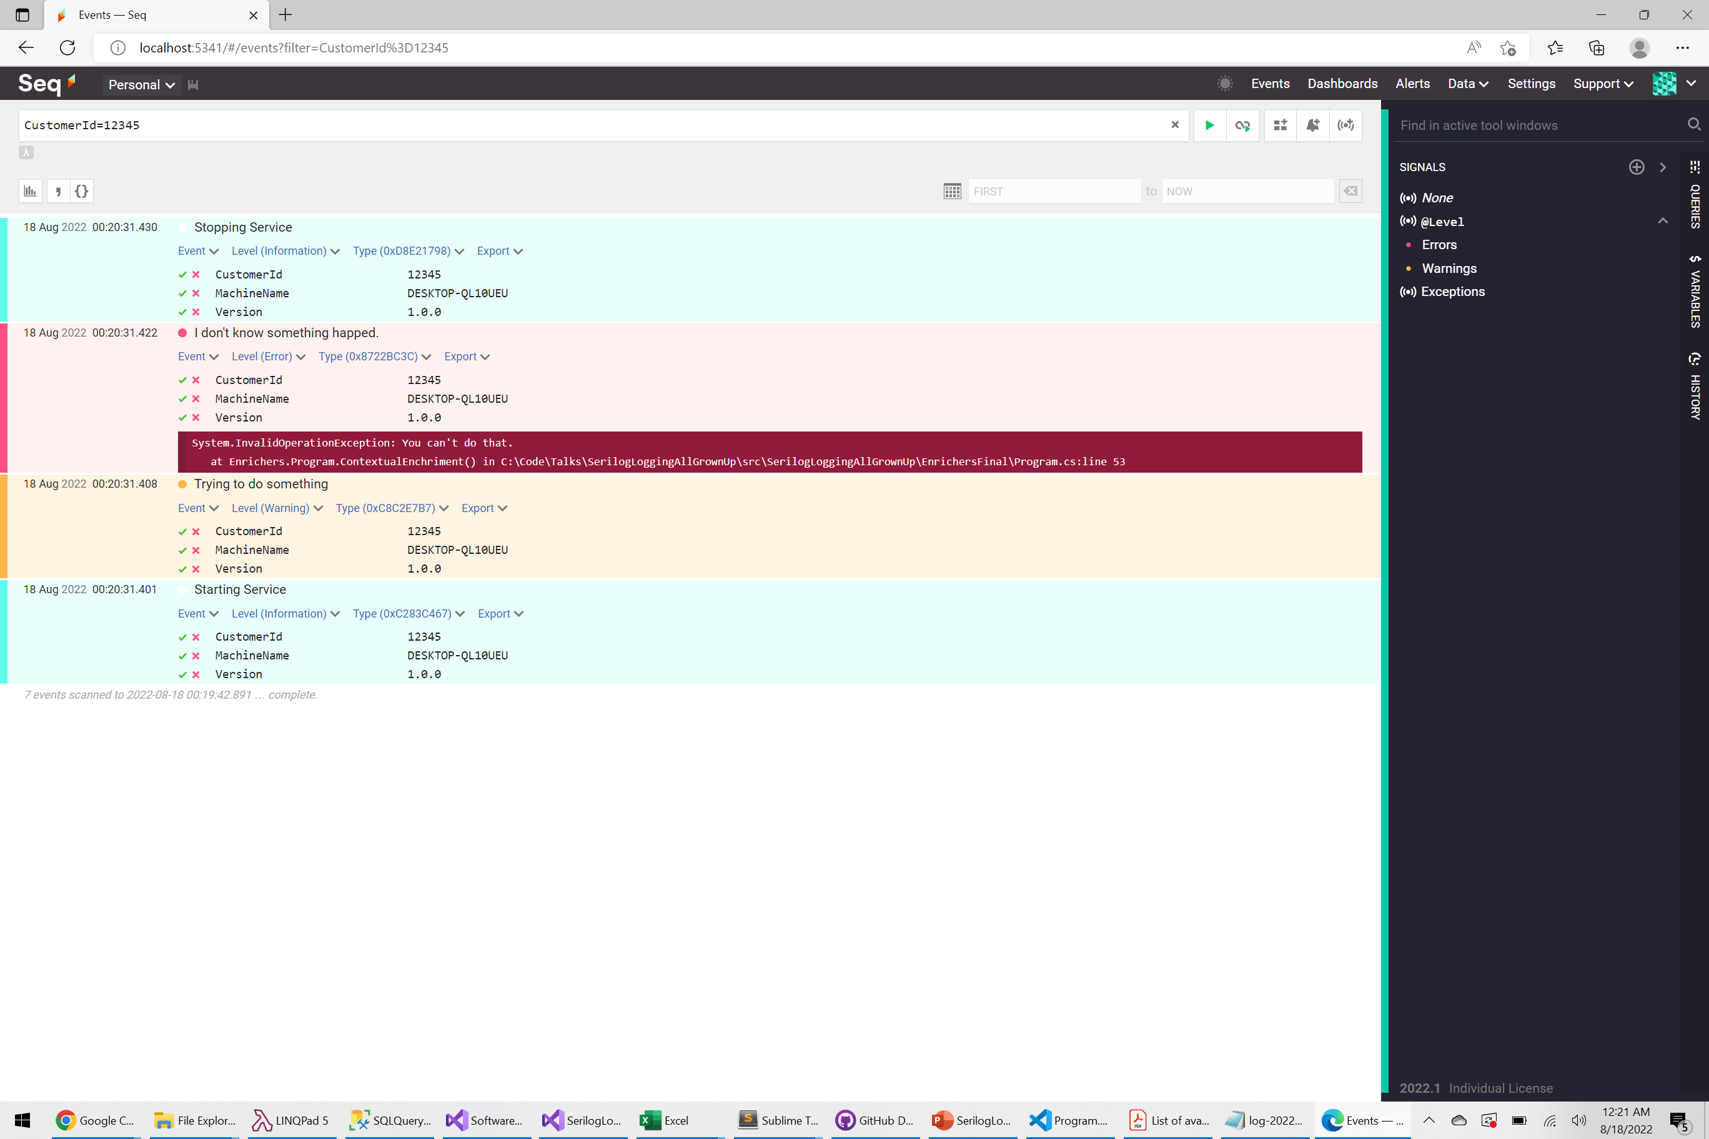

Slide 17
Create Your Own Sink
DEMO

Slide 18
ASYNCHRONOUS LOGGING
NuGets
Serilog.Sinks.Async – provides asynchronous wrapper for Serilog sinks (delegated to work on a background thread)
Serilog.Sinks.AsyncRollingFile – provides better asynchronous handling of log files
Example
Log.Logger = new LoggerConfiguration()
.WriteTo.Async(x => x.LiterateConsole()
.WriteTo.Async(x=>x.RollingFile(“logs/log.txt”)
.CreateLogger();
DEMO

Slide 19
Logging Strategy
First figure out your unique situation and prioritize the things you care about
1 app used by 1 person or 20 apps used by 10,000 people
Create a plan
Where are we going to log?
How do we want to be notified if there are errors?
How do we maintain logs so that they don’t get out of control?
How do we want to consume the logs?
Craft a solution that fits your needs

Slide 20
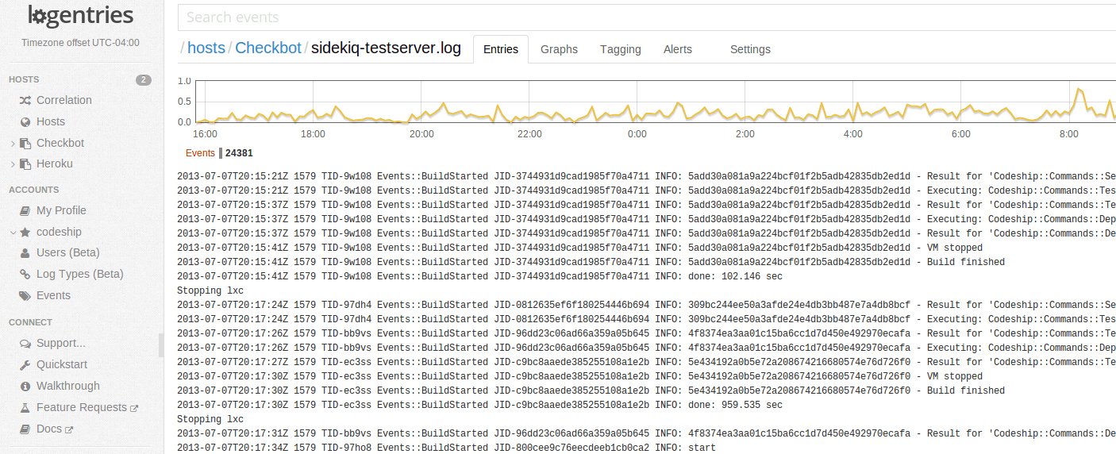
Consuming Logs
https://blog.codeship.com/how-to-understand-logs-with-logentries/

Slide 21
Questions?
http://www.github.com/korz
@bkorzynski

