Slide 1
Amazon S3
Introduction:
Amazon S3 (Simple Storage Service) provides object storage, which is built for storing and recovering any amount of information or data from anywhere over the internet. It provides this storage through a web services interface. While designed for developers for easier web-scale computing, it provides 99.999999999 % durability and 99.99 % availability of objects. It can also store computer files up to 5 terabytes in size. Some Key points -
Amazon S3 is one of the main building blocks of AWS.
Many websites use Amazon S3 as a backbone.
It’s advertised as ”infinitely scaling” storage.
It’s widely popular and deserves its own section.

Slide 2
Amazon S3 Overview – Buckets :
Amazon S3 allows people to store objects (files) in “buckets” (directories).
Buckets must have a globally unique name.
Buckets are defined at the region level.
Naming convention-
• No uppercase
• No underscore
• 3-63 characters long
• Not an IP
• Must start with lowercase letter or number

Slide 3
S3 Object and Path Convention-
Objects (files) have a Key.
The key is the FULL path:
• s3://my-bucket/my_file.txt
• s3://my-bucket/my_folder/another_folder/my_file.txt
The key is composed of prefix + object name.
• s3://mybucket/my_folder/another_folder/my_file.txt
There’s no concept of “directories” within buckets (although the UI will trick you to think otherwise).
Object values are the content of the body. Max Object Size is 5TB (5000GB).
You can version your files in Amazon S3.

Slide 4
Amazon S3 Websites :
S3 can host static websites and have them accessible on the www.
The website URL will be:
• <bucket-name>.s3website-<AWS-region>.amazonaws.com
OR
• <bucket-name>.s3-website.<AWS-region>.amazonaws.com

Slide 5
Directory and S3 Prefix Operations :
Some commands only perform operations on the contents of a local directory or S3 prefix/bucket. Adding or omitting a forward slash or back slash to the end of any path argument, depending on its type, does not affect the results of the operation. The following commands will always result in a directory or S3 prefix/bucket operation:
• sync
• mb
• rb
• ls

Slide 6
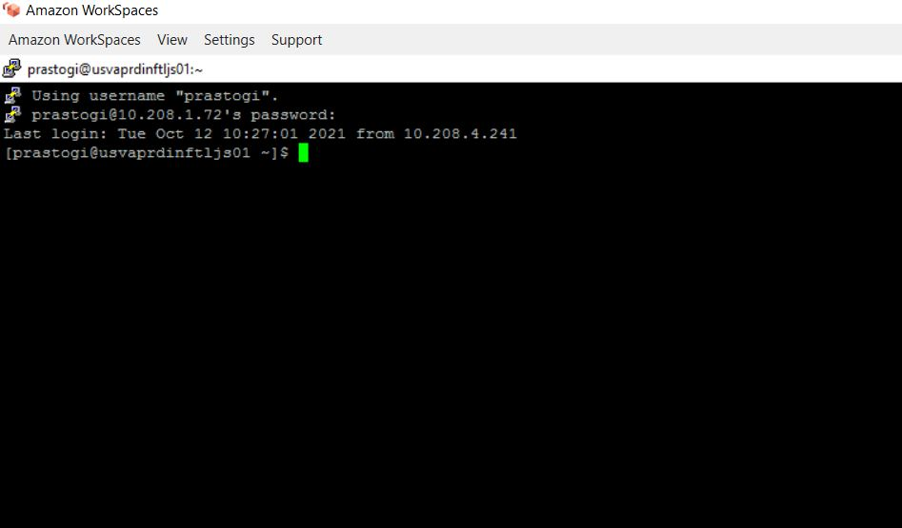
AWS CLI Configuration for new user:
Step 1: Install Putty in your system and then configure it with given credentials after configuration login into putty through your aws workspace credentials. Your session will start (shown in screenshot-1).
Screenshot-1
Step 2: Enter Command - ‘aws configure’. Then enter following key’s (shown in screenshot-2) which will provided by mail – i.e. ‘S3 Credential's’.

Slide 7
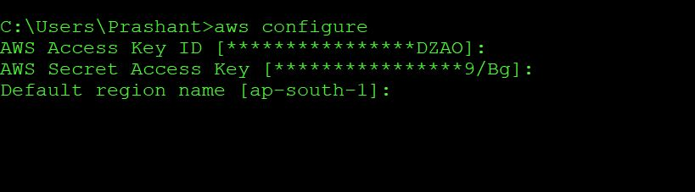
Screenshot-2
Step 2.1: Enter AWS Access key ID and AWS secret access key and in default region you have to enter the nearest AWS region(we generally use us-east-1).
Step 2.2: After completion of your aws CLI, you good to go for doing AWS s3 tasks.

Slide 8
Amazon S3 CLI Basic Commands which we generally use :
• To checking the list of buckets for which we have access:
- aws s3 ls
• For listing/view the content of any specific bucket or folder:
- aws s3 ls s3://full_file_path/
• For Copy the objects/contents of one bucket to another bucket:
- aws s3 cp s3://full_source_path/ s3://destination_path
• We can perform the same copy command recursively:
- aws s3 cp --recursive s3://source_path/ s3://destination_path/
• For sync the objects/contents of one bucket to another bucket:
- aws s3 sync s3://source_path/ s3://destination_path/
• For grabbing any specific files by using its unique keyword:
- aws s3 ls s3://full_destination_path/ | grep “keyword”
• For checking the number of objects/files/content in any specific folder: - aws s3 ls s3://full_destination_path/ | wc -l

Slide 9
Amazon S3 Available Commands :
• ls
• cp
• mb
• mv
• presign
• rb
• rm
• sync
• website

Slide 10
Thank you

