Slide 1
Machine Learning Environment Setup & Data Analysis using Iris Dataset
A step-by-step guide
Aagam Shah
24202701

Slide 2
Introduction
Objective: Setting up a Python environment for ML and performing basic data analysis.
Expected Learning Outcomes:
Understanding Python ML libraries.
Hands-on dataset loading and preprocessing.
Learning basic data visualization techniques.
Understanding data distribution, correlation, and relationships between features.
Preparing data for machine learning applications.

Slide 3
Task 1 - Environment Setup
Install required libraries:
NumPy: Provides support for large, multi-dimensional arrays and matrices, along with mathematical functions for numerical operations.
Pandas: A library for data manipulation and analysis, particularly useful for handling structured data in tabular format.
Matplotlib & Seaborn: Used for data visualization, where Seaborn provides enhanced statistical plotting capabilities.
Scikit-learn: A machine learning library that includes dataset loading, preprocessing, model selection, and evaluation tools.
Python Code:
import numpy as np
import pandas as pd
import seaborn as sns
import matplotlib.pyplot as plt
from sklearn import datasets

Slide 4
Verifying Installations
Checking Versions:
Why Check Versions?
Ensures compatibility and stability of libraries.
Avoids errors due to deprecated functions in older versions.
Output:
Displays installed versions, confirming successful setup.
print(pd.__version__)
print(np.__version__)

Slide 5
Task 2 - Loading the Iris Dataset
The Iris dataset is a well-known dataset containing 150 samples from three different species of Iris flowers:
Setosa, Versicolor and Virginica
Each sample includes four features:
Sepal Length, Sepal Width, Petal Length and Petal Width
Python Code:
Why Load with Pandas?
Allows easy data manipulation and visualization.
from sklearn.datasets import load_iris
iris = load_iris()
df = pd.DataFrame(data=iris.data, columns=iris.feature_names)
df['species'] = iris.target

Slide 6
Exploring the Dataset
Dataset Information:
Python code :
Key Insights:
Number of rows and columns.
Data types of features.
Summary statistics (mean, standard deviation, min, max, etc.).Helps identify any missing or inconsistent data.
df.shape
df.dtypes
df.info()
df.describe()

Slide 7
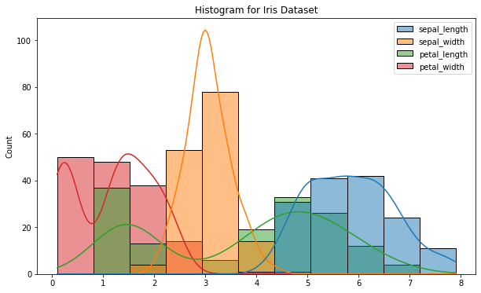
Task 3 - Data Visualization
Histograms: Understanding Feature Distributions
Purpose:
Histograms display the frequency distribution of numerical data.
Helps understand feature spread and identify patterns
Python Code :
Interpretation:
Peaks indicate frequent values.
Can detect skewness or uniformity in the data.
Helps in identifying whether features require normalization.
plt.figure(figsize=(10,6))
sns.histplot(df,kde = True)
plt.title('Histogram for Iris Dataset’)
plt.show()

Slide 8
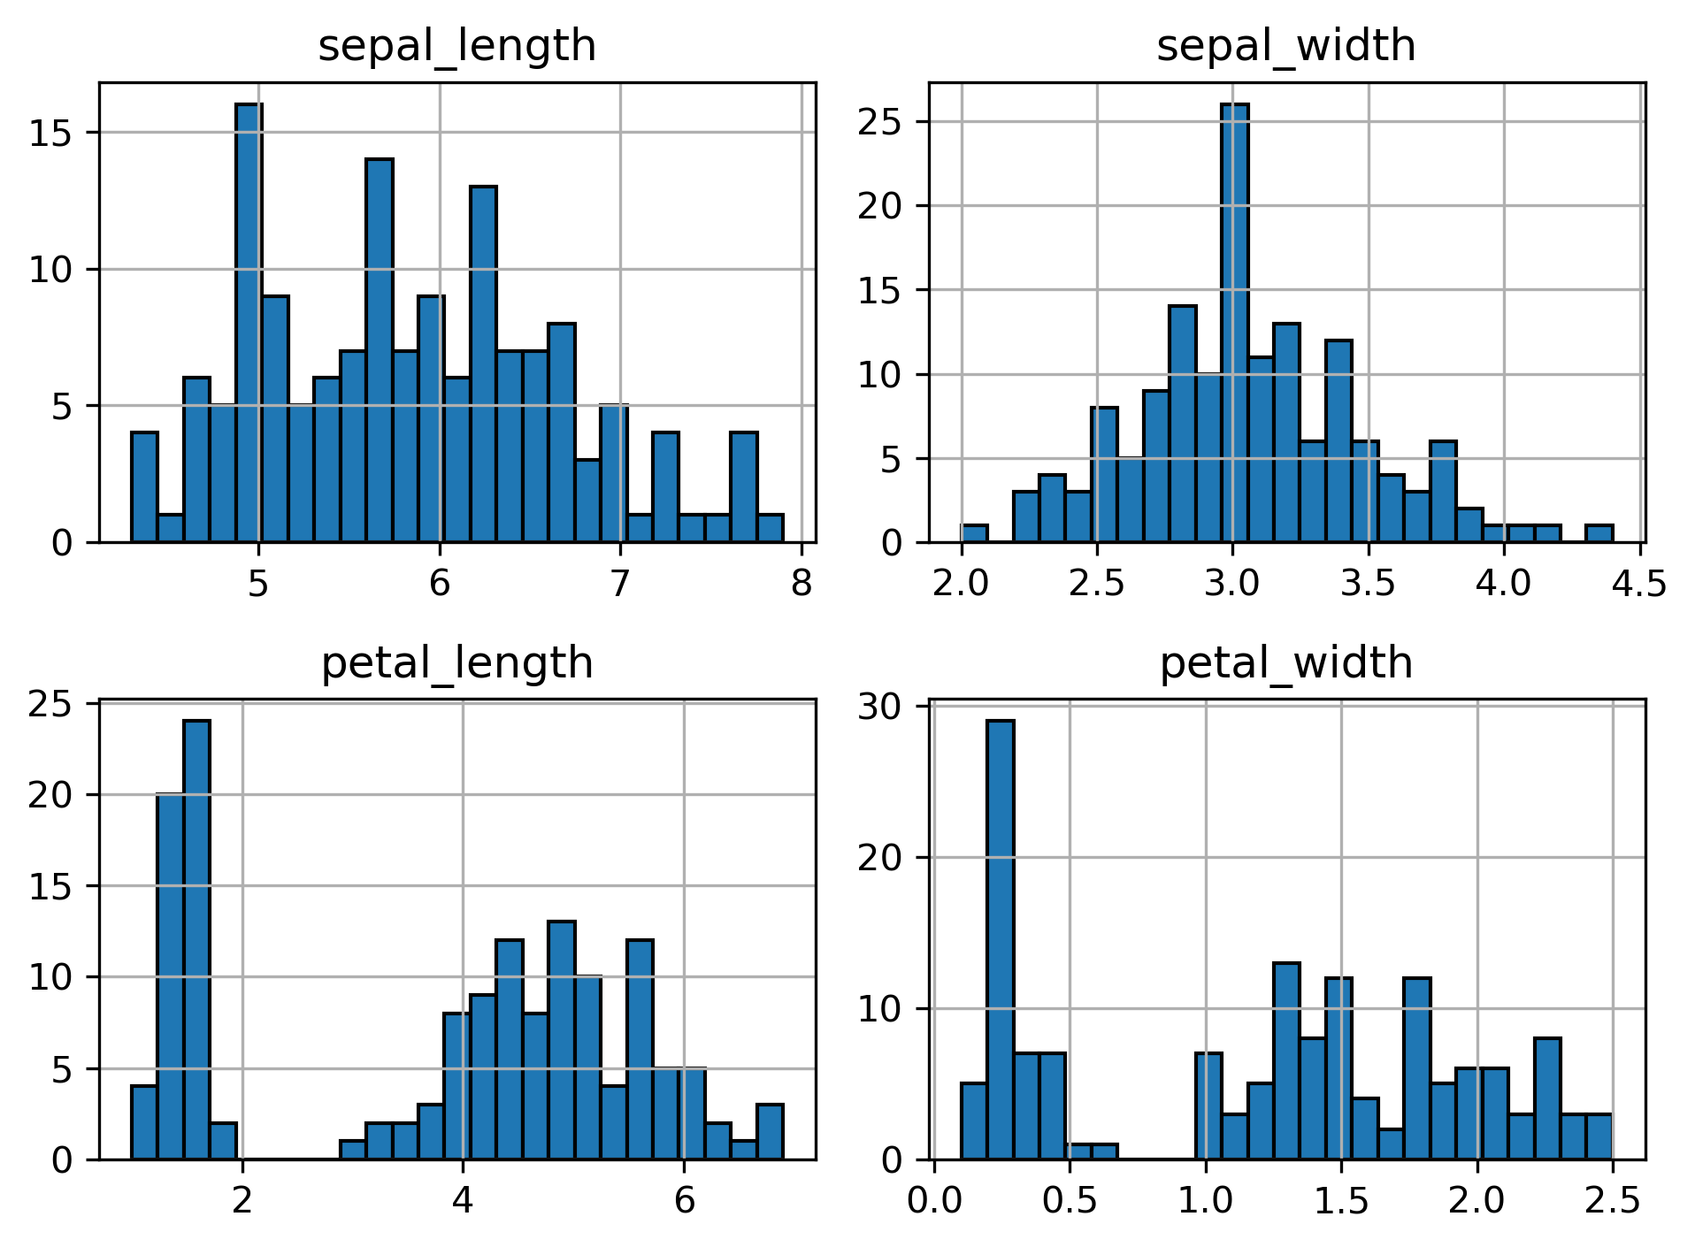
Python code :
plt.figure(figsize = (10,6))
df.hist(bins = 25,edgecolor = 'black’)
plt.tight_layout()
plt.show()

Slide 9
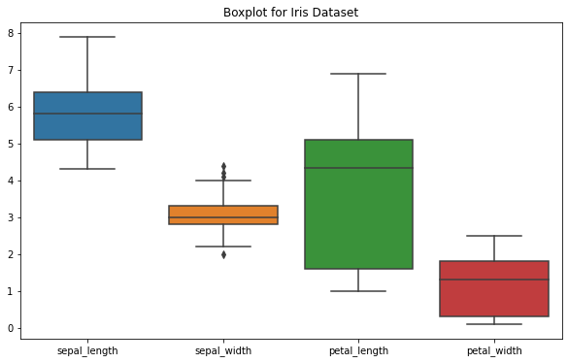
Box Plots for Outliers
Purpose:
Box plots help detect outliers by displaying data spread using quartiles.
Shows median, interquartile range (IQR), and potential outliers.
Python Code :
Interpretation:
Features like petal length and petal width show clear separation between species.
Helps in feature selection for classification tasks.
plt.figure(figsize = (10,6))
sns.boxplot(data = df)
plt.title('Boxplot for Iris Dataset’)
plt.show()

Slide 10
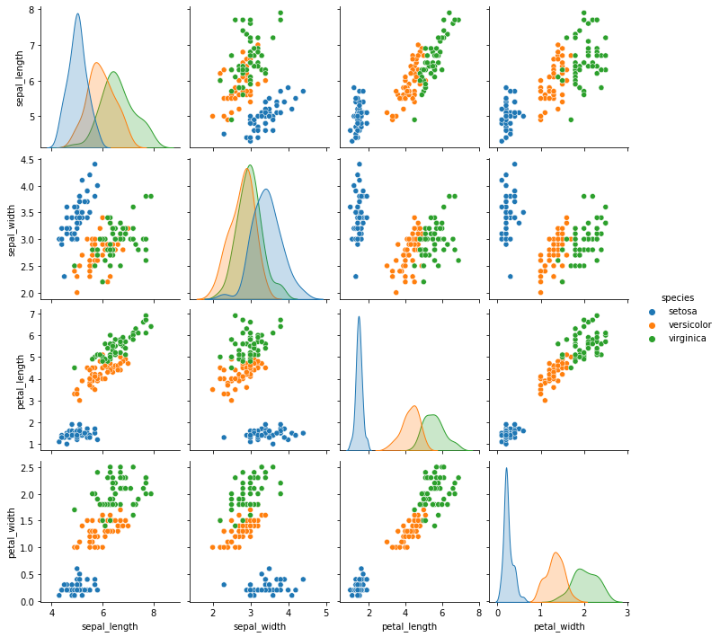
Pair Plots: Exploring Feature Relationships
Purpose:
Pair plots show the relationships between different features.
Helps visualize how well features separate different species.
Python Code:
Interpretation:
Features like petal length and petal width show clear separation between species.
Helps in feature selection for classification tasks.
sns.pairplot(df,hue = 'species’)
plt.show()

Slide 11
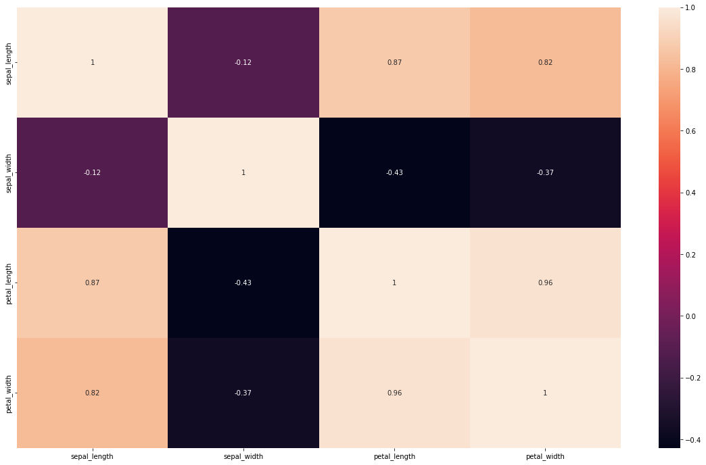
Correlation Heatmap: Feature Relationships
Purpose:
A heatmap visually represents feature correlations.
High correlation between features may indicate redundancy.
Python Code :
Interpretation:
Strong positive/negative correlations help in feature engineering.
Weak correlations suggest independent variables.
corr = df.corr(numeric_only = True)
plt.figure(figsize = (20,12))
sns.heatmap(corr,annot = True)
plt.show()

Slide 12
Task 4 - Basic Data Preprocessing
Handling Missing Values:
Python code :
Why Check for Missing Values?
Missing values can impact model accuracy.
The Iris dataset does not contain missing values, but this step is crucial for real-world datasets.
df.isnull()
df.isnull().sum()

Slide 13
Standardization
Why Standardization?
Ensures features have a mean of 0 and standard deviation of 1.
Essential when using algorithms sensitive to feature scales.
Python Code :
from sklearn.preprocessing import StandardScaler
scaler = StandardScaler()
scaled_features = scaler.fit_transform(df.iloc[:, :-1])

Slide 14
Splitting Data into Train & Test Sets
Why Split Data?
To evaluate model performance on unseen data.
To also prevent data from overfitting.
Python Code:
Split Ratio:
80% training data.
20% testing data.
from sklearn.model_selection import train_test_split
X = df.iloc[:,:-1].values
y = df.iloc[:,-1].values
X_train, X_test, y_train, y_test = train_test_split(X, y, test_size=0.20, random_state=42)

Slide 15
Conclusion
Key Takeaways:
Successfully set up Python ML environment.
Explored and visualized the Iris dataset.
Performed preprocessing for ML models.
Next Steps:
Apply ML algorithms (e.g., kNN, Decision Trees) to classify Iris species.
Perform model evaluation and optimization.

Slide 16
Thank You!

