Slide 1

Flight Cancellation Prediction Modeling Project
Ying Li
5/18/2013

Slide 2

Problem Statement
Quick Fly has been paying unusually high claims for late shipments caused by flight cancellation out of LAX.

Slide 3
Project Objective
What are the main causes of flight cancellation out of LAX?
How can we predict the likelihood of flight cancellation out of LAX?

Slide 4
Data Sources
Dataset “flight delays and cancellations”
Downloaded from Kaggle.com
Published by the U.S. Department of Transportation’s Bureau of Transportation Statistics
Containing 3 files:
airlines.csv
airports.csv
flights.csv

Slide 5
Data Exploration
Bar Chart
Heatmap
AIRLINE
FLIGHT NUMBER
STATE
SCHEDULED DEPARTURE
DESTINATION
CITY
SCHEDULED TIME
AIRPORT
MONTH
DISTANCE
DAY
DAY
SCHEDULED ARRIVAL
DAY OF WEEK

Slide 6
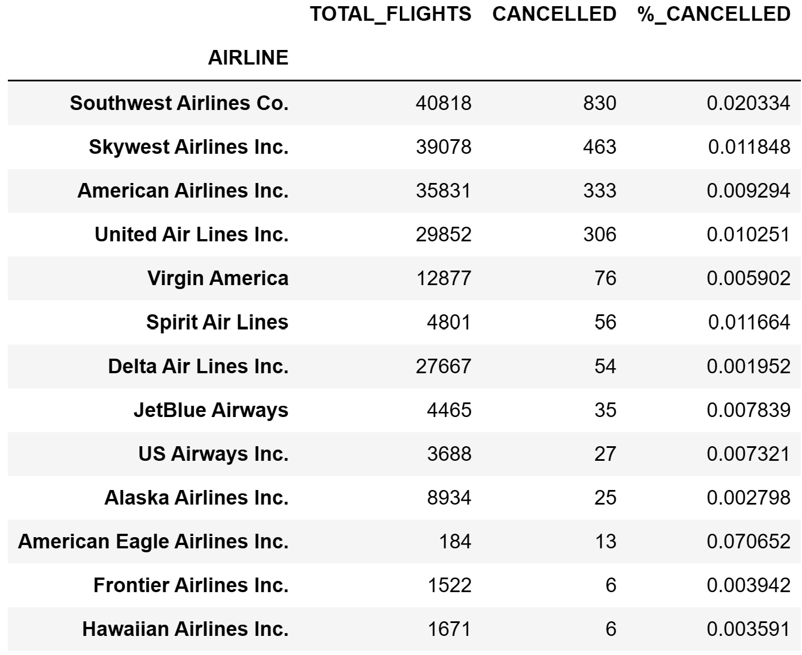
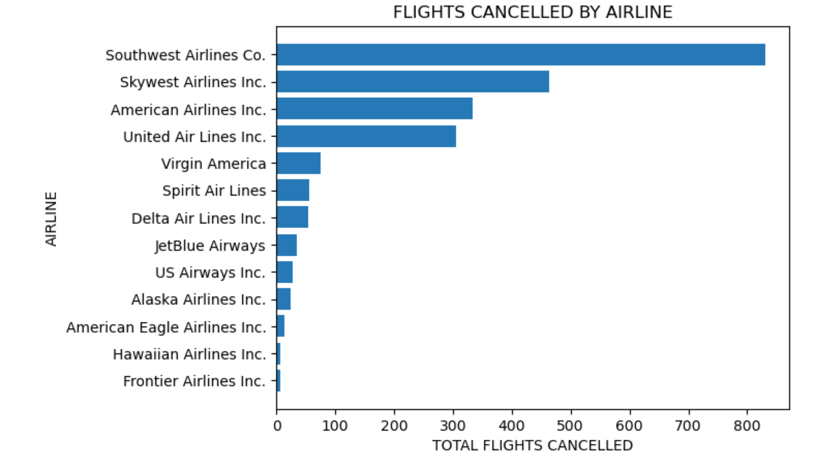
Airline Analysis

Slide 7
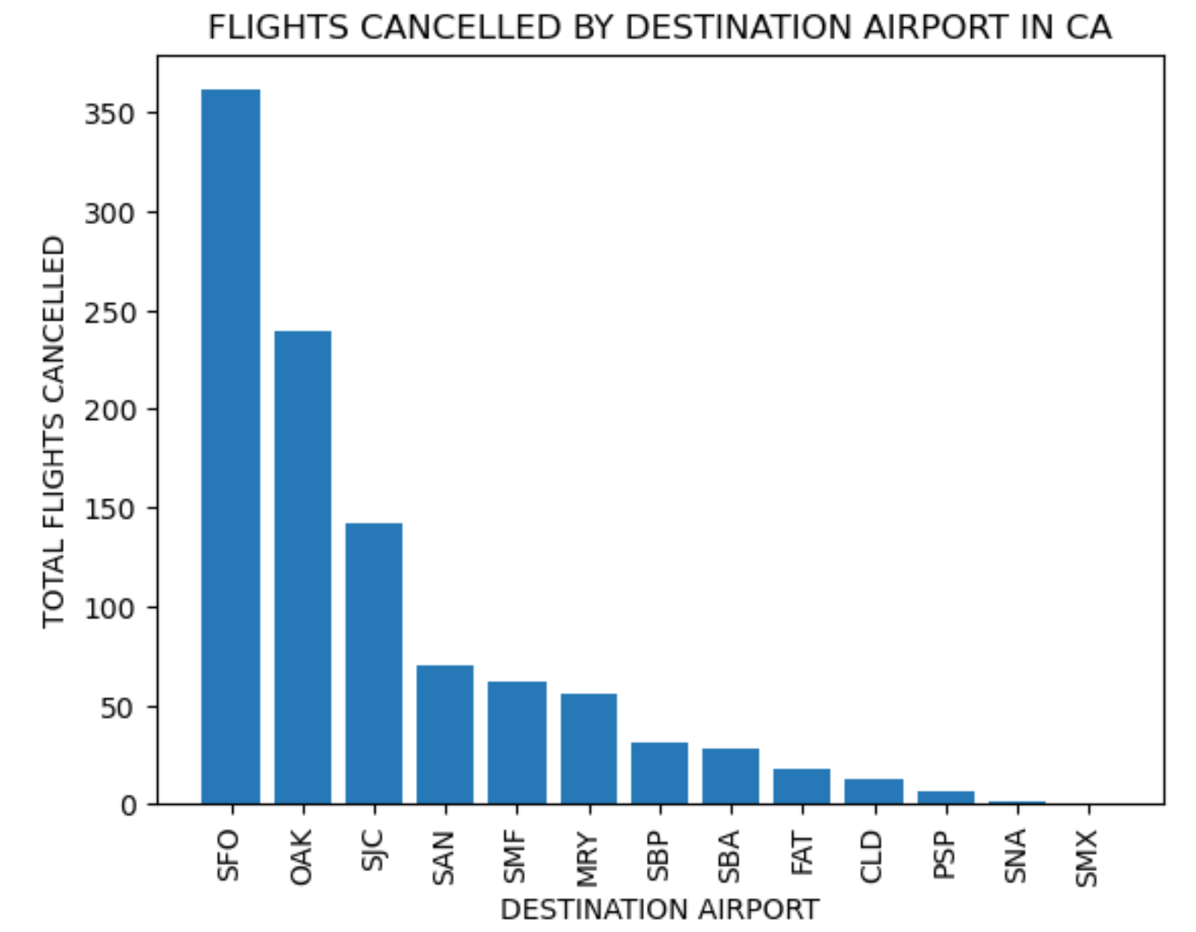
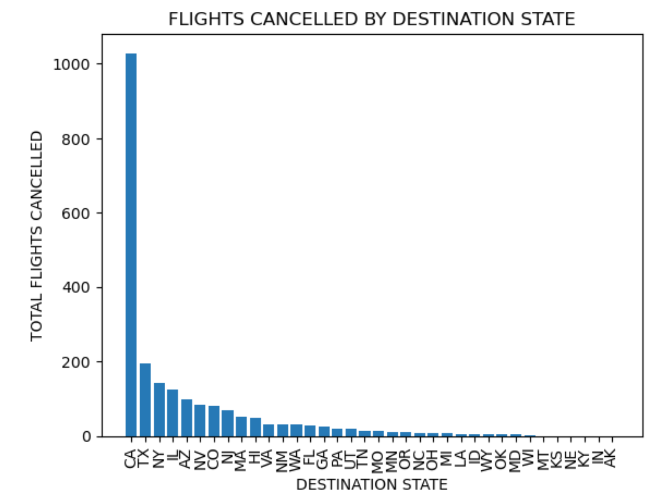
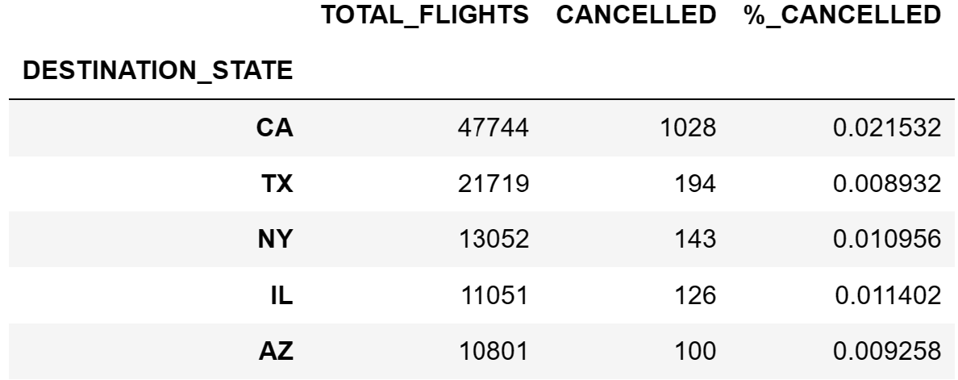
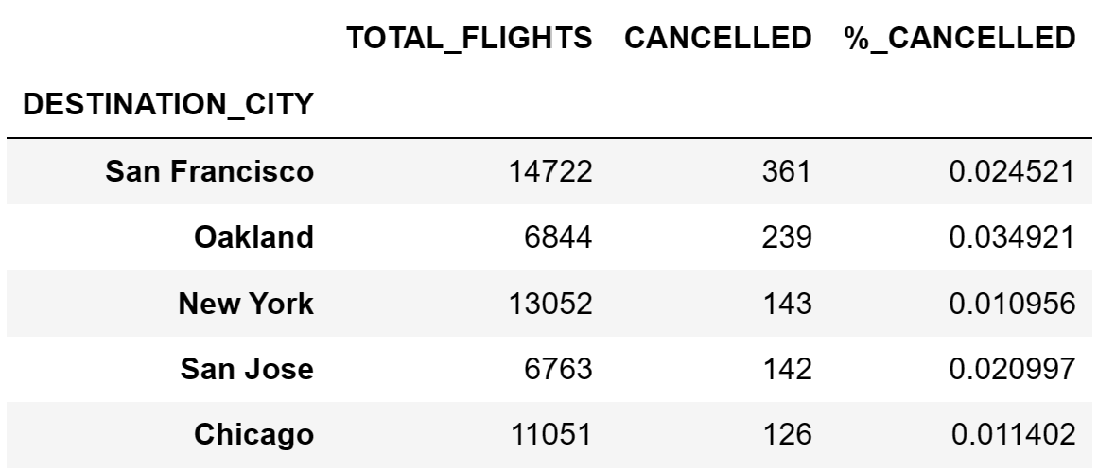
Destination Analysis

Slide 8
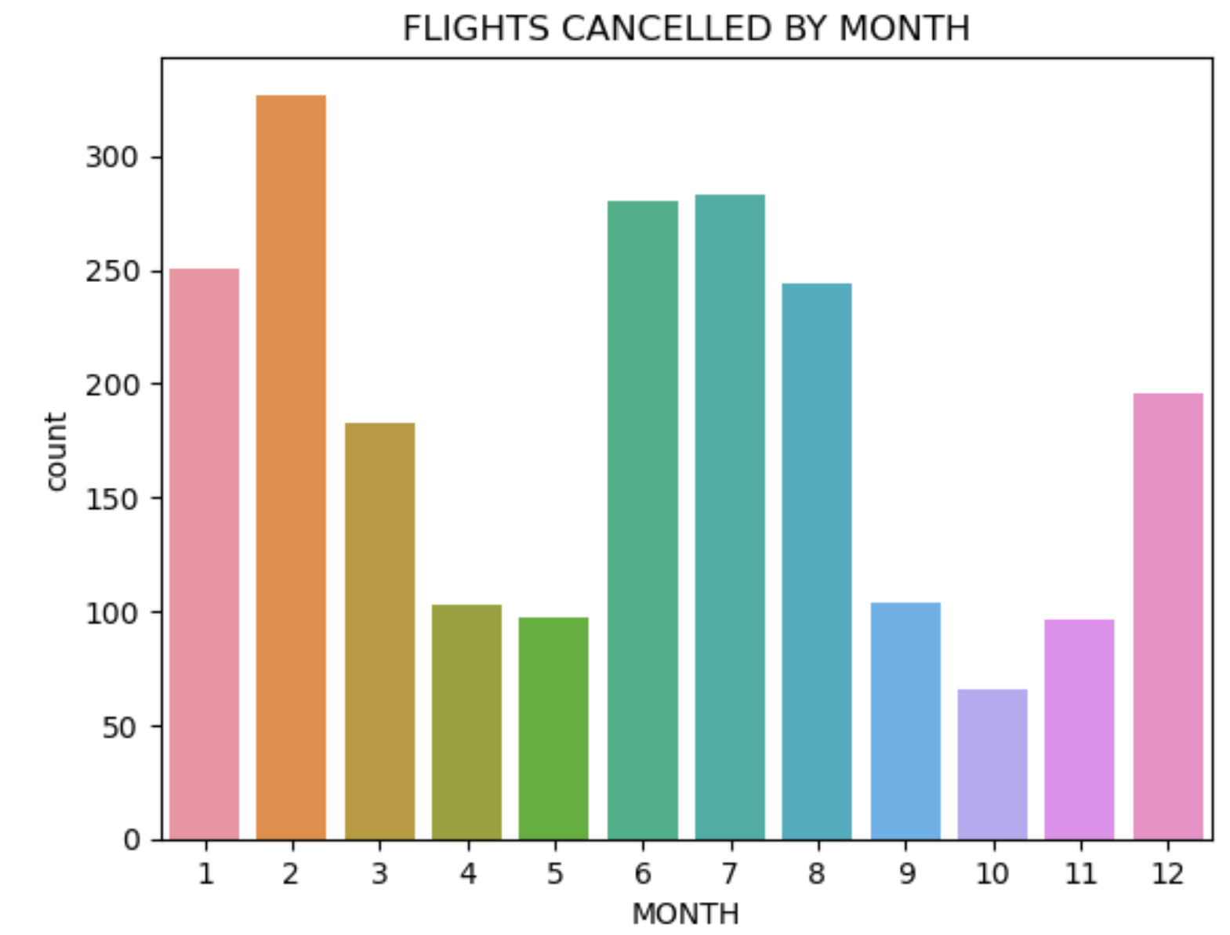
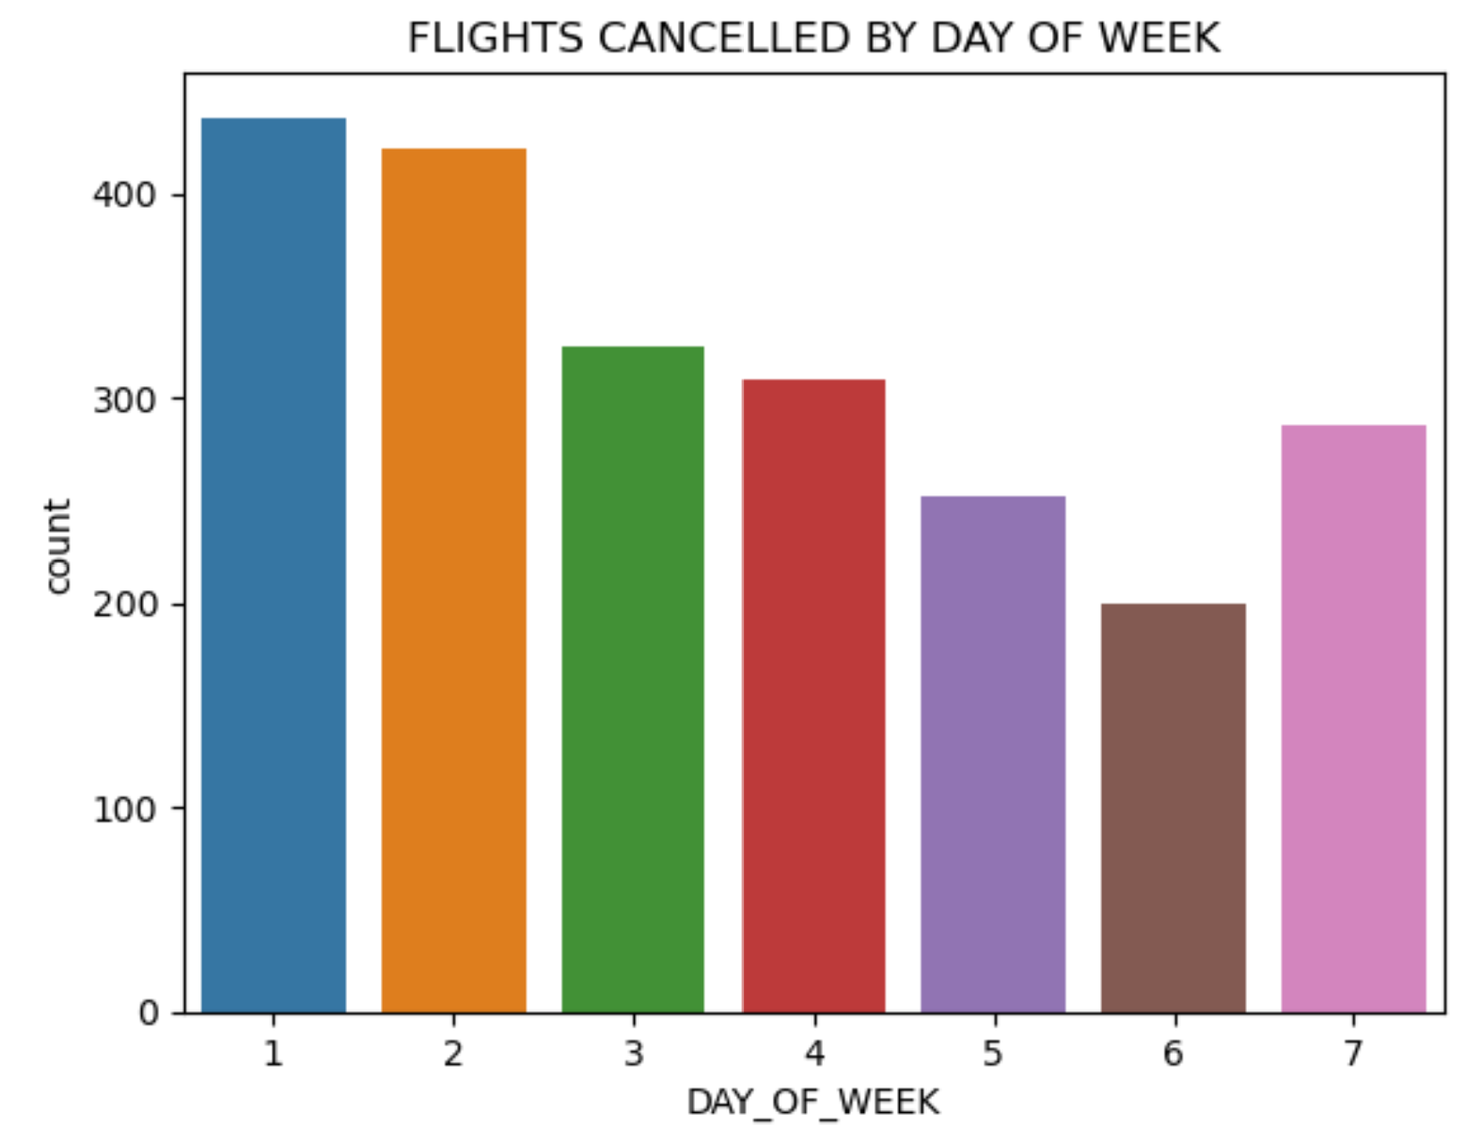
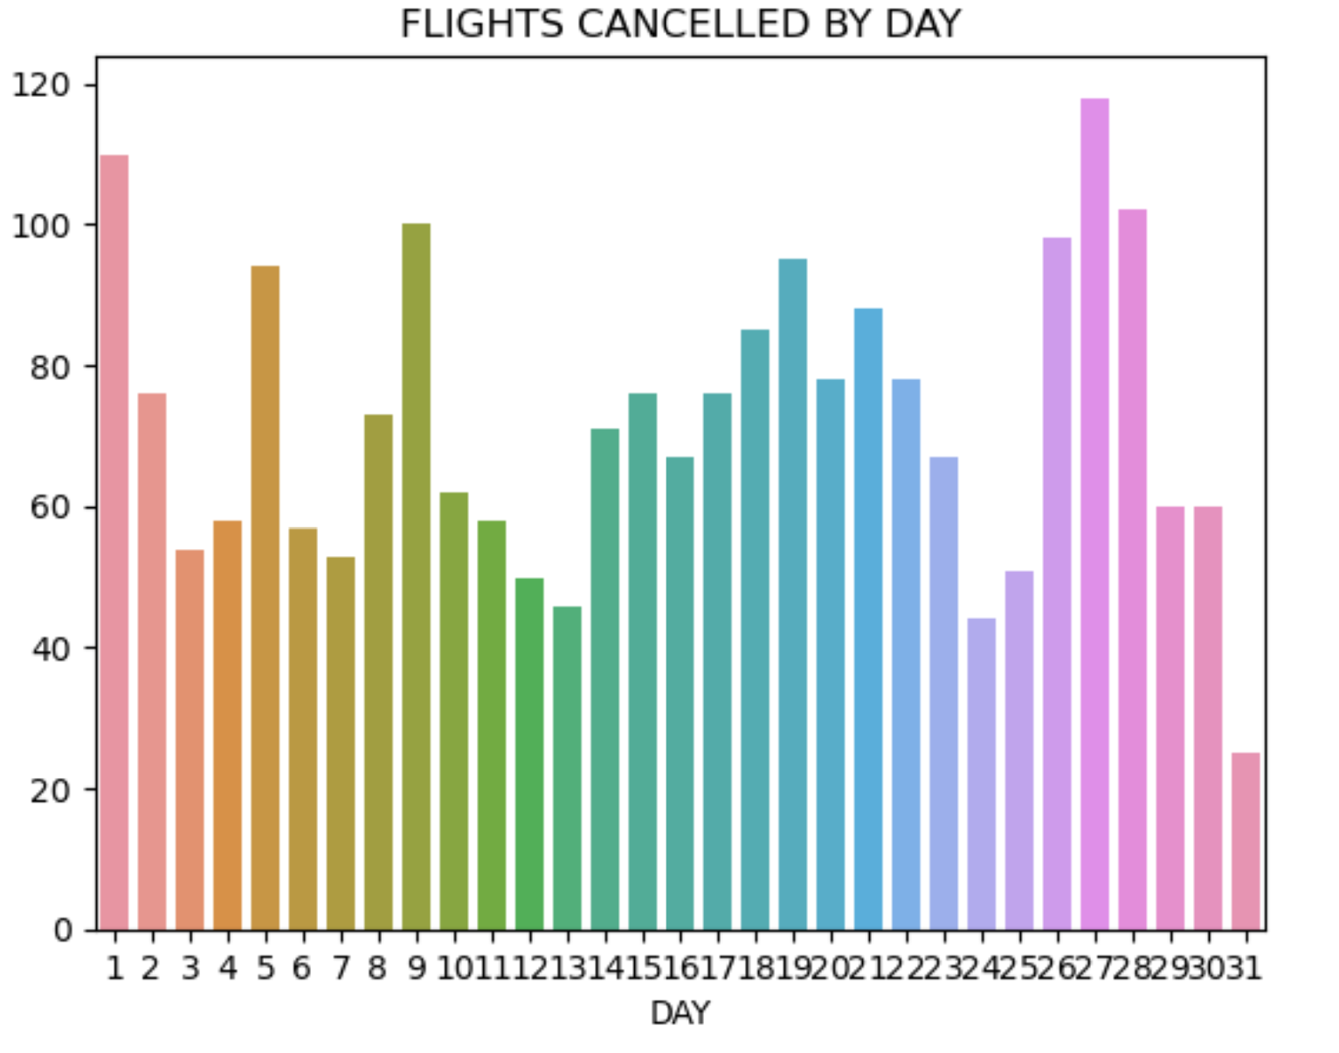
Month/Week/Day Analysis

Slide 9
Algorithms
Logistics Regression
Binary Dependent Variable
kNN
Random Forest
Classification Algorithms
Gradient Boosting
Extreme Gradient Boosting
Classification Tree

Slide 10
Modeling Process
For each algorithm, the same process is followed.
Use grid search to find the optimal hyperparameters for each model
Fit the train data to the model and predict the test data
Calculate performance scores , confusion matrix and classification report

Slide 11
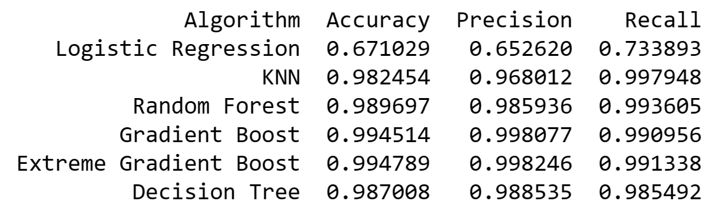
Model Performance Metrics
Recall is most important for our study.

Slide 12
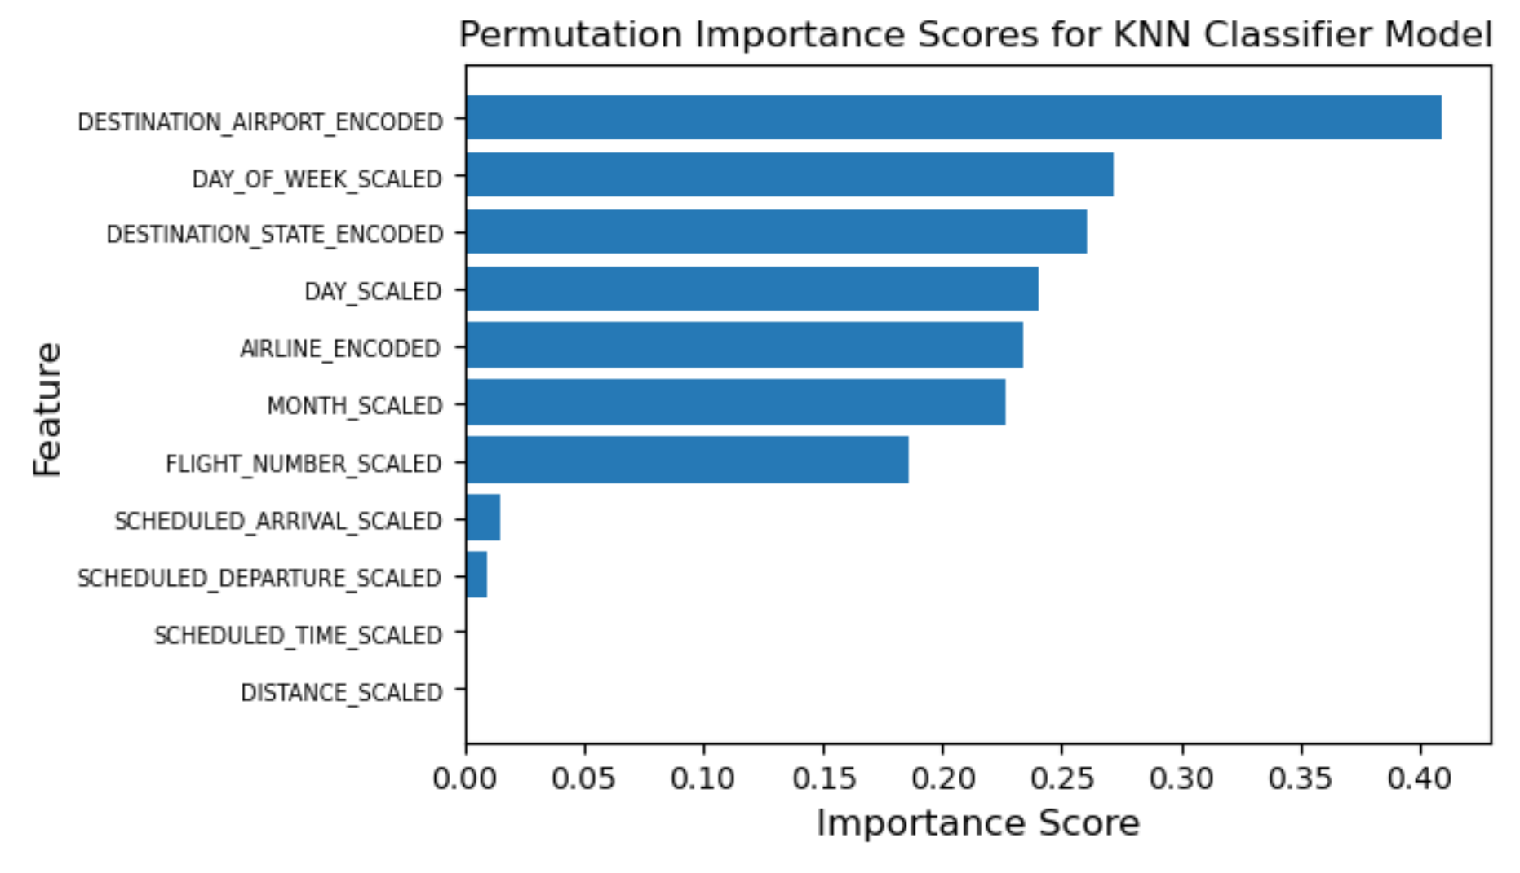
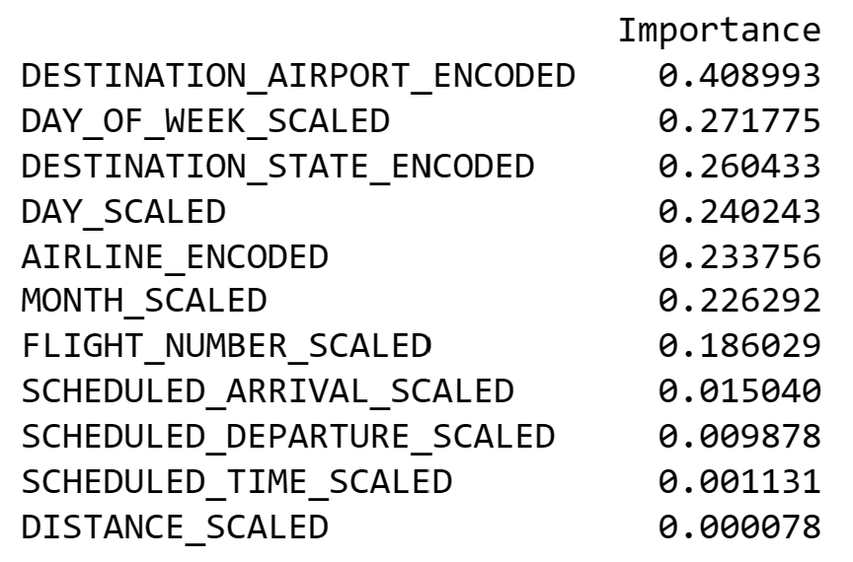
Feature Importance

Slide 13
Conclusion
kNN is our best performing model.
Optimal Hyperparameters:
n_neighbors = 2
p = 1
weights = 'distance’
Recall = 99.8% → The model will accurately predict 99.8% of flight cancellations
Precision = 98.2%

Slide 14
Future Improvement
Try more data
More recent data
New features to be explored:
weather conditions,
aircraft years in service,
booking rates, etc.
Try regression-based modeling with threshold adjustment

Slide 15
Thank You
DOT for the "flight delays and cancellations" datasets on posted Kaggle!
Kenneth Gil-Pasquel for being such an amazing mentor guiding me through the project and throughout the whole course!
Wayne Ang for being there as an on-demand mentor!

