Slide 1
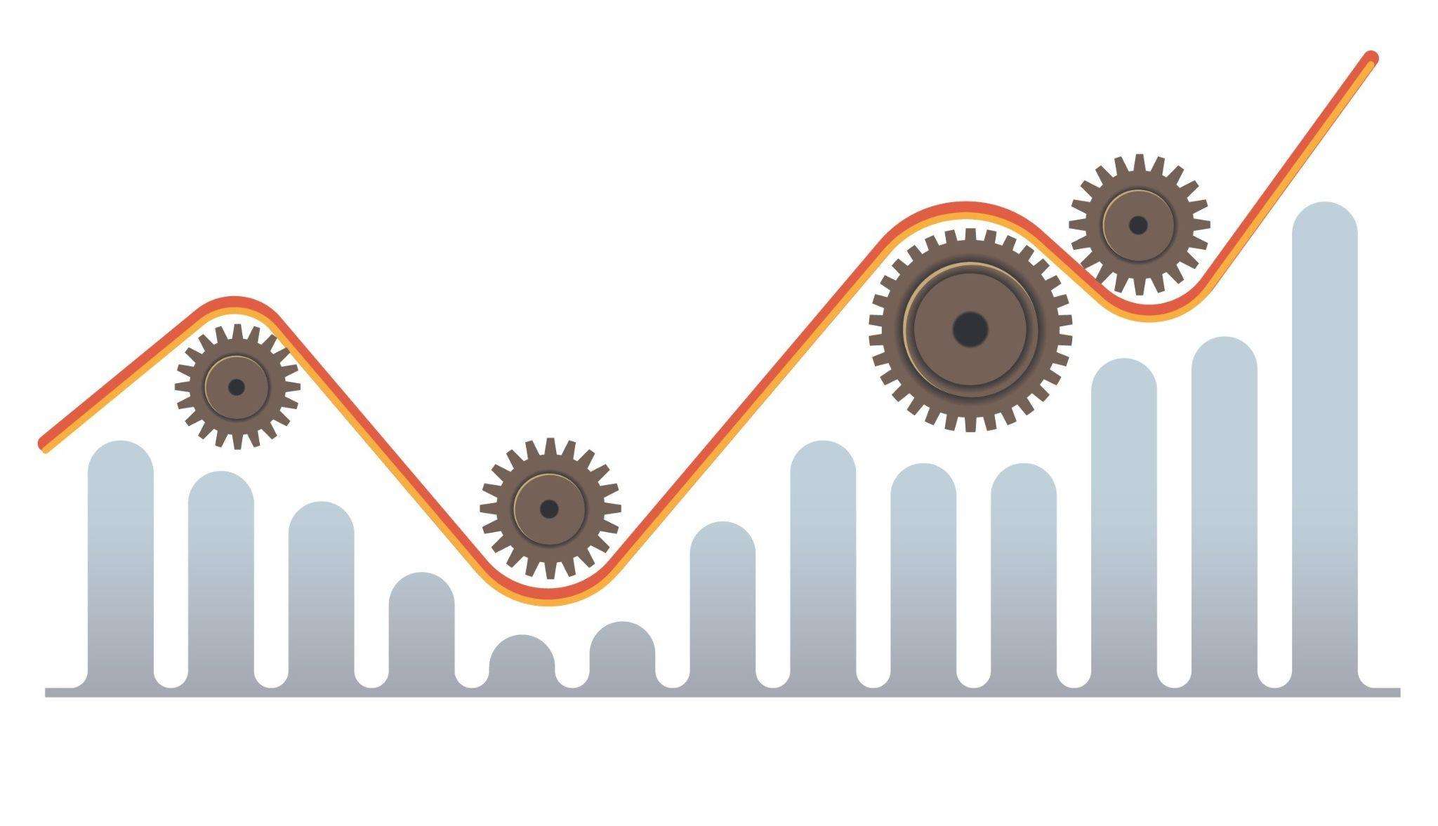
Adidas Sales Forecast Modeling Project
Ying Li
8/13/2023

Slide 2
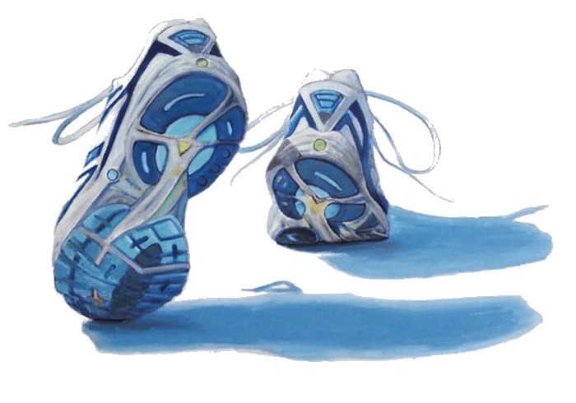
Problem Statement
Post-COVID recovery offers a mix of uncertainties and opportunities. Adidas wants to leverage its historical US sales data to gain insights into sales performance, market dynamics, and customer behavior to drive informed decision making and strategy optimization.

Slide 3

Problem Objective
Enhancing Adidas US Sales Through Market Segmentation Analysis and Sales Forecasting
Sales Trend
Segmentation Strategies
Constructing an Accurate Sales Forecasting Model

Slide 4
Data Sources
Dataset “Adidas US Sales Datasets.xls”
Available at https://data.world/stellabigail/adidas-us-sales-datasets
Contains Adidas US sales data from January 1st, 2020 through December 31st, 2021
Comprises 9,648 rows and 13 columns

Slide 5
Data Wrangling & Exploration
DateTime Variable
INVOICE DATE
Category Variables
Numeric Variables
RETAILER
PRICE PER UNIT
REGION
UNITS SOLD
LOCATION
STATE
TOTAL SALES
CITY
OPERATING PROFIT
PRODUCT
SALES METHOD
OPERATING MARGIN

Slide 6
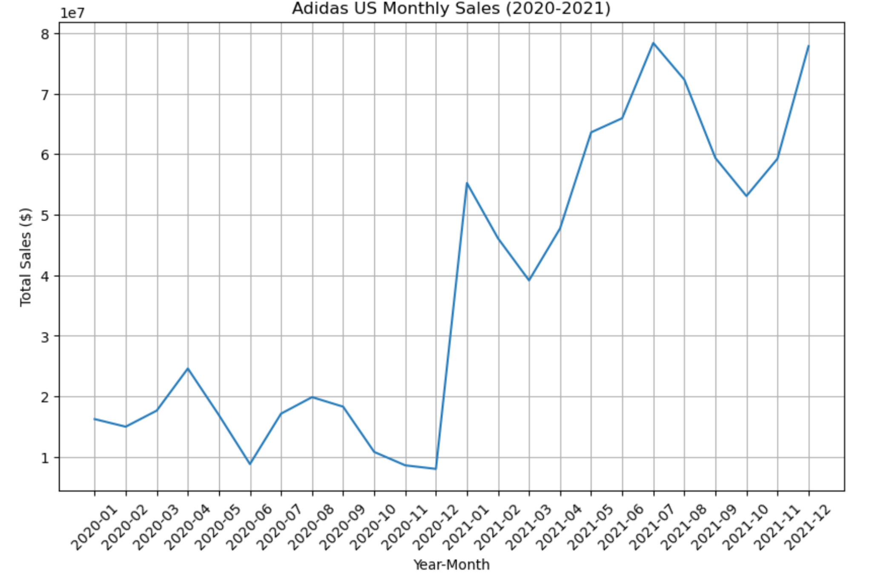
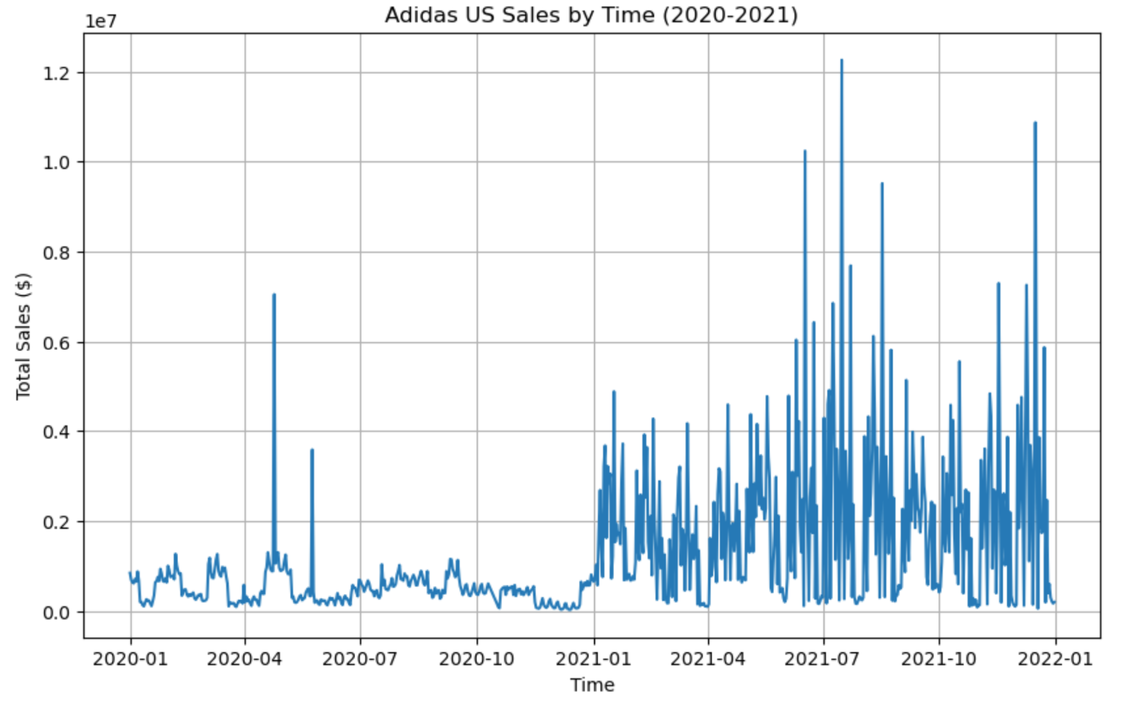
Sales Trend

Slide 7
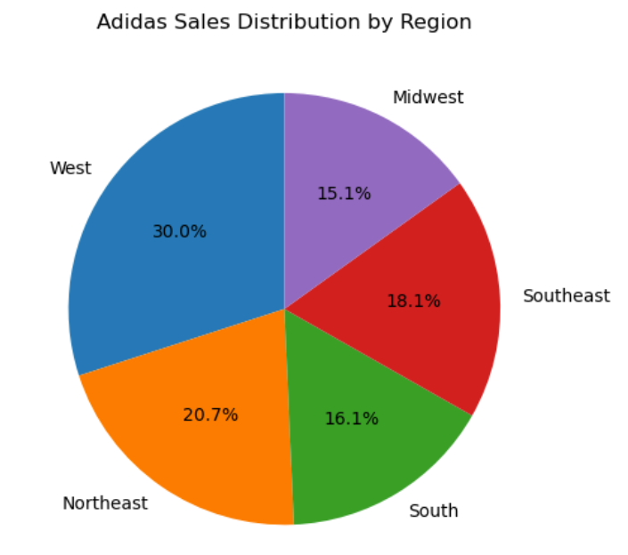
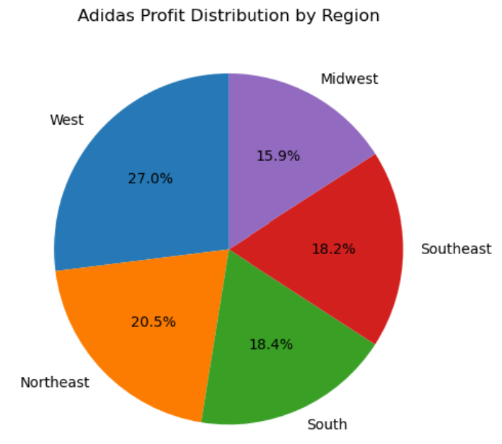
Regional Analysis (1/2)

Slide 8
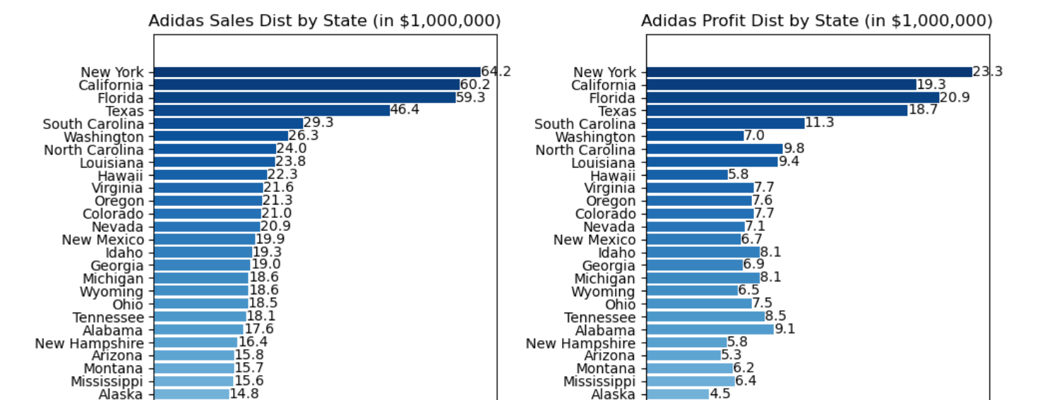
Regional Analysis (2/2)

Slide 9
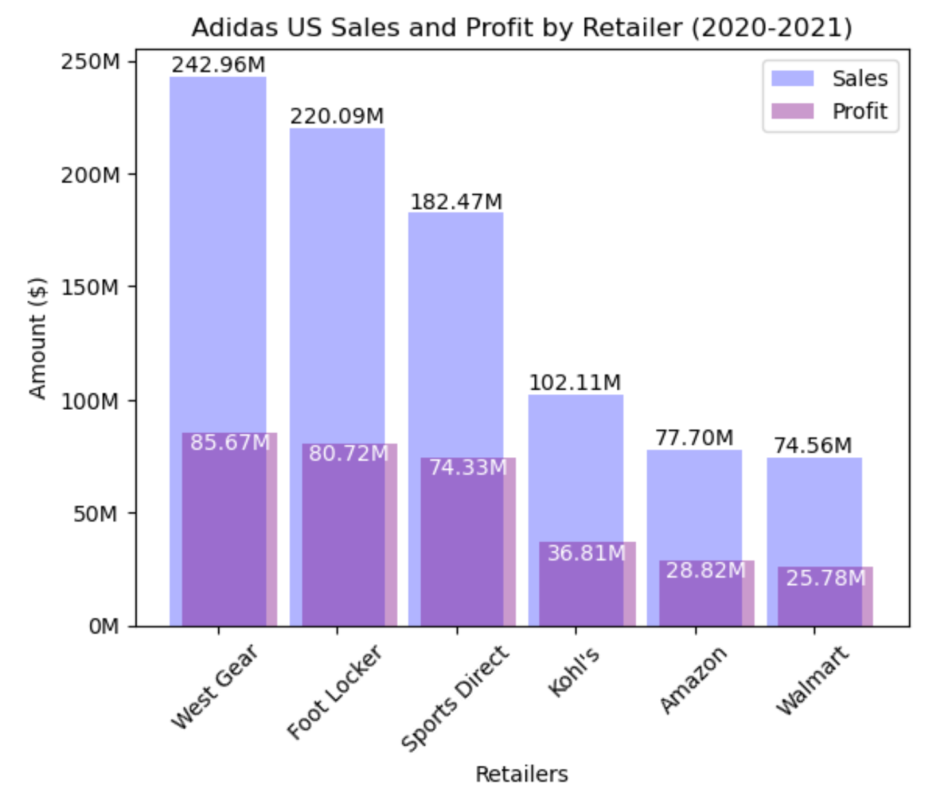
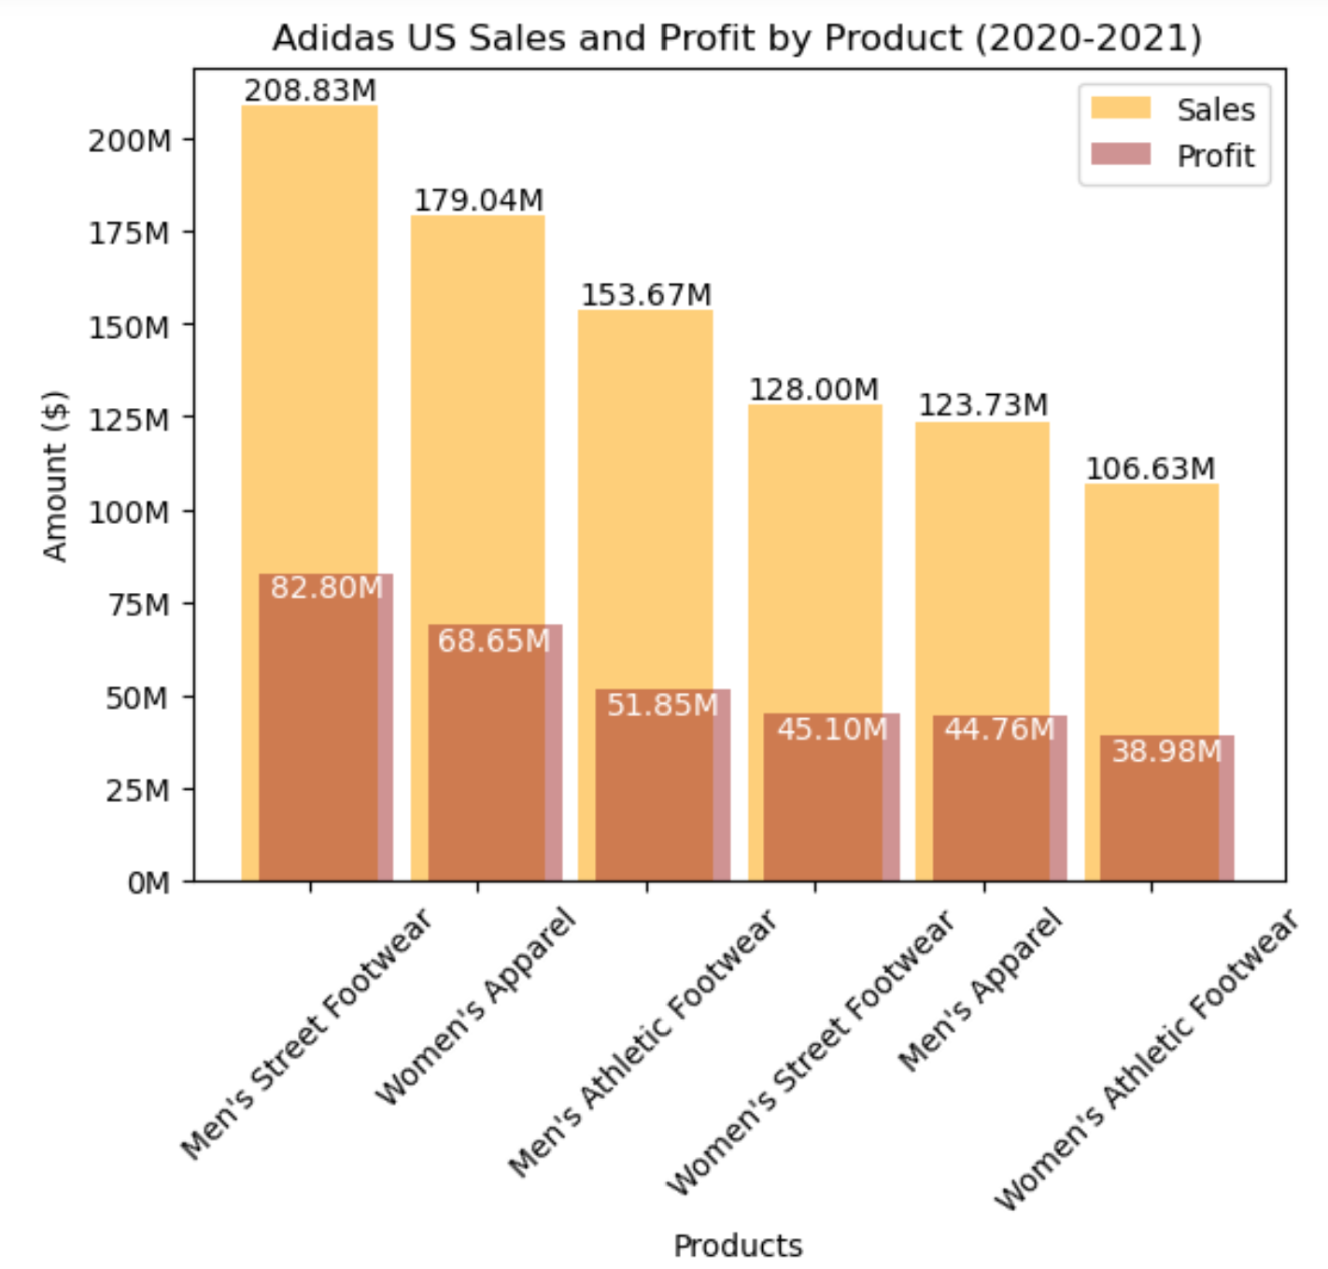
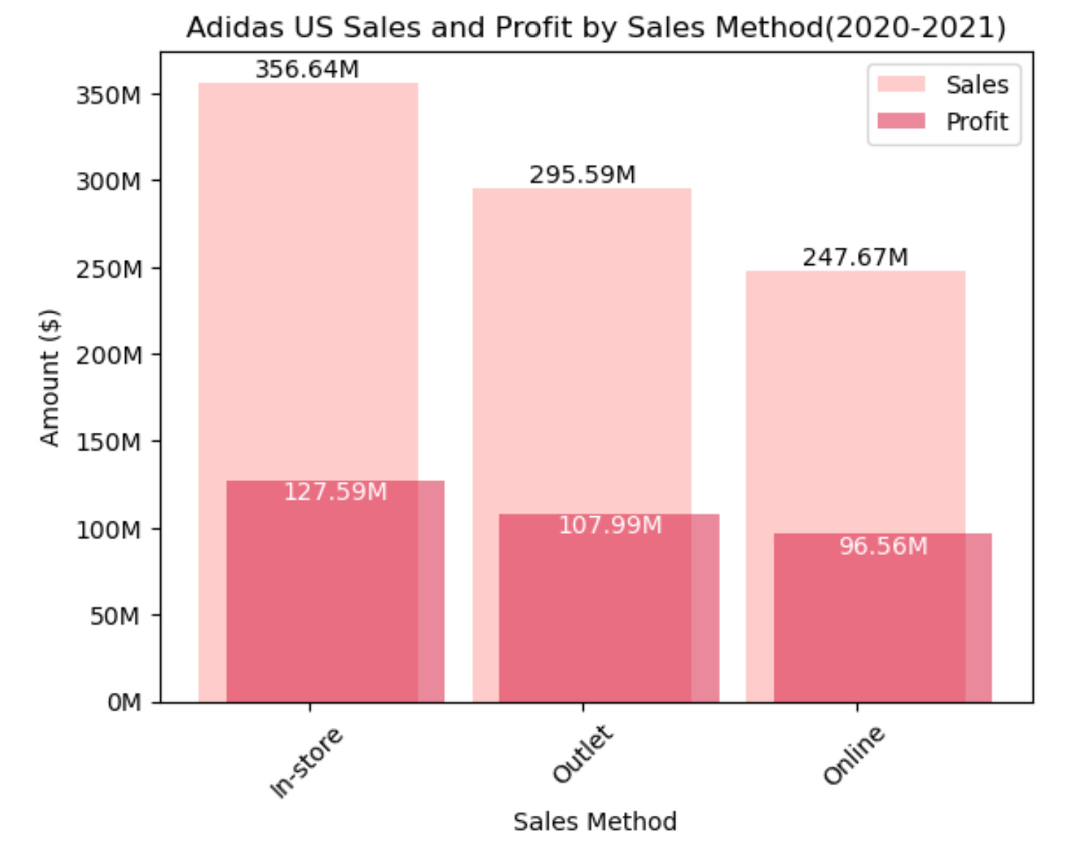
Segmentation Analysis

Slide 10
Algorithm
Time Ordered Data
ARIMA
SARIMA
Time Series Models
PROPHET

Slide 11
Modeling Process
Preprocess the data
Build a baseline model, fit train data & predict test data.
Calculate performance scores
Use grid search to find the optimal hyperparameters
Build, train and fit the best model using the optimal hyperparameters, and calculate performance scores
Conduct a 5-fold cross validation
Accept, reject or finetune the model based upon cross-validation outcome
A consistent modeling process is followed for each algorithm, while slight variations haven been accommodated to leverage the unique strengths and features inherent in each model.

Slide 12
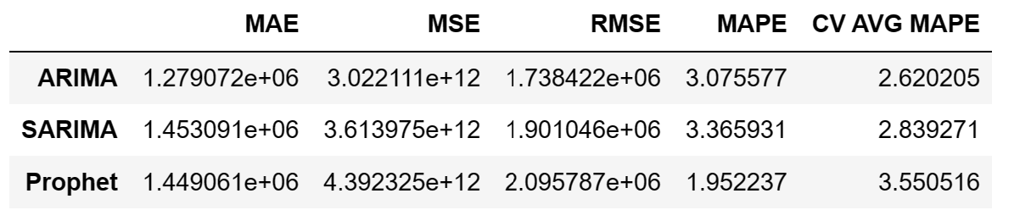
Model Performance Metrics

Slide 13
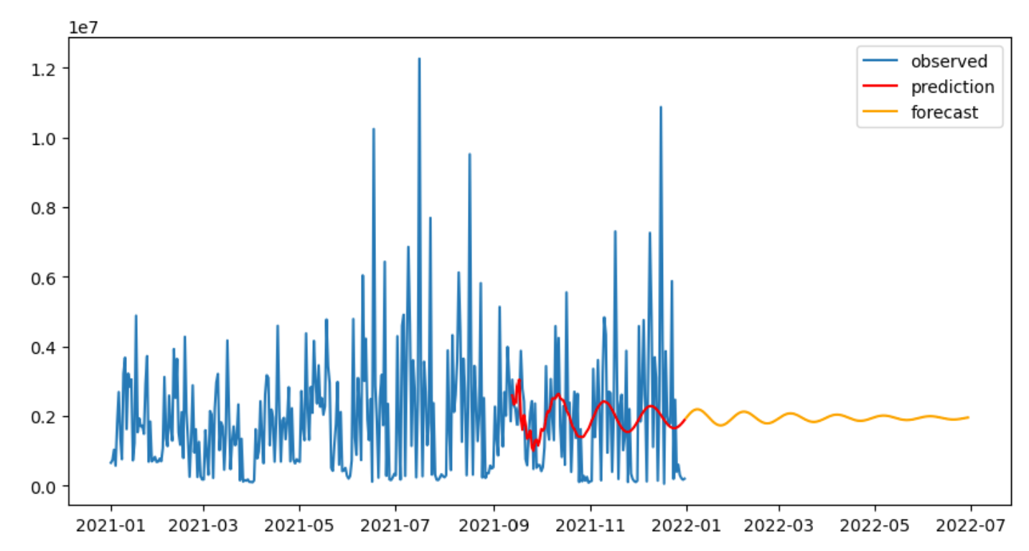
Forecasting Visualization

Slide 14
Conclusion
ARIMA is our best performing model.
Optimal Hyperparameters:
p = 8
d = 0
q = 6
Lowest MAE, MSE and RMSE scores
Reasonably low MAPE score

Slide 15
Future Improvement
Need more data
Recent data
Older data
Multi-dimensional data
External variables
Automate continuous update of the model
Use interactive dashboard to enhance user accessibility

Slide 16
Thank You
Stella Abigail & data.world for making Adidas US Sales Datasets available online!
Kenneth Gil-Pasquel for being such an amazing mentor guiding me through this project and throughout the whole course!
Wayne Ang for always being there as an on-demand mentor and providing honest feedback!

