Slide 1

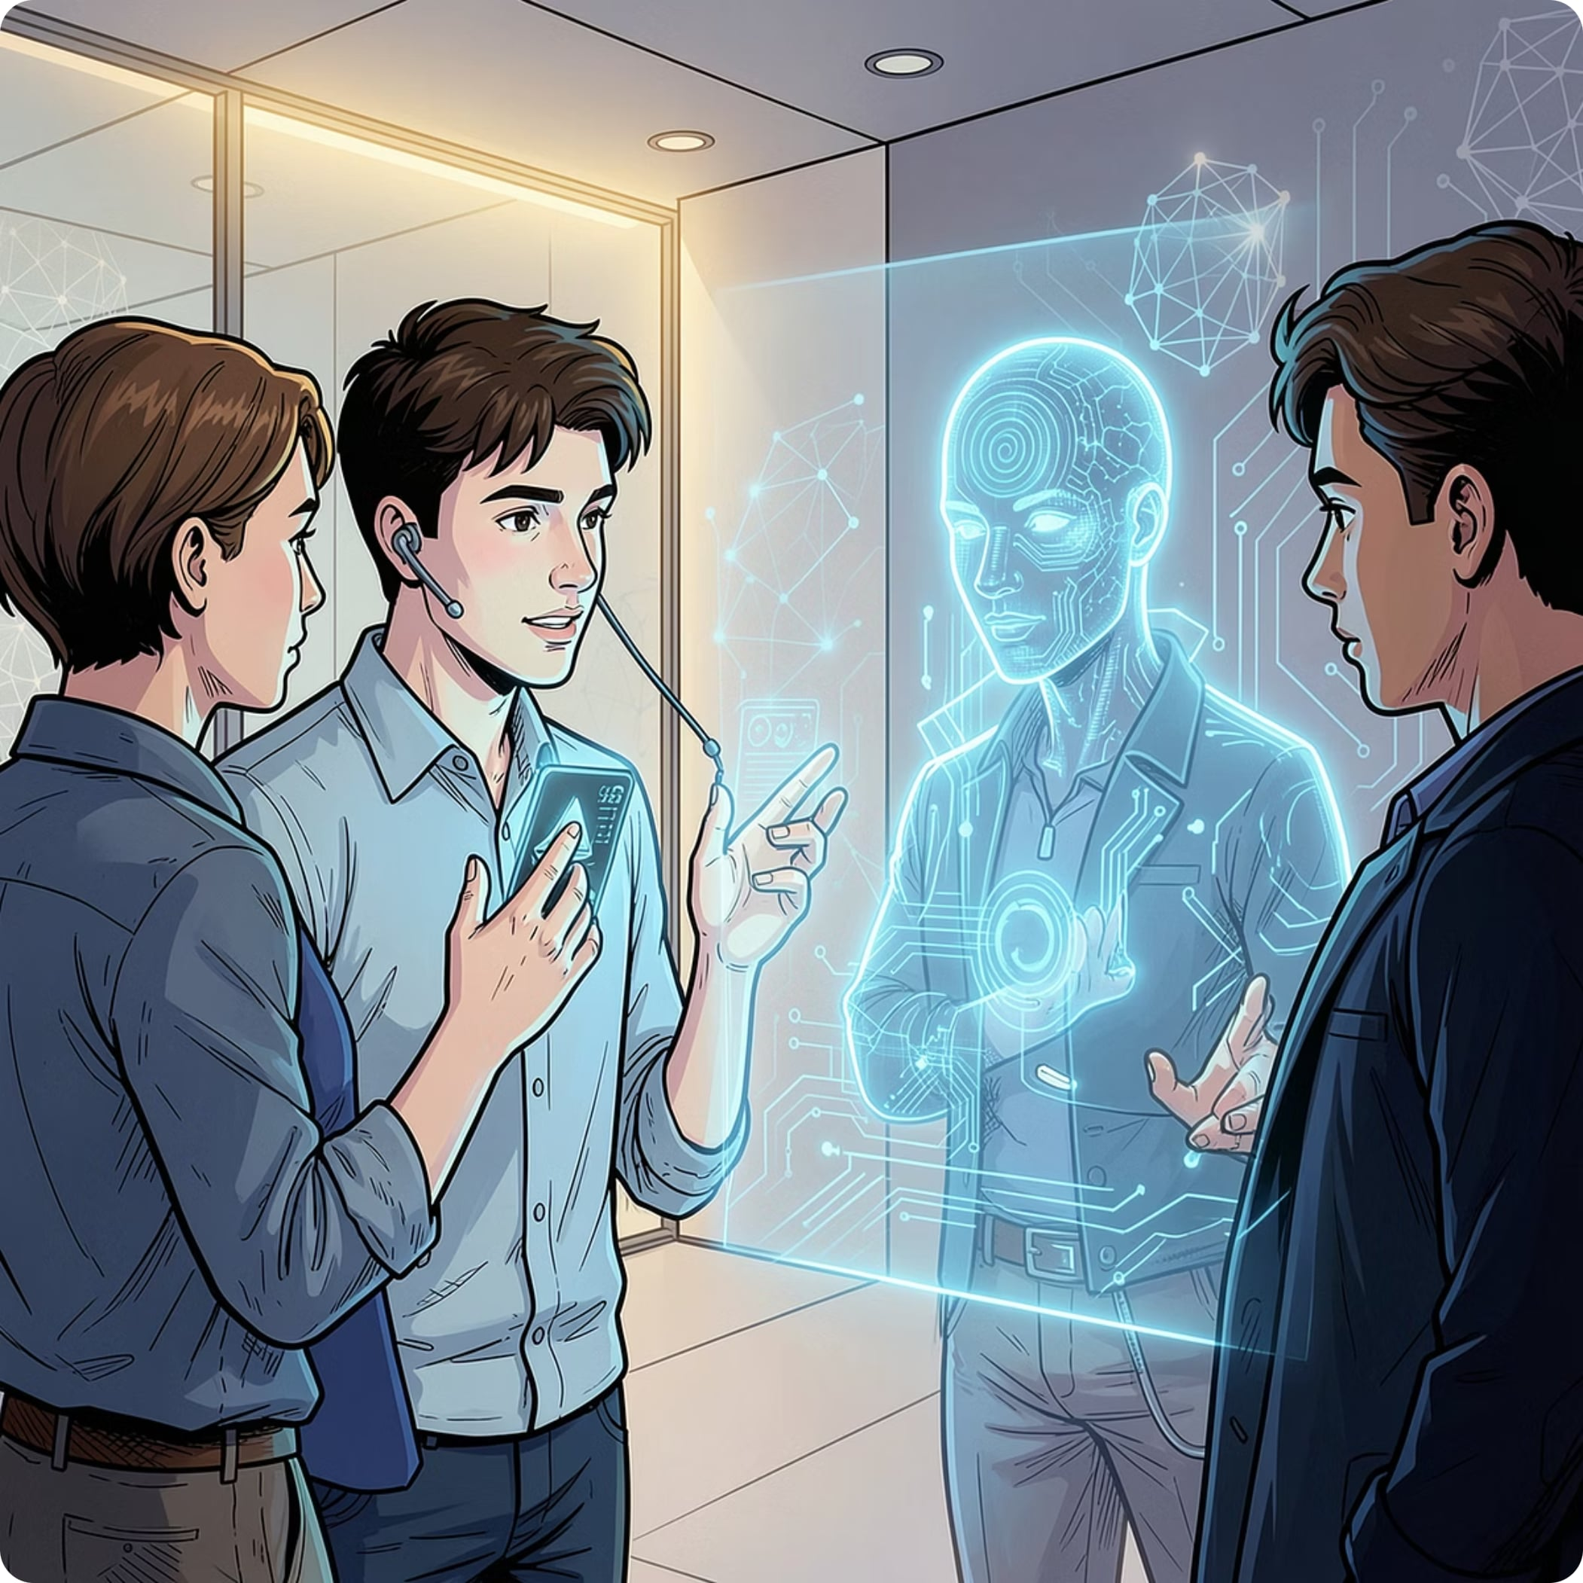
PROJECT MAHIRU / AMANE
AI-Powered Social Confidence & Interview Training
A 24/7 voice-to-voice AI coach that helps Gen Z professionals build real-world communication skills — without judgment, without the $300/hr price tag.

Slide 2
The Problem: Confidence Has a Price Tag
Gen Z is entering the workforce stressed, underprepared, and priced out of professional coaching.
40%
74%
Gen Z Stressed
Needed Time Off
Feel anxious all or most of the time — Deloitte 2025
Due to stress, but only 43% felt safe taking it
$300
0
Per Hour Coaching
Real-Time Tools
Career coaching costs $150–$300/hr — unaffordable for students
No affordable, conversational AI practice environment exists today

Slide 3

Meet Mahiru / Amane
Your always-on AI coach for interview mastery and social confidence — judgment-free, available 24/7.
Instant Feedback
User Speaks
AI Analyzes
Speak naturally, get instant feedback, and build confidence through safe, repeated practice.
🗣️ Voice-to-Voice
🧠 Deep Analysis
🎯 Judgment-Free
✅ Real Scenarios
Speak naturally — no typing required
Detects filler words, tone, and hesitation
Practice anytime, as often as you need
Simulates real interviews and social situations

Slide 4
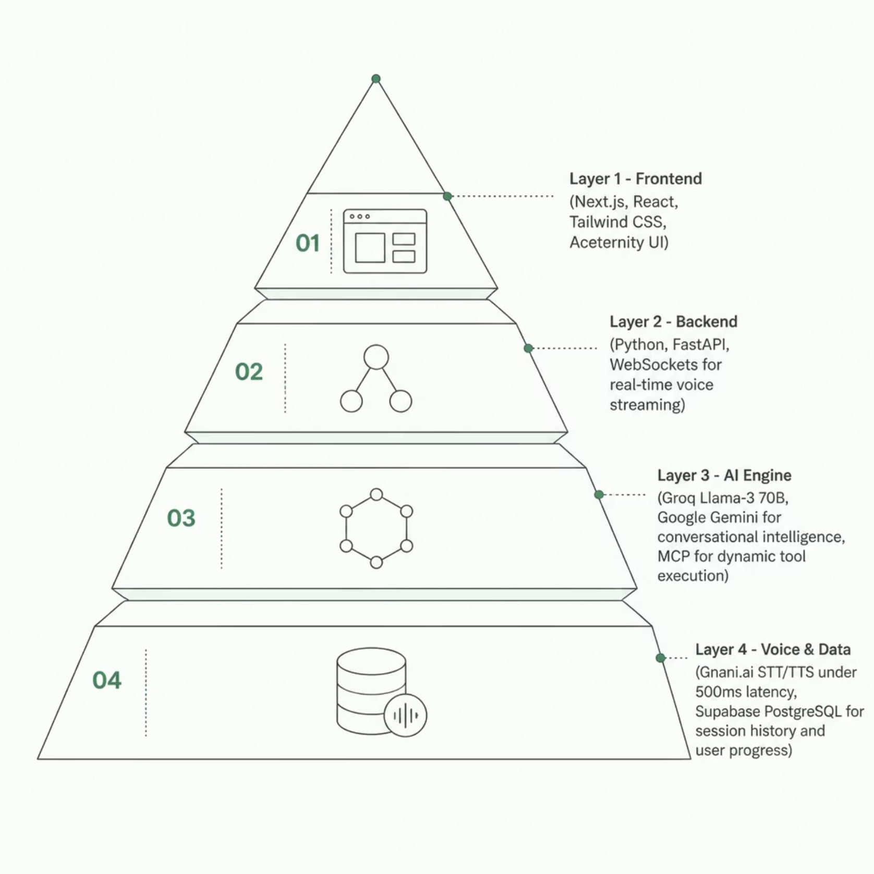
Technology Stack
Built for real-time performance, scalability, and seamless AI integration.
Why This Stack Wins
Sub-500ms voice latency via Gnani.ai — conversations feel natural, not robotic
Groq + Gemini deliver nuanced, context-aware coaching feedback
MCP architecture enables dynamic tool execution during sessions
Supabase tracks progress, session history, and user analytics securely

Slide 5
Strategic Partner Integrations
Powered by industry-leading platforms — each partner strengthens Mahiru/Amane's core capabilities.
Gnani.ai
Supabase
STT/TTS with ultra-fast voice response and natural conversations.
Session history, user progress tracking, and real-time analytics(not partner integreation willing to integreating keploy inbackend in future )
Groq / Google Gemini
Slashy via MCP
LLM intelligence for nuanced coaching, contextual feedback, and adaptive scenarios (not partner integretions wish to you use memO in it in future)
Dynamic tool execution for scheduling, resume analysis, and progress tracking.

Slide 6
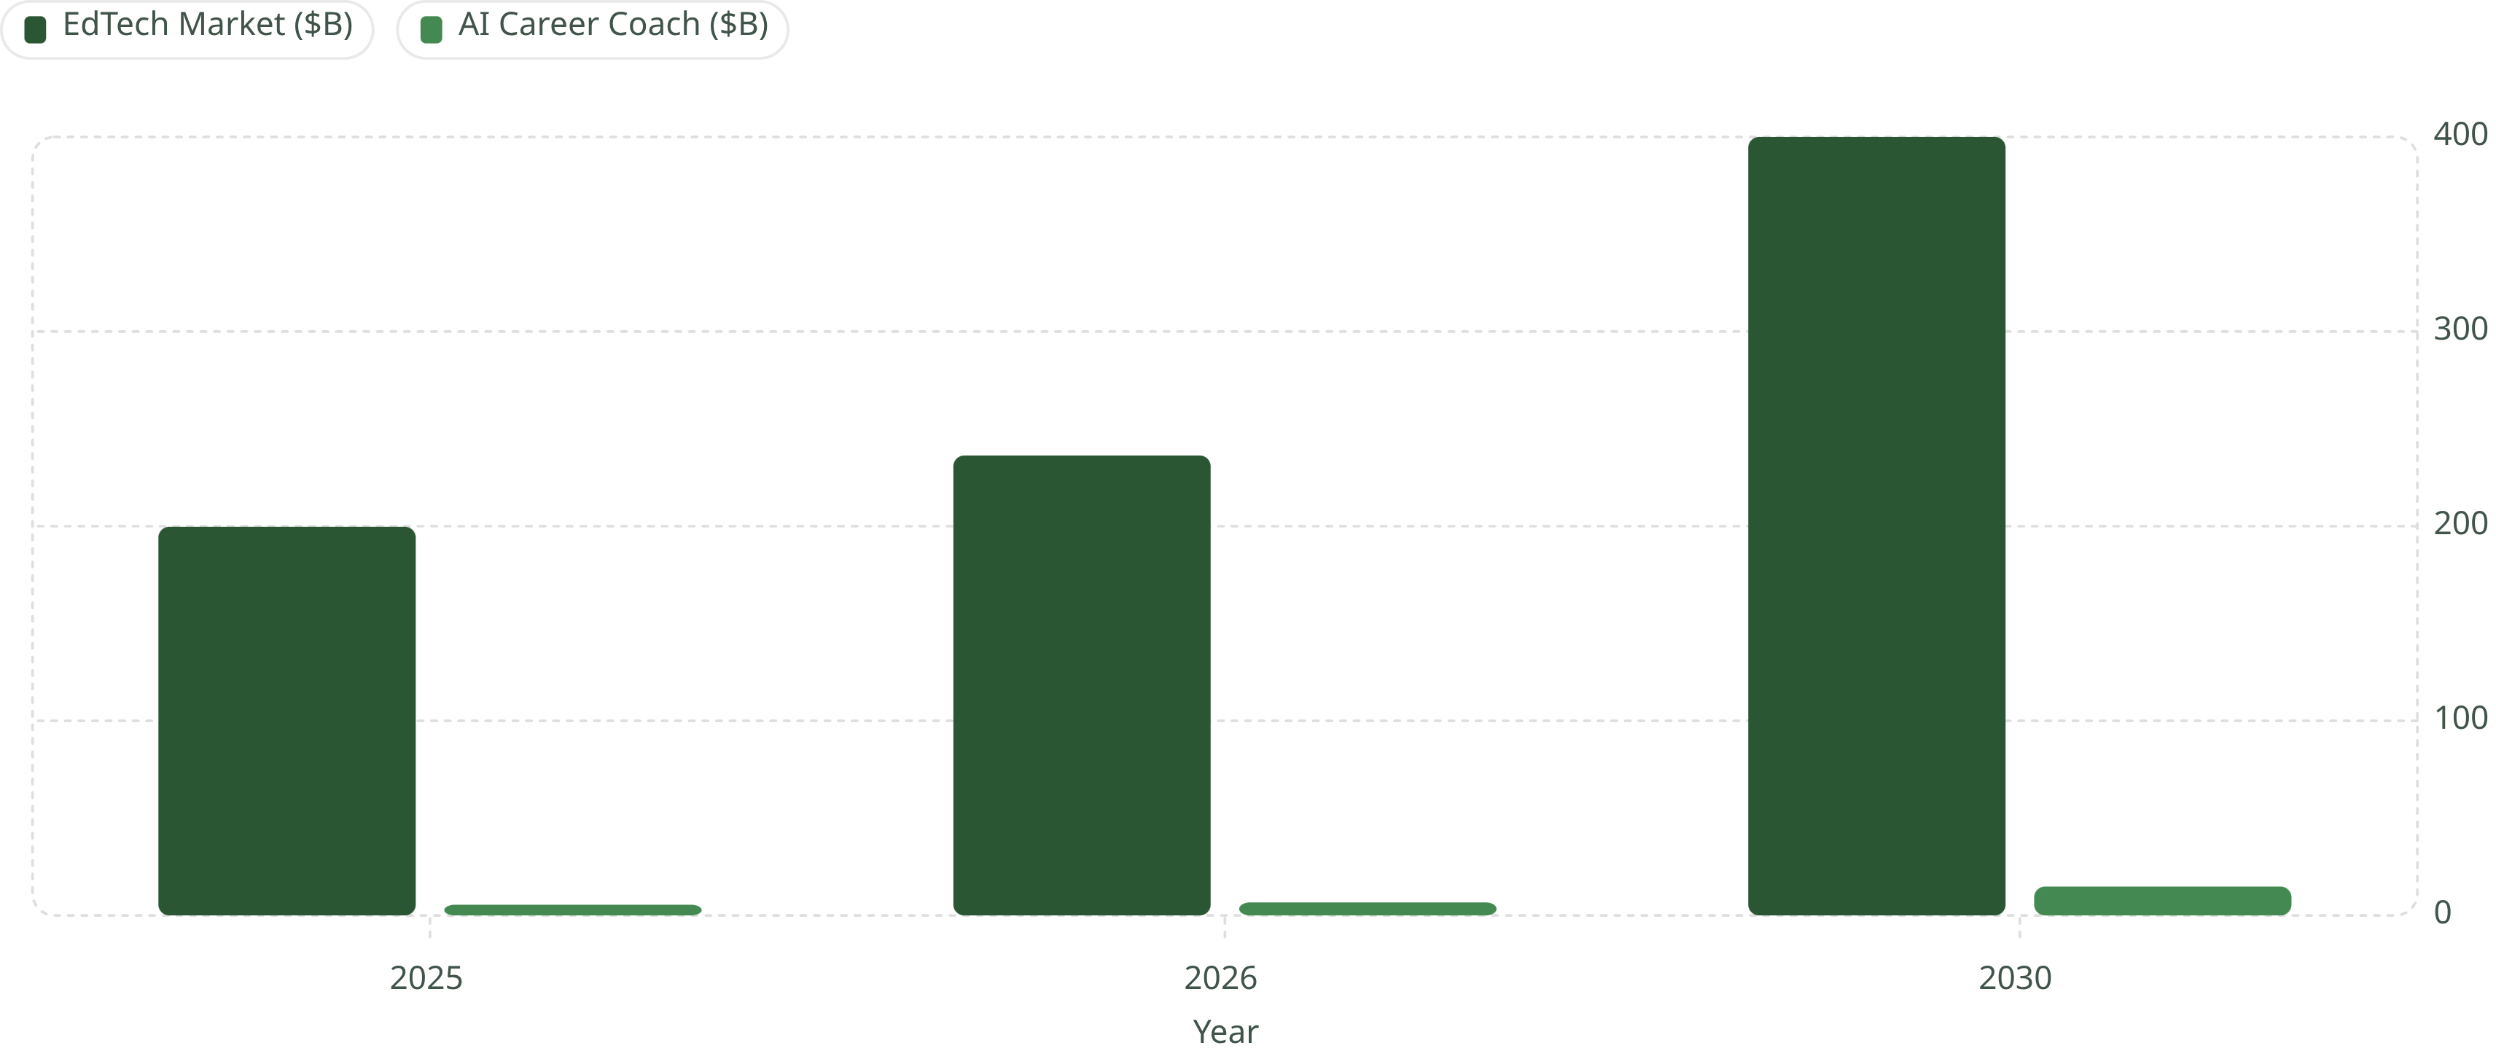
A $236B+ Market Opportunity
Mahiru/Amane sits at the intersection of three high-growth markets — positioned to capture massive Gen Z demand.
Three Markets, One Product
EdTech — $236B
AI Career Coaching — $14.8B
2.3B Gen Z Users
18.3% CAGR through 2026
22.3% CAGR, reaching $14.82B by 2030
Entering workforce during peak mental health awareness
The gap is clear: No affordable, real-time AI social confidence + interview simulator exists for Gen Z. Mahiru/Amane fills it.

