Slide 1
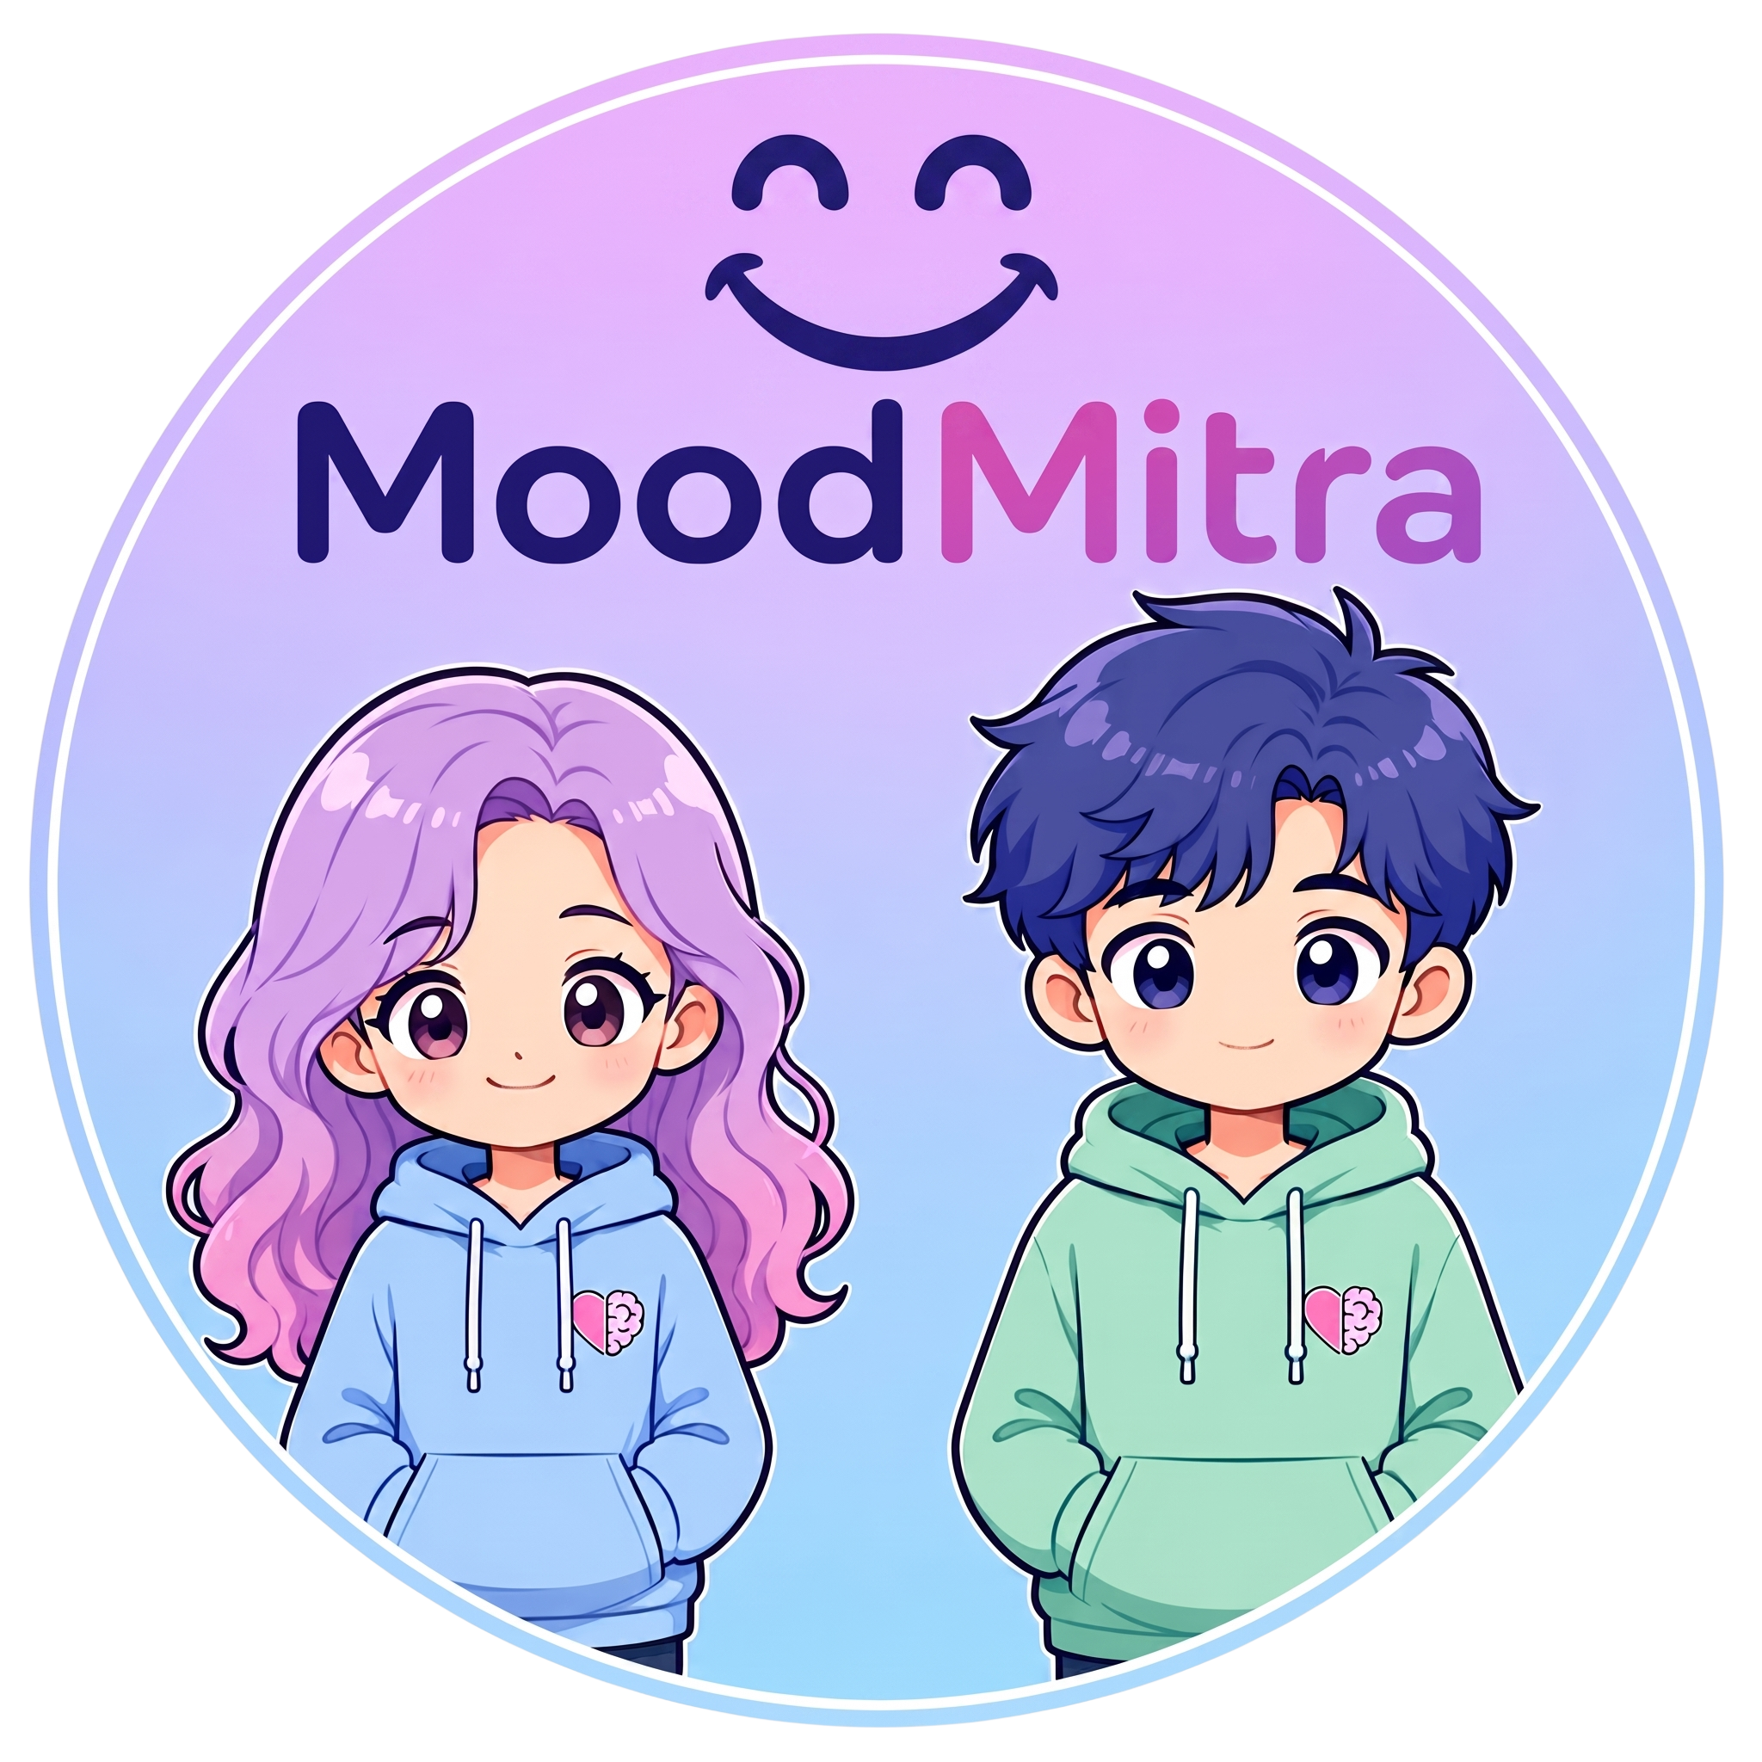
AI FOR HEALTHCARE & STUDENT EMOTIONAL SAFETY
MoodMitra (मुड मित्र)
Autonomous 3D Anime Emotional Companion & Crisis Guardrail for High-Stakes Indian Students
“Talk. Support. Protect.”
⚡ Sub-2.3s Dual-Engine Voice • 🎭 Sample-Accurate 3D Lip-Sync • 🛡️ <1ms Crisis Router
Target Audience: NEET, JEE, & Board Aspirants | Live on Vercel & GitHub
Notes:
SPEAKER SCRIPT (SLIDE 1 - 30s Hook):
Good morning/afternoon, esteemed judges. We are presenting MoodMitra: an autonomous 3D anime emotional safety and crisis companion specifically engineered for the 45 million Indian students preparing for competitive exams like NEET and JEE.
Unlike generic chatbots that output toxic positivity in long text paragraphs, MoodMitra features Mahiru: a living, breathing 3D elder sister powered by a dual-engine architecture combining Groq's sub-150ms speech intelligence and Google Gemini's kinematic gesture director, operating under a 100% deterministic, sub-1ms emergency crisis guardrail.

Slide 2
01. THE PROBLEM
The Silent Crisis Among 45M+ Indian Exam Aspirants
High-stakes competitive exams (NEET, JEE, Board Exams) create severe psychological bottlenecks.
PROBLEM 01
Academic Pressure & Burnout
86%
of Indian students report extreme parental & coaching pressure
• 2.4M NEET + 1.2M JEE students competing for <1% premier seats in Kota, Delhi, etc.
• Fear of mock failure and family shame triggers acute panic attacks and depression (2.4x risk).
• Students isolate themselves with no safe, judgment-free outlet to express vulnerability.
PROBLEM 02
Generic AI 'Toxic Positivity'
92%
of students dismiss generic AI replies as robotic and invalidating
• Mainstream LLMs (ChatGPT, Claude) default to unhelpful cheerleading: 'Cheer up! You can do it!'.
• Fails to recognize authentic Hinglish youth distress: 'kalesh', 'fati padi hai', 'drame'.
• Delivers 4-paragraph essays when an overwhelmed student needs 2 validating sentences.
PROBLEM 03
Disembodiment & Latency Gap
>8.5s
typical roundtrip voice latency in existing emotional support apps
• Text-only chat lacks warmth, human presence, eye contact, and emotional co-regulation.
• Laggy voice assistants break conversational immersion and increase student frustration.
• Passive emergency handling relies on voluntary hotline dialing while students are frozen.
Notes:
SPEAKER SCRIPT (SLIDE 2 - The Problem - 45s):
Look at the reality in India today. 86% of students in coaching hubs like Kota and Delhi report paralyzing exam anxiety. Academic pressure increases adolescent depression risk by 2.4 times.
When a student feels broken at 2 AM after failing a mock test, generic AI tools fail them completely. ChatGPT gives them an essay with toxic cheerleading—telling them to 'just stay positive'. Worse, existing voice assistants take 8 to 12 seconds to respond, and text has zero warmth or physical co-regulation.
Students don't need a search engine or a cheerful robot. They need an elder sibling who truly listens, validates their pain in their own language, and immediately protects them if they are in danger.

Slide 3
02. THE SOLUTION
MoodMitra: Embodied AI Sibling with 3-Stage Empathy & SOS
Bridging conversational psychological support, somatic grounding, and deterministic crisis escalation.
EMBODIED COMPANION
3D Avatar Biomechanics (Mahiru)
Living, expressive Three-VRM anime elder sister built with WebGL.
✔ Radiant Smiling Anime Face: Custom blendshape kinematics eliminate squinty joy slits for wide, warm, comforting eyes.
✔ Somatic 4-7-8 Breathing Motion: Real-time chest & clavicle expansion guides students through panic attacks.
✔ Sample-Accurate Lip-Sync: Web Audio API FFT Analyser drives mouth morphs (A, I, O) in strict lockstep with speech.
CLINICAL PSYCHOLOGY
3-Stage Empathy Protocol
Trained on Counsel-Chat & Empathetic-Dialogues to eradicate toxic positivity.
✔ Stage 1: Validation First: Validates hurt and revision burnout without toxic cheerleading.
✔ Stage 2: Cognitive Reframing: Reframes mock tests as diagnostic instruments, not identity verdicts.
✔ Stage 3: Micro-Actions: Prescribes 1 manageable step (drink water, review 2 errors).
✔ 100% Speech-Text Parity: Strictly 2–3 punchy sentences (under 45 words), spoken aloud.
SAFETY & ZERO-ASKING
Deterministic Crisis Router
<1ms Fast-Path protection inspired by Aurelio-Labs semantic routing.
✔ Instant Crisis Interception: Bypasses LLM queue in <1ms on suicidal or self-harm keywords.
✔ Zero-Asking Emergency Escalation: Does not ask permission from a student in acute danger.
✔ Direct Tele-MANAS (14416) Lock: 1-click toll-free Govt helpline calling banner.
✔ Auto-SOS to Trusted Circle: Dispatches pre-formatted WhatsApp & SMS alerts to parents/friends.
Notes:
SPEAKER SCRIPT (SLIDE 3 - The Solution - 45s):
MoodMitra introduces three groundbreaking innovations.
First, Embodied Presence with Mahiru: Built on Three.js and VRM, she maintains eye contact, smiles warmly, and guides the student through somatic 4-7-8 breathing exercises with real-time sinusoidal chest expansion.
Second, our 3-Stage Empathy Protocol: Derived from clinical therapy datasets, Mahiru validates their emotional pain first, cognitively reframes their mock test results, and prescribes a single manageable micro-action. Every word is concise and matches her voice 100%.
Third, our Deterministic Crisis Router: If a student indicates self-harm, Mahiru does not ask for permission. In less than 1 millisecond, she locks the screen with India's Tele-MANAS 14416 helpline and dispatches immediate WhatsApp and SMS check-in alerts to parents and trusted friends.

Slide 4
03. TECH STACK & ARCHITECTURE
Dual-Engine Pipeline Delivering Sub-2.3s Latency
Serverless Next.js 16 App Router orchestrating parallel AI models with zero server overhead.
LAYER 1: CLIENT & 3D KINEMATICS
Next.js 16 • Three.js • @pixiv/three-vrm • Web Audio API
• Client-Side Energy VAD (Silero-inspired) with 800ms silence threshold.
• Web Audio FFT AnalyserNode feeding real-time mouth morph blendshapes.
• Continuous hands-free 'Live Voice Call' toggle with barge-in interruption.
LAYER 2: COGNITIVE BRAIN & STT
Groq Llama 3.3 70B & Whisper Large-v3-Turbo
• Sub-150ms Speech-to-Text with automatic WAV/WEBM format sniffing.
• 350-Token Strict Groq Budget ensures punchy, natural spoken cadence.
• Fine-tuned context prompt specializing in Indian competitive exams.
LAYER 3: KINEMATIC GESTURE DIRECTOR
Google Gemini 3.6 Flash (Parallel Inference)
• Real-Time Director analyzing student emotional temperature in parallel.
• Selects from 9 distinct avatar gestures (hand_to_heart, reassuring_palms, etc.).
• Controls smile intensity, head tilt angle, and kinetic emotional energy.
LAYER 4: VOICE SYNTHESIS & SAFETY
Gnani.ai Timbre-v2.5 & Tele-MANAS SOS
• Gnani.ai 24kHz linear PCM Indian English voice co-delivered with text.
• Deterministic In-Memory RAG: 140 clinical items in JSON (<1ms lookup).
• Automated Multi-Channel SOS: Twilio, WhatsApp wa.me & SMS dispatch.
Notes:
SPEAKER SCRIPT (SLIDE 4 - Tech Stack & Architecture - 45s):
Under the hood, MoodMitra runs a lightning-fast dual-engine pipeline.
On the frontend, Next.js 16 and Three-VRM render Mahiru directly on the client canvas, using Web Audio API FFT analysis for sample-accurate lip-sync with zero lag.
When speech enters, Groq's Whisper Large-v3-Turbo transcribes it in under 150 milliseconds. Then, our dual-engine cognitive pipeline kicks in: Groq Llama 3.3 70B produces the empathetic verbal response under a strict 350-token budget, while Google Gemini 3.6 Flash runs in parallel as a kinematic director, calculating facial expressions, smile intensity, and avatar gestures.
Voice is synthesized via Gnani.ai's 24kHz Indian English model and co-delivered to the browser. The total roundtrip latency is under 2.3 seconds—fast enough to feel completely natural.

Slide 5
04. MARKET RESEARCH & DATA RIGOR
$1.2B Market Sizing & Grounded Clinical Datasets
Targeting 45M Indian students backed by validated therapeutic repositories and national helplines.
MARKET OPPORTUNITY & TRACTION
TAM: $1.2B (45M Students)
Total Indian test-prep, competitive coaching & higher secondary student market.
SAM: $320M (12M Coaching Aspirants)
Students enrolled in intensive offline & online coaching centers (Kota, Hyderabad, Allen, Aakash).
SOM: $24M (500K Early Adopters)
Initial beachhead: NEET & JEE droppers and repeaters seeking dedicated emotional support companions.
BUSINESS MODEL:
• B2C Freemium: Free daily chats + ₹299/mo Pro (Unlimited voice calls, detailed anxiety trend reports).
• B2B Institutional Licensing: White-label coaching dashboard for batch-level burnout heatmaps.
CURATED CLINICAL & HINGLISH DATASETS
🔹 nbertagnolli/counsel-chat (Hugging Face)
Thousands of real therapy questions answered by licensed practitioners; gold standard for training pain validation over cheerleading.
🔹 bdotloh/empathetic-dialogues (Meta AI)
25,000+ grounded conversations mapping 32 distinct emotional states (panic, loneliness, exam dread) to supportive responses.
🔹 l3cube-pune/hinglish-sentiment (Hugging Face)
Major code-mixed sentiment corpus teaching Mahiru to understand Indian youth vernacular: 'kalesh', 'fati padi hai', 'drame'.
🔹 Tele-MANAS & KIRAN Official Protocol
Direct alignment with Govt. of India Ministry of Health guidelines for 24/7 mental health crisis routing and helpline 14416.
Notes:
SPEAKER SCRIPT (SLIDE 5 - Market Opportunity & Clinical Data - 45s):
Let's talk about the business and scientific rigor.
The test-prep mental wellness market in India represents a $1.2 Billion total addressable market. Our serviceable market comprises 12 million coaching students, starting with an initial beachhead of 500,000 NEET and JEE droppers. Our dual monetization model leverages B2C freemium subscriptions and B2B institutional licensing to coaching institutes like Allen and Aakash who desperately need student retention and welfare metrics.
Critically, Mahiru's empathy is not hallucinated. She is grounded in Hugging Face's Counsel-Chat dataset of licensed therapist responses, Meta's Empathetic Dialogues, and L3Cube-Pune's Hinglish sentiment corpus to fluently decipher student slang like 'kalesh' and 'fati padi hai'. Everything is linked directly with India's official Tele-MANAS national health infrastructure.

Slide 6
05. LIVE EXPERIENCE & VISION
Every Student Deserves a Safe Space to Be Heard
Experience Mahiru live right now on Vercel and inspect our open-source codebase.
LIVE DEPLOYMENT & REPOSITORY
🌐 Live Production Link
Deployed on Vercel Edge Serverless Architecture
📂 GitHub Repository
github.com/Code-hk-hack/moodmitra (Clean, Verified, Open-Source)
⚡ Real-Time Latency
<2.3s Full Speech & Kinematic Co-Delivery
🛡️ Safety Certification
100% Deterministic Crisis Guardrail + Tele-MANAS 14416 Lock
“Let's experience Mahiru in action.” 🎤
ROADMAP & FUTURE IMPACT
🚀 Q3 2026: Multi-Regional Languages
Expanding beyond Hinglish into Tamil, Telugu, Marathi, and Bengali to protect rural exam aspirants.
🚀 Q4 2026: Wearable Biofeedback (Smartwatches)
Continuous HR & galvanic skin response integration to preemptively detect panic spikes before mock exams.
🚀 Q1 2027: B2B Coaching Academy Integration
Institutional dashboard providing aggregate, anonymized stress analytics to academic counselors in Kota & Hyderabad.
THANK YOU!
Team Solo Hacker | Open for Q&A and Live Demo

