Slide 1

Welcome! Please help yourself to breakfast and coffee!

Slide 2
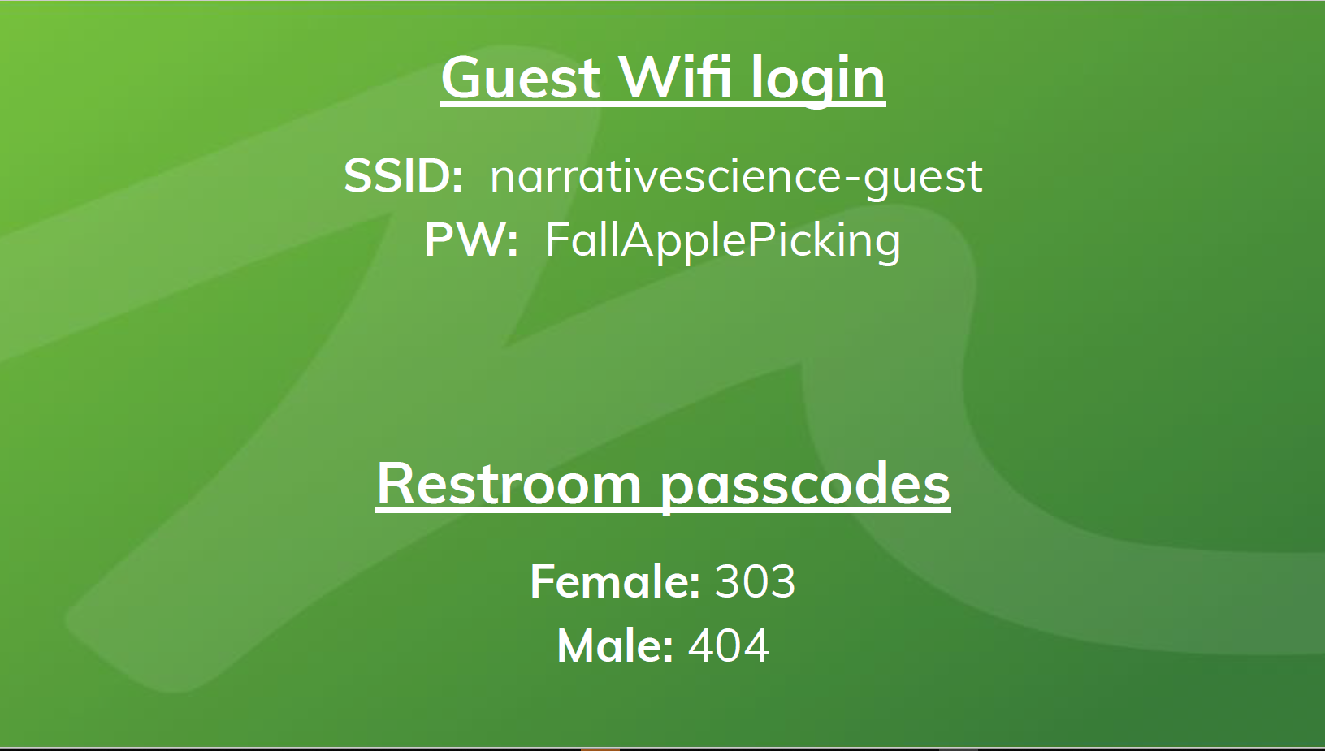
WiFi
Text
Text

Slide 3
Welcome to Code out Violence: A Datathon for Crime Analysts
Notes:
Opening remarks: Welcome to the event. Introduce ourselves as event organizers and MC’s. I’m sure some of you are wondering what the Crime Lab is, what do we do, and why are we hosting a law enforcement analyst event. No we are not NCIS, although I consider myself to have a lot of the same qualities as “Gibbs” and Michael is definitely a McGee.

Slide 4
What is the University of Chicago Crime Lab?
Notes:
UChicago Crime Lab works to have social impact by carrying out Research and Development in close collaboration with the public sector and community-based partners. Sometimes this resembles a rigorous academic evaluation, and other times this work focuses on hands-on technical assistance and project implementation and support.

Slide 5

Urban Labs partners with cities to identify and rigorously evaluate the policies and programs with the greatest potential to generate large-scale social change across five key dimensions of urban life:
EDUCATION
HEALTH
ENERGY &
ENVIRONMENT
CRIME
POVERTY
Notes:
Urban Labs = Umbrella
Crime Lab is 1 of 5 labs

Slide 6
OUR APPROACH
WE PARTNER WITH CIVIC LEADERS TO:
IDENTIFY
Promising solutions to urban challenges
TEST
The most promising urban policies and programs
SCALE UP
The most effective and cost-efficient policies and programs

Slide 7
December
CPD/Mayor’s Office requests Crime Lab assistance with initial pilot
July
With support from CRED, Crime Lab hires additional analysts, embeds 3 in each of CPD’s Areas
January
Crime Lab analysts go on ridealongs, attend roll calls, identify analysis products for pilot districts
January
SDSCs open in 003, 004, 005, & 025
June
SDSCs open in 017 & 018
2016
2017
2018
March
SDSCs open in 006, 009, 010, & 015
March
SDSCs open in 002, 008, & 012
September
Crime Lab embeds analyst in CPIC, CompStat, and DoC
November
Mayor’s Office approves SDSC pilot in districts 007 & 011
August
CPD hires first ever civilian analysts
October
DOJ team of technical experts performs assessment of CPD
February
SDSCs open in 007 & 011
July
SDSC opens in Bureau of Patrol
Notes:
Crime Lab had been working with CPD in a smaller, research driven capacity through 2016. When Chicago’s homicide rate spiked 60% over the previous year, the Crime Lab felt like we had to do something more drastic with how many lives were at stake in our city. Queue SDSC project, embedded work, and the current shift to consulting and capacity scale-up (training and support). We will share some of work tomorrow around lunch time.
Enough about us, by show of hands, whose first time is it in Chicago? Let’s give everyone some context of where we are in the city.

Slide 8
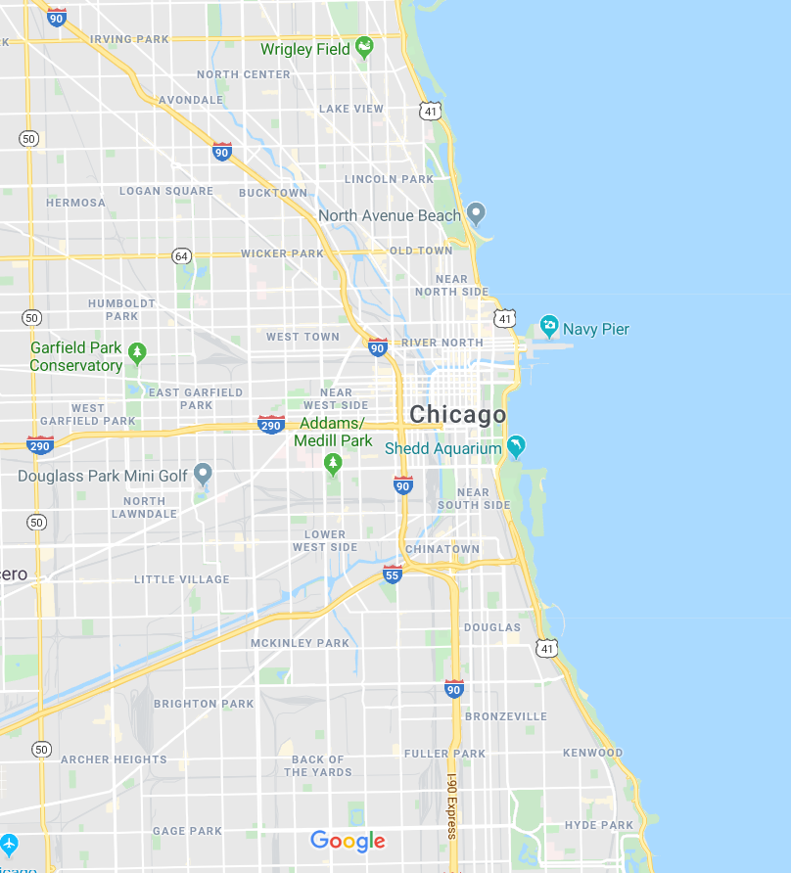

NarrativeScience 1 Dearborn St, #700
Notes:
If you hadn’t noticed, we’re in the heart of The Loop/Downtown Chicago

Slide 9
Lake Michigan
Notes:
Lake Michigan, aka East Chicago. I wouldn’t advise jumping in the lake this time of year.

Slide 10
Navy Pier 600 East Grand Ave
Notes:
Big Ferris wheel

Slide 11
CloudGate (aka The Bean) 201 E Randolph St
Notes:
There is to be no mention of the Cloud Column, Houston’s grotesque facsimile of our beloved mirrored legume. Stop by and get your classic Chicago tourist picture, as they say, “If you didn’t get a picture with The Bean, were you really even in Chicago?” We can’t guarantee you’ll travel reimbursement without photo documentation of you and The Bean. /s

Slide 12
IACP McCormick Place 2301 S King Dr
Notes:
Fun fact for the day, McCormick Place is the largest convention center in North America. 12 people are lost inside McCormick Place every year. Hard Stop.

Slide 13
Soldier Field 1410 Museum Campus
Notes:
Home of Daaaaa Bears. Saint Louis is like what is a football stadium?

Slide 14
Wrigley Field 1060 W Addison St
Notes:
Pay your respects to the Cubs 2019 season (Michael)
Cardinals fans laugh (Kevin)

Slide 15
University of Chicago Campus 924 E 57th St
Notes:
Campus is beautiful this time of year. Highly recommended to make your way down here with a group of people. Check out the bookstore

Slide 16
Chicago Police HQ 3510 South Michigan Ave

Slide 17
Pequod's Pizza 2207 N Clybourn
Notes:
Best pizza in the world.

Slide 18
Staff introductions
Notes:
Crime Lab present, NarrativeScience – Look for green shirts!

Slide 19
Your turn! Name Department Role ?
Notes:
Crime Lab present, NarrativeScience – Look for green shirts!

Slide 20




Sponsors/Partners
Silver Sponsor
Sponsor
Host Partner
Partner
Notes:
We’d like to take a moment to thank you sponsors, starting with NarrativeScience for offering their amazing workspace to us for the weekend and their awesome tool.
ESRI has been a huge support of the event with their software and staff resources.
Tableau contributed enough to be a silver sponsor for the event. Discuss Tableau roll-out at CPD and Crime Lab, preview dashboards.

Slide 21
What is a Datathon!?
Sprint-like event for coders and analysts
Involves analysis, design, concept, brainstorming, domain knowledge
Less specific on outcomes, software, or existing state of affairs. More focused on innovation and learning
Datathon solutions begin from scratch at the start of the event and “culminate” in a product
Notes:
Who has attended a Hackathon or Datathon before by show of hands?
The word Datathon is a combination of “data” and “marathon” – “data” is used in the sense of exploratory data analysis, “marathon” = endurance

Slide 22
Mission
Innovate
Collaborate
Learn
Notes:
Innovate – work on something you wouldn’t normally work on. Try something new. Push the limits of crime analysis.
Collaborate – work together, expand your professional network, share your experiences
Learn – learn new ways of doing things, learn new software, learn from others

Slide 23
Objectives
Day 1 Objective: Have an relevant topic chosen that is complex enough to challenge the team, but realistic enough to be completed during the Datathon time period.
Day 2 Objective: Bulk of the work gets done
Day 3 Objective: Wrap up project work and prepare for presentation

Slide 24
Project Expectations
Successful project ≠ Finished project
Notes:
Our first hackathon (tableau) didn’t result in a end product. But we learned a lot about how hackathons worked, about Tableau’s software accessibility, we learned about prior hacks and potential for the software. We took some of the thing we learned into our workflow as well as this event. So it was a success, for us.
Presentations about your idea, what you learned, how it might impact your work, and what your project would have been capable of are all successes to us.

Slide 25
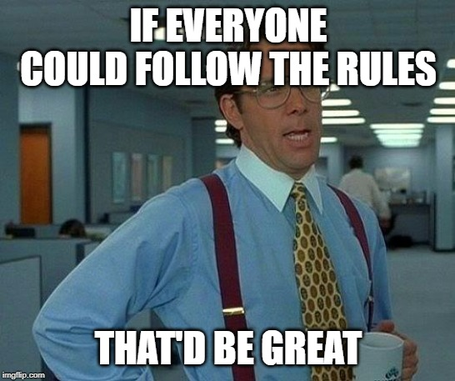
Rules
Fresh work – We will all being at the same time. No prior code or templates were used on prior work products
You build it, you own it - It's your code, your ideas, your workflow.
Team size - No more than 5 people to team
Demos – you will have 10 minutes to present your product to the judges

Slide 26
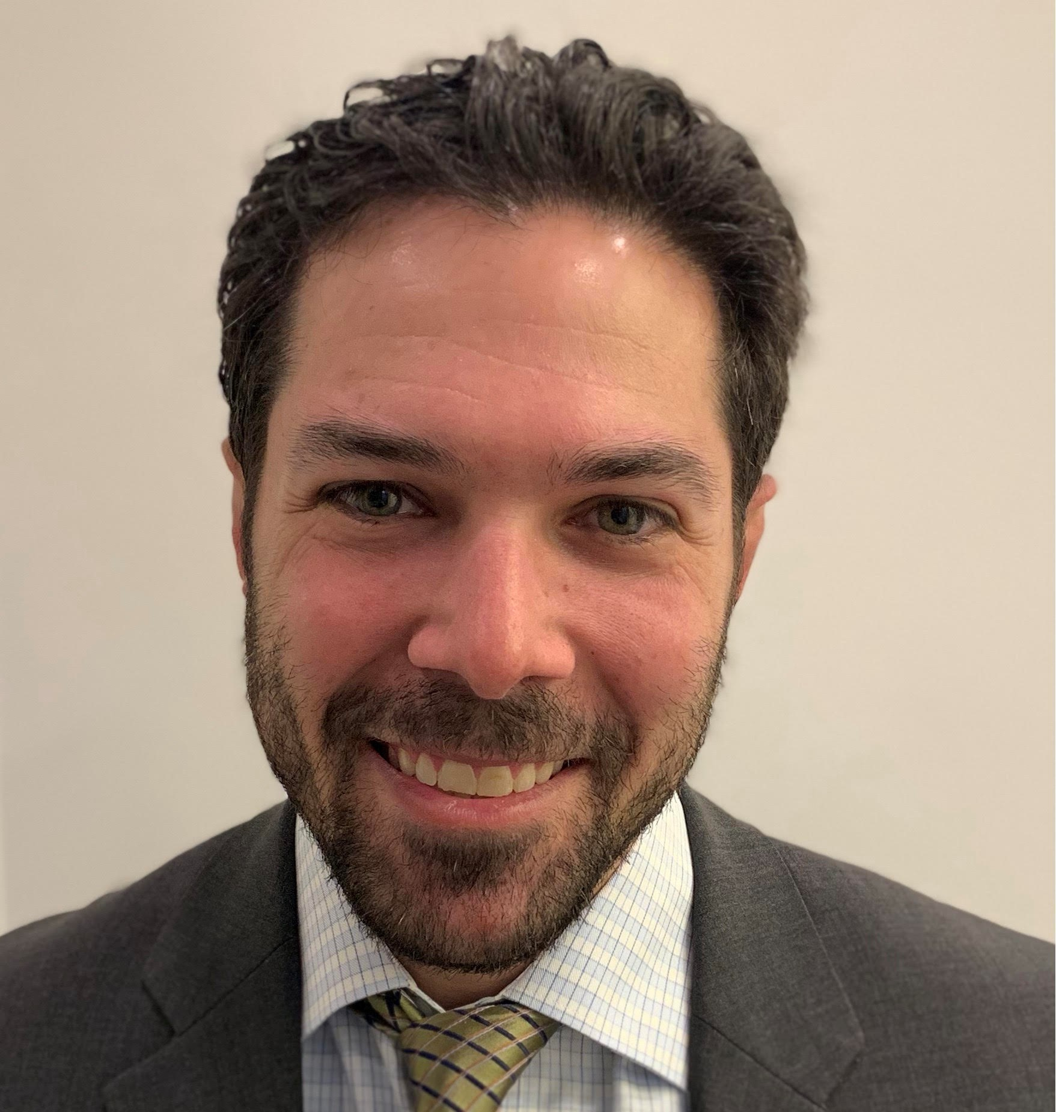
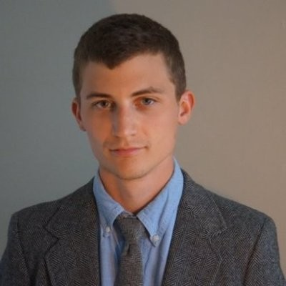
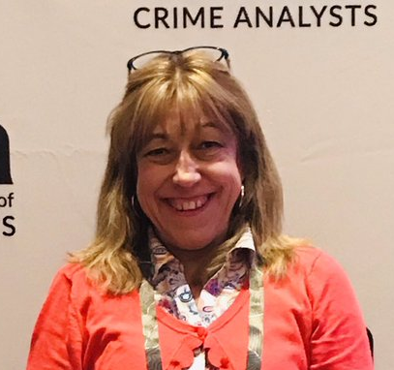
Judges
Dan Platt
Senior Principal of Market Innovation
Narrative Science
Terry Neumann
Senior Data Scientist
UChicago Crime Lab
Deb Piehl
Crime and Policing Consultant
The Piehl Group

Slide 27
Scoring
Projects will be scored based on:
Concept - How would you rate the project concept. Specifically, how exciting and ambitious is the project topic as a concept?
Execution – Given the goals of the project, and the constraints of the weekend, have they made good progress during their time?
Presentation - How well did they present their project, was it clear and focused? Did they share what they learned?

Slide 28
We have a GitHub! README
Notes:
Let’s hop over to the README file on the GitHub where you will find all relevant details for the event.

Slide 29
If you need assistance...
Look for green shirts
Message us over Slack

Slide 30
Project Pitches

Slide 31
Form Teams!
Tableau
ESRI
R
Python
Excel
Other
Pitch 1
Pitch 2
Pitch 3
Pitch 4
Pitch 5
Pitch 6
Notes:
Split off room with table tops. Software on one side, project pitches on another.

