Slide 1

SRI VENKATESWARA COLLEGE OF ENGINEERING
(AUTONOMOUS)
DEPARTMENT OF ELECTRONICS AND COMMUNICATION ENGINEERING
SECTION -C
BATCH NO -6
Real Time Milk Quality Detection System using Machine Learning
TEAM MEMBERS:
M V Deepika 21BF1A04F1
S B Amshu 22BF5A0423
M Sai Vikas 21BF1A04E1
B Mahidhar 22BF5A0416
N Vasanth 22BF5A0421
UNDER THE ESTEEMED GUIDANCE OF:
Mrs. M. Poornima, M. Tech(Ph. D)
Assistant Professor
SV COLLEGE OF ENGINEERING, TIRUPATI

Slide 2

CONTENTS
Problem Identification
Objectives
Abstract
Introduction
Motivation of the Project
Existing Method & Dis-advantages
Proposed Method
Block Diagram & Methodology
Tools Required
Hardware and Software Description
Advantages & Applications
Results and discussions
Conclusion
Future Scope
References
Publication details
SV COLLEGE OF ENGINEERING, TIRUPATI
Dept. of ECE

Slide 3
PROBLEM IDENTIFICATION
Milk quality and safety are critical for health, but traditional methods of monitoring are slow and inefficient. Contamination, improper storage, or exposure to environmental factors like heat and light can lead to spoiled or unsafe milk. Consumers and producers need a faster, more reliable way to ensure that milk meets safety standards before consumption.
This project resolves the issue by integrating sensors and machine learning to continuously monitor key milk quality parameters such as pH, temperature, and gas levels and gives buzzers and alerts to mobiles, in real time. Abnormalities in milk are instantly flagged, with alerts sent to users, helping to prevent the consumption of contaminated milk and improving overall food safety.
SV COLLEGE OF ENGINEERING, TIRUPATI
Dept. of ECE

Slide 4
OBJECTIVES
1.Design and develop a comprehensive milk quality monitoring system integrating hardware and machine learning.
2.Utilize sensors(pH, temperature, LDR, gas) to monitor key parameters affecting milk quality.
3.Implement real-time data display on LCD for system status
4.Develop machine learning algorithms to predict milk quality and detect anomalies
5.Implement alert systems(buzzer, GSM) for notification of quality deviations.
SV COLLEGE OF ENGINEERING, TIRUPATI
Dept. of ECE

Slide 5
ABSTRACT
This project is designed to ensure the safety and quality of milk through innovative integration of hardware and machine learning[Random Forest Algorithm]. The system uses Arduino Mega 2560 to interface with various sensors that monitor key parameters of milk quality. These sensors include a pH sensor for acidity measurement, temperature sensor for thermal stability, a LDR for detecting light exposure, and a gas sensor for potential contamination. Data from these sensors is displayed on an LCD for immediate feedback. Machine learning algorithms[Random Forest] process the collected data to predict the quality of the milk, identifying any deviations from safe standards. In the event of detected anomalies, the system activates a buzzer and sends an alert via GSM to notify the user. This project is a real-time solution for monitoring and ensuring milk quality, promoting safety and reducing the risk of consuming contaminated milk.
SV COLLEGE OF ENGINEERING, TIRUPATI
Dept. of ECE

Slide 6
INTRODUCTION
Testing dairy products particularly milk poses significant challenges due to the large volume produced. A single drop of contamination can spoil gallons of milk, raising serious health concerns for consumers. Maintaining high quality milk is very important, as it serves as a foundational ingredient in various dairy products like butter, cheese, ghee, and curd.
Traditional testing methods often depends only on hardware or software leading to inefficiencies and increased costs. This project proposes an integrated approach that combines hardware and machine learning to monitor milk quality effectively. By using an Arduino Mega 2560 to connect various sensors for critical quality parameters, we can provide real-time feedback and alerts, verifying the safety and quality of milk throughout its supply chain.
SV COLLEGE OF ENGINEERING, TIRUPATI
Dept. of ECE

Slide 7
MOTIVATION OF THE PROJECT
The increasing demand for safe and high-quality milk highlights the need for effective monitoring systems. With the potential to detect contamination and deviations from safety standards instantly, our system not only promotes consumer safety but also supports dairy producers in maintaining product quality. This innovative approach is essential in ensuring that milk and dairy products remain safe for consumption, reducing the risk of health issues associated with contaminated milk.
SV COLLEGE OF ENGINEERING, TIRUPATI
Dept. of ECE

Slide 8
EXISTING METHOD
Traditional methods for assessing milk quality often rely on manual testing and sensory evaluation, such as taste and smell, or simple chemical tests conducted in a laboratory setting. These methods, while effective, are typically time-consuming, require specialized equipment, and are not feasible for real real-time monitoring. Additionally, they lack the ability to provide continuous, automated quality assessments, leading to potential delays in identifying and addressing milk contamination or spoilage. The reliance on manual processes can also introduce human error and inconsistencies in quality measurement.
SV COLLEGE OF ENGINEERING, TIRUPATI
Dept. of ECE

Slide 9
DRAWBACKS
1.Less milk parameters were considered for milk quality detection in existing methods.
2.GSM(buzzers and alerts) feature is not implemented in existing method.
SV COLLEGE OF ENGINEERING, TIRUPATI
Dept. of ECE

Slide 10
PROPOSED METHOD
The proposed “Milk Safe” system integrates embedded hardware with machine learning to provide real-time, automated milk quality prediction. Utilizing an Arduino Mega 2560, the system collects data from multiple sensors, including pH, temperature,LDR, and gas sensors. This data is processed through machine learning algorithms implemented in Python to predict milk quality and detect potential issues. Real-time feedback is provided through an LCD, and alerts are sent via GSM if abnormalities are detected. Additional visual indicators are given by LEDs, and a buzzer alerts user to any quality concerns. This method ensures continuous, accurate monitoring and timely intervention, significantly improving the reliability and efficiency of milk quality assessment.
SV COLLEGE OF ENGINEERING, TIRUPATI
Dept. of ECE

Slide 11
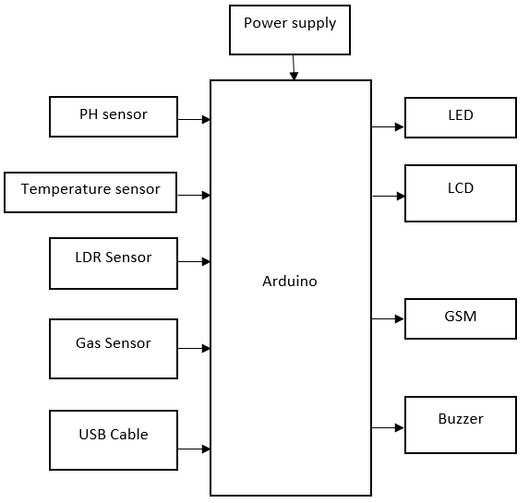
BLOCK DIAGRAM
Dallas Temperature Sensor(35-40)
Analog pH Sensor(6.7-6.9)
LDR Sensor (2.3-2.5 NTU)
MQ2 Gas Sensor(0-100 ppm)
Liquid Crystal Display(LCD)
Global System for Mobile Communications(GSM)
SV COLLEGE OF ENGINEERING, TIRUPATI
Dept. of ECE

Slide 12
METHODOLOGY
It involves designing a system that integrates hardware components and sensors for accurate real-time milk quality monitoring. It collects continuous data from sensors, such as temperature, pH, LDR value and gas levels, which are used to access milk quality. A machine learning model is developed and trained to predict milk quality based on the collected data. The system is extensively tested to validate its performance and accuracy. After successful testing, the fully integrated system is deployed for real-world use. Periodic maintenance and calibration ensure its long-term reliability and precision. By combining hardware with machine learning, this project offers an automated solution to ensure milk safety. Accurate predictions and timely alerts reduce risks associated with contaminated milk consumption.
SV COLLEGE OF ENGINEERING, TIRUPATI
Dept. of ECE

Slide 13
TOOLS REQUIRED
1.pH Sensor
2.Temperature Sensor
3.Gas Sensor
4.LDR Sensor
5.Aurdino Mega 2560
6.Aurdino IDE
7.GSM
8.LCD
9.Python Compiler IDLE 3.12
SV COLLEGE OF ENGINEERING, TIRUPATI
Dept. of ECE

Slide 14
HARDWARE AND SOFTWARE DESCRIPTION
Temperature Sensor :Measures ambient temperature, commonly used in weather monitoring and industrial applications.
Gas Sensor : Detects specific gases like CO, CO₂, or LPG by measuring changes in electrical conductivity when exposed to gas molecules.
pH Sensor : Measures the acidity or alkalinity of a solution by detecting the hydrogen ion concentration, widely used in agriculture and water quality monitoring.
Buzzer : An electronic device that produces sound or alarm signals when activated, commonly used for alerts and notifications.
GSM Module : Enables communication over mobile networks, allowing devices to send SMS, make calls, or access the internet.
LDR Sensor : Detects light intensity by changing resistance based on light exposure, commonly used in automatic lighting systems.
LCD : A display module that uses liquid crystals to show alphanumeric characters, commonly used in embedded systems for real-time data visualization.
Arduino Mega 2560: Arduino boards are physical microcontrollers that can be used to control sensors, motors, LEDs, and other electronic components.
Arduino IDE: The Arduino IDE is used to write and upload code to the microcontroller.
Languages used: Python 3.12,Embedded C
SV COLLEGE OF ENGINEERING, TIRUPATI
Dept. of ECE

Slide 15
ADVANTAGES
1.Automation
2.Efficiency
3.Alerts
SV COLLEGE OF ENGINEERING, TIRUPATI
Dept. of ECE

Slide 16
APPLICATIONS
1.Milk Quality
2.Food Safety
3.Quality Control
4.Dairy Farming
5.Contamination Detection
SV COLLEGE OF ENGINEERING, TIRUPATI
Dept. of ECE

Slide 17
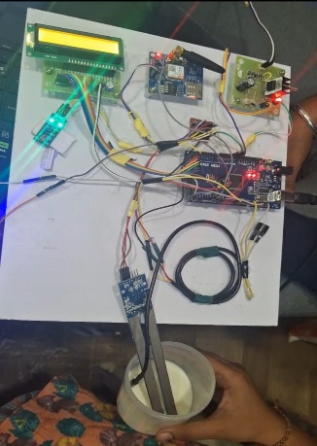
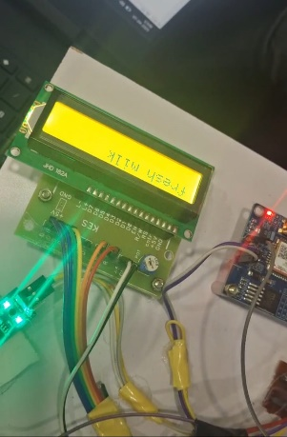
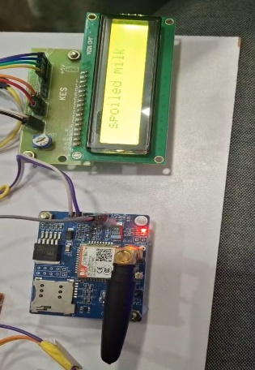
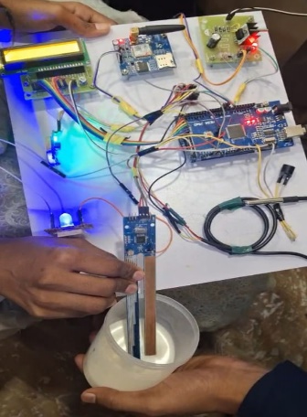
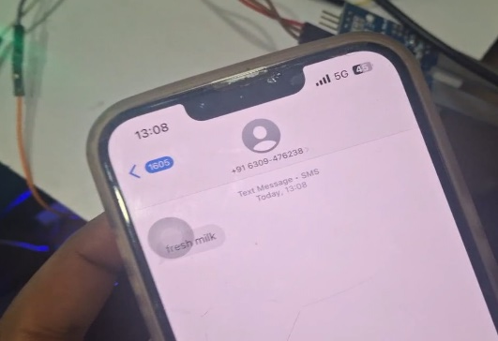
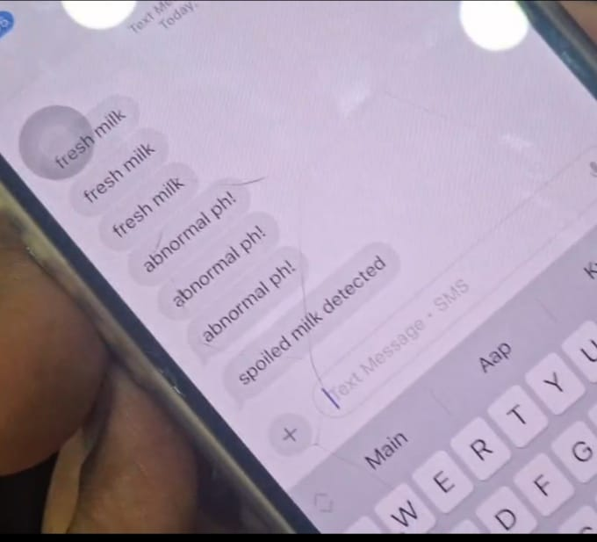
RESULTS AND DISCUSSIONS
Spoiled Milk
Fresh Milk
SV COLLEGE OF ENGINEERING, TIRUPATI
Dept. of ECE

Slide 18
CONCLUSION
The "MilkSafe" project integrates sensors with an Arduino Mega 2560 and machine learning to monitor milk quality in real time. It captures parameters like pH, temperature, light exposure, and gas contamination, using machine learning algorithms to predict quality and detect anomalies. Immediate feedback is provided via an LCD, GSM alerts, and visual/auditory cues. This innovative system enhances food safety and demonstrates the potential of combining IoT and machine learning for intelligent and reliable quality monitoring.
SV COLLEGE OF ENGINEERING, TIRUPATI
Dept. of ECE

Slide 19
FUTURE SCOPE
1.Improved accuracy and speed through machine learning models
2.Integration with IOT and smart sensors
3.Automated dairy management systems
4.Blockchain for milk traceability
5.Government and regulatory adoption
6.Cost effective and scalable solutions[low cost and portable devices] etc
SV COLLEGE OF ENGINEERING, TIRUPATI
Dept. of ECE

Slide 20
REFERENCESS
1. S. Goswami and A. Dangi, “Arduino-Based Milk Quality Monitoring System,” 2019 International Conference on Intelligent Computing and Control Systems (ICICCS), Madurai, India, 2019
2. Subhash Bhatnagar,Empowering Dairy Farmers: A Portal and Dairy Information and Services Kiosk.
3. A. Singh and S. Saini(2023). Real-time Monitoring of Milk Quality: Integrating IOT and Machine Learning. Journal of dairy Science
4. R. P. Gangodagamaarachchi, H. Pasqual, and S. Jayathilake, “Portable Electronic Curd Quality Tester,” in 2021 11th International Conference on Information and Automation for Sustainability (ICIAFS), Colombo, Sri Lanka,2021,pp. 1-6
SV COLLEGE OF ENGINEERING, TIRUPATI
Dept. of ECE

Slide 21
PUBLICATION DETAILS
Conference Name: ICITSM
Paper ID: ICITSM – 131
Paper Title: Real Time Milk Quality Detection System using Machine Learning
SV COLLEGE OF ENGINEERING, TIRUPATI
Dept. of ECE

