Slide 1
CLIENT SERVER MODEL OF COMMUNICATION
A client and server networking model is a model in which computers such as servers provide the network services to the other computers such as clients to perform a user based tasks. This model is known as client-server networking model.
The client-server model describes the communication between two computing entities over a network. Clients are the ones requesting a resource or service and Servers are the ones providing that resource or service

Slide 2
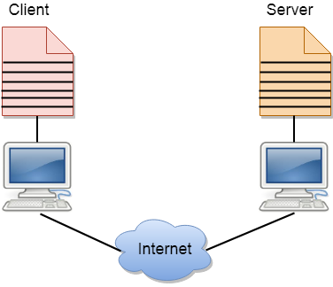
Architecture Of Client Server Communication

Slide 3
Open Source Software (OSS)
OSS is computer software that is released under a license in which the copyright holder grants users the rights to use, study, change, and distribute the software.
Its source code to anyone and for any purpose. Open-source software may be developed in a collaborative, public manner.

Slide 4
Freeware Software
Freeware s/w is released without charge to public.
freeware is software under copyright but available at no cost.
Freeware is cost-free software and free software is copyright-free software.
Ex: Adobe Reader, Free Studio and Skype.

Slide 5
Terminologies
Source code:
It’s a programming statements that are created by a programmer with a text editor or a visual programming tool and then saved in a file.
Object code generally refers to the output, a compiled file, which is produced when the Source Code is compiled with a C compiler.
Fork:
fork happens when developers take a copy of source code from one software package and start independent development on it, creating a distinct and separate piece of software.

Slide 6
Branch:
it means an instruction that tells a computer to begin executing a different part of a program rather than executing statements one-by-one.
Branching is implemented as a series of control flow statements in high-level programming languages.
Patch:
A patch is a set of changes to a computer program or its supporting data designed to update, fix, or improve it.
Upstreaming:
when software has been forked or uses a chain of libraries/dependencies, upstream refers to an issue that occurs in software related to the chain. It is the direction that is toward the original authors or maintainers of software.

Slide 7
Dynamic Website
Dynamic websites are those websites that changes the content or layout with every request to the webserver.
These type of websites have the capability of producing different content for different visitors from the same source code file.
A dynamic website contains information and content that changes, depending on factors such as the viewer of the site, the time of the day, the time zone, or the native language of the country the viewer).

Slide 8
Web Server
A web server is a dedicated computer responsible for running websites sitting out on those computers somewhere on the Internet.
They are specialized programs that circulate web pages as summoned by the user. The primary objective of any web server is to collect, process and provide web pages to the users.
Web server accept the client request and send response to client.

