Slide 1
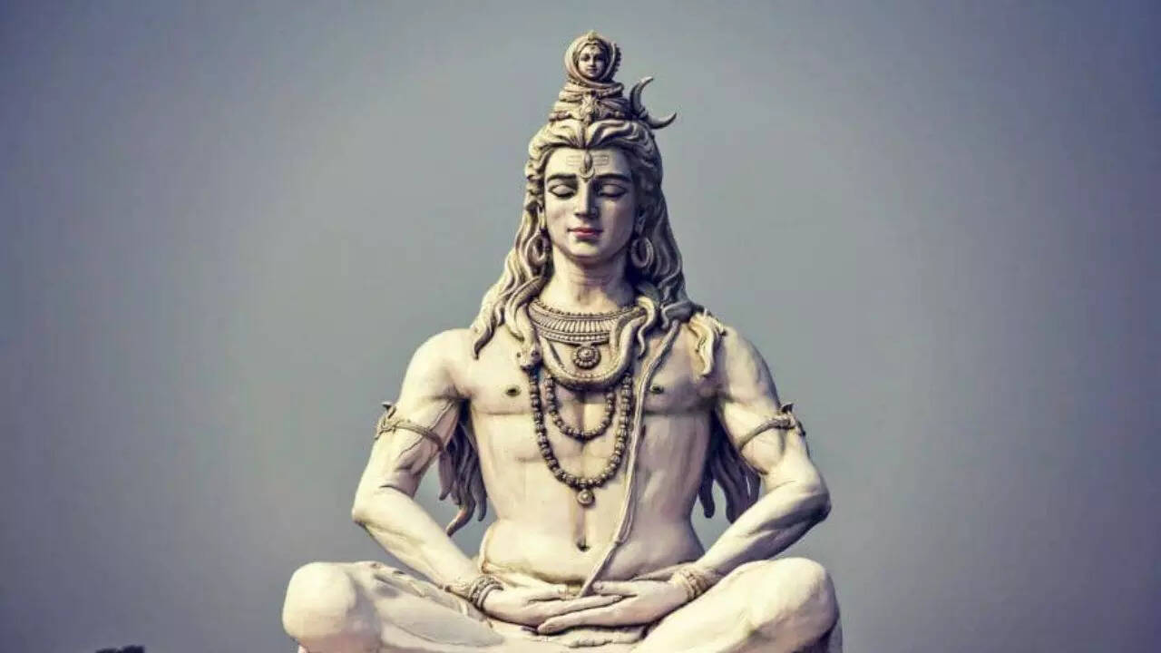
MAHA SHIVRATRI-The Geat night of Lord Shiva
It is celebrated on 14th night of the dark fortnight in the Hindu month of Phalguna
Devotees observe fasting and offers prayers to honor Lord Shiva

Slide 2
Legends Behind Shivratri
Maha shivratri marks the divine marriage of lord shiva and goddess parvati.

Slide 3
Spiritual Significance
The night of MahaShivratri is meant for self reflection and meditation .
It reminds us to destroy negativity and embrace peace and truth

Slide 4
Thank you!

