Slide 1

H E A D Q U A R T E R S 1301ST (CAMANAVA) COMMUNITY DEFENSE CENTER NCR RCDG, ARESCOM T. Bugallon Street, Brgy 09, Caloocan (South) City MILITARY PERSONAL FILE
RAMMUEL T DAGUIL
Cpl (RES) PA ML-R20-001065

Slide 2
TABLE OF CONTENTS
RESERVIST INFORMAMATION DATA SHEET A
ENLISTMENT/ COMMISION/ INCORPORATION OR ORDER B
LATEST PROMOTIONAL ORDER C
UNIT ASSIGNMENT ORDER E
PRE-ENTRY TRAINING CERTIFICATE & DECLARATION OF GRADUATE F
CERTIFICATE OF EMPLOYMENT/ BUSINESS CERTIFICATE OF REGISTRY G
EDUCATIONAL ATTAINMENT RECORD (DIPLOMA & TOR OR CERTIFCATION OF GRADES) H
TRAINING & SEMINARS ( CERTIFICATE OR DECLARATION OF GRADUATES) I
AWARDS & RECOGNITION (ORDERS/ CERTIFICATE/ OR PICTURE OF PLAQUE) J
CADTT/ OJT OR AADT CALLING ORDERS K
DEPENDENTS OR BENIFICIARIES (MARRIAGE OR BIRTH CERTIFICATE) L
WHOLE BODY POST CARD SIZE PICTURE (IN PHILARPHAT UNIFORM) M

Slide 3
- A -
RESERVIST INFORMATION DATA SHEET

Slide 4
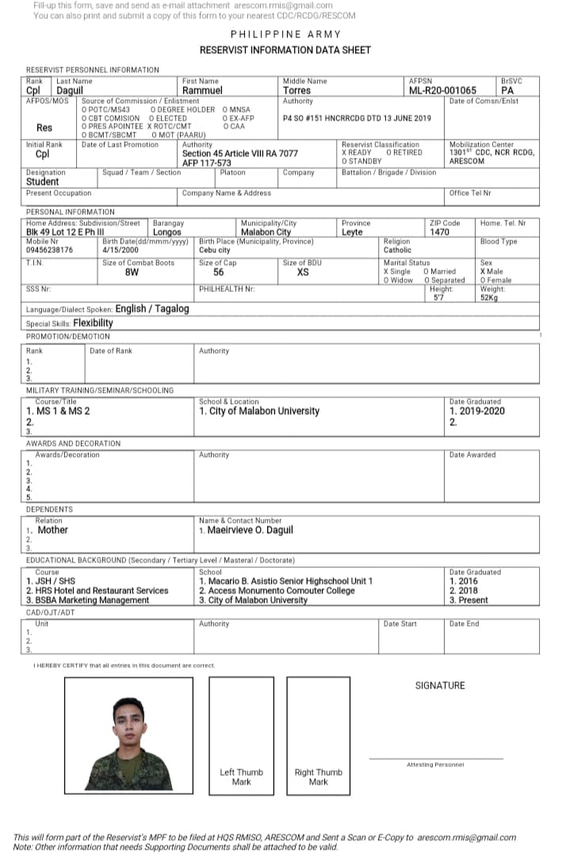
( INSERT RIDS HERE. IMAGE FORMAT )

Slide 5
- B -
ENLISTMENT/ COMMISION/ INCORPORATION OR
ORDER

Slide 6
( INSERT HERE )

Slide 7
- C -
LATEST
PROMOTIONAL ORDER

Slide 8
( INSERT HERE )

Slide 9
- E -
UNIT ASSIGNMENT
ORDER

Slide 10
( INSERT HERE )

Slide 11
- F -
PRE-ENTRY TRAINING CERTIFICATE & DECLARATION OF GRADUATE

Slide 12
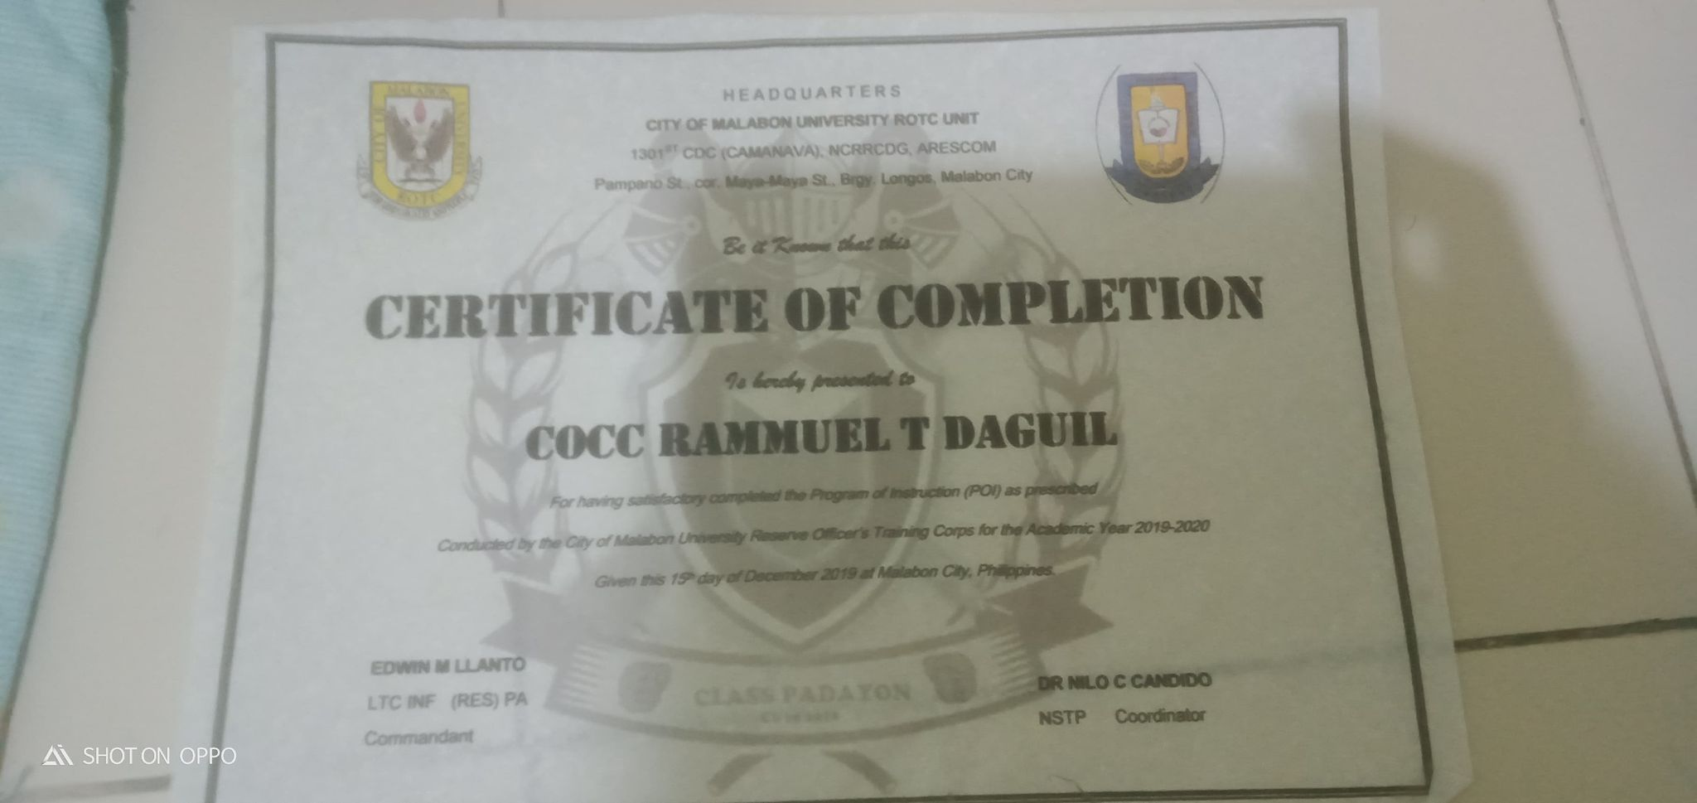
( INSERT HERE)

Slide 13
- G -
CERTIFICATE OF EMPLOYMENT/ BUSINESS CERTIFICATE OF REGISTRY

Slide 14
( INSERT HERE )

Slide 15
- H -
EDUCATIONAL ATTAINMENT RECORD (DIPLOMA & TOR OR CERTIFCATION OF GRADES)

Slide 16
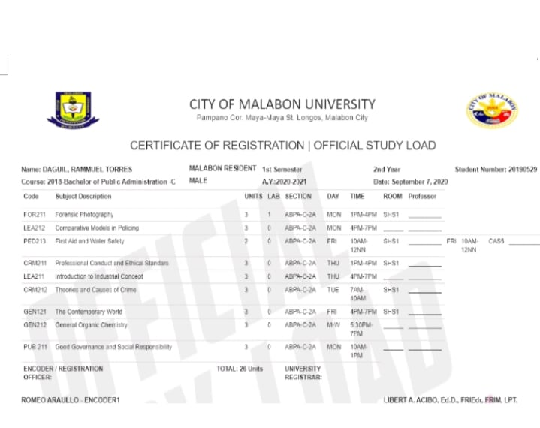
( INSERT HERE )

Slide 17
- I -
TRAINING & SEMINARS
( CERTIFICATE OR DECLARATION OF GRADUATES)

Slide 18
- J -
AWARDS & RECOGNITION (ORDERS/ CERTIFICATE/ OR PICTURE OF PLAQUE)

Slide 19
(INSERT HERE )

Slide 20
( INSERT HERE )

Slide 21
- K -
CADTT/ OJT OR AADT
CALLING ORDERS

Slide 22
( INSERT HERE )

Slide 23
- L -
DEPENDENTS OR BENIFICIARIES (MARRIAGE OR BIRTH CERTIFICATE)

Slide 24
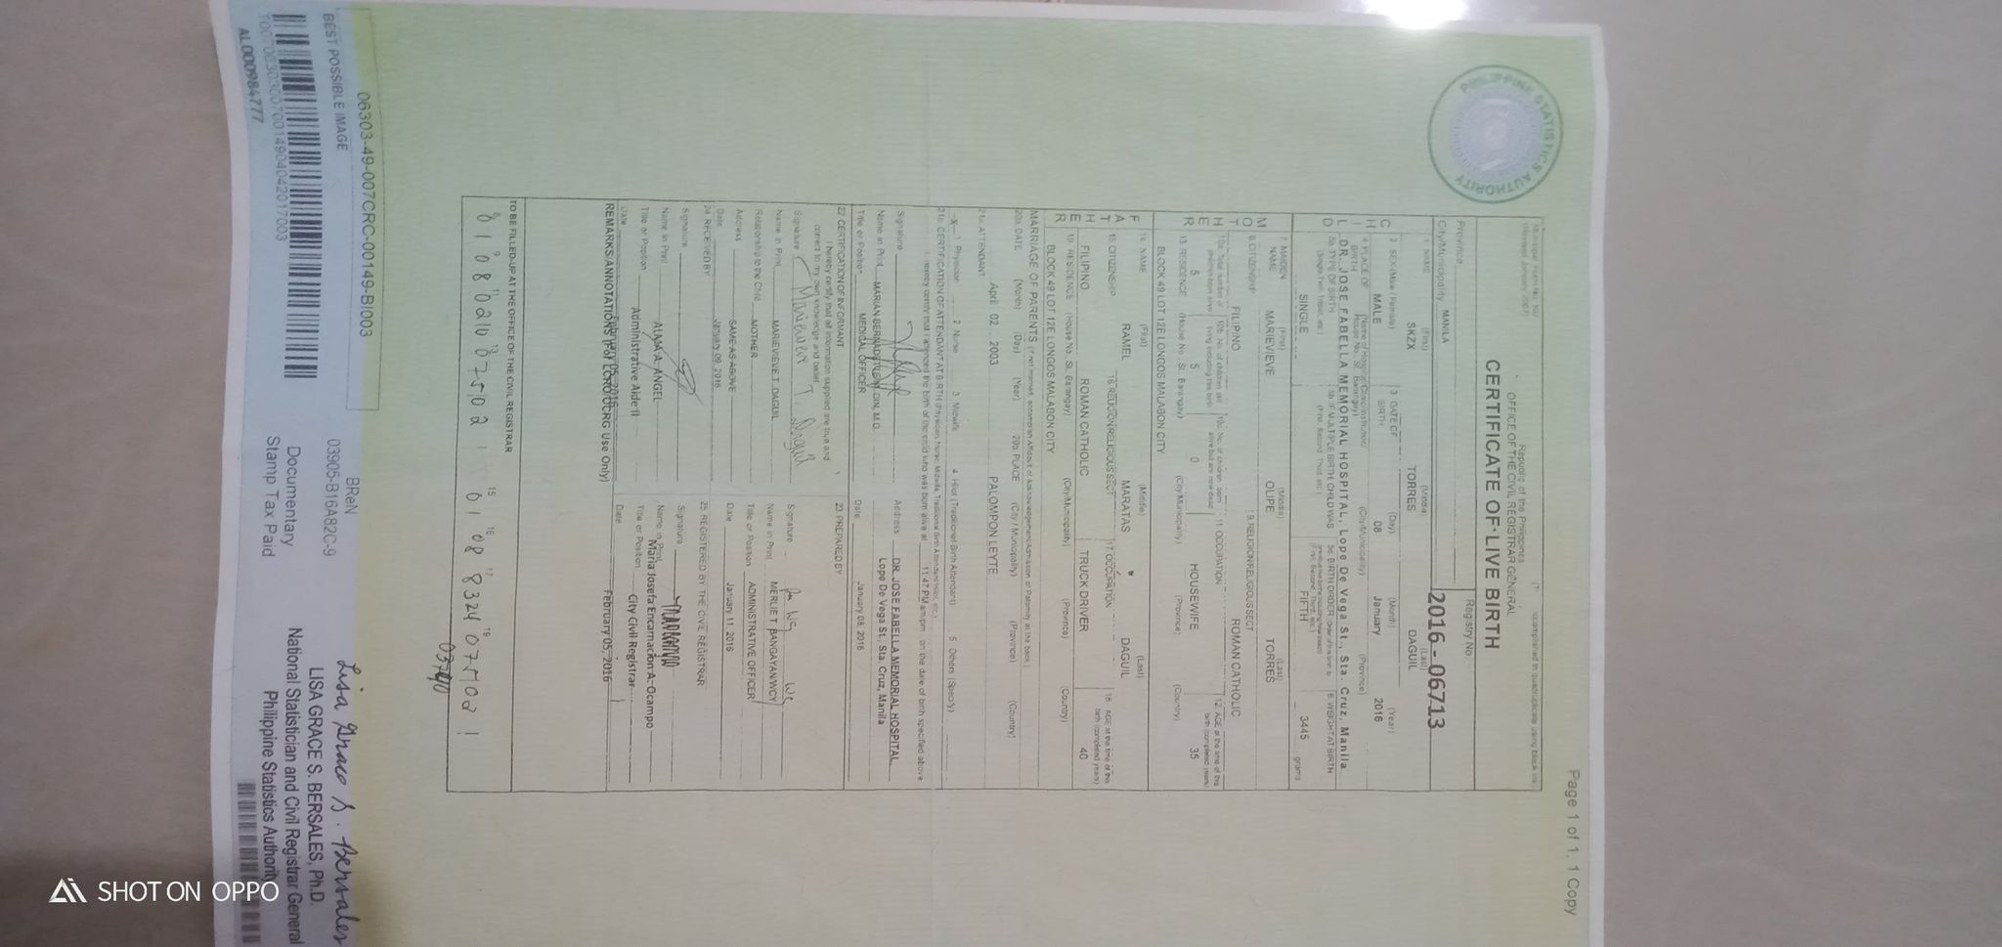
( INSERT HERE )

Slide 25
- M -
WHOLE BODY POST CARD SIZE PICTURE
(IN PHILARPHAT UNIFORM)

Slide 26
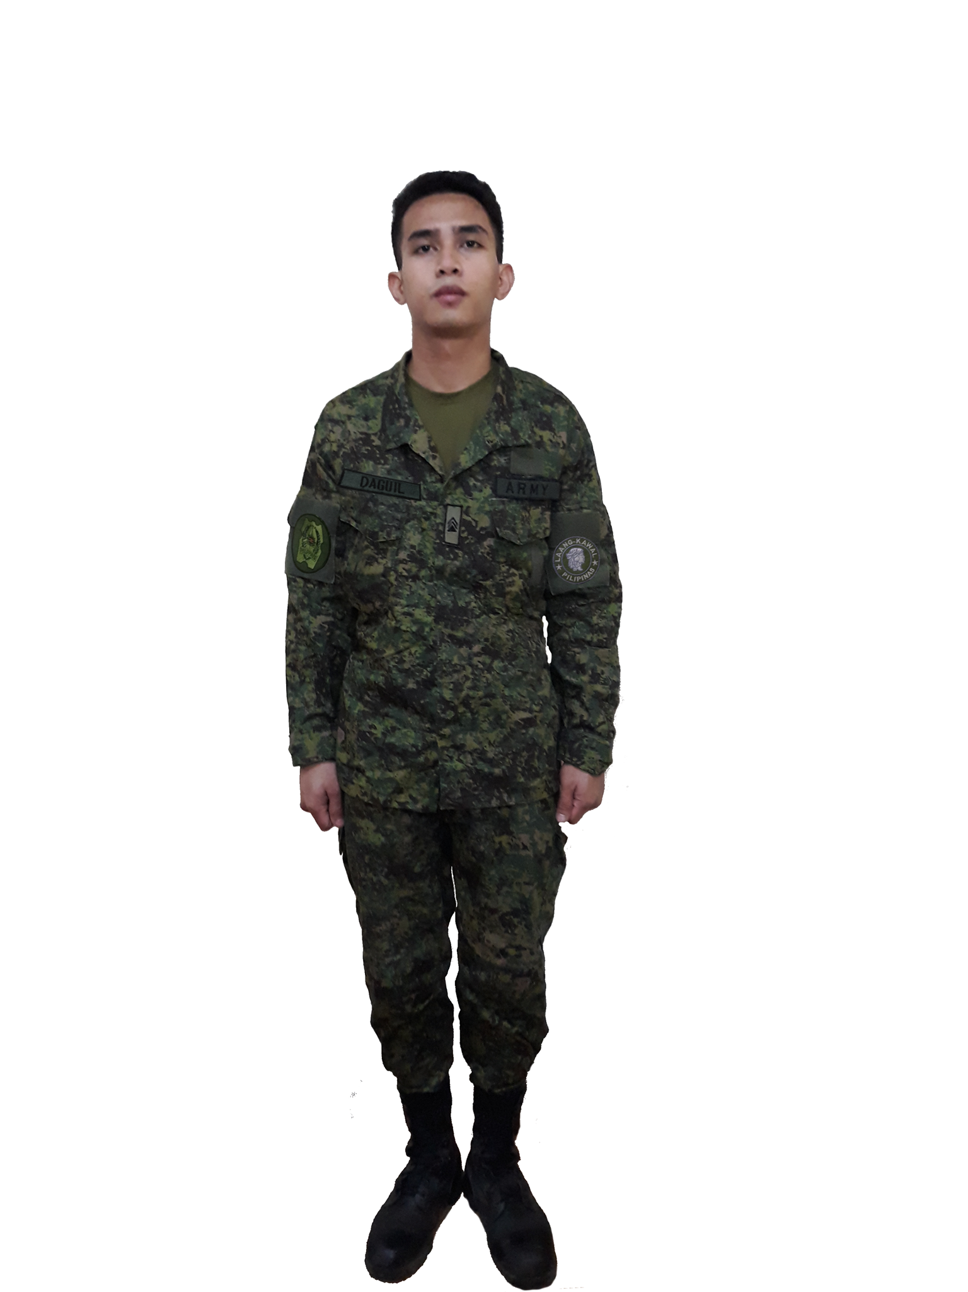
( INSERT HERE )

