Slide 1





Automate Mailbox Responses Workflow
Scans Mailbox
Scans Mailbox
Filter emails
Message is sent to Azure OpenAI
No
Was this useful?
Response is sent back with feedback request
Create a support ticket
Send ticket information
Yes
End

Slide 2


Scans mailbox
Answers question

Slide 3
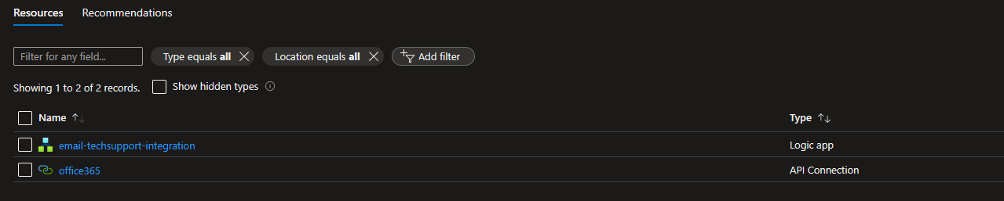
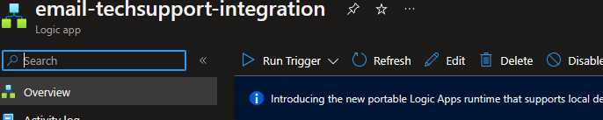
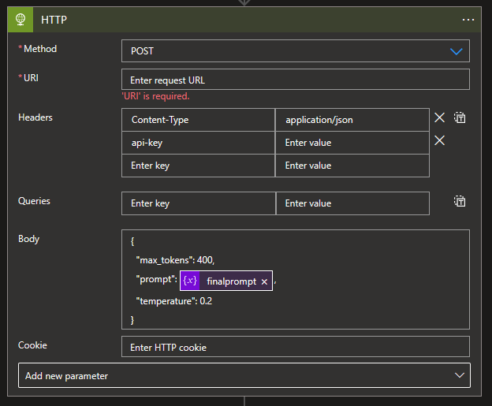
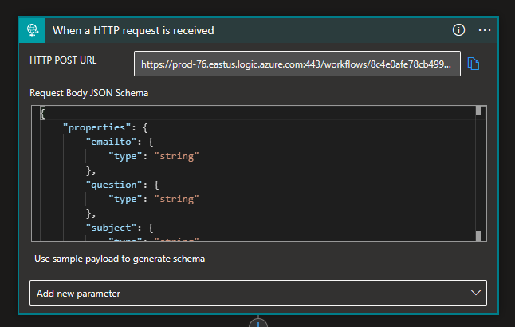
OpenAI End Point
OpenAI Key

Slide 4
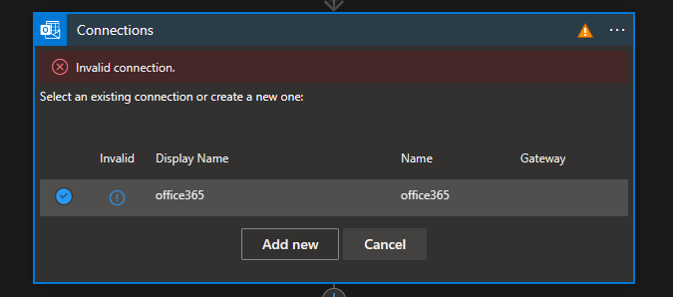
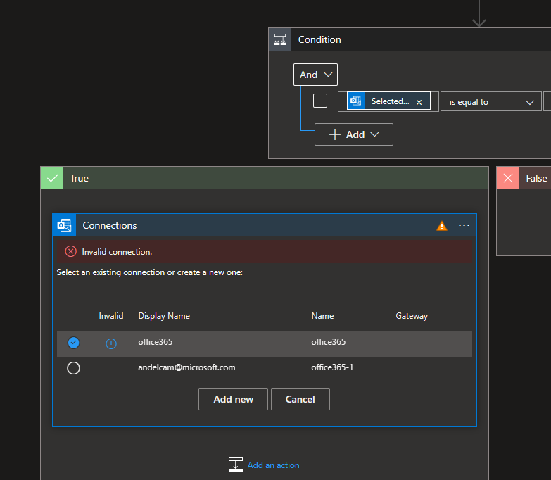

Slide 5
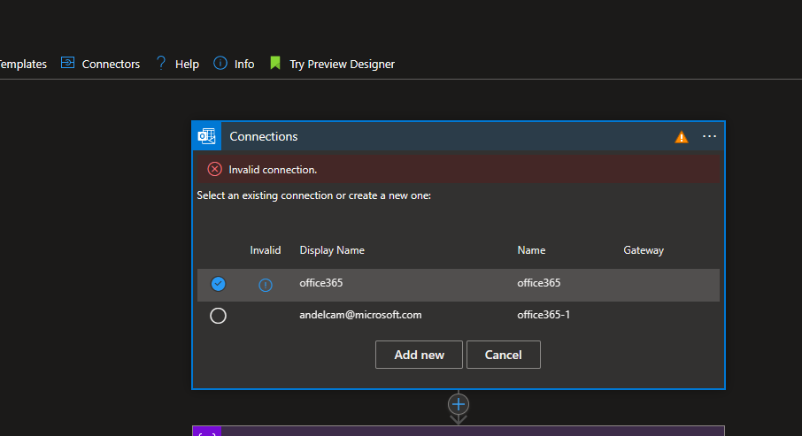

Slide 6




Top performing students by grade

Slide 7
