Slide 1
Module 1

Slide 2
About Apache Spark Spark execution modes Basic Spark data structures (RDDs) Hands-on tutorial
▶ RDDs and operations
▶ DataFrames, User defined functions and SparkSQL
Hands-on lab exercises – Jupyter notebooks Hands-on lab exercise – Spark on an HPC
▶ Apache Spark deployment using Slurm
Independent work & debug session

Slide 3
On Apache Spark
Fast, expressive, general-purpose in-memory cluster computing framework compatible with Apache Hadoop and built around speed, ease of use and streaming analytics Faster and easier than Hadoop MapReduce* Large community and 3rd party libraries
Provides high-level APIs (Java, Scala, Python, R) Supports variety of workloads
▶ interactive queries, streaming, machine learning and graph processing

Slide 4
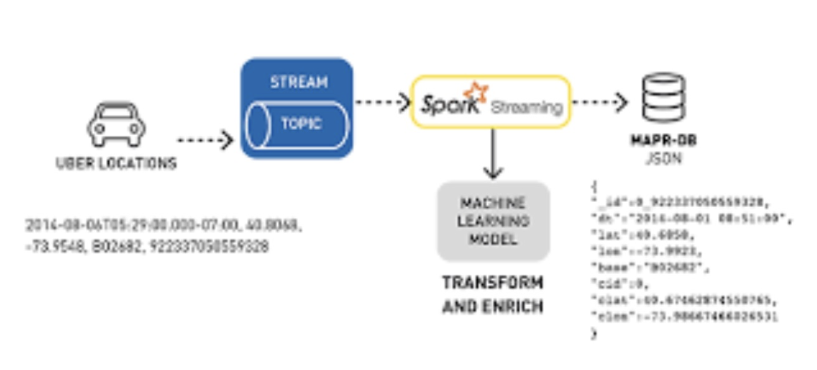
Spark Use-Cases
Logs processing (Uber)
Event detection and real-time analysis
Interactive analysis
Latency reduction
Advanced ad-targeting (Yahoo!)
Recommendation systems (Netflix, Pinterest)
Fraud detection
Sentiment analysis (Twitter)

Slide 5
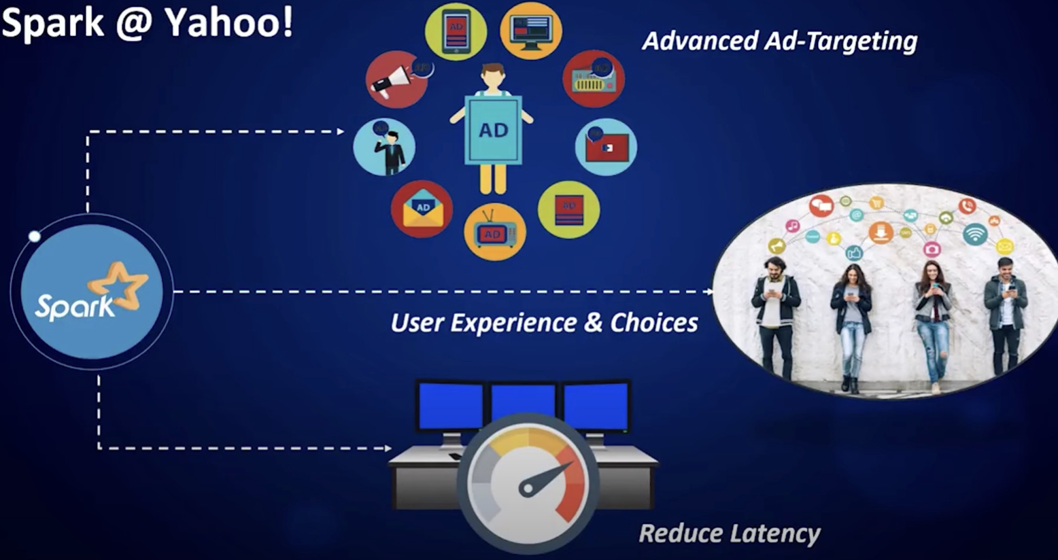
Spark Use-Cases
Logs processing (Uber)
Event detection and real-time analysis
Advanced ad-targeting (Yahoo!)

Slide 6
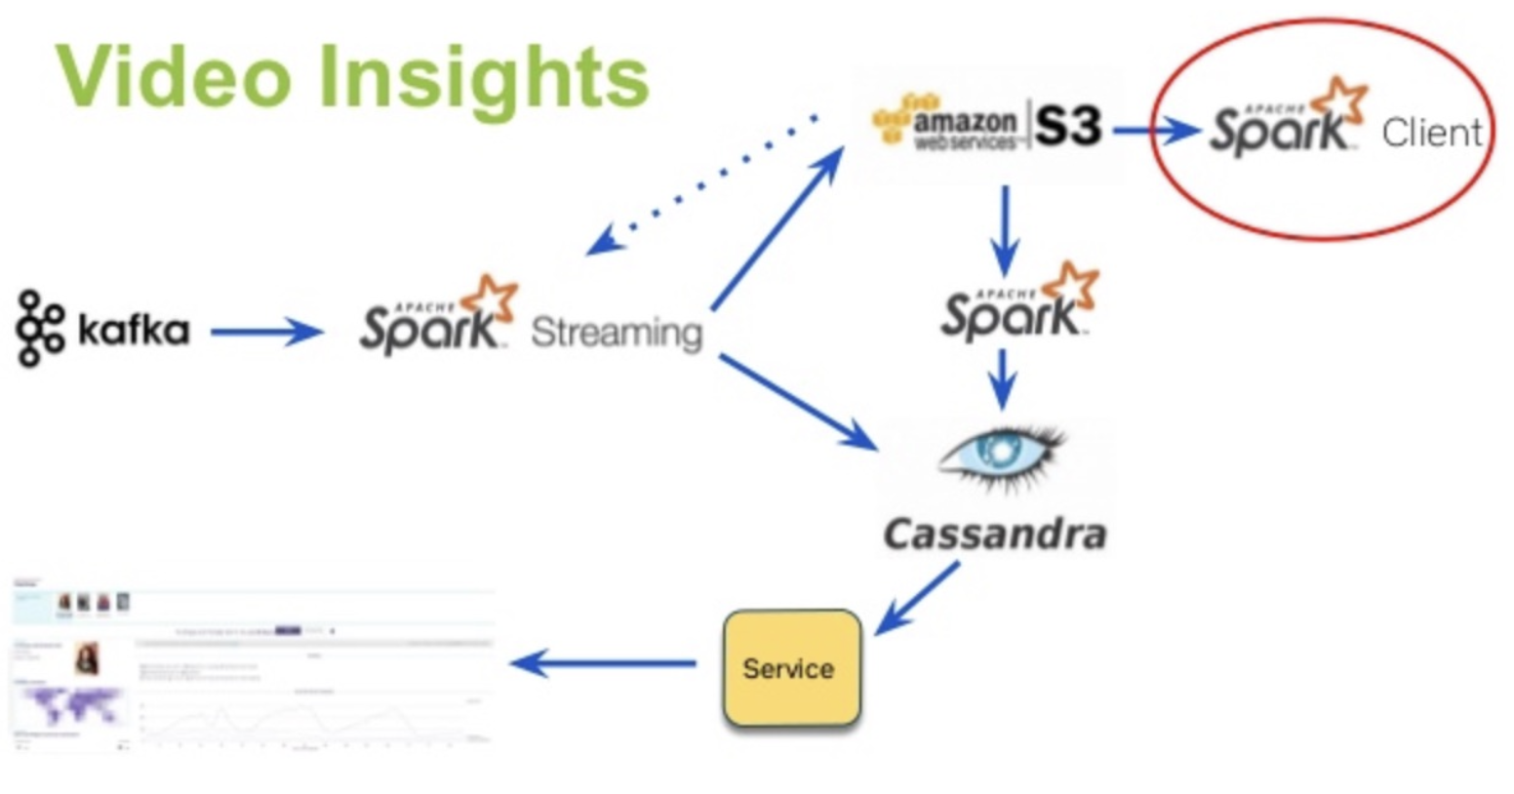
Spark Use-Cases
Logs processing (Uber)
Event detection and real-time analysis
Interactive analysis
Latency reduction
Advanced ad-targeting (Yahoo!)
Recommendation systems (Netflix, Pinterest)
Fraud detection
Sentiment analysis (Twitter)

Slide 7
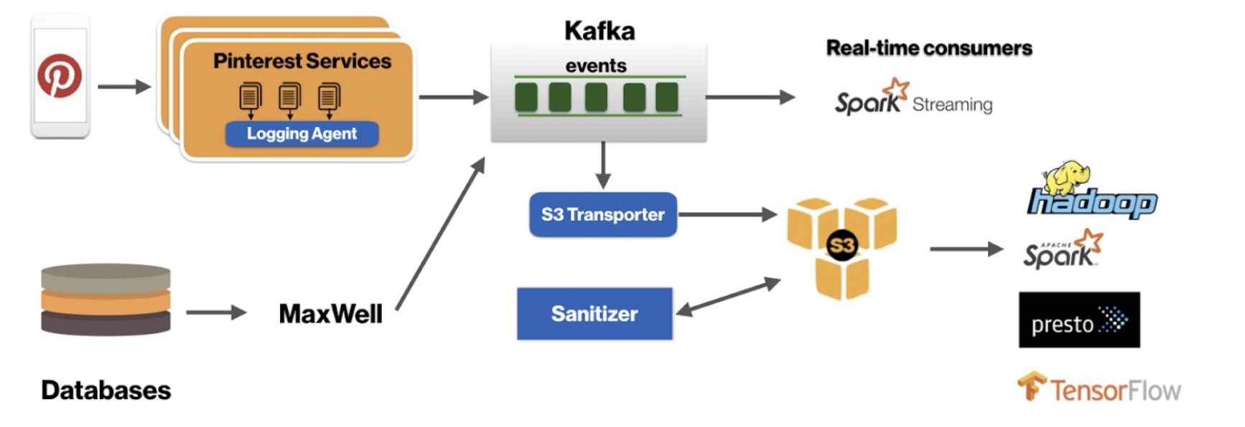
Spark Use-Cases
Recommendation systems (Netflix, Pinterest)
Fraud detection
Sentiment analysis (Twitter)

Slide 8
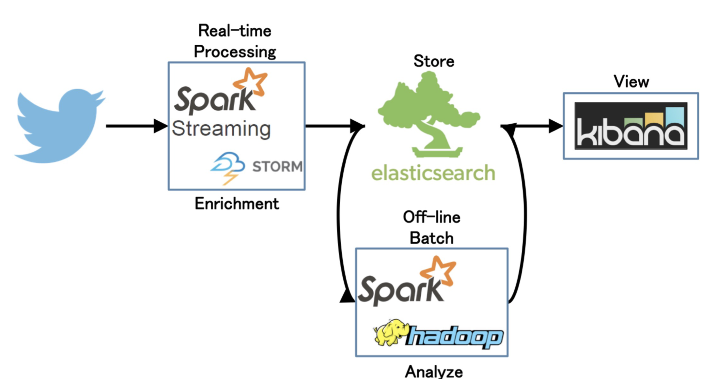
Spark Use-Cases
Sentiment analysis (Twitter)

Slide 9
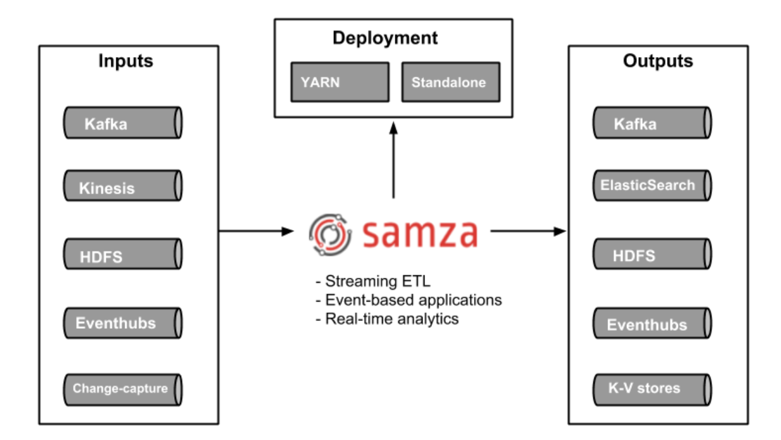
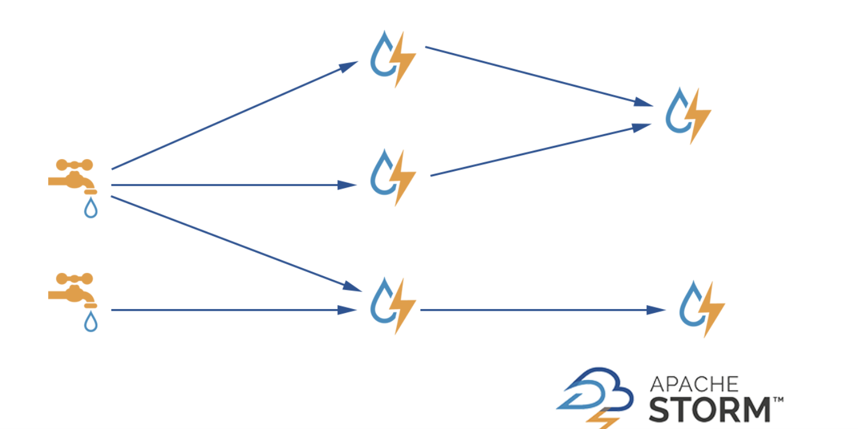
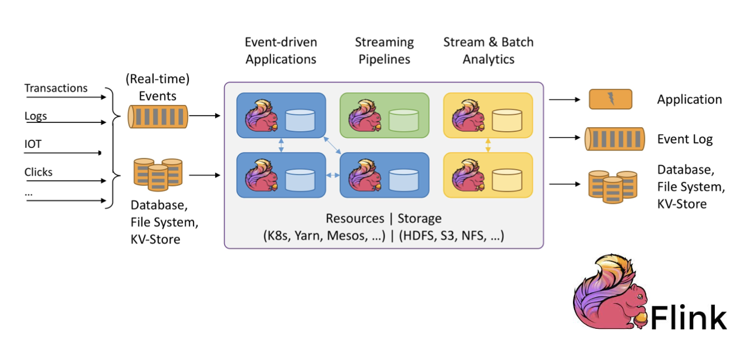
Apache Spark “real-time”
Apache Samza (library/framework)
Apache Storm (real-time stream processing)
Apache Flink (native streaming support for all workloads)

Slide 10
Apache Spark 3.x
Latest release – v3.1.1. (March 2, 2021)
Improvements over Spark 2 (v2.4.1)
▶ Python 2 deprecated
▶ Adaptive execution of Spark SQL (merging intermediate results among workers)
▶ Dynamic partition pruning
▶ Support for deep learning (GPU support for Nvidia, AMD, Intel)
▶ Better Kubernetes integration
▶ Graph features (Morpheus as extension of Cypher, neo4j support)
▶ ACID transactions (for Delta Lake storage)
▶ Apache Arrow data format integration (columnar format for analytics)

