Slide 1
Module 1

Slide 2
About Apache Spark Spark execution modes Basic Spark data structures (RDDs) Hands-on tutorial
▶ RDDs and operations
▶ DataFrames, User defined functions and SparkSQL
Hands-on lab exercises – Jupyter notebooks Hands-on lab exercise – Spark on an HPC
▶ Apache Spark deployment using Slurm
Independent work & debug session

Slide 3
On Apache Spark
Fast, expressive, general-purpose in-memory cluster computing framework compatible with Apache Hadoop and built around speed, ease of use and streaming analytics Faster and easier than Hadoop MapReduce* Large community and 3rd party libraries
Provides high-level APIs (Java, Scala, Python, R) Supports variety of workloads
▶ interactive queries, streaming, machine learning and graph processing

Slide 4
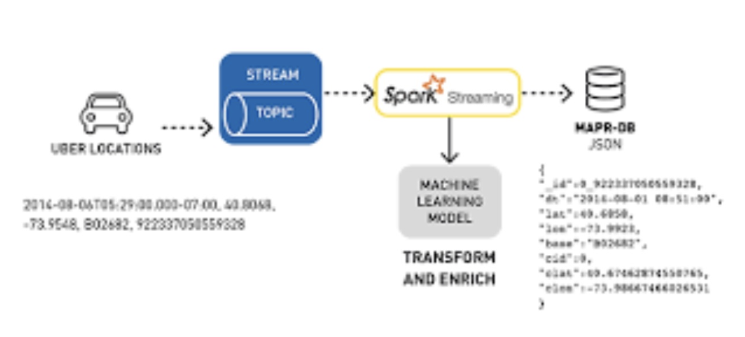
Spark Use-Cases
Logs processing (Uber)
Event detection and real-time analysis
Interactive analysis
Latency reduction
Advanced ad-targeting (Yahoo!)
Recommendation systems (Netflix, Pinterest)
Fraud detection
Sentiment analysis (Twitter)

