Slide 1

GeoME Bot: Navigate Your Urban World
Welcome to GeoME Bot - your intelligent urban companion. Discover how our location-aware assistant transforms city exploration through personalized recommendations and intuitive navigation.
By Team4

Slide 2




Location-Based City Information
Real-time Context Awareness
Comprehensive Urban Data
Location-Tailored Results
Receive information that's relevant to exactly where you stand.
Access immediate information about your surroundings as you move through the city.
Find details on amenities, public services, and city infrastructure in seconds.

Slide 3
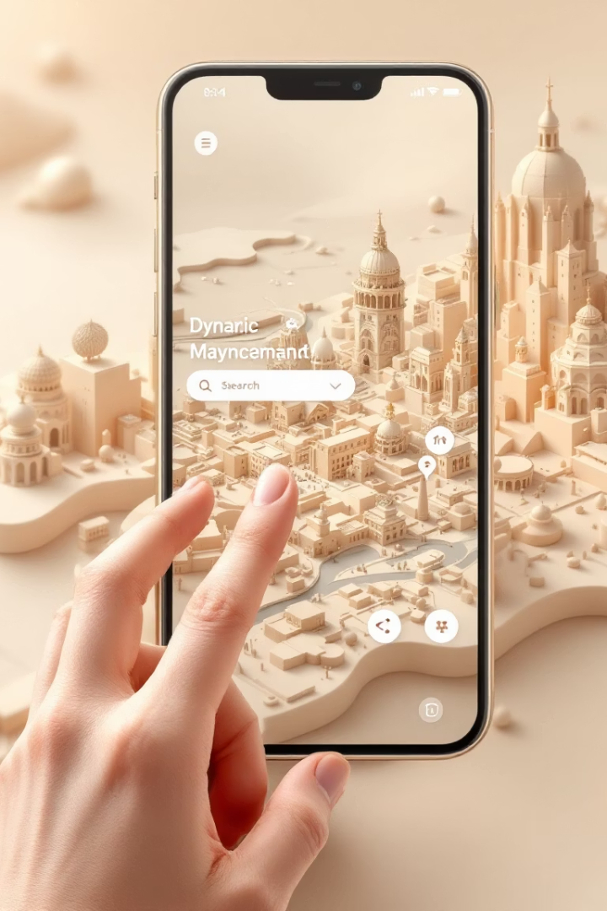




Interactive Map Exploration
Search for Destinations
Find specific locations with intelligent search capabilities.
Visualize Your Environment
See your surroundings from different perspectives with interactive maps.
Navigate with Ease
Move through the urban landscape with confidence and clarity.
Toggle Information Layers
Customize your map view to show only what matters to you.

Slide 4
Conversational Navigation
Natural Language
Step-by-Step Guidance
Transit Information
Ask questions just like you would to a local guide. The bot understands conversational queries.
Receive clear directions that adapt as you move through the city.
Get comprehensive public transportation details integrated with your journey.
Turn-by-turn instructions
Schedule updates
"How do I get to the museum?"
Real-time route adjustments
Platform numbers
"Where's the nearest coffee shop?"

Slide 5








Discover Points of Interest
Food & Drink
Attractions
Discover cafes, restaurants, and bars that match your tastes.
Uncover cultural sites, monuments, and local landmarks.
Shopping
Green Spaces
Locate markets, boutiques, and shopping districts in your vicinity.
Find parks, gardens, and outdoor recreation areas nearby.

Slide 6








Personalized Recommendations
Your Perfect Match
Suggestions that align perfectly with your unique preferences.
Learning from History
Recommendations based on your past interactions and favorites.
Preference Filtering
Results tailored to your specified interests and needs.
Comprehensive Data
Drawing from vast datasets to find ideal matches.

