Slide 1
World City Explorer
Your smart AI companion for City Exploration – Hackathon Project 14th May

Slide 2
Problem Statement
Travelers – Student often struggle to get instant, reliable, and localized info about cities around the world.

Slide 3
Solution Overview
An AI-powered bot that offers:
City guides
Near by-visit places
Local food tips
Weather updates
Budget advice
Cultural insights

Slide 4
Key Features
City search & recommendations
Smart Q&A on local info
Real - Time & images –
Travel Quiz –Place of the City( Knowledge base)
Map Glimpse
Food, weather, budget tips - MVP ++
Packing/safety guidance - MVP ++

Slide 5
Tech Stack
Frontend: React / HTML + CSS
Backend: Python , spaCy
APIs: Open Weather, Google Maps, ChatGPT, Wikipedia

Slide 6
How It Works
1. User inputs a city
2. Bot fetches info from APIs
3. AI summarizes & replies
4. Optionally shows map/images
5. User explores, learns, travels

Slide 7
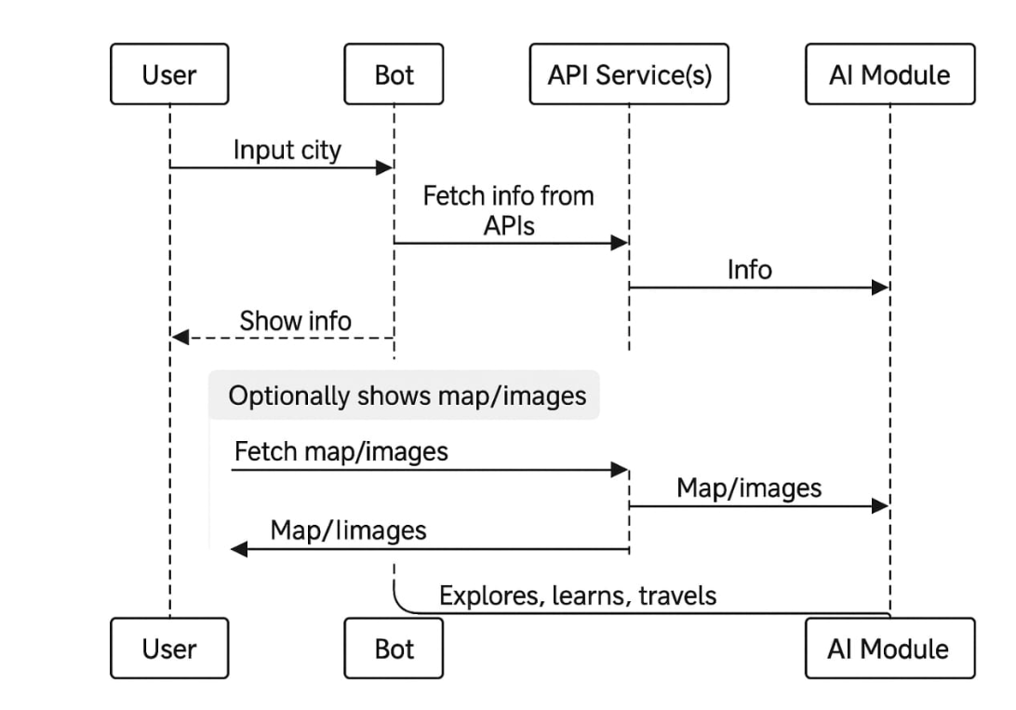
Design

Slide 8
Use Cases
Student travelers
Tourists
Teachers & learners

Slide 9
Future Scope
• Multilingual support
• Voice assistant integration
• Offline mode
• Itinerary planning

Slide 10
Thank You
Explore the world, one city at a time ☺
Akshay Rathore
Prajwal Kuthwal
Priyanka Shinde
Sarala Tambe
Priyanka Patil
Shubhanshi Garg
Nilesh Badani

