Slide 1
Git
Content tracker
How it works
Commits
3 Trees model
Branches
Repos
Examples

Slide 2
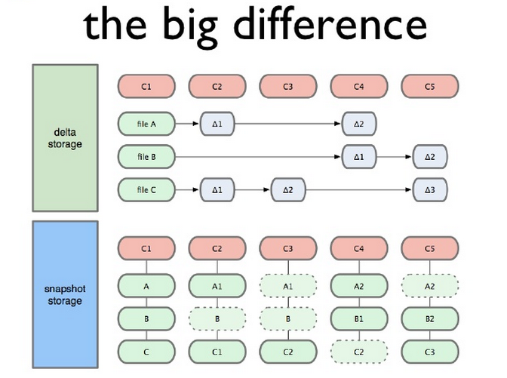
How it works
Snapshot storage

Slide 3
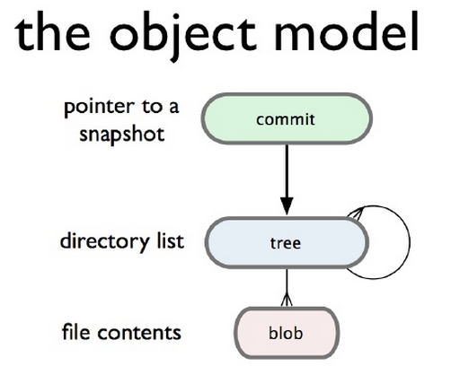
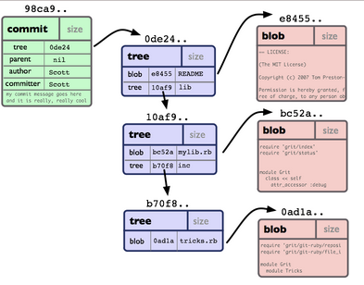
Commits
A snapshot at a given time
Snapshot of a directory tree

Slide 4
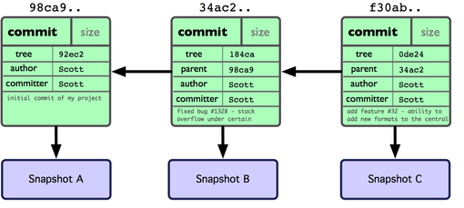
Commits
Every commit, references its complete history
How? References its parent
Has a 40 char hash

Slide 5
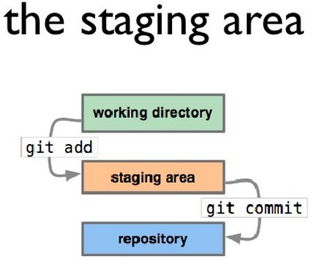
3 Trees model
Working directory
Staging
Repo
(Remote repo)
git push

Slide 6
Branches
Named pointers to a commit
Git default: master
Choose the branch:
git checkout branch_name
Make new branches from it:
git checkout -b new_branch_name
Delete branches
git branch -d branch_name
See all local branches
git branch

Slide 7
Repos
Collection of branches
Operations:
git init
git clone https://a.b/c/d.git

Slide 8
Examples
Workflow 1
create local repo,
make some changes,
commit a few times,
create new branch for an older state
make some changes in it
merge it back
> git init my_repo
> cd my_repo
> echo “asdf” > myfile.txt
> git add .
> git commit -m “first commit yaay”
> echo “zxcv” >> myfile.txt
>git commit -am “second commit. Can use -a switch which auto adds modified files”
>echo “qwer” >>myfile.txt
>git commit -am “third”
>git checkout HEAD^^
> git checkout -b asdf_state_branch
>echo “relevant text” >mysecondfile.txt
>git add .
>git commit -m “first commit on new branch”
>git checkout master
>git merge asdf_state_branch

Slide 9
Examples
Workflow 2
Clone remote repo
Create local branch
Make some changes
Commit
Check if still compatible with master (merge possible?)
Cleanup the merge fake attempt
If yes, push to NEW remote branch
Create pull reques
1.
>git clone https://a.b/c.d.git
2.
>git checkout -b my_branch
>cd d
3.
>echo “asdf” >myfile.txt
>git add .
4.
>git commit -m “my commit”
>git checkout master
>git pull
5.
>git merge –no-commit my_branch
6.
> git reset –hard HEAD
7.
>git push origin my_branch
Use the web interface to create PR

Slide 10
Examples
Workflow 3
Clone repo
Make changes
Pull from remote, conflicts
Solve conflicts
Commit merge
>git clone https://a.b/c/d.git
> #edit file asdf.txt on line 7. The text said: 'asdf asdf' – change that to 'asdf zxcv'
>git commit -am “my commit”
>git pull
># Assuming asdf.txt was also eddited on the remote branch. Someone changed 'asdf asdf' to 'asdf qwer'.
Open asdf.txt:
>>>>>>> HEAD
asdf zxcv
=======
asdf qwer
>>>>>>> master
Change that whole part, starting from >>>>>>> ending with <<<<<<< with the change you want... for instance 'asdf zxcv qwer'
#This will have a default commit message
>git commit

