Slide 1
Physics Informed Neural Networks
Jacob
Joseph
Qasim

Slide 2
What are the Physics Informed Neural Networks?

Slide 3
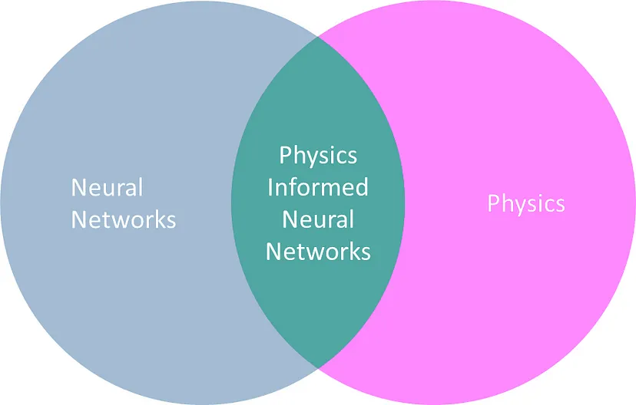
PINNs
Notes:
PINNs are combining the power of Neural Networks with Physics Laws
What are those powers?

Slide 4
PINNs
Time Consuming
Computationally Expensive
Domain Expert Needed
Boundary Conditions
Parameters Accuracy
Extrapolation is hard
No Understanding of Physics
Lack of Interpretability
Can learn from Data without explicitly solving DE Analytically
Efficient for High Dimensional Data
Non-Linear Problems
Solves PDE, ODE and Inverse Problems
Notes:
PINNs are combining the power of Neural Networks with Physics Laws
What are those powers?

Slide 5
Training with Neural Network

Slide 6
Training with PINNs

Slide 7
How do we do it?
In PINNs, the governing equation is added as Regularized term.
Regularized term is added to the loss function of the Neural Network.
A punishment to make sure learning direction by acting as a constraint
Regularized term is controlled by Hyperparameters
Regularized term is calculated through gradient
PINNs are different than traditional Neural Networks making physics consistent while learning the problem.

Slide 8
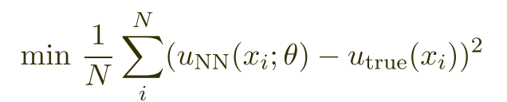
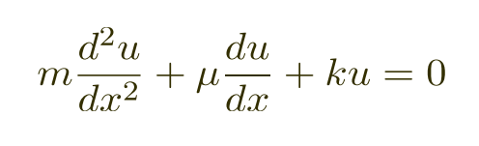
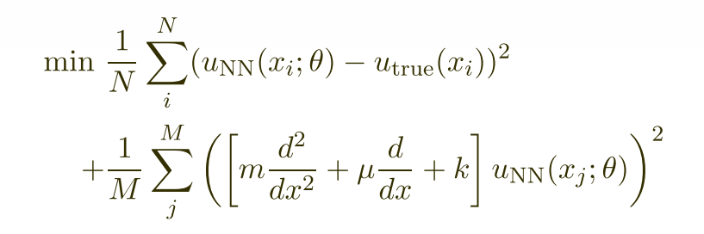
PINNs Loss Function
Neural Network
Physics
Physics Informed Neural Network

Slide 9
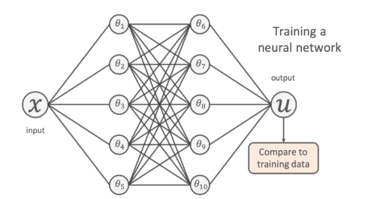
PINNs Loss Function Continued

Slide 10
PINNs Loss Function Continued
Normally, we would tune our NN by minimizing the MSE between the training data and the model’s predictions.

Slide 11
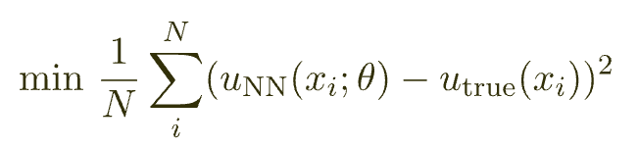
PINNs Loss Function Continued
Normally, we would tune our NN by minimizing the MSE between the training data and the model’s predictions.

Slide 12
PINNs Loss Function Continued
Normally, we would tune our NN by minimizing the MSE between the training data and the model’s predictions.

Slide 13
PINNs Loss Function Continued
Normally, we would tune our NN by minimizing the MSE between the training data and the model’s predictions.

Slide 14
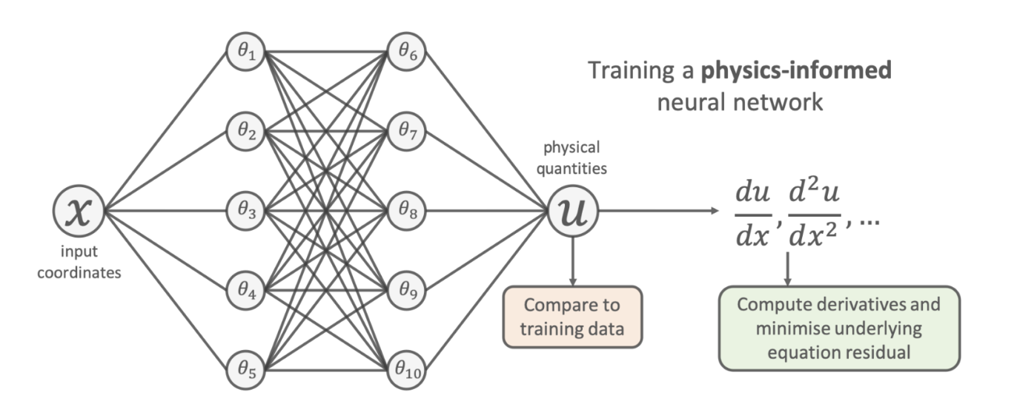
One way we can get our network to extrapolate accurately is to supply the NN with an additional loss term, one guided my well-established and known physical properties.

Slide 15
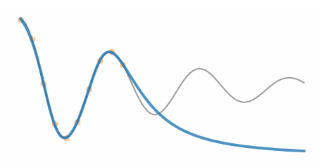

Slide 17
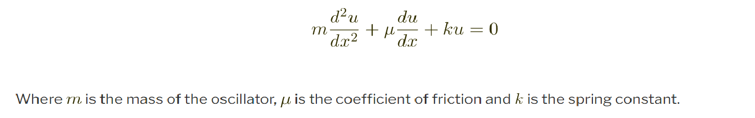

Slide 18
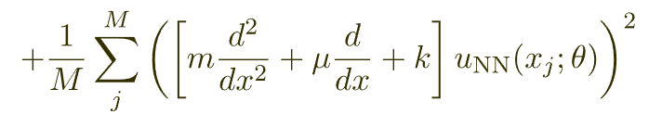
Add known differential equations directly into the loss function, and make sure the solution the PINN learns matches the underlying differential equation.

Slide 19
Add known differential equations directly into the loss function, and make sure the solution the PINN learns matches the underlying differential equation.

Slide 20
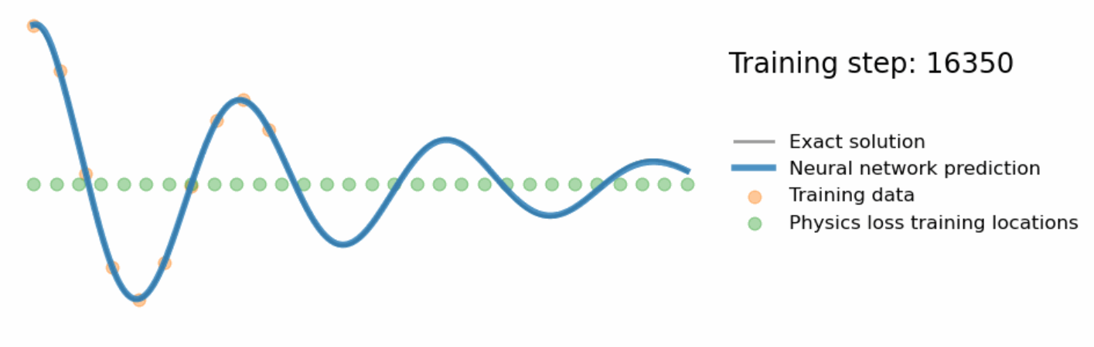

Slide 21
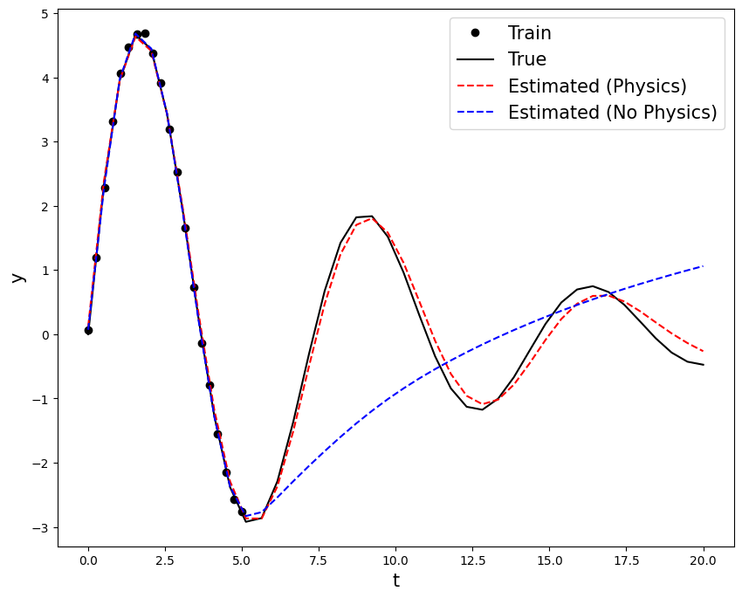
Demo

Slide 22

A much more complex example using the 2D acoustic wave equation

Slide 23
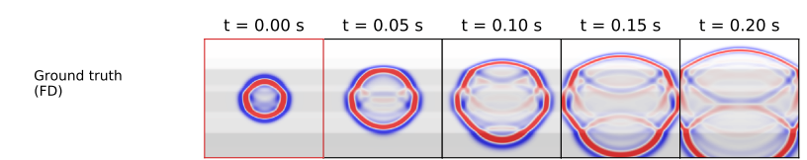

Slide 24


Slide 25
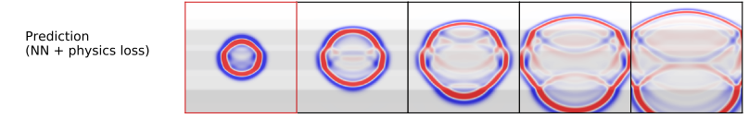

Slide 26
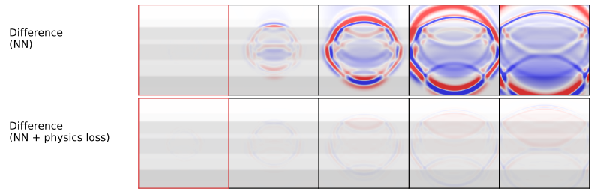
Difference between Ground Truth and Predictions

