Slide 1
ReneWind
Business Presentation
Enoch Adogla
1-21-2022

Slide 2
Contents
Business Problem Overview
Data Overview
Exploratory Data Analysis (EDA)
Model Performance Summary
Business Insights and Recommendation

Slide 3
Business Problem Overview and Solution Approach
Wind energy is one of the most developed renewable energy alternatives world wide
The U.S Department of Energy has put together a guide to achieving operational efficiency using predictive maintenance practices
This requires fitting sensors that gather information about environmental factors(temperature, humidity, wind speed, etc.) and features related to machine components (gearbox, tower, blades, break, etc.) of wind energy generating machines
The information gathered can be analyzed to predict degradation and failure of component of wind energy systems

Slide 4
Business Problem Overview and Solution Approach
The objective of this work is to build various classification models, tune them, and find the best one that will help identify failures so that the generator could be repaired before failing/breaking to reduce the maintenance cost. The different costs associated with maintenance are as follows:
Replacement cost = $40,000
Repair cost = $15,000
Inspection cost = $5,000
“1” in the target variables should be considered as “failure” and “0” will represent “No failure”.

Slide 5
Data Overview
The data contains information on 40 predictor variables. They include environmental factors such as rain and humidity and component features such as gear box and brakes that impact the target variable.
“1” in the target variables is considered as “failure” and “0” will represent “No failure”.
The data is separated into train data, having 40000 rows and test data, having 10,000
The train data has 2187 failures and 37813 No failure in the Target columns
The test data has 547 failure and 9543 No failures in the Target column
Only two of the target variables had some missing data V1 and V2. There were a few of them.

Slide 6
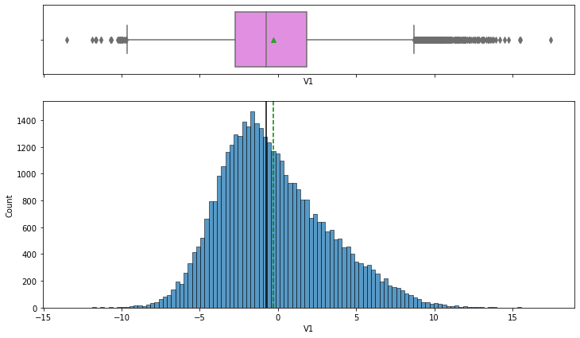
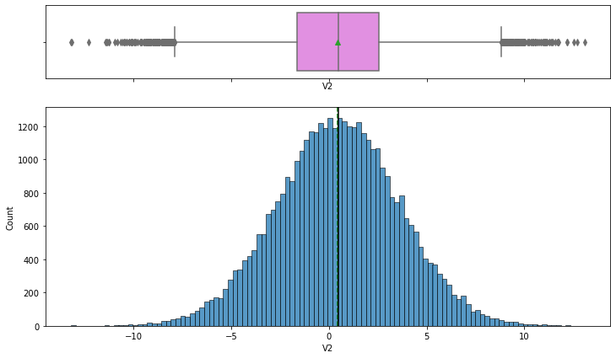
Explorative Data Analysis
All the target predictor variables are normally or nearly normally disturbed with some outliers.
The data has both negative and positive values

Slide 7
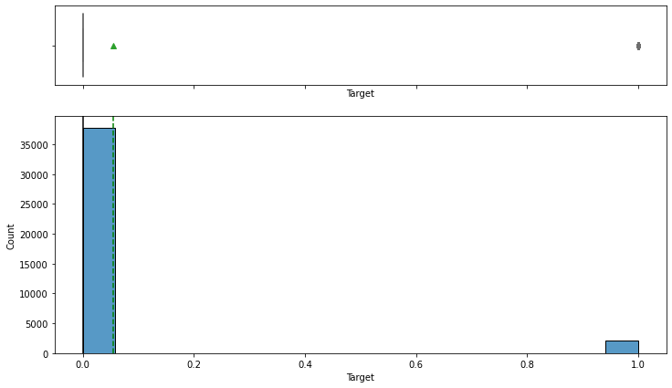
Explorative Data Analysis
The data is imbalanced.
94.5% of the Target column is for 0 (No failure)
4.5% of the Target variable is for Failure
Oversampling and undersampling required to
avoid bias in the models

Slide 8
Cross Validation
We will build different models using cross validation: Logistic regression, Bagging, Random Forest, GradientBoosting, AdaBoost and XGB
We will use Recall as a scorer in cross validation
Higher Recall values will enable us maximize True Positives and minimize False Negatives
If a machine is due for repairs and is identified early, the company spends less in repairs cost.
Conversely, if a machine that’s due for repairs is not identified, the repairs cost will increase when it eventually breaks down or may have to be replaced at higher.
The models will be built on the original data, the oversampled data, and the undersampled data
The models built on oversampled and undersampled data will prevent biases occasioned by imbalanced data in the Target column.
The scores of the different models will be compared

Slide 9
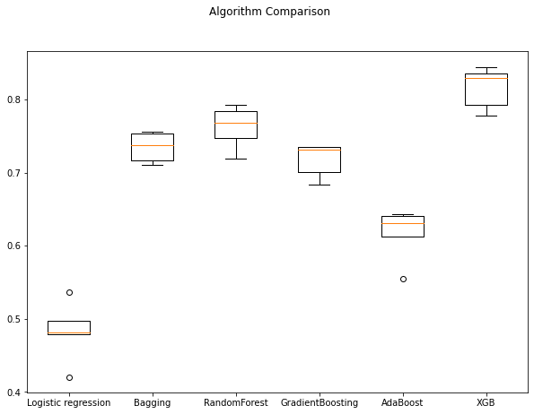
Scores for Models Built with Original Data using Cross Validation
The XGB gave the best model, with a score of 81.5% followed by Random Forest 76%
The best four model are: XGB, Random Forest, Gradient Boosting and Bagging
Logistic Regression had the worst score, less than 50%

Slide 10
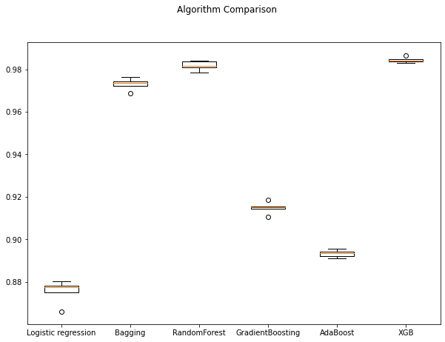
Scores from Oversampled Data using Cross Validation
All the models have higher score than in the original imblanced data
The best four model are: XGB, Random Forest, Gradient Boosting and Bagging
XGB – 98.4% and Random Forest – 98.1%

Slide 11
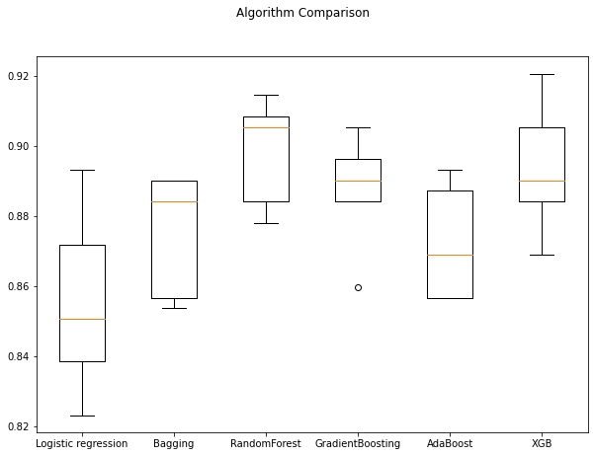
Scores from Undersampled Data using Cross Validation
Random Forest gave slightly higher score here than XG Boost - 89.8% for Randome Forest and XGB 89.1%
The best four models in all three models are the same: XGB, Random Forest, Gradient Boosting and Bagging
These four models will be tuned using hyperparameters and their performances compared

Slide 12
Model Performance Summary
We will use our best four models from cross validation scores – XGB, RandomForest, Bagging, Gradient Boosting
We will use balanced class weight so models focus equally on both classes. Since oversampling gave the best scores on cross validation, oversampled data will be used.
The models will be tuned using hyperparameters
We will compare the performance of the tuned models on the train, validation and test sets to determine the best model
We will again use Recall score as the metric for evaluation of the performance of the models

Slide 13
Model Performance Summary
 | Train Accuracy | Validation Accuracy | Test Accuracy | Train Recall | Validation Recall | Test Recall | Train Precicsion | Validation Precision | Test Precision | Train F1 | Validation FI | Test F1
Gradient Boosting tuned with oversampled data | 0.954 | 0.974 | 0.973 | 0.926 | 0.883 | 0.876 | 0.981 | 0.713 | 0.705 | 0.953 | 0.789 | 0.781
XGBoost tuned with oversampled data | 1 | 0.988 | 0.985 | 1 | 0.89 | 0.87 | 1 | 0.892 | 0.859 | 1 | 0.891 | 0.865
Bagging classifier tuned with oversampled data | 0.999 | 0.985 | 0.983 | 0.986 | 0.770 | 0.718 | 1 | 0.974 | 0.977 | 0.993 | 0.861 | 0.826
Random forest tuned with oversampled data | 0.999 | 0.991 | 0.991 | 0.998 | 0.872 | 0.857 | 1 | 0.950 | 0.951 | 0.999 | 0.909 | 0.902
Best model
With a recall of 87.6%, the chances of a predicted failure using Gradient Boosting with oversampled data being an actual failure is almost 9 out 10.

Slide 14
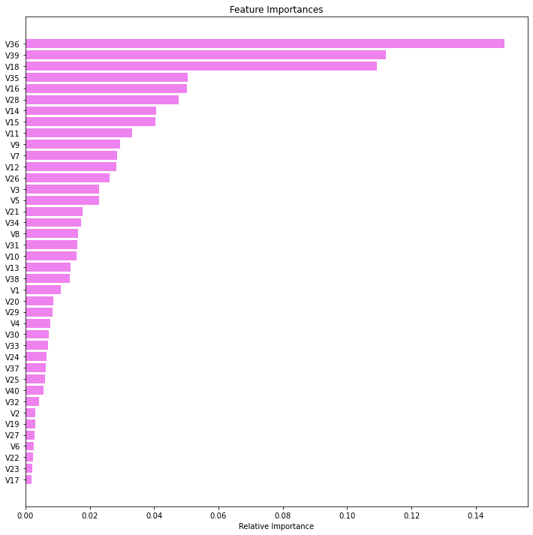
Feature Importances
The top 3 most important machine failure predictors are :
V 36, V 39, V18.
The top 3 failure predictors all have feature importances at least twice higher than the 4th failure predictor.
The 4th – 6th failure predictors are:
V35, V16, V28

Slide 15
Actionable Insights and Recommendation
Since we do not know what the specific predictors are, we will use their numbers V1 to V40. What each represent can be found out from the company
Data is generator for many factors that are thought to impact machine wear or degradation, but many have very minimal impact the machine failure
V36 is the most important predictors of failures in the wind energy generating machine, followed by V39 and V18. Attention need to be paid to these factors, and if they are environmental factors, the machines be shielded from them. But if they are machine parts, they should be changed periodically.
The best recall on the test data is for Gradient Boosting, 87.6%, but it also has the lowest precision, and consequently the lowest F1 on the test data, 70% and 78% respectively. This means 30% chance of model predicting a machine does not require repairs when it actually does. This will be costly to the company in the long runner as maintenance cost will go higher with more deterioration, or the company will have to purchase a new machine.
Data should therefor be gathered often and analyzed to enable the model identify such False negatives

