Slide 1
Trade&Ahead
Business Presentation
Enoch Adogla
2-11-2022

Slide 2
Content
Business Problem Overview
Data Overview
Exploratory Data Analysis (EDA)
Summary
Business Insights and Recommendations

Slide 3
Business Problem Overview
The stock market is a good place for savings and investment for the future. It provides a good steady returns on investments over a long period of time and can also grow a lot more than expected
The earlier one starts investing, the larger the returns one can have at retirement and can help meet life’s financial expectations in old age
Potential losses when a company one invested in is not doing well is a real risk. It’s therefore important to maintain a diversified portfolio in stock to temper losses and maximize earnings at any given time
However, analyzing the performance of a multitude of companies to determine the worth of their stock can be tedious and time-consuming
In this work, we will do a cluster analysis to identify stocks that exhibit similar characteristics and ones which exhibit minimum correlation. We will also analyze the performance of each cluster and give actionable insights
This will help investors better analyze stocks across different markets and hedge against risks that could occasion losses to their portfolio

Slide 4
Data Overview
The data has 340 rows and 15 columns representing 340 companies and 15 features to analyze
No duplication in the data
No missing values in the data
The data type is float, int, and object
The numeric columns (float and int) are 11
Only 4 are object type
The income of all the companies combined is over 500 billion

Slide 5
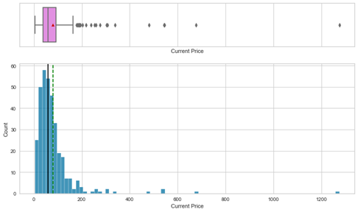
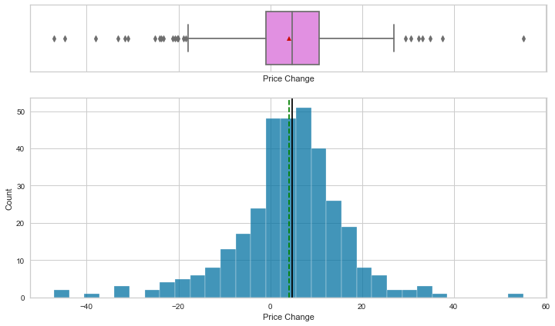
EDA – Univariate Analysis
Current Price is the current stock price in dollars
The minimum price per stock is $4.5 and the max is $1274.95
The distribution is skewed toward higher prices
The mean is $80.86 and the median is $59.71
Price Change is the percentage change in the stock price in 13 weeks
The Price Change per stock is almost normally distributed
The Price change ranges from $-47.12, indicating losses to $55.05 indication profits
The mean price change is $4.07 and median is $4.8

Slide 6
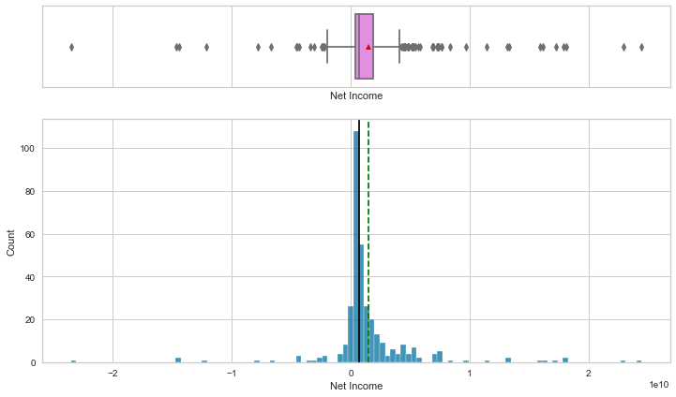
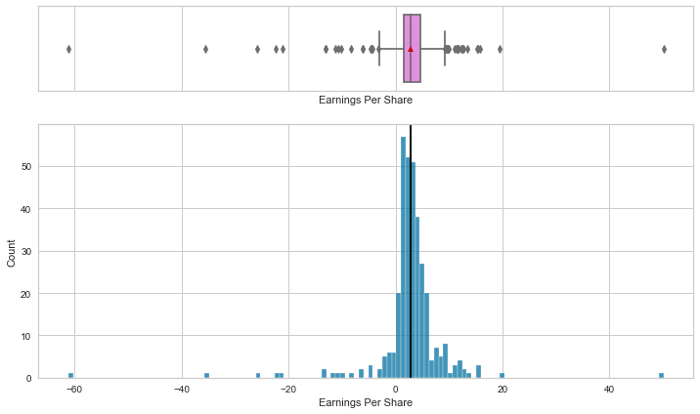
EDA – Univariate Analysis
The net income distribution is slightly skewed to the right with outliers on both sides
The net income of 9.4% of the investors is less than zero
The median net income is about 703 million dollars whiles the mean net income is 1.4 billion dollars
The maximum net income is over 2 billion dollars
The Earning Per Share is almost normally distributed, but with outliers on both ends
Some shares returned profits while others lost value
The highest lost per share was $61.20 and the highest earning per share was $50.01
The mean earning per share is $2.77 and the median is $2.89

Slide 7
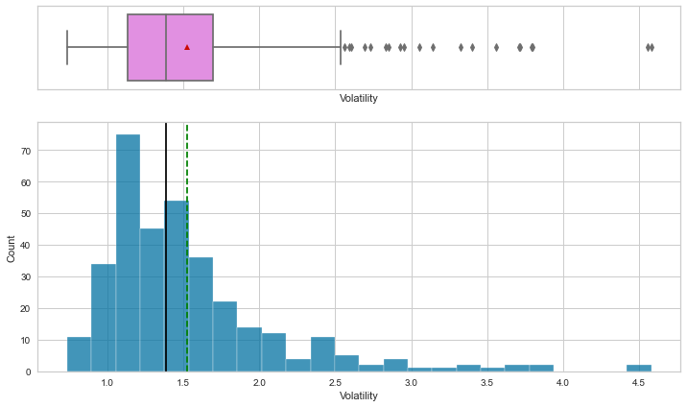
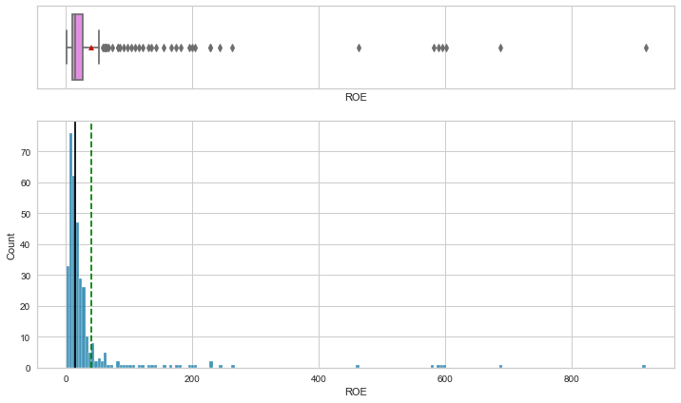
EDA – Univariate Analysis
Volatility or standard deviation of the stock price over the past 13 days is right skewed
Ranges from 0.73 to 4.2, and a median of 1.38
ROE is a measure of financial performance calculated by dividing net income by shareholders' equity
The equity per share holder is also right skewed
Ranges from $1 to $917
The mean share holder equity is $39 and the median is $15

Slide 8
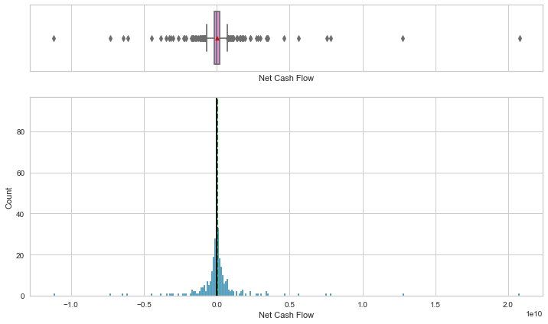
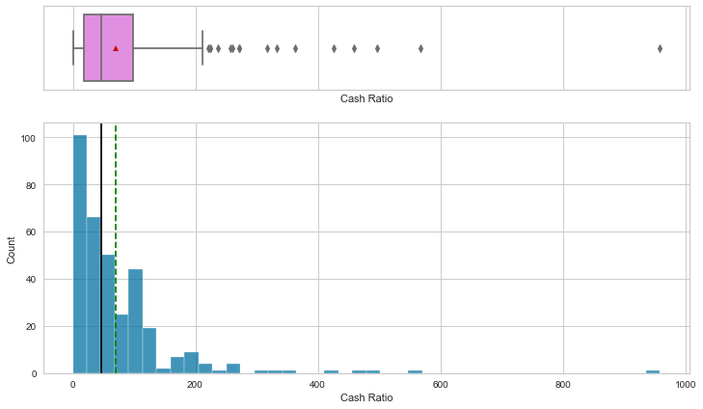
EDA – Univariate Analysis
Net Cash Ratio is the ratio of a company's total reserves of cash and cash equivalents to its total current liabilities
Some companies had negative Net Cash flows and other positive
Distribution is close to normal with outliers on both sides
Cash Ratio is ratio of a company's total reserves of cash and cash equivalents to its total current liabilities
Skewed heavily to the right.

Slide 9
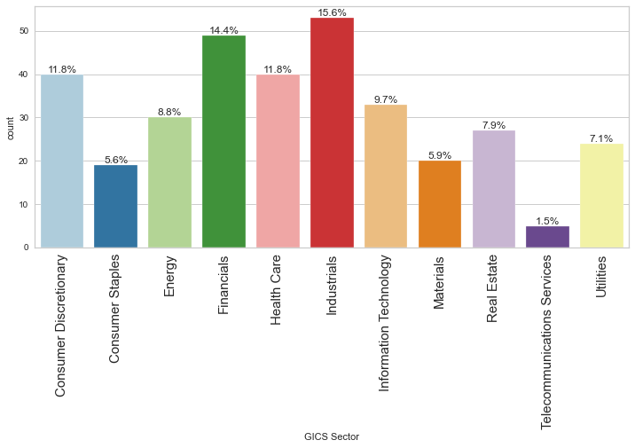
EDA – Univariate Analysis
The specific economic sector assigned to a company by the Global Industry Classification Standard (GICS)
There are 11 of them under this data
Industrials are the highest and make up 15% of the assigned, followed by Financials at 14.4% and Health Care at 11.8%
The lowest is Telecommunication Services at 1.5%

Slide 10
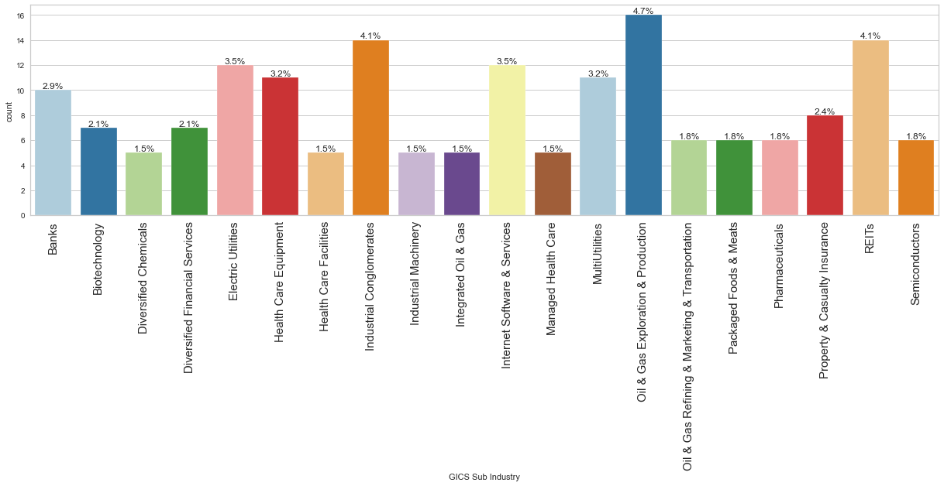
EDA – Univariate Analysis
The GICS Sub Industry is made has 104 categories
The top 20 and their percentage are represented above
Oil and Gas Exploration is the most common category

Slide 11
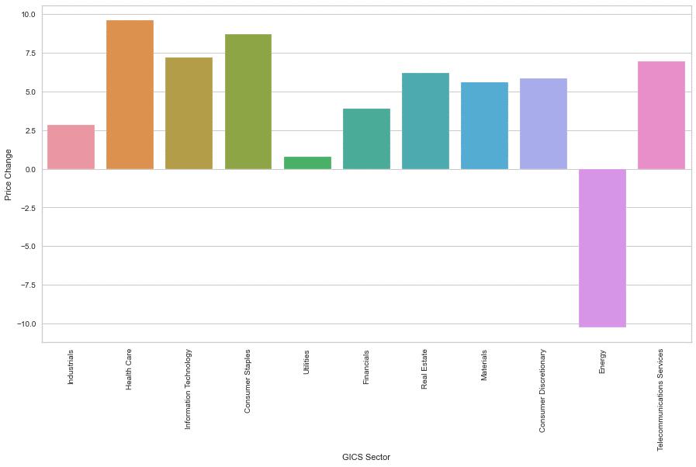
EDA – Bivariate Analysis
Only the Energy sector had a negative Price change over the 13 weeks data was collected (~ -10%)
The Health Sector had the most positive price change (~9.75%) followed by Consumer Staples (~8.5%)

Slide 12
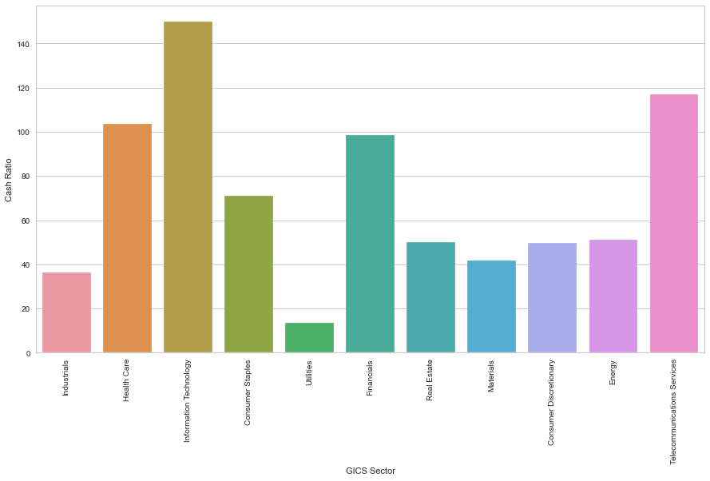
EDA – Bivariate Analysis
Cash Ratio is ratio of a company's total reserves of cash and cash equivalents to its total current liabilities
Information Technology had the highest cash ratio (~150) followed by Telecommunication services (~115) and
Health care (~112)
Financials, Consumer Staples has Cash Ratios less than 100 but greater than 50
Utilities had the lowest cast ration (~12%)

Slide 13
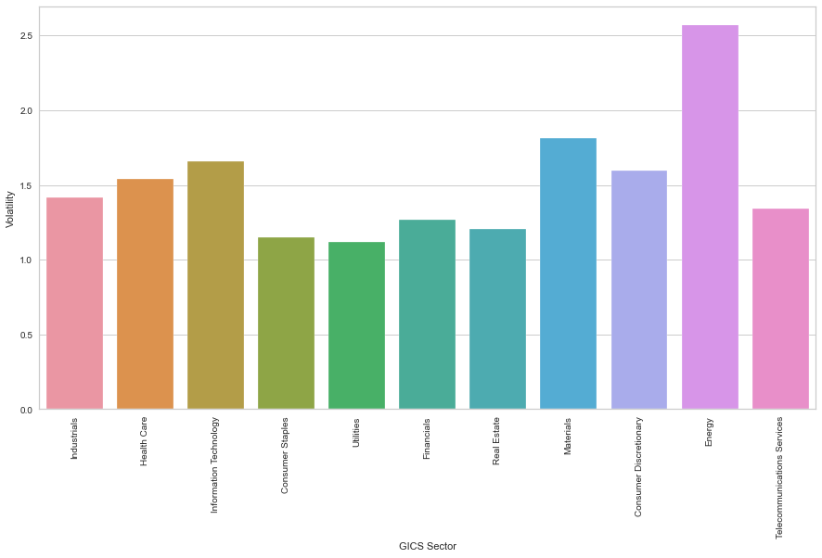
EDA – Bivariate Analysis
The energy sector had the highest volatility (~2.6). This was evidently occasioned by the loss.
Material, Information and Health Care had a greater than 1.5 but less than 1.75 volatility
The rest had volatility between 1 and 1.5

Slide 14
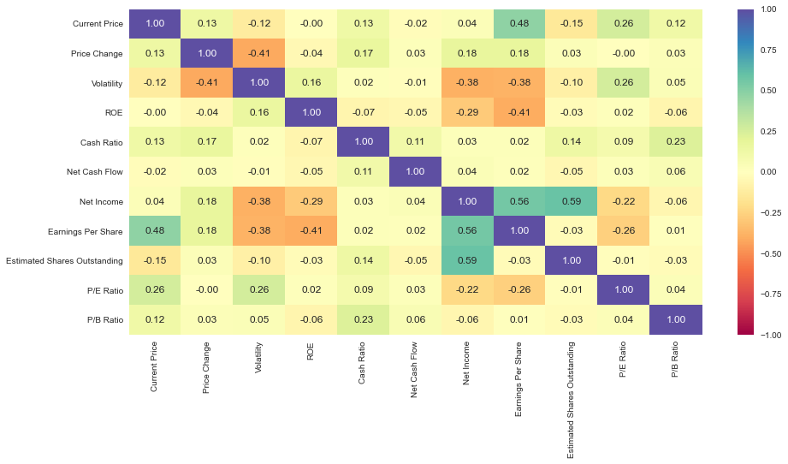
EDA – Bivariate Analysis
I consider correlation above 0.4 as significant
No significant negative correlation
Significant positive correlated features are:
Current Price and Earning Per Share a
Net Income and Estimate Shares Outstanding
Net Income and Earning Per Share

Slide 15
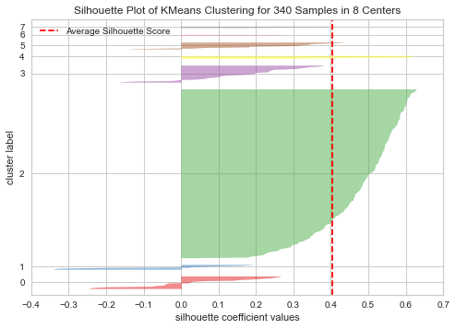
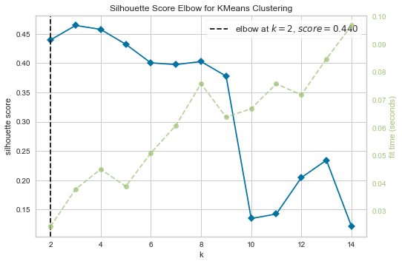
Applying K-Means Clustering
From the silhouette scores, and the plots of several silhouette visualizers, it appears 8 is an optimum number of clusters
It has a good silhouette score, K = 0.4, and an “elbow” and the best distribution of clusters

Slide 16
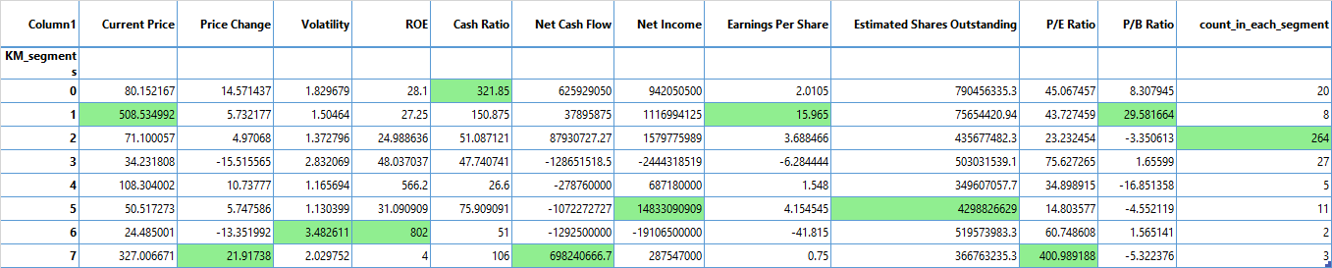
Cluster Profiles – mean values
Cluster 0 had the highest mean cash ratio of $321.85
Cluster 1 had the highest mean Current Price, Earning Per Share and P/B Ration. A good cluster for those looking to get big returns on investment
Cluster 2 is the biggest cluster
Cluster 5 had the highest mean Net Income and Estimated Shares Outstanding
Cluster 6 had the highest mean Volatility, ROE
Cluster 7 had the highest mean Price Change and Net Cash Flow

Slide 17
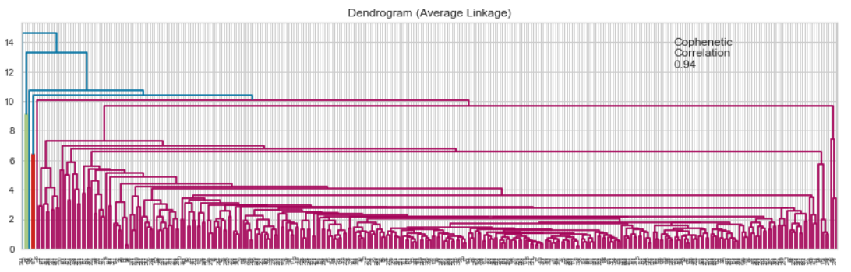
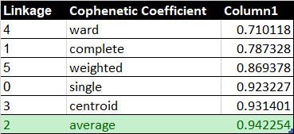
Applying Hierarchical Clustering
The dendogram (Average Linkage) gave highest Cophenetic Correlation for our plots
We will pick 7 as our optimum number of clusters

Slide 18
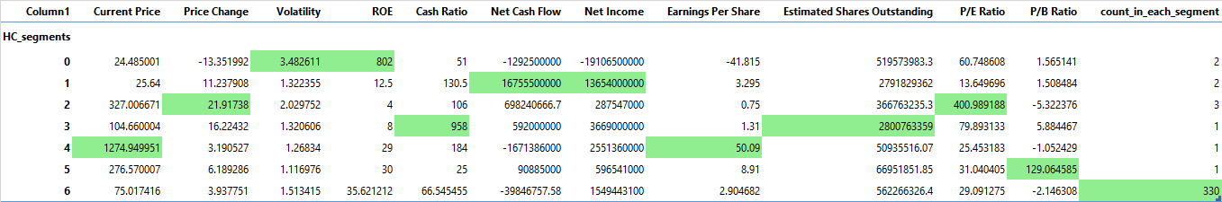
Applying Hierarchical Clustering
97% of the Companies are under cluster 6 in our Hierarchical clustering; not a good clustering
Here cluster 4 with only one company, Priceline.com Inc, gave the highest mean Current Price and Earning per share
Cluster 1 with a similar performance in K-Means clustering has 8 companies including Priceline.com Inc
Cluster 4 here has the highest volatility, the two companies under the cluster are the same two for K-Means under cluster 6 (the highest mean Volatility) for K-Means clustering

Slide 19
Summary
K-Means clustering appears to give a better clustering than Hierarchical clustering
K-Means clustering gave a more distinct cluster. It has more observations per cluster. The highest cluster had 77% of the observations as compared to 97% for Hierarchical
The Silhouette score vary from 0.12 to 0.46. Our chose number of cluster (8) had a score of 0.40
Our recommendations will be based on the K-Means clustering

Slide 20
Business Insights and Recommendations
The best performing companies to an investor will be one that returns the highest mean and steady Earning Per Share, Highest Net Income and PB
Cluster 1 made of 8 companies: Alliance Data Systems, Biogen IDEC Inc, Chipotle Mexican Grill, Equinix, Intuitive Surgical Inc, Mettle Toledo, Priceline.com Inc and Regeneron is the best for this
Cluster 0, made of 20 companies, has a high mean Cash Ratio, but low Current Price
Cluser 2, the biggest cluster made of 264 companies has an average performance on most metrics
Cluster 3 and 4, made of 27 and 5 companies respectively are also average on most metrics
Cluster 5, made of 11 companies has the highest mean Net Income and the highest mean Estimated Shares Outstanding. The company is doing well, so worth investing in
Cluster 6, made of only 2 companies is doing well on the ROE, but has high Volatility. Individual wishing for early return on investment should study trends before choosing companies in this cluster for investment
Cluster 7,made of 3 companies has the highest Price Change, Net Cash Flow, and P/E ratio. The stock price per earning is high; not the best in terms of profit per dollar invested. But it gives steady returns

