Slide 1


SHIELD
(Smart Helmet Integrated Engine Lock Device)
Team Members :
Parikshit Kulkarni
Ved Kyada
Mahin Khokhar
Harsh Shah
Parth Koringa
Mentor :
Prof. (Dr).Rizwan Alad
Faculty of Technology

Slide 2
Team Strength
Parikshit Kulkarni
  Specializes in electronic circuit design and has successfully developed projects like a Maze Solver Robot and a Smart Air Purifier in competitions such as Eureka.
Harsh & Mahin
Harsh and Mahin have strong skills in soldering and problem-solving. They have implemented practical projects like an Automatic Headlight Controller and RC Car.
.
These combined skills ensure a seamless development process in hardware-based projects—from circuit design and fabrication to assembly, troubleshooting, and final implementation.
.
Ved & Parth
Ved and Parth both possess expertise in PCB fabrication and hands-on electronics work, contributing significantly to hardware integration in various projects.

Slide 3
Brief Description
A smart ignition system that enhances two-wheeler safety by enforcing helmet use through NFC-based authentication, with secure emergency override and retrofit-friendly design.
Lack of an effective and affordable mechanism to enforce mandatory helmet usage, resulting in frequent safety violations and increased risk of head injuries.
Introduces NFC-based ignition control that mandates helmet use before starting the vehicle — a low-cost, retrofit-ready solution not present in existing systems.
Development of an NFC-based ignition lock system that enforces helmet use, with a modular design, low cost, and secure emergency override—features not present in current solutions.

Slide 4
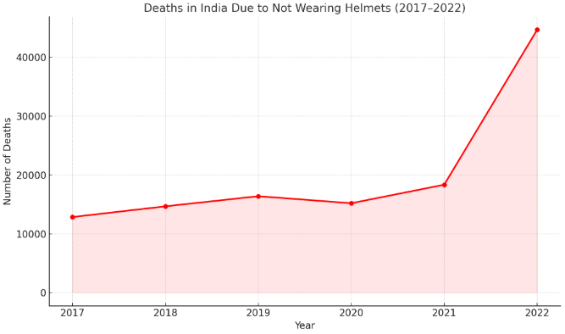
Problem Identification
43,000+ people die annually in India due to not wearing helmets
No system currently enforces helmet use before starting the vehicle.
Lack of awareness and enforcement leads to neglect of basic safety practices.

Slide 5
Value proposition
Ensures rider safety by mandating helmet usage before vehicle ignition, reducing head injury risks.
Utilizes NFC-based authentication for a seamless and user-friendly experience.
Targets two-wheeler users, especially in urban and semi-urban areas, aiming to improve road safety compliance.

Slide 6
Market Survey
Existing systems use cameras or Bluetooth, which reduce reliability and ease of use.
Our system uniquely combines NFC helmet authentication, ignition control, and secure override.
Compared to market solutions priced around ₹12,000–₹15,000, our system offers similar or better safety features under ₹8,000.
Few general NFC patents exist; none cover our specific helmet-integrated safety system.

Slide 7
Current Stage
The project has been in development for 1 months, with the design finalization phase actively carried out over the past month, and the design now finalized.
The system design has been finalized, and theoretical validation confirms functional feasibility; practical implementation and testing are yet to be initiated.
TRL 2 – Technology concept and application formulated; initial design finalized and theoretical feasibility established.

Slide 8
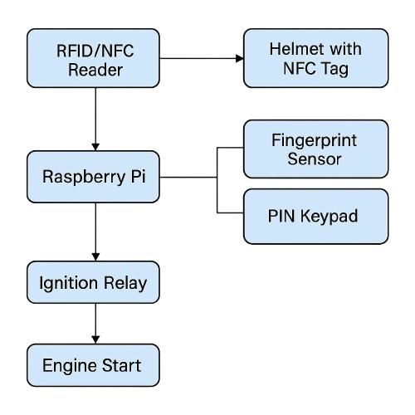
Proposed solution
System Functionality:
Two-wheeler starts only when the rider wears a helmet with an embedded NFC tag.
NFC reader near ignition verifies the helmet.
Optional fingerprint sensor or keypad override for added security.
Microcontroller processes inputs and activates a relay to enable ignition.
Prevents riding without a helmet, enhancing safety.
Benefits:
Promotes road safety and reduces head injuries.
Affordable and easy to install.
Supports government safety initiatives.
Uses low-power components for energy efficiency and sustainability.

Slide 9
Fund requirements
Total cost (including consumables, non consumables, recurring and non recurring):
RS.8000

Slide 10
Components
Component Name | Where it will be used? | Quantity | Price per Unit (INR) | Total
Raspberry Pi 4 (4GB) | Core controller for entire system | 1 | 4000 | 4000
RC522 NFC Reader + NFC Tag | Helmet authentication via NFC | 1 Set | 250 | 250
Helmet | Worn by rider and tagged with NFC | 1 | 400 | 1500
R307 Fingerprint Sensor | Fingerprint-based emergency override | 1 | 650 | 650
4x4 Keypad + Buzzer + LCD | Emergency input, indication and display | 1 | 600 | 300
Relay Module + Wiring + Supply | Controls ignition, connection to system power & output | 1 | 2100 | 900
Total(A) |  |  | 7200 | 7200

Slide 11
Other Expenses
Expense Head (Mention whichever are applicable) | Give details of the items | Total Price
Consumables | Solder, zip ties, heat shrink, breadboard, extra jumpers | 400
Minor works | Enclosure box, acrylic sheet, mounting hardware, ignition tap wiring | 400
Professional services (from outside)
Mentoring services (from outside)
Patent filing
Any other (Pl. Specify)
 | Total(A) | 800

Slide 12
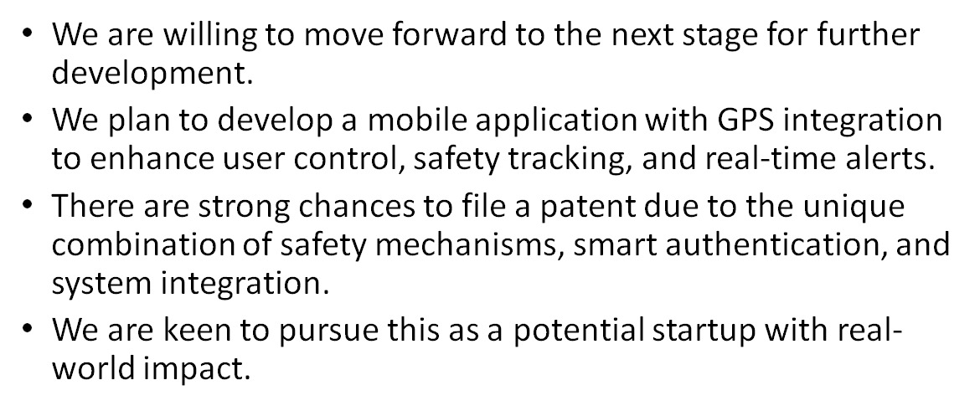
Path forward

Slide 13
Thank You

