Slide 1
SENSORS
The control of the manipulator demands exact determination of parameters of Interest so that the controller can compare them with desired values and accordingly command the actuators of the manipulator. For manipulator motion control, joint-link positions, velocities, torques, or forces are required to be sensed and the end-effector position and orientation is required for determining actual trajectory being tracked.
The task performance capability of a robot is greatly dependent on the sensors used and their capabilities. Sensors provide intelligence to the manipulator Sensors used in robotics are tactile sensors or nontactile sensors, proximity or range sensors, contact or noncontact sensors, or a vision system.
A robotic vision system Imparts enormous capabilities to a robot. The robotic vision or vision sensing provides the capability of viewing the workspace and interpreting what is seen.

Slide 2
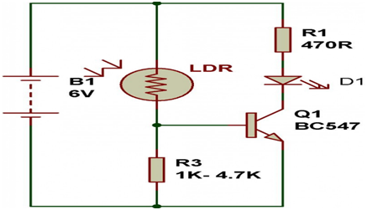
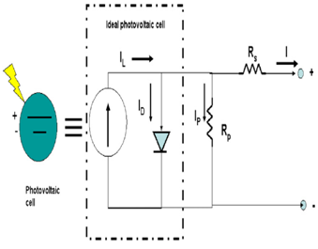
Light Sensors: Used for detecting light and creates a voltage difference equivalent to the light intensity fall on a light sensor.
Photo resistor - It is a type of resistor used for detecting the light. In photo resistor resistance varies with change in light intensity.
Photovoltaic Cells - Photovoltaic cells are energy conversion device used to convert solar radiation into electrical electric energy.

Slide 3
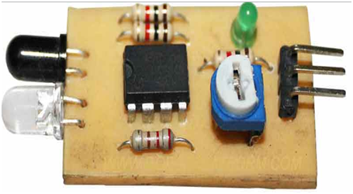
Proximity Sensor: Proximity sensor can detect the presence of nearby object without any physical contact. The working of a proximity sensor is simple. In proximity sensor transmitter transmits an electromagnetic radiation and receiver receives and analyzes the return signal for interruptions.
Infrared (IR) Transceivers
In IR sensor LED transmit the beam of IR light and if it find an obstacle then the light is reflected back which is captured by an IR receiver.
Ultrasonic Sensor
In ultrasonic sensors high frequency sound waves is generated by transmitter, the received echo pulse suggests an object interruption.

Slide 4
Other Sensors
Internal Sensor: It is the part of the robot. Internal sensors measure the robot's internal state. They are used to measure position, velocity and acceleration of the robot joint or end effectors.
Position sensor
Position sensors measure the position of a joint (the degree to which the joint is extended). They include:
Encoder: a digital optical device that converts motion into a sequence of digital pulses.
Potentiometer: a variable resistance device that expresses linear or angular displacements in terms of voltage.
Velocity Sensor
A velocity or speed sensor measures consecutive position measurements at known intervals and computes the time rate of change in the position values.
Sound Sensor
Temperature Sensor

Slide 5
User Interface
The user interface is where interaction between humans and machines occurs. The interface allows the user to control the machine for effective operation and obtain feedback from the machine. Graphical user interfaces allow users to interact with electronic devices through graphical icons and visual indicators as opposed to text-based indicators.
A seamless user experience and frictionless user interface (UI) are essential for fostering collaboration between humans and robots.

Slide 6
Controller
The controller is the brain of the robot. Often in a separate cabinet and connected by umbilical cables to the arm the controller has a Central Processing Unit, memory, Power supplies and servo controllers. The controller usually has various buttons and displays to allow control of the robot. Most robot controllers have a PLC (Programmable Logic Controller) built in that allows the robot to receive inputs and process information from sensors and also set outputs and relay other information.

Slide 7
Non-Servo controlled robot
implemented by setting limits or mechanical stops for each joint and sequencing the actuation of each joint to accomplish the cycle
No control over the motion at the intermediate points, only end points are known. So used in end point robots

Slide 8
Servo controlled robots
Servo controlled robots have a wide range of capabilities.
Perform multiple point to point (PTP) transfers or can move along a Continuous path (CP).
Most servo controlled robots use jointed arm mechanism and can be programmed to avoid an obstruction.
Programming can be rather sophisticated - Complete servo controlled robot system is relatively expensive
Information about position and velocity monitored and fed back to control system.
Control System Controls the movements

