Slide 1

Structured Query Language (SQL)
Advanced SQL Concepts – Part II

Slide 2
Agenda
In this session, you will learn about:
Views and Indexes
Sub-Queries

Slide 3

Introduction to Views

Slide 4
Virtual Tables
A virtual table is a derived form of data from a physical database tables
They are logically represented using physical data but do not store any data
It is a construct that allows us to define things that are not tables so that they can be used in SQL statements as if they are tables
Views are the database objects that can also be called as virtual tables

Slide 5
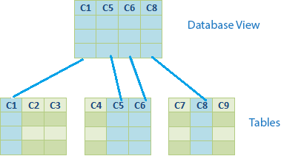
What is a View?
A view is a database object that is created using a Select query with complex logic
They are said to be a logical representation of physical data
It behaves like a physical table and users can use them as database objects in any part of SQL queries
DML operations can be performed on base tables via views
Since they are stored in the data dictionary , they can be retrieved easily

Slide 6


How DBMS handles Views?
First, it finds the definition of the view stored in the database
Then the DBMS translates the request that references the view into an equivalent request against the source tables of the view
And finally it carries out the equivalent request
Views
Database

Slide 7
How DBMS handles Views?
For simple views:
DBMS constructs each row of the view on the fly, drawing the data for the row from the source table(s)
For more complex views
DBMS actually carry out the query that defines the view and store its results in a temporary table
The DBMS fills your requests for view access from this temporary table and discards the table when it is no longer needed
Views
Database

Slide 8
Creating View
The CREATE VIEW statement is used to create a view
The statement assigns a name to the view and specifies the query that defines the view
To create the view successfully, you must have permission to access all of the tables referenced in the query

Slide 9
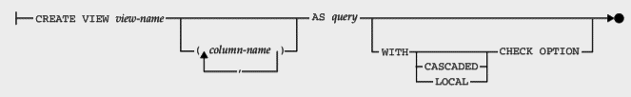
Creating View
Syntax
CREATE
[OR REPLACE]
VIEW view_name [(column_list)]
AS select_statement
[WITH [CASCADED | LOCAL] CHECK OPTION]

Slide 10
Creating View
The CREATE VIEW statement creates a new view
view_name
select_statement
column_list
OR REPLACE
view_name is the name of the view
The select_statement is a SELECT statement and provides the definition of the view
It provides a list of names for the view's columns right after the view name where the names must be unique
If the optional OR REPLACE clause is added with CREATE VIEW statement, the CREATE VIEW statement replaces an existing view and create a new one

Slide 11
Creating View
[WITH [CASCADED | LOCAL] CHECK OPTION]
LOCAL - restricts the CHECK OPTION only to the view being defined
CASCADED - causes the checks for underlying views to be evaluated as well
When neither keyword is given, the default is CASCADED
In a WITH CHECK OPTION clause for an updatable view, the LOCAL and CASCADED keywords determine the scope of check testing when the view is defined in terms of another view.

Slide 12
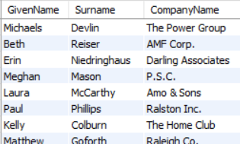
Creating View - Example
Create a view named customer_info from customers table that has customer’s basic info like id, name details, address details and company name:
Syntax
CREATE OR REPLACE VIEW customer_info AS
select ID, GivenName, Surname,CompanyName FROM customers;

Slide 13
Advantages
Views are stored queries and re-used
They are accessible by multiple users in different sessions
Scalability is high
They are used to hide the confidential columns data like SSN, date of birth, Address , telephone

Slide 14
Advantages
Avoids direct access to physical data
Views protects the data when views are invoked by downstream users to build web applications that are prone to hackers
Materialized views are useful in a centralized environment where multiple users access it in batches of data rather streaming data

Slide 15
Disadvantages
When a base table of an associated view is dropped, it becomes obsolete
Queries using views are bit slow compared to accessing data directly from physical tables
Because , SQL engine will take an additional processing of semantics checking of view each time when queries are running on it

Slide 16
Disadvantages
Views created using aggregate functions are restricted to use in WHERE clauses
Materialized views stores physical data hence it holds redundant data and results in consumption of additional space for its Mviews and Logs
Views are in-efficient when joined with remote database tables as they consume lot of I/O transactions between local and remote database tables

Slide 17
Types of Views
Horizontal View
Vertical View
Row/Column Subset View
Grouped View
Joined View

Slide 18
Horizontal View
A horizontal view slices the source table horizontally to create the view
All of the columns of the source table participate in the view, but only some of its rows are visible through the view
Appropriate when the source table contains data that relates to various organizations or users
They provide a private table for each user, composed only of the rows needed by that user

Slide 19
Horizontal View - Example
Now you can give each sales manager permission to access either the US_Customers or the CA_Customers view
Denying them permission to access the other view and the Customers table itself

Slide 20
Vertical View
A vertical view slices the source table vertically to create the view
Commonly found where the data stored in a table is used by various users or groups of users
They provide a private virtual table for each user, composed only of the columns needed by that user

Slide 21
Vertical View - Example
The Employees tables has personal information like SSN, Salary, Phone Number
There is no need for an employee to see fellow colleague’s personal information
This selective view of the Employees table can be constructed with the following view:
Syntax
CREATE OR REPLACE VIEW basic_emp_info as
SELECT EmployeeID, GivenName, Surname, Sex, DepartmentID FROM Employees;

Slide 22
Vertical View - Example
The staff is given access to this view and denying access to the Employees table itself
Access to sensitive sales and quota data is effectively restricted
A view like the basic_emp_info view is often called a vertical view

Slide 23
Row/Column Subset View
SQL does not restrict you to purely horizontal or vertical slices of a table
A view can be created to represent the subset of records and lesser columns in order to filter the records and hide the columns
Only the columns explicitly named in the select list of the view and the rows that meet the search condition are visible through the view

Slide 24
Row/Column Subset View - Example
It’s quite common to define a view that slices a source table in both the horizontal and vertical dimensions
Define a view that contains the customer id, customer name and company name of all customers from the state of New Jersey
Syntax
CREATE OR REPLACE VIEW NJ_Cust as
SELECT ID, GivenName, Surname, CompanyName FROM customers
WHERE State = 'NJ';
The data visible through this view is a row/column subset of the CUSTOMERS table

Slide 25
Grouped View
The query specified in a view definition may include a GROUP BY clause
This type of view is called a grouped view
Grouped views perform the same function as grouped queries
A grouped view makes these grouped query results into a virtual table, allowing you to perform further queries on them

Slide 26
Grouped View - Example
Below query defines a view that contains summary of salaries for each department:
Syntax
CREATE OR REPLACE VIEW ord_by_emp (Department_ID, HOW_MANY, TOTAL_SALARY, LOWEST_SALARY, HIGHEST_SALARY, AVERAGE_SALARY) AS
SELECT DepartmentID, COUNT(*), SUM(Salary), MIN(Salary), MAX(Salary),
AVG(Salary)
FROM employees
GROUP BY DepartmentID;
Once this grouped view is defined, it can be used to simplify queries

Slide 27
Joined View
A joined view created such that it draws data from two or three different tables and presents the query results as a single virtual table
A simple single-table query can then be used against the view for requests instead of creating two-table or three-table join

Slide 28
Joined View - Example
The vice president of a company does not like to work with department number and employee numbers
He’d like to be able to use a version of the Departments table that has names instead of numbers
Here is a view that meets the vice president’s needs:
Syntax
CREATE VIEW DEPT_INFO (DeptName, ManagerName, Manager_Surname, Gender) AS
SELECT DepartmentName, GivenName, Surname, Sex
FROM Departments, Employees
WHERE EmployeeID = DepartmentHeadID;

Slide 29
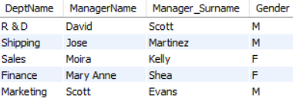
Joined View - Example
Here is a query against the view that is generated by Departments and Employees tables:
Syntax
SELECT * FROM DEPT_INFO;
Output:

Slide 30
Updating a View
The original ANSI/ISO SQL standard (SQL1) specifies the views that must be updateable in a database that claims conformance to the standard
Updateable in this context refers to inserts, updates, and deletes
The SQL standard rules on view updates are very restrictive

Slide 31
Updating a View - Example
Consider the view NJ_Customers that we created earlier, you can add a new customer details with the insert statement:
Syntax
INSERT INTO CA_Customers VALUES( 151, 'Brownlee', 'Jason', '3087 Powell Street', 'Hamilton', 'ON', 'Canada', 'L7N 3N4', '9898555908', 'Gemgols' );
The DBMS will add the new row to the underlying Customers table, and the row will be visible through the CA_Customers view

Slide 32
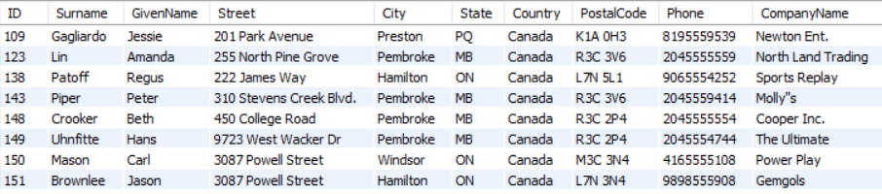
Updating a View - Example
View:

Slide 33
Updating a View - Example
But what happens when you add a new customer detail with the following INSERT statement:
Syntax
INSERT INTO CA_Customers VALUES( 152, 'Paul', 'Ashley', '216 Hill Road', 'Hull', 'IN', 'USA', '46808', '9876543210', 'ESPN Sports' );

Slide 34
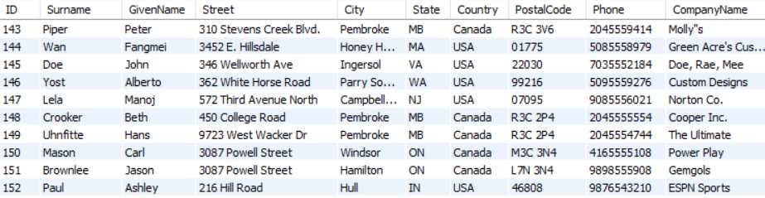
Updating a View - Example
Value inserted in the Customer Table:

Slide 35
Updating a View - Example
The newly inserted row doesn’t meet the search condition for the view since the inserted customer belongs to USA and not Canada

Slide 36

Under the standard, a view can be updated if the query that defines the view meets all of these restrictions:
DISTINCT must not be specified
The FROM clause must specify only one updateable table
Each select item must be a simple column reference
The WHERE clause must not include a subquery
The query must not include a GROUP BY or a HAVING clause

Slide 37
Dropping a View
A view can be dropped using DROP VIEW statement
Suppose we have a view on the Employees table as:
Syntax
CREATE OR REPLACE VIEW NY_Employees as SELECT * FROM employees WHERE State = 'NY';

Slide 38
Dropping a View
The following DROP VIEW statement will delete the NY_Employees view:
Syntax
DROP VIEW NY_Employees;

Slide 39
Indexes

Slide 40
Joins Introduction
#1
A database index is a data structure
#2
Improves the speed of operations in a table
#3
Is created using one or more columns, providing the basis for both rapid random lookups and efficient ordering of access to records

Slide 41
Why do we use Indexes?
Speed
Constraints (Uniqueness)
i/o Optimization
Sorting Grouping

Slide 42
Unique Index
A unique index means that two rows cannot have the same index value. Here is the syntax to create an Index on a table:
Syntax
CREATE UNIQUE INDEX index_name ON table_name (column1, column2,...);
You can use one or more columns to create an index

Slide 43

Unique Index
Consider the table Customers where you can create an unique index on the ID column, as follows:
Syntax
CREATE UNIQUE INDEX Cust_ID ON Customers (ID);
Use the command show index from table_name, to take a look at the indexes for that table

Slide 44
Simple Index
A Simple index allows duplicate values in a table
Omit the UNIQUE keyword from the query to create a simple index
Syntax
CREATE INDEX index_name ON table_name (column1, column2,...);

Slide 45

Simple Index
Create a simple index on the City column in the Customers table:
Syntax
CREATE INDEX loc ON Customers (City);
Use the command show index from table_name, to get the indexes for that table

Slide 46
Adding Index in an Existing Table
There are four types of statements for adding indexes to a table:
ALTER TABLE tbl_name ADD PRIMARY KEY (column_list)- indexed values must be unique and cannot be NULL
ALTER TABLE tbl_name ADD UNIQUE index_name (column_list)- indexed column values must be unique (except for the NULL values, which may appear multiple times)
ALTER TABLE tbl_name ADD INDEX index_name (column_list)- adds an ordinary index in which any value may appear more than once
ALTER TABLE tbl_name ADD FULLTEXT index_name (column_list)- creates a special FULLTEXT index that is used for text-searching purposes

Slide 47

Dropping Index in an Existing Table
You can drop any INDEX by using the DROP clause along with the ALTER command
Try out the following example to drop the created index on Customers table:
Syntax
ALTER TABLE Customers DROP INDEX Cust_ID;

Slide 48
Sub Queries

Slide 49
Sub Queries Introduction
QUERY
Parent Query
SUBQUERY
Nested/Inner Query
A SELECT query when it is nested in another main query, then it is called as a sub-query
Like JOINS, Subqueries need common key columns for joining with main queries
Subqueries are otherwise called as virtual table enclosed with an independent business logic and shares with main query

Slide 50
Sub Queries Introduction
Subqueries are important in real environment because it separates the complex business logic from the main query
It is easy for debugging the individual subquery instead of walking through entire main query which is usually large
Subqueries improve the performance when they are used in a better way
Subqueries can be written anywhere in the SELECT , FROM and WHERE clauses of another SQL query

Slide 51
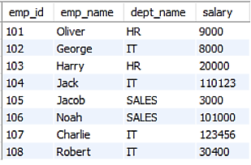
Sub Queries Introduction
Consider the following table:

Slide 52
Sub Queries Introduction
SQL subqueries are most frequently used with the SELECT statement
Syntax
SELECT column_name
FROM table_name
WHERE column_name expression operator
(SELECT column_name from table_name WHERE ... );

Slide 53
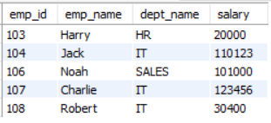
Sub Queries Introduction
The subquery with a SELECT statement will be:
Syntax
SELECT * FROM emp WHERE emp_id IN
(SELECT emp_id FROM emp WHERE salary > 10000);
Output:

Slide 54
Types of Sub Queries
Subqueries can be categorized in different ways:
whether they can return one or more rows (single-row vs. multiple-row subqueries)
whether they are correlated or uncorrelated
whether they are nested within another subquery

Slide 55
Tables Used for Subquery Exercise
Contacts
Customers
Departments
FinancialCodes
FinancialData
Products
SalesOrderItems
SalesOrders
Employees

Slide 56
Single Row Subquery
A single row subquery is used when the outer query's results are based on a single, unknown value
Although this query type is formally called "single-row," the name implies that the query returns multiple columns-but only one row of results
However, a single-row subquery can return only one row of results consisting of only one column to the outer query
Single-row subqueries are subqueries used with a comparison operator in a WHERE, or HAVING clause

Slide 57
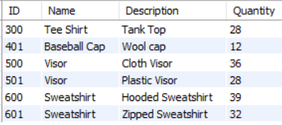
Single Row Subquery - Example
If a company reorders products when there are fewer than 50 of them in stock, then it is possible to answer the question "Which products are nearly out of stock?" with the following query:
Syntax
SELECT ID, Name, Description, Quantity FROM Products WHERE Quantity < 50;
Output:

Slide 58
Single Row Subquery - Example
A more helpful result would take into consideration how frequently a product is ordered
Since having few of a product that is frequently purchased is more of a concern than having few product that is rarely ordered
You can use a subquery to determine the average number of items that a customer orders, and then use that average in the main query to find products that are nearly out of stock

Slide 59

Single Row Subquery - Example
The following query finds the names and descriptions of the products which numbers less than twice the average number of items of each type that a customer orders
Syntax
SELECT Name, Description FROM Products
WHERE Quantity < 2 * ( SELECT AVG( Quantity ) FROM SalesOrderItems );
Output:

Slide 60
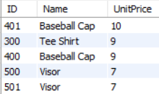
Single Row Subquery - Example
The following single-row subquery calculates the average price of the products in the Products table:
Syntax
SELECT ID, Name, UnitPrice FROM Products
WHERE UnitPrice < ( SELECT AVG( UnitPrice ) FROM Products )
ORDER BY UnitPrice DESC;
Output:
The average is then passed to the WHERE clause of the outer query. The outer query returns the ID, Name, and UnitPrice of all products that are less expensive than the average

Slide 61
Multiple Row Subquery
Multiple-row subqueries are nested queries that can return more than one row of results to the parent query
Multiple-row subqueries are used most commonly in WHERE and HAVING clauses
Since it returns multiple rows, it must be handled by set comparison operators (IN, ALL, ANY)
ANY operator compares a specified value to each value returned by the subquery while ALL compares a value to every value returned by a subquery

Slide 62
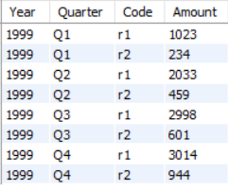
Multiple Row Subquery - Example
The FinancialCodes table is a table holding the different codes for financial data and their meaning. To list the revenue items from the FinancialData table, execute the following query:
Syntax
SELECT * FROM FinancialData WHERE Code IN (SELECT Code FROM FinancialCodes WHERE type = 'revenue' );
Output:

Slide 63
Multiple Row Subquery - Example
The ANY and ALL keywords can be used in a similar manner. For example, the following query returns the same results as the previous query, but uses the ANY keyword:
Syntax
SELECT * FROM FinancialData WHERE FinancialData.Code = ANY (SELECT FinancialCodes.Code FROM FinancialCodes WHERE type = 'revenue');
Output:

Slide 64
While the =ANY condition is identical to the IN condition, ANY can also be used with inequalities such as < or > to give more flexible use of subqueries

Slide 65

Replace ANY with IN and compare the results: Few record gets filtered and the meaning of the result gets changed

Slide 66
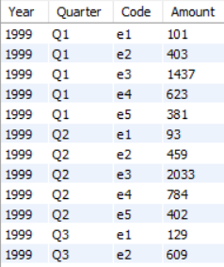
Multiple Row Subquery - Example
The ALL keyword is similar to the word ANY. For example, the following query lists financial data that is not revenue:
Syntax
SELECT * FROM FinancialData WHERE FinancialData.Code <> ALL (SELECT FinancialCodes.Code FROM FinancialCodes WHERE type = 'revenue' );
Output:

Slide 67
Multiple Row Subquery - Example
The result from the previous query is equivalent to the following query using
NOT IN:
Syntax
SELECT * FROM FinancialData WHERE FinancialData.Code NOT IN (SELECT FinancialCodes.Code FROM FinancialCodes WHERE type = 'revenue' );
Output:

Slide 68
Correlated Subquery
A subquery can contain a reference to an object defined in a parent statement. This is called an outer reference
A subquery that contains an outer reference is called a correlated subquery
Correlated subqueries cannot be evaluated independently of the outer query because the subquery uses the values of the parent statement
That is, the subquery is performed for each row in the parent statement
So, results of the subquery are dependent upon the active row being evaluated in the parent statement

Slide 69

Correlated Subquery - Example
The subquery in the statement below returns a value dependent upon the active row in the Products table:
Syntax
SELECT Name, Description FROM Products WHERE
Quantity > (SELECT AVG( Quantity ) FROM SalesOrderItems WHERE Products.ID=SalesOrderItems.ProductID );
Output:

Slide 70
Correlated Subquery - Example
In the example, the Products.ID column in the subquery is the outer reference
The query extracts the names and descriptions of the products whose in-stock quantities are greater than the average ordered quantity of that product — specifically, the product being tested by the WHERE clause in the main query
The subquery does this by scanning the SalesOrderItems table
The Products.ID column in the WHERE clause of the subquery refers to a column in the table named in the FROM clause of the main query—not the subquery
As the database server moves through each row of the Products table, it uses the ID value of the current row when it evaluates the WHERE clause of the subquery

Slide 71
Uncorrelated Subquery
While the =ANY condition is identical to the IN condition, ANY can also be used with inequalities such as < or > to give more flexible use of subqueries. A subquery that does not contain references to objects in a parent statement is called an uncorrelated subquery
In the example in the next, the subquery calculates exactly one value: the average quantity from the SalesOrderItems table

Slide 72
Uncorrelated Subquery - Example
Syntax
SELECT * FROM Products WHERE Quantity < 2 * (SELECT AVG( Quantity )
FROM SalesOrderItems );
Output:
In evaluating the query, the database server computes this value once, and compares each value in the Quantity field of the Products table to it to determine whether to select the corresponding row.

Slide 73
Nested Subquery
A nested subquery is a subquery nested within another subquery
There is no limit to the level of subquery nesting you can define
However, queries with three or more levels take considerably longer to run than do smaller queries.

Slide 74

Nested Subquery - Example
The following example uses nested subqueries to determine the order IDs and line IDs of those orders shipped on the same day when any item in the fees department was ordered:
Syntax
SELECT * FROM SalesOrderItems WHERE ShipDate = ANY
(SELECT OrderDate FROM SalesOrders WHERE FinancialCode IN
(SELECT Code FROM FinancialCodes WHERE Description = 'Fees' ) );
Output:

Slide 75
Nested Subquery
In this example, the innermost subquery produces a column of financial codes whose descriptions are "Fees"
The next subquery finds the order dates of the items whose codes match one of the codes selected in the innermost subquery
Finally, the outermost query finds the order IDs and line IDs of the orders shipped on one of the dates found in the subquery

Slide 76
MYSQL executes the low level subquery first and pass its intermediate result to its next immediate subquery.
Here in Eg, Subquery-C is executed first and pass its result to Subquery-B, and so on

Slide 77
Subqueries in the WHERE Clause
Subqueries in the WHERE clause work as part of the row selection process
You use a subquery in the WHERE clause when the criteria you use to select rows depend on the results of another table

Slide 78

Subqueries in the WHERE Clause - Example
Find the products whose in-stock quantities are less than double the average ordered quantity
Syntax
SELECT Name, Description FROM Products WHERE
Quantity < 2 * (SELECT AVG( Quantity )FROM SalesOrderItems);
Output:
This is a two-step query:
first, find the average number of items requested per order; and then
find which products in stock number less than double that quantity

Slide 79
Multi-row operators perform on multiple rows returned by subquery
Single-row operators perform on single row returned by subquery

Slide 80
Subqueries in the HAVING Clause
Although you usually use subqueries as search conditions in the WHERE clause, sometimes you can also use them in the HAVING clause of a query
When a subquery appears in the HAVING clause, like any expression in the HAVING clause, it is used as part of the row group selection

Slide 81
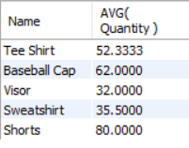
Subqueries in the HAVING Clause - Example
Here is a request that lends itself naturally to a query with a subquery in the HAVING clause: "Which products' average in-stock quantity is more than double the average number of each item ordered per customer?"
Syntax
SELECT Name, AVG(Quantity)FROM Products GROUP BY Name
HAVING AVG(Quantity) > 2* (SELECT AVG( Quantity )FROM SalesOrderItems );
Output:

Slide 82
Subqueries in the HAVING Clause - Example
The query executes as follows:
The subquery calculates the average quantity of items in the SalesOrderItems table
The main query then goes through the Products table, calculating the average quantity per product, grouping by product name
The HAVING clause then checks if each average quantity is more than double the quantity found by the subquery. If so, the main query returns that row group; otherwise, it doesn't
The SELECT clause produces one summary row for each group, displaying the name of each product and its in-stock average quantity

Slide 83



Thank you
Mumbai | Bangalore | Pune | Chennai | Jaipur
ACCREDITED TRAINING PARTNER:

