Slide 1

Structured Query Language (SQL)
Advanced SQL Concepts – Part I

Slide 2
Agenda
In this session, you will learn about:
Date functions
Union, Union All & Intersect Operators
Joins

Slide 3

Date Functions

Slide 4

NOW()
Use Now() function to get the current date and time
Syntax
SELECT NOW();

Slide 5

DATE(NOW())
Use Date() function to get only the date part of the DATETIME
Syntax
SELECT DATE(NOW());

Slide 6

CURDATE()
Use CURDATE() function to get the current system date
Syntax
SELECT CURDATE();

Slide 7

DATE_FORMAT()
Get the date as mm/dd/yy format
Syntax
SELECT DATE_FORMAT(CURDATE(), '%m/%d/%Y') today;

Slide 8
How to query date?
Create a table
Syntax
CREATE TABLE SalesOrders (
ID INTEGER,
CustomerID Integer,
OrderDate Date,
FinancialCode Char( 2 ),
Region Char( 7 ),
SalesRepresentative Integer);

Slide 9
How to query date?
Insert the values
Syntax
INSERT INTO SalesOrders VALUES(2001, 101, '2000-03-16', 'r1', 'Eastern', 299);
INSERT INTO SalesOrders VALUES( 2002, 102, '2000-03-17', 'r2', 'Western', 399);
INSERT INTO SalesOrders VALUES (2003, 103, '2000-03-18', 'r3', 'Western', 499);
INSERT INTO SalesOrders VALUES (2004, 104, '2001-01-02', 'y1', 'Eastern', 599);
INSERT INTO SalesOrders VALUES (2005, 105, '2001-01-03', 'y2', 'Western', 699);
INSERT INTO SalesOrders VALUES (2006, 106, '2001-01-04', 'y3', 'Eastern', 799);

Slide 10

How to query date?
Find orders between 2000-03-15 and 2000-03-20
Syntax
SELECT *
FROM salesorders
where OrderDate between '2000-03-15' and '2000-03-20';

Slide 11
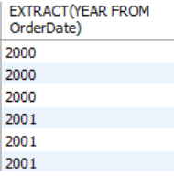
How to query date?
Extract year from the date values
Syntax
SELECT EXTRACT(YEAR FROM OrderDate) FROM SalesOrders;

Slide 12
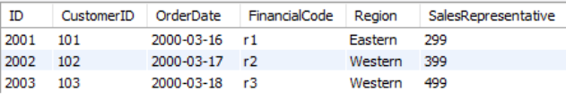
How to query date?
Select the orders from the year 2000
Syntax
SELECT * FROM salesorders WHERE YEAR(OrderDate) = 2000;

Slide 13
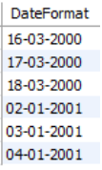
How to query date?
Format the date to ‘dd-mm-yyyy’
Syntax
SELECT DATE_FORMAT(STR_TO_DATE(OrderDate,'%Y-%m-%d'), '%d-%m-%Y') as DateFormat from salesorders;

Slide 14
Union, Union All & Intersect Operators

Slide 15
Union Operator
Union operator allows us to combine two or more result sets of queries into a single result set
Syntax
SELECT * FROM table1
UNION
SELECT * FROM table2;

Slide 16
Matching the Select Statement
Syntax
SELECT Street, GivenName FROM event_a
UNION
SELECT GivenName, Surname, CustomerID FROM event_b;
Error Code: 1222. The used SELECT statements have a different number of columns
0.000 sec

Slide 17
Union Operator
Basics rules to follow:
The number and the orders of the column that appear in all SELECT statement must be the equal
The data types of the columns must be the equal
Note: By default, the union operator removes duplicate rows

Slide 18
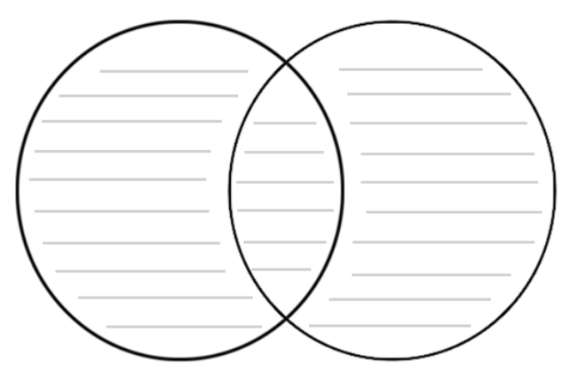
Union Operator
The union operator will eliminate the duplicate rows from the result table

Slide 19
Union Operator
Output
ID
1
2
3
ID
2
3
4
ID
1
2
3
4
The rows with value 2 and 3 are duplicates, the union operator removed it and kept only distinct ones

Slide 20
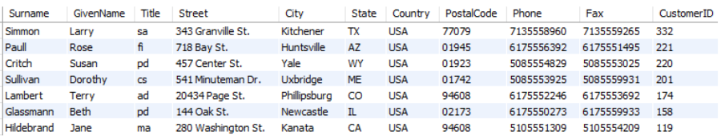
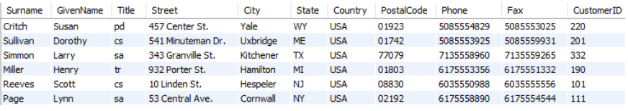
Union Operator
Consider the following two tables:
Table1: Event_A table is as follows:
Following are the customers participated in Event_A
Table2: Event_B table is as follows:
Following are the customers participated in Event_B

Slide 21
Union Operator
Find all the customers that exist in both the events
Syntax
SELECT * FROM event_a
UNION
SELECT * FROM event_b;

Slide 22
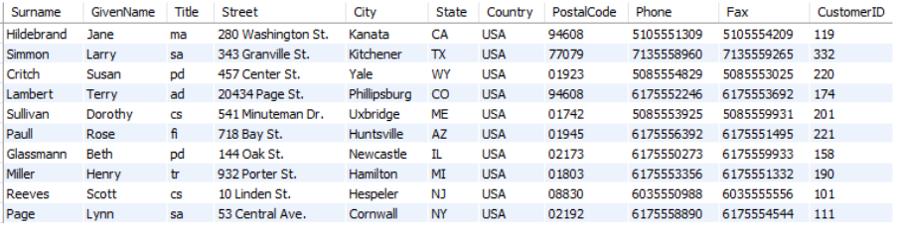
Union Operator
Output:

Slide 23
Union All Operator
Union all operator allows us to combine two or more result sets of queries into a single result set without removal of any duplicates

Slide 24
Union All Operator
Output
ID
1
2
3
ID
2
3
4
ID
1
2
3
2
3
4
If we use the union all explicitly, the duplicate rows, if available remain in the result

Slide 25
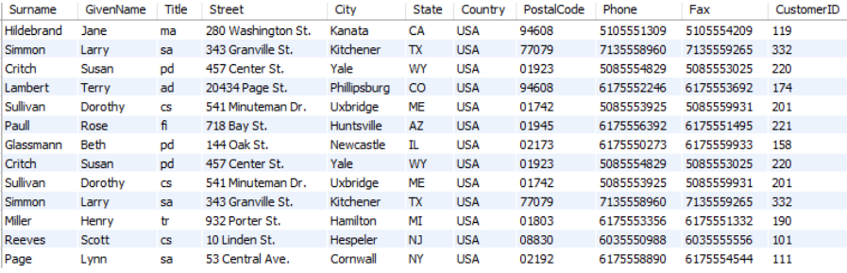
Union All Operator
Output:

Slide 26

MySQL DOES NOT support INTERSECT operator. However, you can emulate the INTERSECT using IN operator.

Slide 27
Intersect Operator
The Intersect operator is a set of operator that returns only distinct rows of two queries or more queries
Syntax
SELECT * FROM table1
WHERE table1.column_name IN (SELECT table2.column_name FROM table2);
Since we can’t use intersect operator in MySQL, we use the IN operator to simulate the intersect query

Slide 28
Intersect Operator
Basics rules to follow:
The number and the orders of the column that appear in all SELECT statement must be the equal
The data types of the corresponding columns must be compatible

Slide 29

Intersect Operator
It returns the elements which are common from both the sets

Slide 30
Intersect Operator
Output
ID
1
2
3
ID
2
3
4
ID
2
3
The intersect operator returns the intersection between two sets

Slide 31
Intersect Operator
Find the common customers that exist in both the events
Syntax
SELECT * FROM event_a
WHERE event_a.CustomerID IN (SELECT event_b.CustomerID FROM event_b);

Slide 32
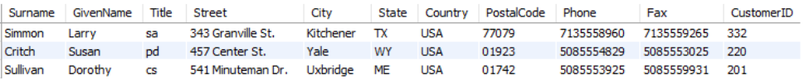
Intersect Operator
Output:

Slide 33
Joins

Slide 34
Joins Introduction
#1
MySQL Joins allow us to combine data from two or more tables, in the same table, that also helps us understand the relationship among those tables
#2
These relations are established or identified with the help of key attributes
#3
In other words, Facts and Dimensional tables are joined using Key columns to produce an output of records with more meaningful relationships between each data fields

Slide 35
Fact table consists of real time data, usually static in nature, and do not change frequently.
E.g Customer data is single and do not change all the time
Dimension tables consists of data that is changed more frequently than the fact tables.
E.g : Transaction data which is frequently updated

Slide 36
Joins Introduction
For Example: Consider a table Customer(Name, Age, Address, Telephone). Consider another table Account_Details that contains details of different types of bank accounts held by a customer
Joins will help you present all the details of your customers at once
It prevents the need to do a repetition of the data and present it more systematically

Slide 37

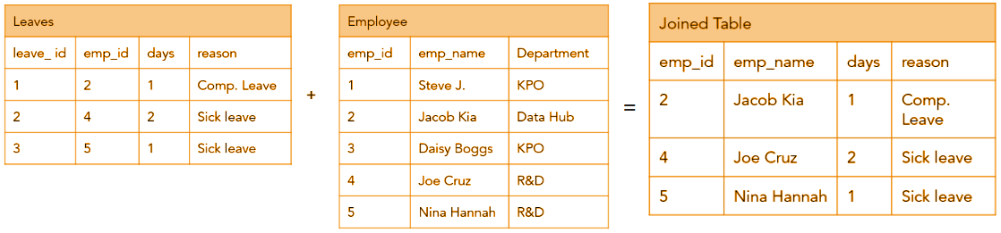
With JOINs, queries avoids a lot of repetition of the data and able to present it in a more systematic way

Slide 38
Joins Introduction
Following JOIN clauses are commonly used by all:
Inner Join
Left Join
Right Join
Full Outer Join
Self Join

Slide 39
Create Customer Table
Create a customer table with sample data having customer details only
Create Table:
Syntax
CREATE TABLE Customer (cust_id INT ,
cust_name VARCHAR(20),
contact_name VARCHAR(20),
city VARCHAR(10),
telephone VARCHAR(10));
Insert Records:
Syntax
INSERT INTO Customer VALUES (101, "Oliver", "Joy", "New York", 2016776708),
(102,"George", "George", "Chicago" , "209761700"),
(103,"Harry", "Harry", "Texas" , "2097617866"),
(104,"Jack", "Noah", "California", "2097627999");

Slide 40
Create Orders Table
Create a orders table with sample data having order details only
Create Table:
Syntax
CREATE TABLE Orders ( cust_id INT ,
order_id INT ,
order_date varchar(20),
shipper_id varchar(20));
Insert Records:
Syntax
INSERT INTO Orders VALUES (101, 4501, '12/03/1997', 'A111' ),
(102, 4502, '13/03/1997', 'A112'),
(103, 4503, '14/03/1997', 'A113'),
(105, 4505, '16/03/1997', 'A115'),
(106, 4506, '17/03/1997', 'A116');

Slide 41
Alias for Tables
Tables aliases are useful when you are selecting common columns from both the tables that arises ambiguity errors
Aliases are given for tables as well as for individual columns
It is used to make column names more readable
Example:
A table is created in the database as Customer
It can be represented as Customer "cust" when representing in the SQL query
Aliases are useful when you want to write table name in a shortcut form and avoid mess in the large queries. And it is easy for debugging

Slide 42
Alias for Tables
Use the "Customer" and "Orders" tables, and give them the table aliases of "cust" and "ord" respectively
Syntax
SELECT cust.cust_id, cust.cust_name, cust.contact_name, cust.city, cust. telephone,
ord.cust_id, ord.order_id, ord.order_date, ord.shipper_id
FROM Customer AS cust, Orders AS ord;

Slide 43
While table aliases simplifies the names of tables, column alias will simplify the SELECT query columns with more meaningful representation

Slide 44
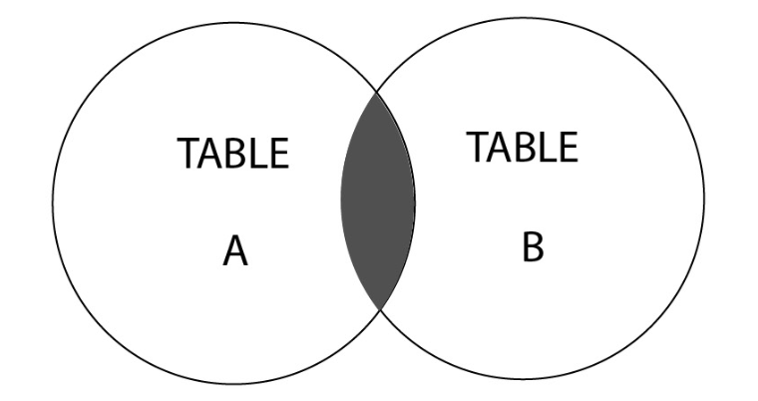
What is an Inner Join?
The Inner Join is the default type of join that is used to select data with matching values in both tables
It can be represented with the following Venn diagram:
The Inner Join represents the highlighted section, which is the intersection between these two tables

Slide 45
Inner Join - Syntax
The INNER JOIN keyword selects observations that have matching values in both tables
Syntax
SELECT column_name(s) FROM table1 INNER JOIN table2 ON table1.column_name = table2.column_name;

Slide 46
Inner Join - Example
If you want to know the customers and their order details by joining Customer and Orders table using cust_id – common key column
Syntax
SELECT cust.cust_id,
cust.cust_name ,
cust.contact_name,
cust.telephone,
ord.order_date,
ord.shipper_id
FROM Customer as cust
INNER JOIN Orders as ord
ON cust.cust_id = ord.cust_id;
INNER JOIN ensures there are matching records in both tables based on cust_id, and can retrieve all the fields from Customer and Orders tables.

Slide 47

Inner Join - Example
Output:
The output of this query consists of records if and only if cust_id exists in both the tables.

Slide 48
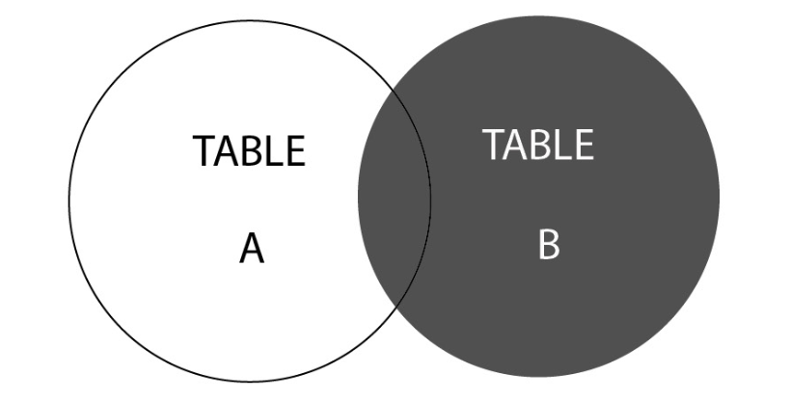
What is a Right Join?
Right Join is used when you want to select records that are available in the second table and matching records in the first one
This can be visualized with the following Venn diagram:
As we can see, the Right Join represents the highlighted section, that is, TABLE B, and the intersected section of TABLE A.

Slide 49
Right Join -Syntax
Syntax
SELECT [Column List]
FROM [Table 1] RIGHT JOIN [Table 2]
ON [Table 1 Column Name] = [Table 2 Column Name]
WHERE [Condition]

Slide 50
Right Join - Example
Syntax
SELECT cust.cust_id,
cust.contact_name ,
cust.telephone,
ord.order_date,
ord.shipper_id
FROM Customer cust
RIGHT JOIN Orders ord
ON cust.cust_id=ord.cust_id;
RIGHT JOIN ensures to extract matching records in both tables based on cust_id. And for unmatched records, it pulls all the records from right table i.e. Orders, and shows NULL values for fields in the left table.

Slide 51
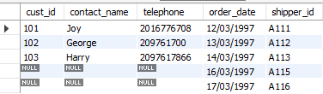
Right Join - Example
Output:

Slide 52
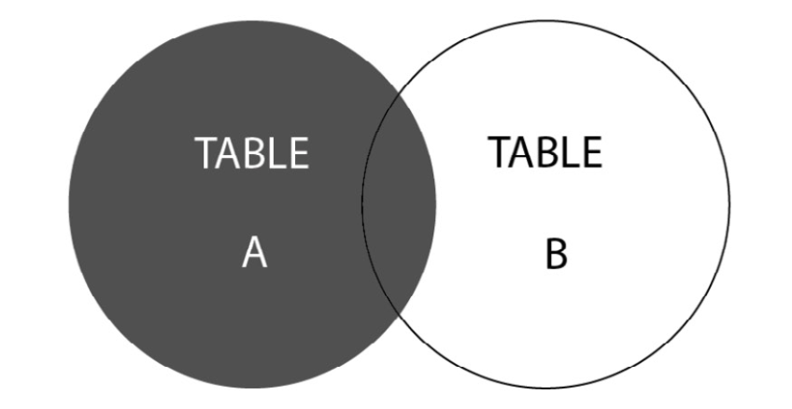
What is a Left Join?
The Left Join is used when you want to select records that are available in the first table and match records in the second one
It can be represented with the following Venn diagram:
The Left Join represents the highlighted section from TABLE A and the intersected section from TABLE B

Slide 53
Left Join -Syntax
Syntax
SELECT [Column List]
FROM [Table 1] LEFT JOIN [Table 2]
ON [Table 1 Column Name] = [Table 2 Column Name]
WHERE [Condition]

Slide 54
Left Join - Example
Syntax
LEFT JOIN ensures to extract matching records in both tables based on cust_id. And for unmatched records, it pulls all the records from left table i.e. Customer, and shows NULL values for fields in the right table: Orders as there are no records.
SELECT cust.cust_id,
cust.contact_name ,
cust.telephone,
ord.order_date,
ord.shipper_id
FROM Customer cust
LEFT JOIN Orders ord
ON cust.cust_id=ord.cust_id;

Slide 55

Right Join - Example
Output:

Slide 56
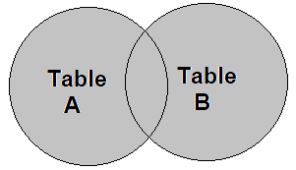
What is a Full Outer Join?
Full outer Joins helps to retrieve combination of Left and Right join results
The Full Outer Join keyword returns all records when there is a match in left (table1) or right (table2) table records
This can be visualized with the following Venn diagram:

Slide 57
Full Outer Join - Syntax
You don't have FULL JOINS on MySQL, but you can sure emulate them
Syntax
SELECT cust.cust_id, cust.contact_name,
ord.order_date, ord.shipper_id
FROM Customer cust
LEFT JOIN Orders ord
ON cust.cust_id=ord.cust_id
UNION
SELECT cust.cust_id, cust.contact_name ,
ord.order_date, ord.shipper_id
FROM Customer cust
RIGHT JOIN Orders ord
ON cust.cust_id=ord.cust_id;
FULL OUTER JOIN combines LEFT and RIGHT JOINS to retrieve valid data only and leave other invalid fields blank
The purpose of FULL Join is to avoid invalid data fields to show as blank

Slide 58
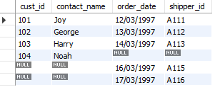
Full Outer Join - Example
Output:

Slide 59
Self-Join - Create Employee Table
Create an employee table with sample data having employee details only
Create Table:
Syntax
CREATE TABLE employee (Name VARCHAR(20),
Age int,
City VARCHAR(20),
Salary int);
Insert Records:
Syntax
INSERT INTO employee (Name, Age, City, Salary)
Values ('Allex', 34, 'New York', 50000),
('Mia', 25, 'Texas', 30000),
('Sara', 30, 'California', 67000),
('Allen', 29, 'New York', 45000),
('John',45, 'Texas', 55000);

Slide 60
Self Join - Example
SELF JOIN is usually applied when we see meaningful data in a same table
It means joining the same table to itself for multiple times
Syntax
SELECT DISTINCT b.Name, b.Age, b.City, b.Salary
FROM emp AS a,
emp AS b
WHERE a.City = b.City
and a.Salary > 50000;
Use self join to get employees from the same city and having a salary higher than 50000

Slide 61

Self Join - Example
Output:

Slide 62



Thank you
Mumbai | Bangalore | Pune | Chennai | Jaipur
ACCREDITED TRAINING PARTNER:

