Slide 1
Streaming Architecture
Xun Liu 10-27-2018

Slide 2
Agenda
Story: Build Netflix
Streaming tool: Kafka
What we could do?

Slide 3
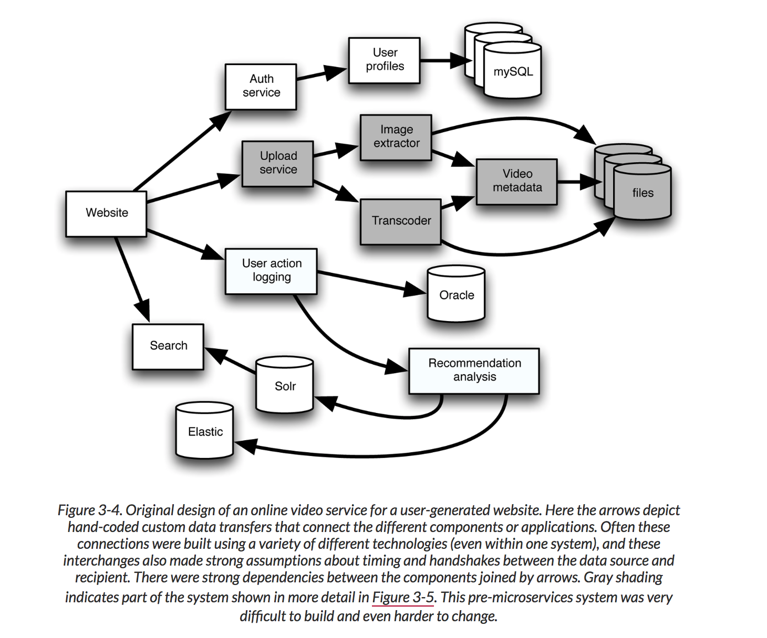
Build netflix
Problems of grey boxes
Multiple techniques for arrow between different components
Dependency between two components

Slide 4
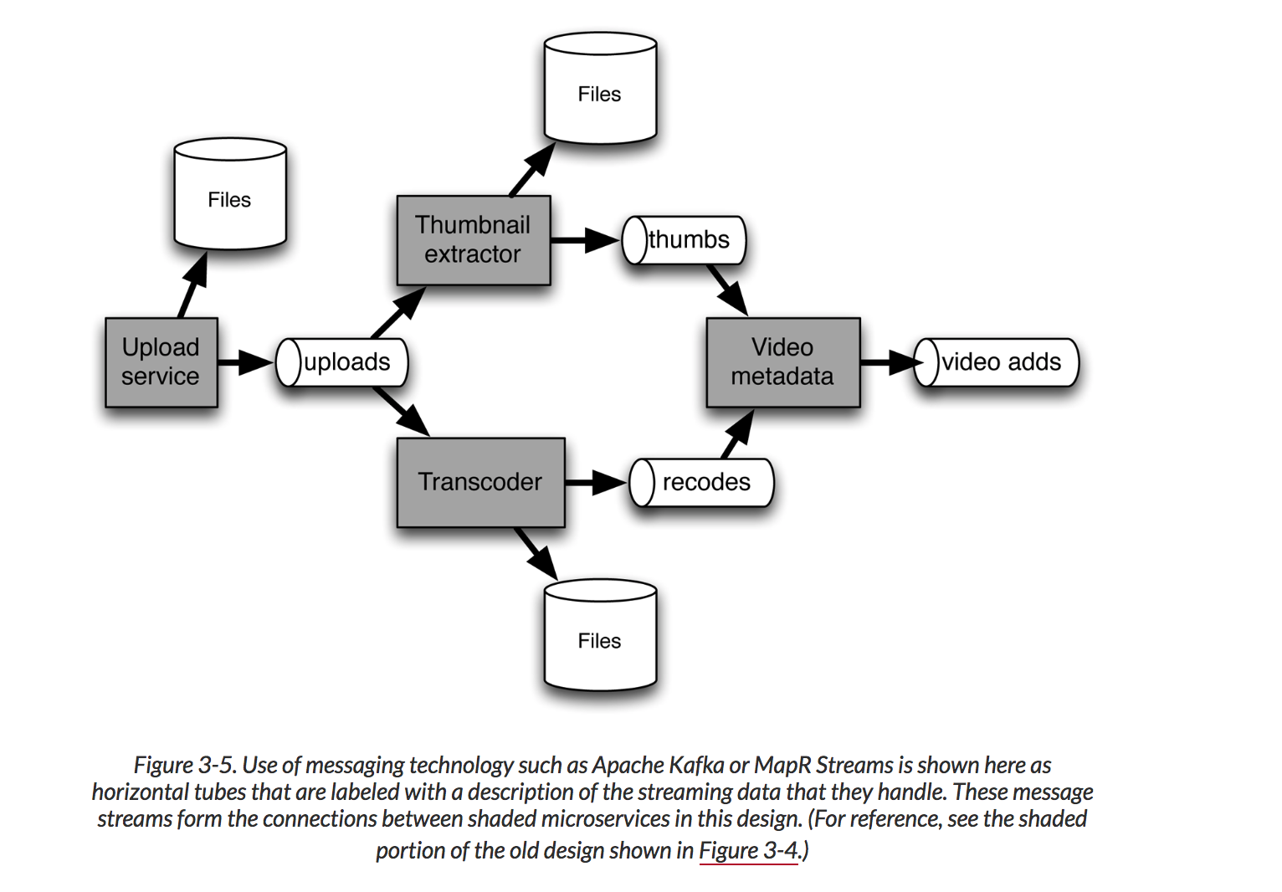
Message technology
Remove unnecessary dependency and complexity

Slide 5
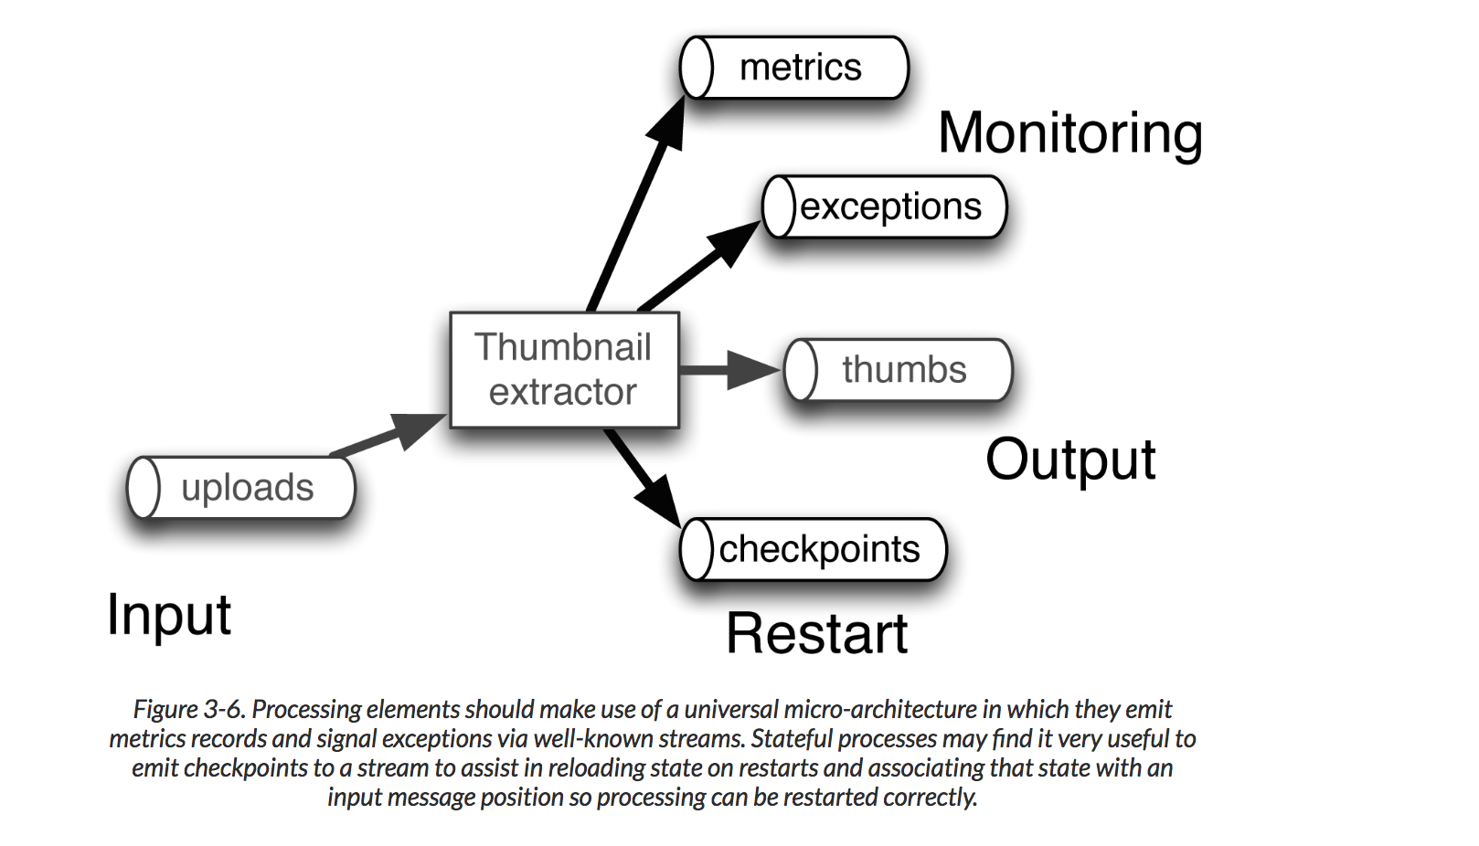
More requirements for Thumbnail

Slide 6
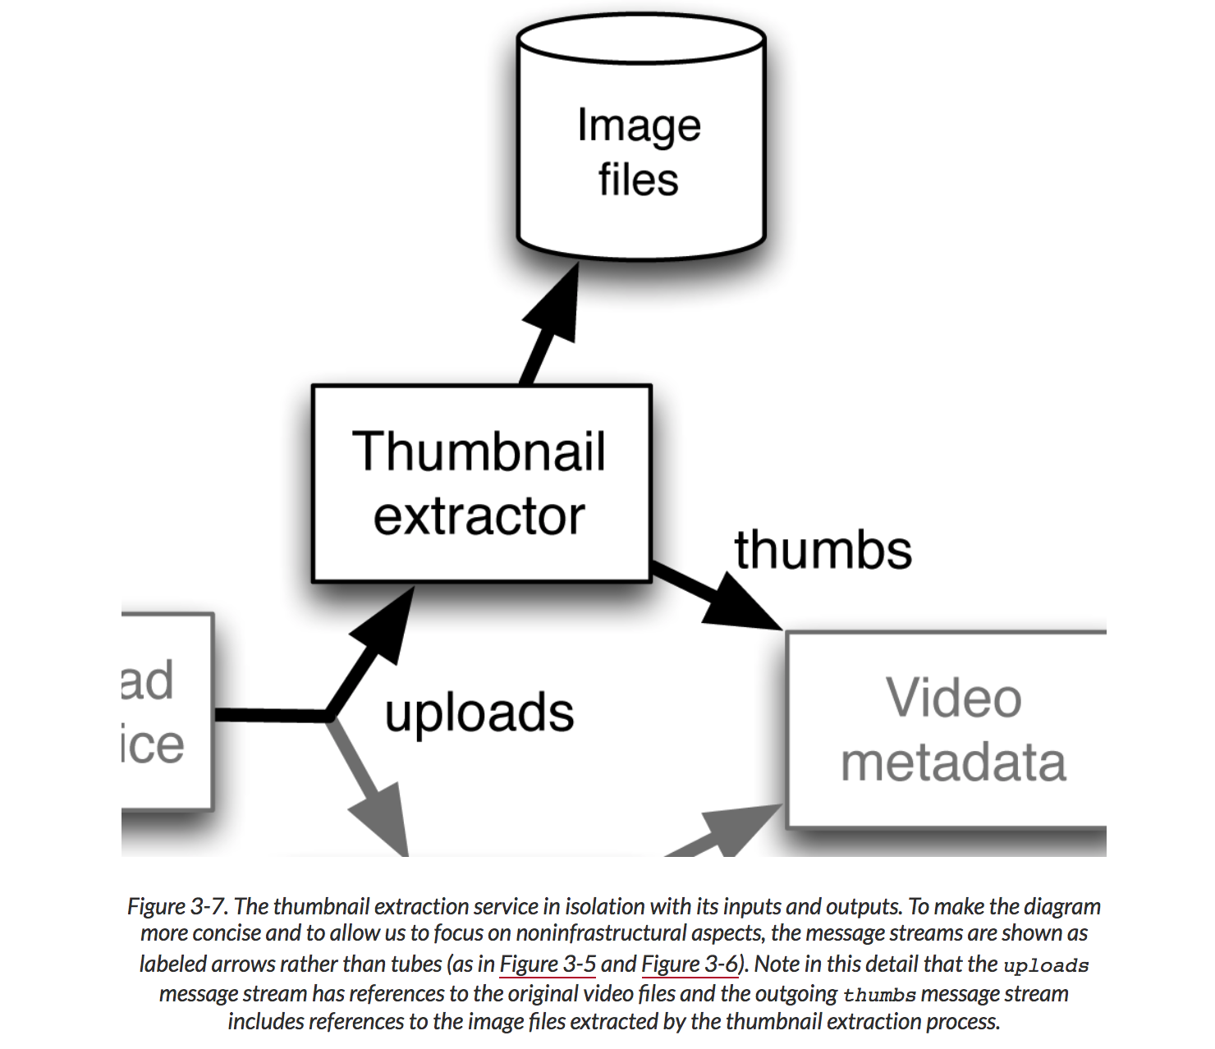
More Adjustment for Thumbnail

Slide 7
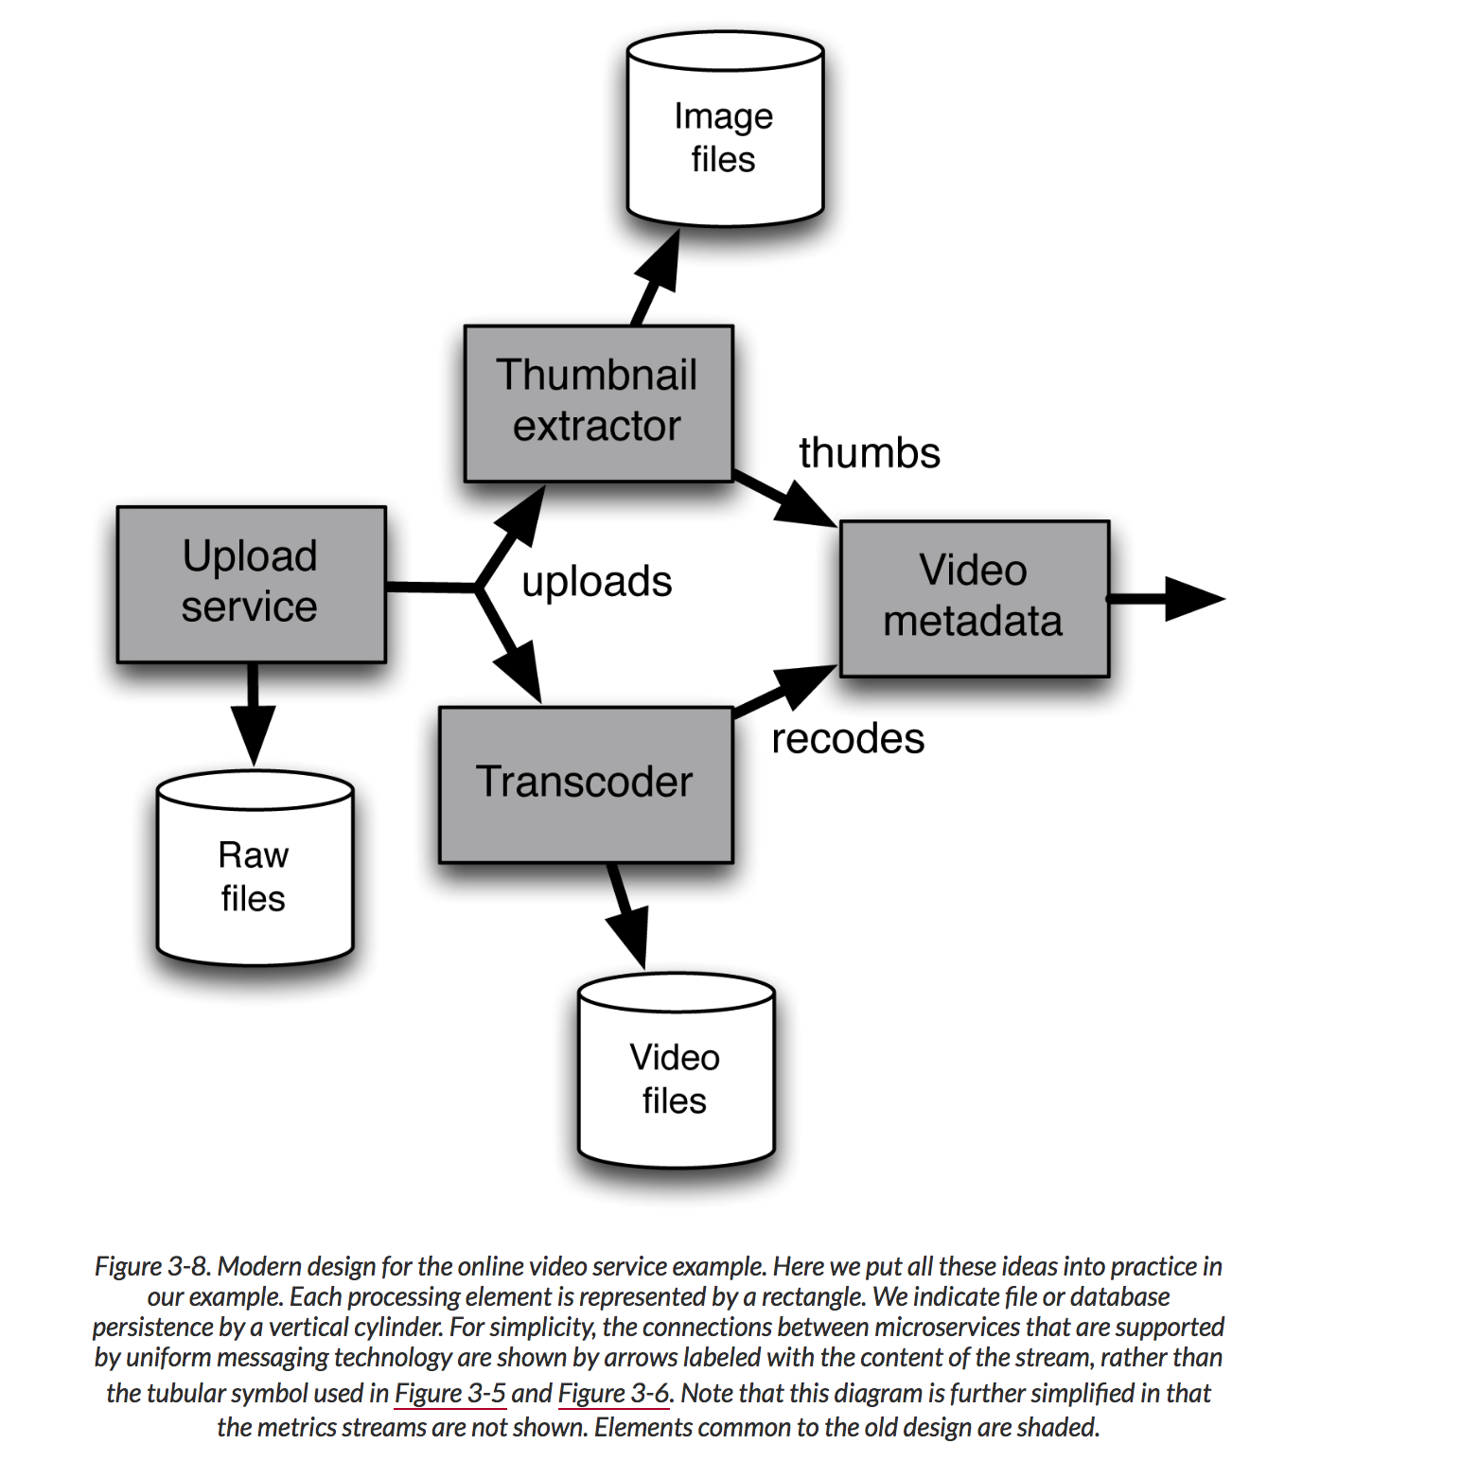
Final

Slide 8
Final
Universal microservices architecture
Maintaining independence of microservices by using lightweight communications between services via a uniform message-passing technology (such as Apache Kafka or MapR Streams) that is durable and high performance
Use of distributed files, NoSQL databases, and snapshot

Slide 9
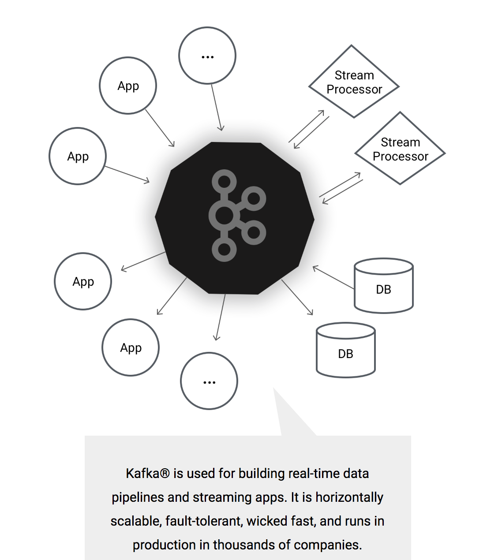
What is Kafka

Slide 10
Why Kafka
From Jay Kreps
#1. Transporting data between system
#2. Core of Analytics system
Original problem raised by Jay Kreps: When you use database to analysis data, during analysis time new data come in, how to reflect changes? Tails+Tails + Tails? MessageMQ?

Slide 11
Why Kafka
Message durability(commit log, append only behavior)
Keep message sequence
Designed for large volume of data
One message be consumed by multiple consumer for different purpose
Message be consumed Just once for each topic
Notes:
How Kafka improve transportation between systems
Traditional solution: buffer data in memory, consumer could get it quickly
Problem: lack of durability -> persistent on disk to achieve low latency and high throughput
Richer processing: each message could take different time

Slide 12
Kafka terminology
Message Broker: serve to persist data and handle request from both producer and consumer
Producer client: produce publish
Consumer client: consume subscribe
Topic: partition at message broker layer
when have large and large volume of data could scale up, partition topic
partition: concept of topic, parameters
user specific or generated based on certain pattern

Slide 13
Kafka Scenarios
#1. online data to offline data
Online data like page view/impression, -> offline hadoop system, kafka be consumed by ETL
#2. online data to online pipeline
Emails/news feed
#3. Offline data to online pipeline
Data be generated in offline data wareehouse -> online machine learning

Slide 14
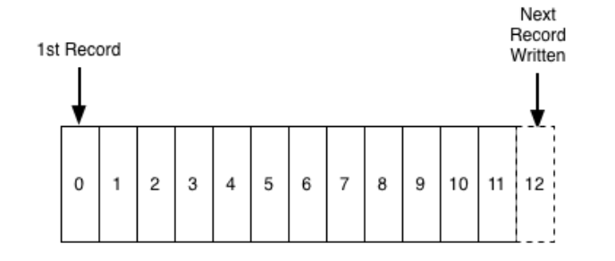
Core of kafka – replicated distribute log
Log is an append-only, totally-ordered sequence of records ordered by time

Slide 15
why log is important
The answer is that logs have a specific purpose: they record what happened and when
The two problems a log solves—ordering changes and distributing data—are even more important in distributed data systems.
One of the beautiful things about this approach is that the time stamps that index the log now act as the clock for the state of the replicas—you can describe each replica by a single number, the timestamp for the maximum log entry it has processed. This timestamp combined with the log uniquely captures the entire state of the replica.

Slide 16
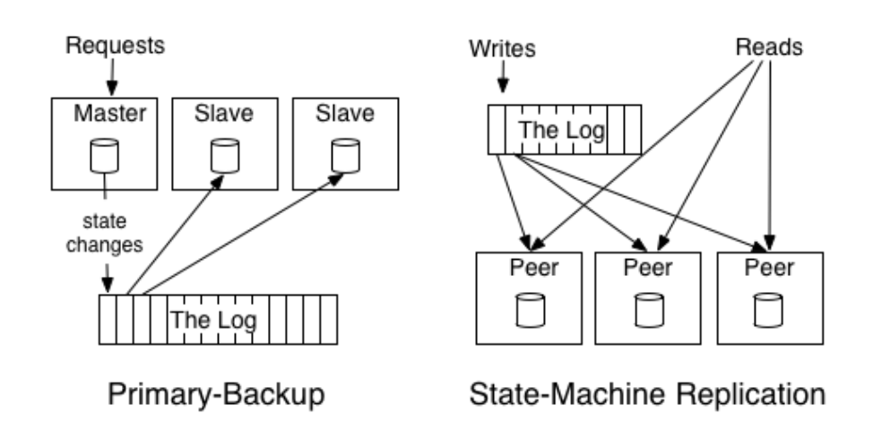
State machine replication
State-Machine-> active active -> The active-active approach might log out the transformations to apply, say "+1", "*2", etc. Each replica would apply these transformations and hence go through the same set of values.
Primary-Backup -> Active-Passive -> a single master execute the transformations and log out the result, say "1", "3", "6", etc.

Slide 17
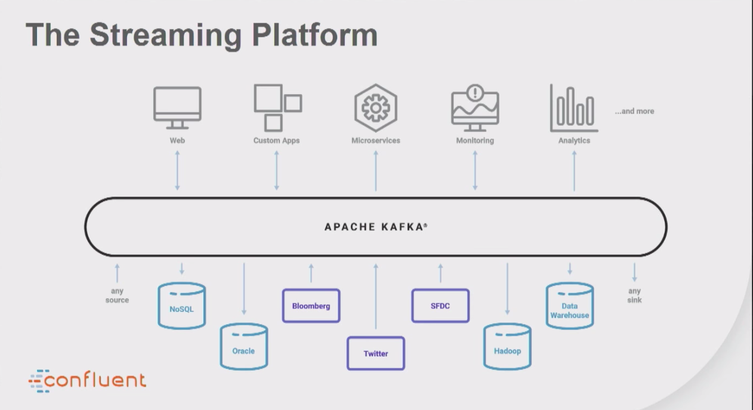

Slide 18
Relation with Telenav
Decouples Data producer with consumer
Log Replay(A/B test, parallel test)
data
Data analytics
User Prob Data
Message Bus(Kafka)
data
A/B test
User Service Requset
Data update
Live traffic generation
Kafka Logs
data
Live data(weather, traffic)
Data preprocessing
data

Slide 19
Reference
Kafka Stream Examples https://github.com/CodeBear801/kafka-streams-examples
Jay Kreps https://engineering.linkedin.com/distributed-systems/log-what-every-software-engineer-should-know-about-real-time-datas-unifying
https://www.confluent.io/blog/stream-data-platform-1

