Slide 1

Empowering Sightless Minds through STEM Education
Notes:
Entered text
1. Who are the users?
Visually impaired individuals, blind institutions, blind NGOs, and visually disabled schools & schemes.
2. What problems are they facing?
3. What alternatives do they have at present?
Alternatives include Braille books, audio books, talkback feature, tactile blocks, and abacus.
4. Why will they take your solutions?
- Tailored Solutions: eDrishti offers specialized resources and curriculum designed specifically for visually impaired individuals, addressing their unique educational needs.
- Accessibility: Our platform leverages emerging technologies to provide accessible learning materials and software-embedded systems, ensuring equitable access to education for the visually impaired.
- Empowerment: By bridging the gap in visually impaired education, eDrishti empowers individuals to gain confidence, unlock opportunities, and pursue higher learning and meaningful employment.
- Impact: Our solution directly addresses a pressing societal issue, with the potential to transform the lives of millions of visually impaired individuals globally, garnering support and adoption from stakeholders and communities alike.
How much would they invest/pay for your offerings?
On average, they would like to pay $2K-$3K for the hardware product.

Slide 2
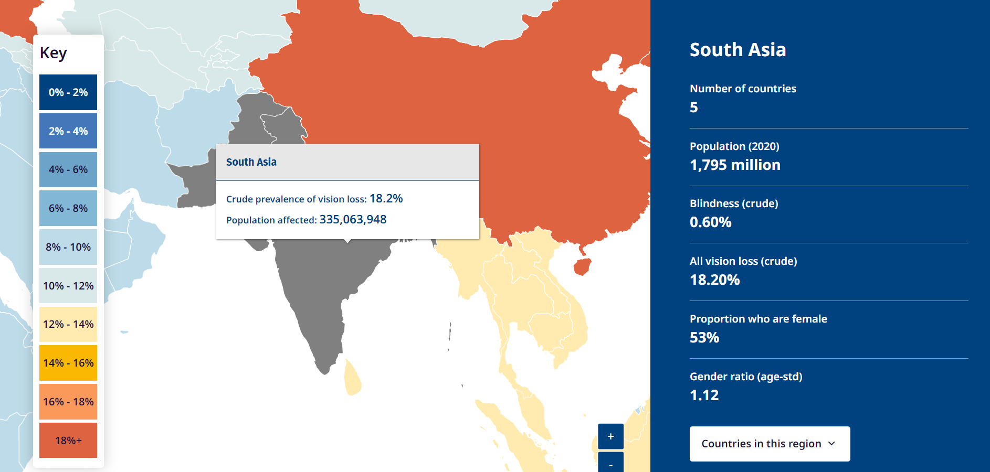

Slide 3
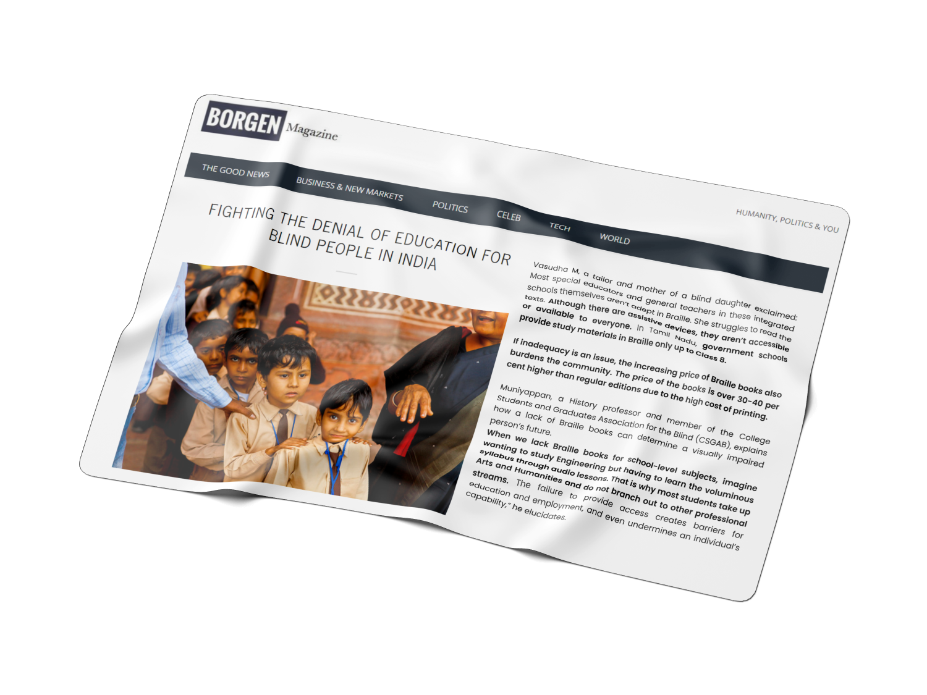
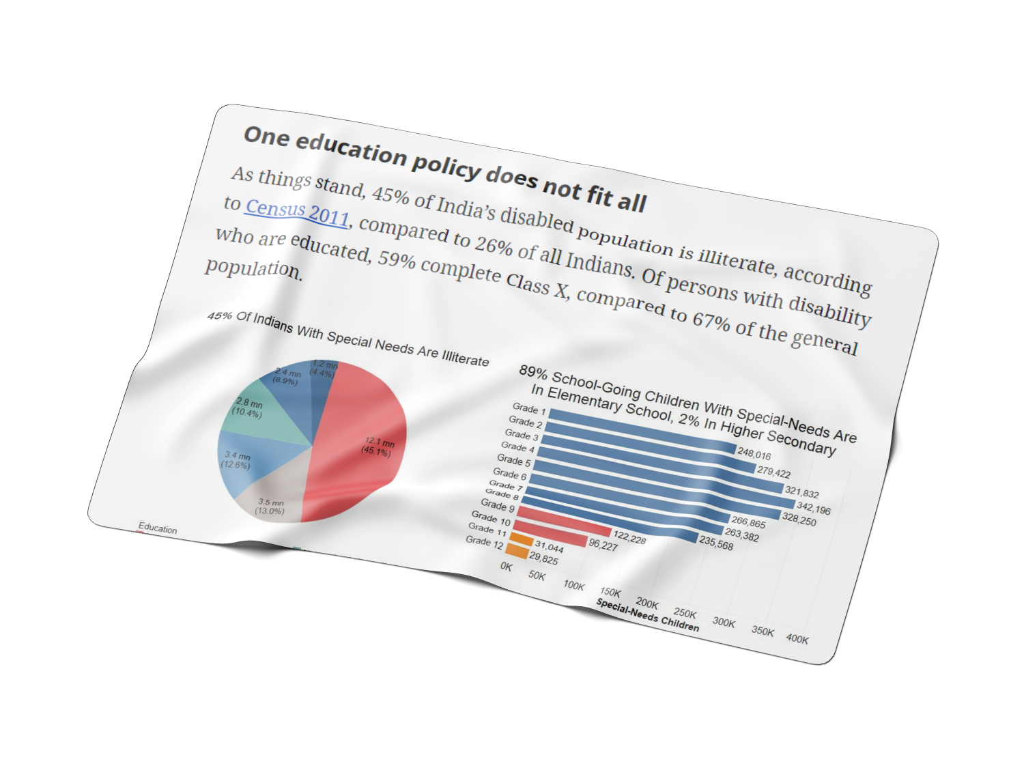
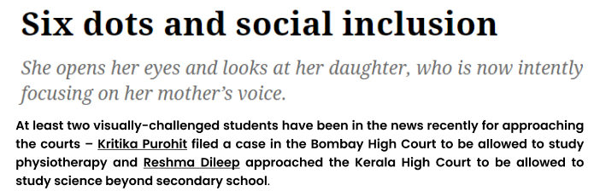


Slide 4
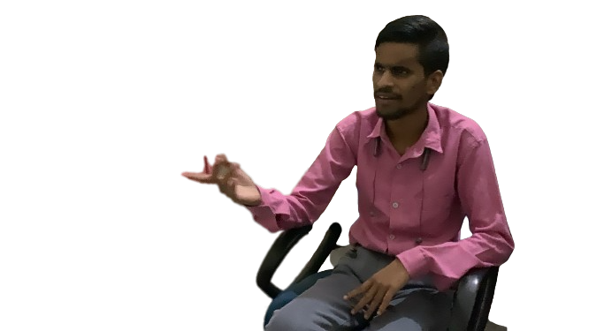
Meet Rajesh Kumar…..
….Currently pursuing Bachelor of Arts student at a private university in Delhi

Slide 5
Problem Statement
Scarce Braille and educational materials for Science and Maths subjects.
High expenses associated with blind education.
Difficulty comprehending Science and Maths concepts presented in Braille.

Slide 6

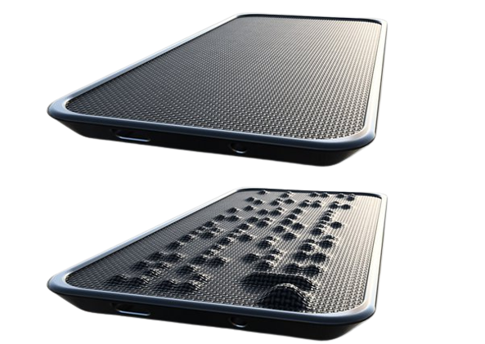

Product We
Offer
Maths
TalkBack Controlled Android Application
Science
Up and down movement of actuators embedded in the hardware
Voice Controlled mobile application
Mobile application is connected to hardware via bluetooth
Hardware device

Slide 7
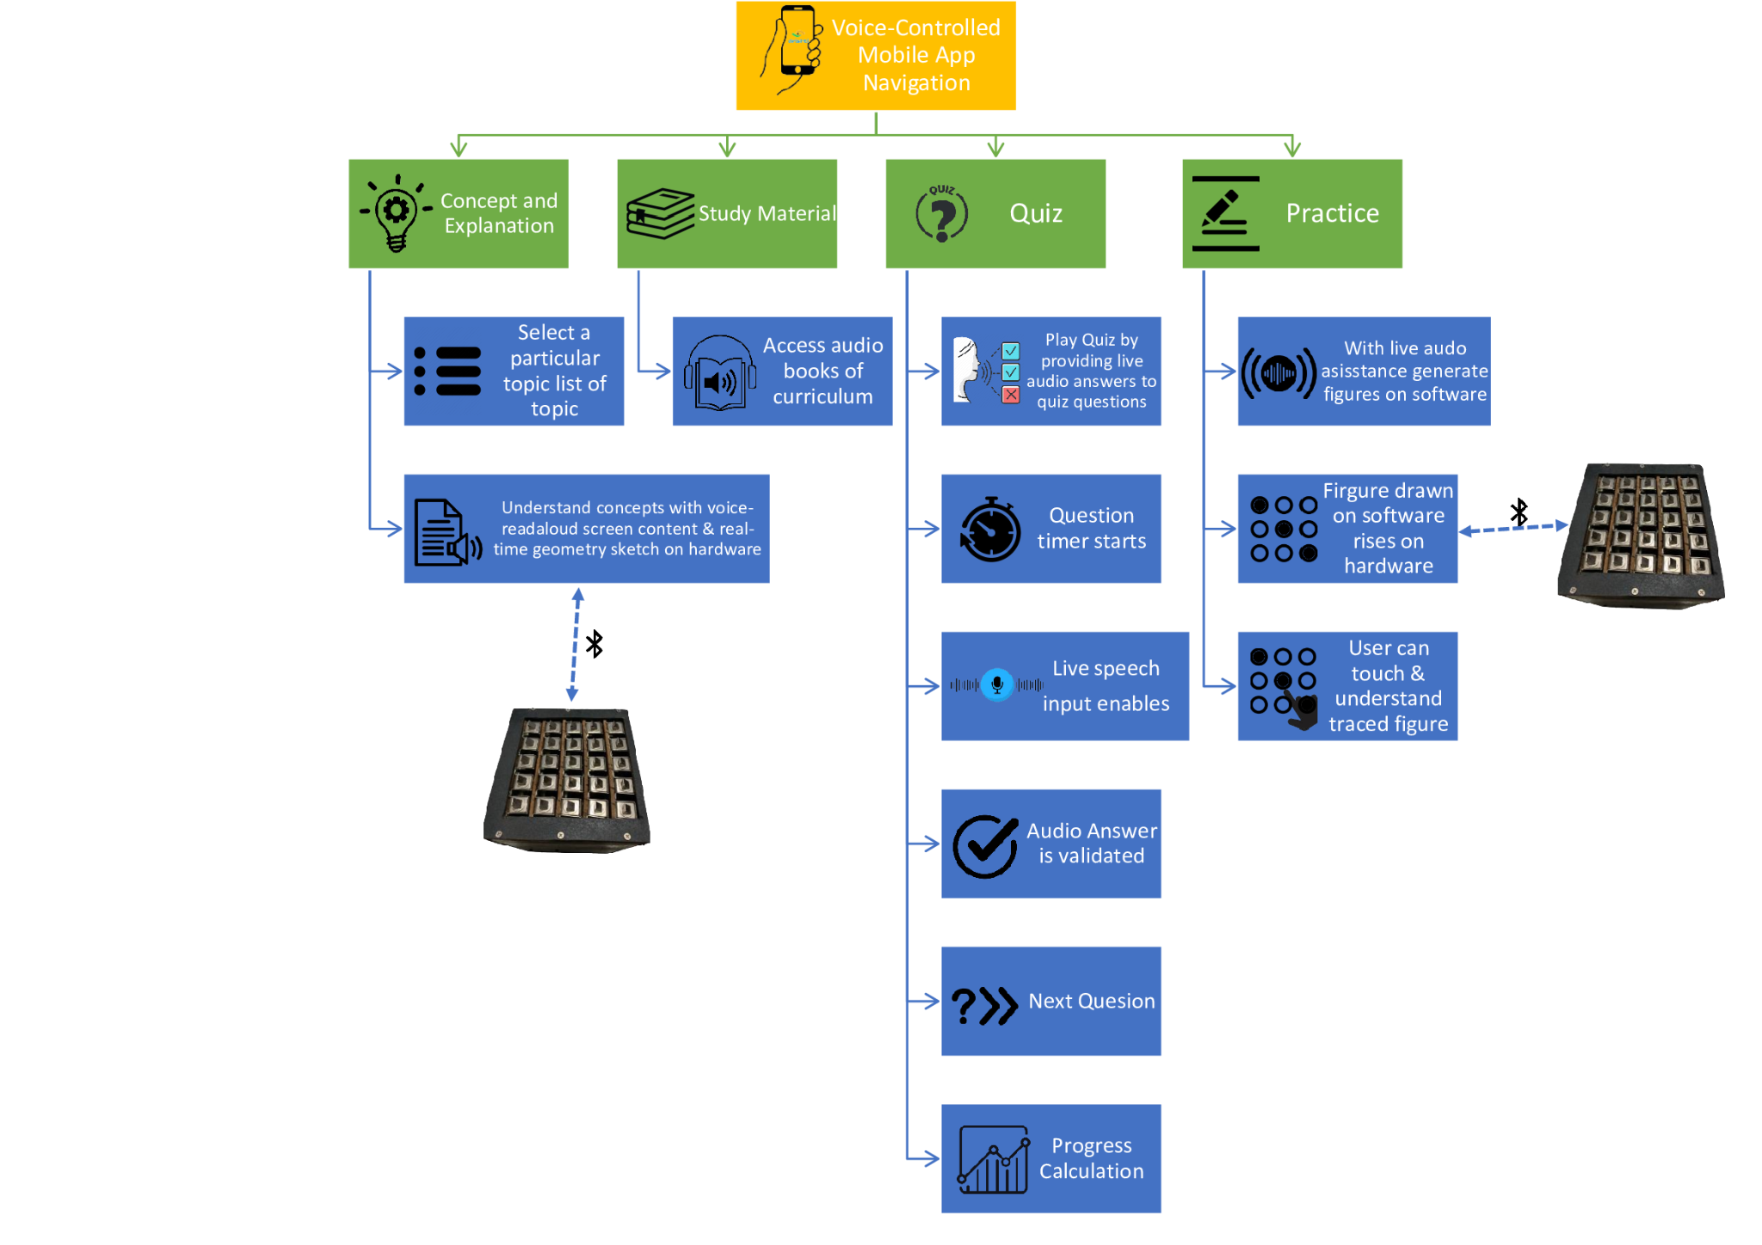
User Journey

Slide 8
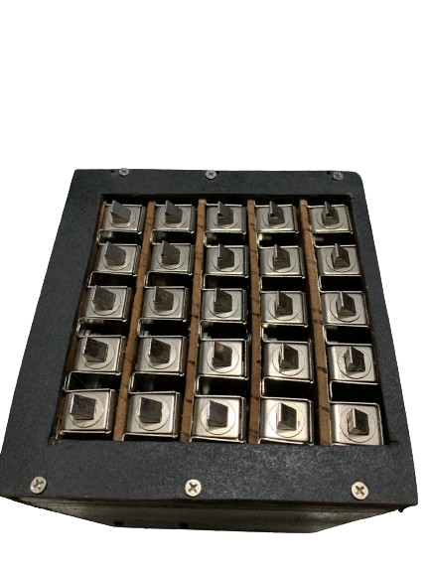
Prototype Demonstration https://drive.google.com/file/d/1-UC3PDsoLnE3-LCY3tzbE3yvJNUTEOFY/view?usp=sharing

Slide 9
User Validation
https://drive.google.com/file/d/16nOzHgPuLTnaP7oWm4qvXDhqz_bucaGH/view?usp=sharing

Slide 10
Market Size
WORLDWIDE VISUALLY IMPAIRED MARKET
: >2.2 Billion
SOM: >4.95 Million
WORLDWIDE BLIND MARKET
TAM: >202 Million
INDIAN VISUALLY IMPAIRED & BLIND MARKET
SAM: >70 Million

Slide 11
Who are the users?
Visually impaired individuals
Blind NGOs
Blind institutions
Visually disabled schools & schemes

Slide 12
Revenue Model
One time hardware cost - INR 10,000 (Prototype)
Software monthly chargers
INR 100 (Basic)
INR 200 (Premium)
Institution Pricing: 10% off for orders of 100+ units

Slide 13
Market Strategy
Forge partnerships with educational institutions, NGOs, government agencies, and assistive technology providers to increase awareness and distribution.
Provide comprehensive training and support programs for users and educators.
Offer tutorials, user guides, workshops, and technical assistance to maximize user proficiency.
1
3
2
4
Utilize online and offline channels, including social media, digital advertising, events, and conferences.
Explore opportunities for geographic expansion beyond initial target markets.
Continuously monitor market trends and adapt strategies to capitalize on emerging opportunities.

Slide 14


Competitors
 | All in one system for educational resources | Providing STEM education to visually impaired | Cost-effective
E-DRISHTI
BlindPad
Tactile Braille Pro by PCT
BlisCare

Slide 15
Partnerships
Sai Netraheen Sewa Sanstha & National Blind School
Microsoft Azure: Public Relations Partner
Voice of Specially Abled People: UNICEF Subsidiary Organisation

Slide 16
Future Impact
Enhanced Accessibility
Empowerment
Social Inclusion
eDrishti's solutions break down barriers to education for the visually impaired, enabling greater access to learning resources and opportunities.
By providing tools for independent learning and skill development, eDrishti empowers visually impaired individuals to unlock their full potential and pursue their goals.
Through improved access to education and employment opportunities, eDrishti contributes to greater social inclusion and economic empowerment for visually impaired communities, fostering a more equitable society.
1
2
3

Slide 17





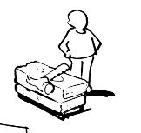



Business Model Canvas
KEY
PARTNERS
KEY
ACTIVITIES
VALUE
PROPOSITIONS
CUSTOMER
RELATIONSHIPS
CUSTOMER
SEGMENTS
Easy to understand STEM concepts.
Easy to carry and use hardware.
Hardware devices compatible with all devices.
Providing an alternative to old methods of learning STEM concepts through Braille/interpreters/ abacus.
Cost-effective.
Increasing literacy and employability rate.
Blind educational institutions
Sai Netraheen Sewa Sanstha, New Delhi
National Blind School, New Delhi
Existing companies & startups
Microsoft Azure
NGOs
GirlUpFoundation, NYC
Voice of Specially Abled People
Suppliers of electrical & electronic components
Maintenance
Hardware Development
Software Development (mobile and web application for visually impaired)
Sales & Marketing
Best-in-usage and services relationship.
Budget-friendly.
Feedback to improve customer experience.
Visually impaired people (any age group and people suffering through any type of visual impairment)
Blind Educational Institutions and Organizations
Blind associations
KEY
RESOURCES
CHANNELS
Software mobile application
Cloud services
Hardware manufacturing
Intellectual resources
Human resources
Organize hackathons and workshops for visibility.
Form partnerships with educational institutions and NGOs.
Offer live demonstrations and ongoing support for customers.
COST STRUCTURE
REVENUE STREAMS
Manufacturing of Hardware
Advertisement
Software platform charges
Dealerships
Maintenance of hardware
Offline campaigns
Employees
Average number of blind people using our software per year: 500
Average software charges: INR 300 per month
Hardware charges (one-time): INR 12000/ unit
Average number of hardware units sold: 200 units
Total income per year: 500*(300*12)+12000*200= 34.5 lakhs
After removing expenditure, estimated profit = 10 lakhs per annum

Slide 18
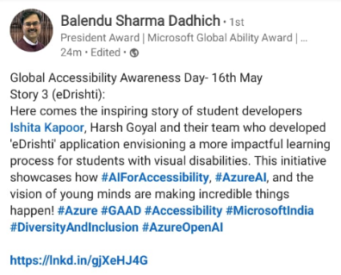
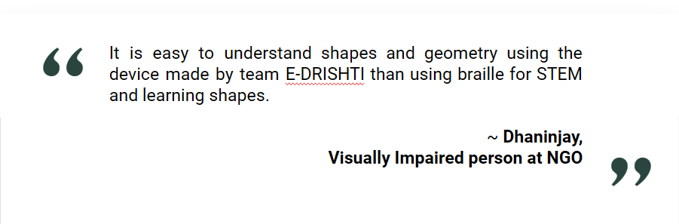
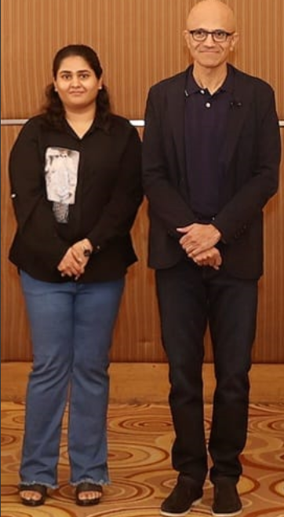
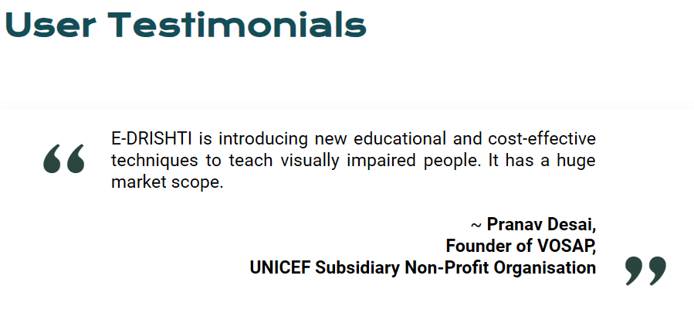
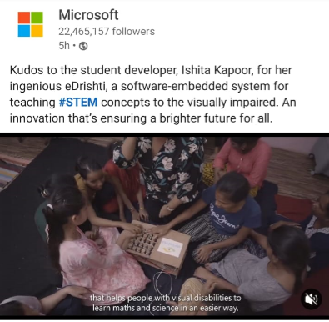
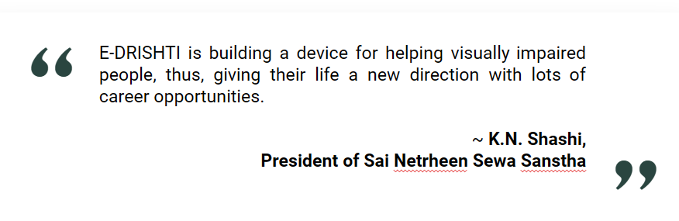
Customer Validation
eDrishti at Microsoft AI Event with Satya Nadella

Slide 19
Thank you for your time 😊

