Slide 1
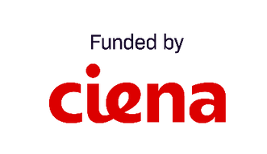
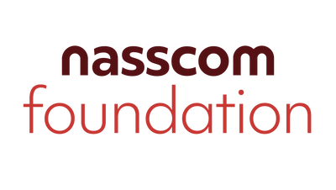
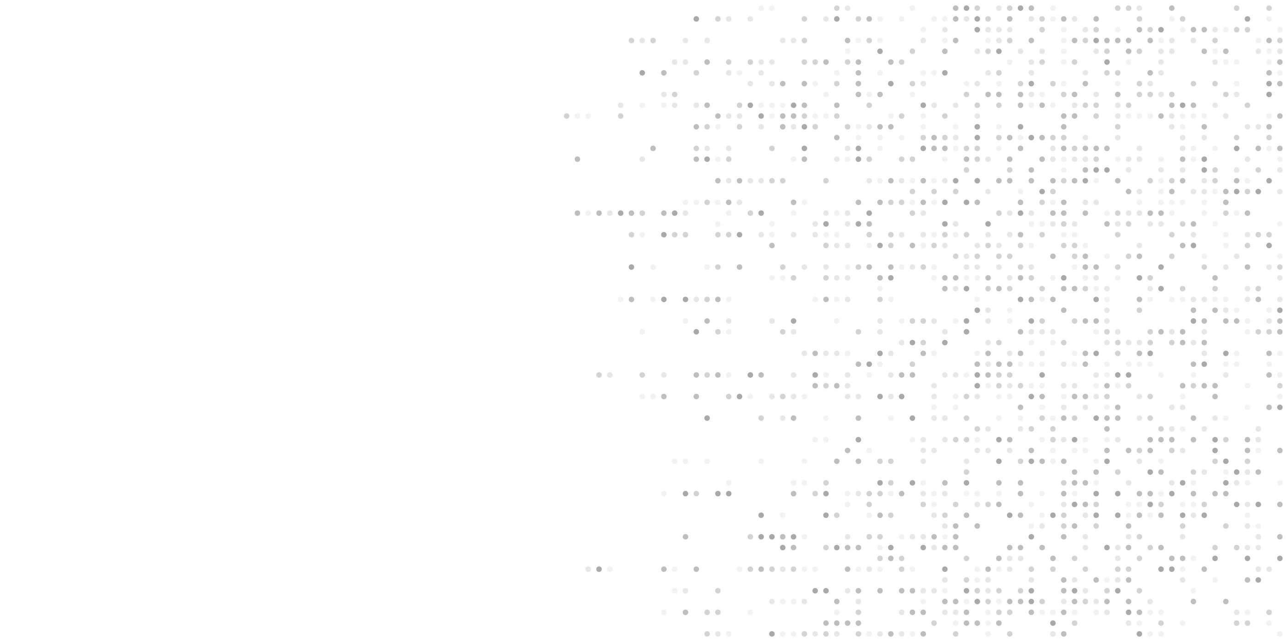
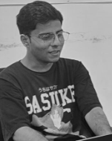
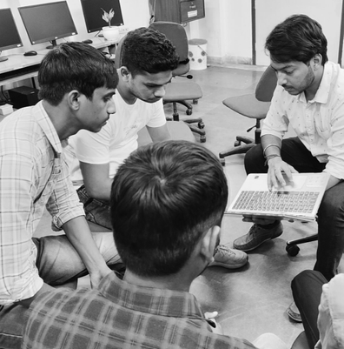
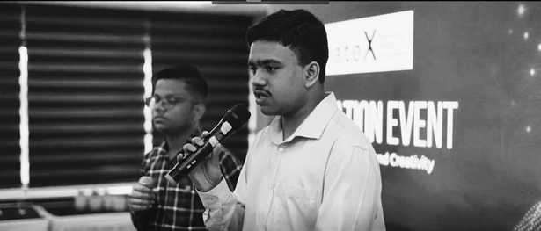
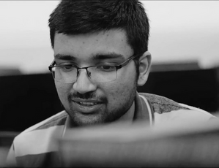
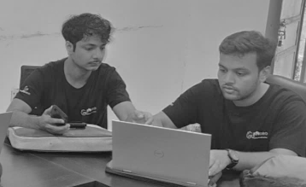
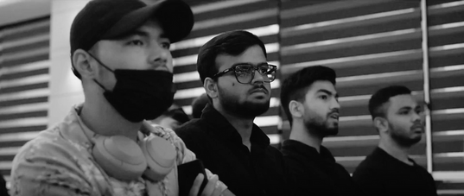
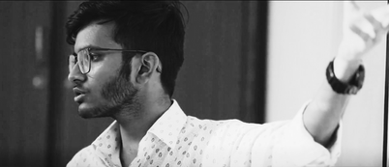
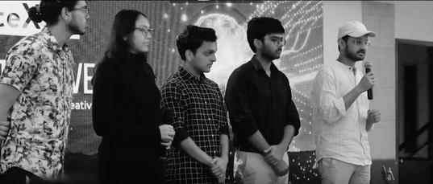
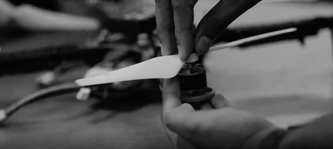
TechForChange
COHORT 4

Slide 2
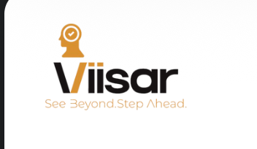
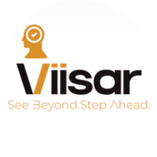

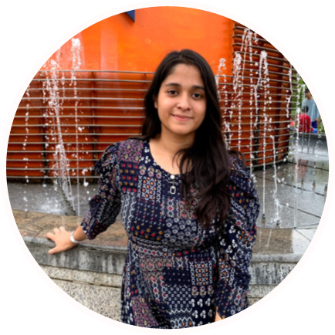
Adarsh Goyal
Founder
Sneha Gupta
Co-Founder

Slide 3

PROBLEM STATEMENT
Visually impaired students face major barriers in STEM education due to its visual nature, lack of accessible materials, and costly assistive devices.
Affordable, tactile-based, software-integrated tools are urgently needed to make STEM concepts accessible.
Millions of visually impaired students globally—especially in developing countries like India—are excluded from STEM learning and careers.
Leads to educational exclusion, unemployment, and low literacy among visually impaired individuals.

Slide 4

Market Analysis & Opportunity
Relevance
Highlights
Competitors
Gaps
Over 43 million people are blind globally, and access to Braille or tactile learning tools remains limited. This lack directly affects education and employment opportunities, especially in developing regions.
The refreshable Braille display market is growing fast — valued around USD 500M in 2024, projected to reach USD 1B by 2033 (8% CAGR). Studies also show Braille literacy strongly improves employment rates among visually impaired individuals.
Companies like HumanWare, Orbit Research, Dot Inc., Freedom Scientific, and Innovision (BrailleMe) are active in this space, focusing on making Braille more digital and portable.
High cost of multi-line/tactile devices
Limited graphics support for STEM learning
Lack of local language & training ecosystem
Low accessibility in developing countries

Slide 5

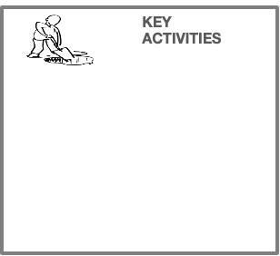


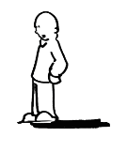
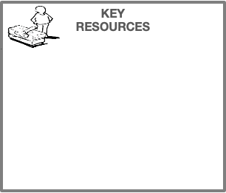
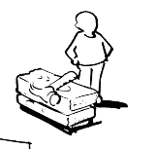

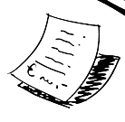
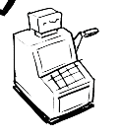
KEY
ACTIVITIES
KEY
RESOURCES
Business Model Canvas
KEY
PARTNERS
VALUE
PROPOSITIONS
CUSTOMER
RELATIONSHIPS
CUSTOMER
SEGMENTS
Maintenance
Hardware Development
Software Development (mobile and web application for visually impaired)
Sales & Marketing
Easy to understand STEM concepts.
Easy to carry and use hardware.
Hardware devices compatible with all devices.
Providing an alternative to old methods of learning STEM concepts through Braille/interpreters/ abacus.
Cost-effective.
Increasing literacy and employability rate.
Best-in-usage and services relationship.
Budget-friendly.
Feedback to improve customer experience.
Blind educational institutions
Sai Netraheen Sewa Sanstha, New Delhi
National Blind School, New Delhi
Existing companies & startups
NGOs
GirlUpFoundation, NYC
Voice of Specially Abled People
Visually impaired people (any age group and people suffering through any type of visual impairment)
Blind Educational Institutions and Organizations
Blind associations
B2B
CHANNELS
Software mobile application
Cloud services
Hardware manufacturing
Intellectual resources
Human resources
Organize hackathons and workshops for visibility.
Form partnerships with educational institutions and NGOs.
Offer live demonstrations and ongoing support for customers.
COST STRUCTURE
REVENUE STREAMS
Manufacturing of Hardware
Advertisement
Software platform charges
Dealerships
Maintenance of hardware
Offline campaigns
Employees
Average number of blind people using our software per year: 500
Average software charges: INR 300 per month
Hardware charges (one-time): INR 12000/ unit
Average number of hardware units sold: 200 units
Total income per year: 500*(300*12)+12000*200= 34.5 lakhs
After removing expenditure, estimated profit = 10 lakhs per annum

Slide 6
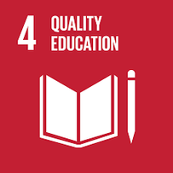
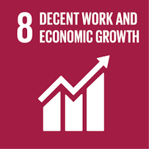
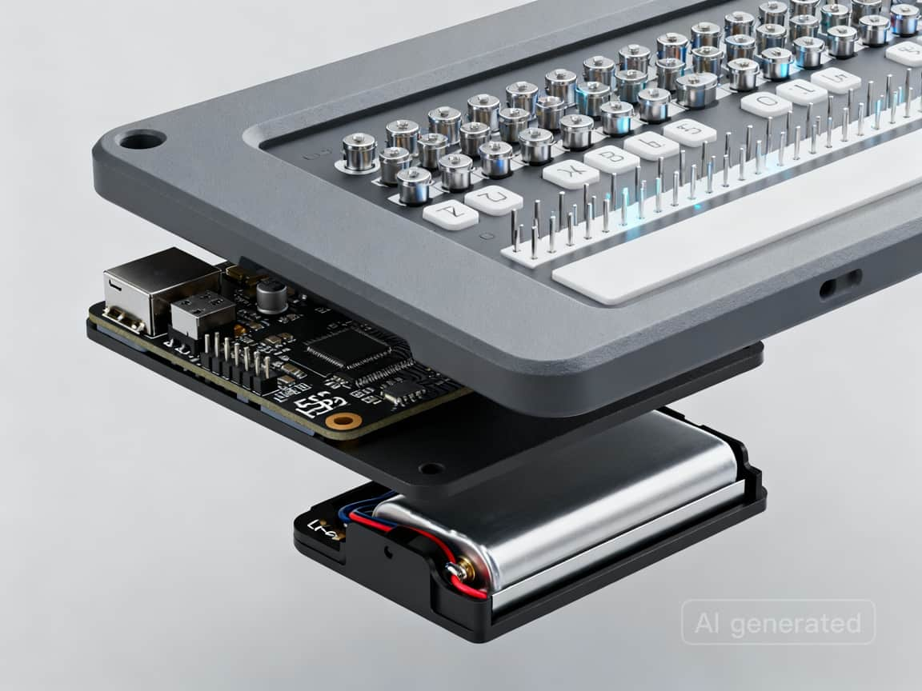
Proposed solution and SDGs:
A lightweight, modular refreshable Braille display using 5V solenoids, ESP32 microcontroller, I2C architecture, and 3D-printed housing, reducing cost from $10,000–$20,000 to $500–$1,500.
It directly solves the affordability, multi-line display, and portability gaps—making Braille and STEM content accessible to millions of visually impaired learners and professionals at a fraction of the cost.
Combines low-cost components, open-source scalability, and local 3D printing, enabling rapid manufacturing, local repair, and 19x wider accessibility compared to current products.

Slide 7
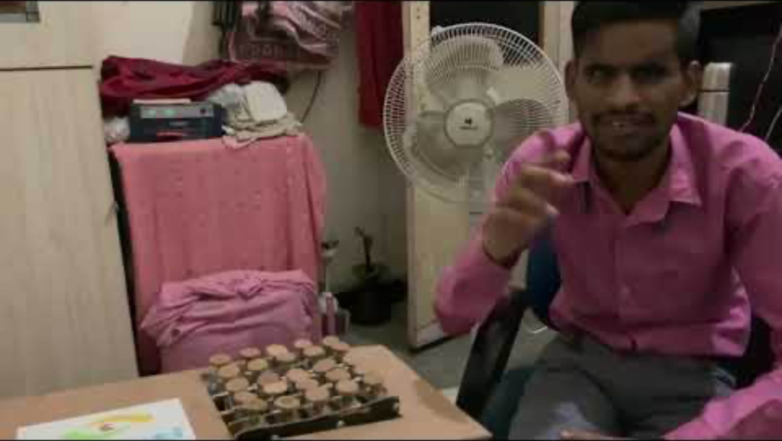
Customer Validation

Slide 8
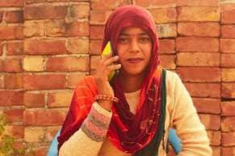
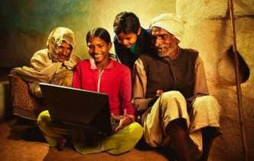

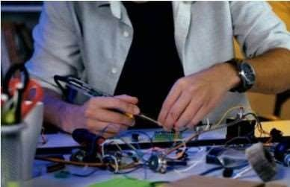

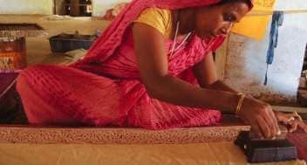
Thank You

