Slide 1

Empowering Sightless Minds through STEM Education

Slide 2
Table of Contents
Problem
Solution
Market Validation
Market Size
Product
Business Model
Evolution
Competitor
User Testimonial
Team

Slide 3


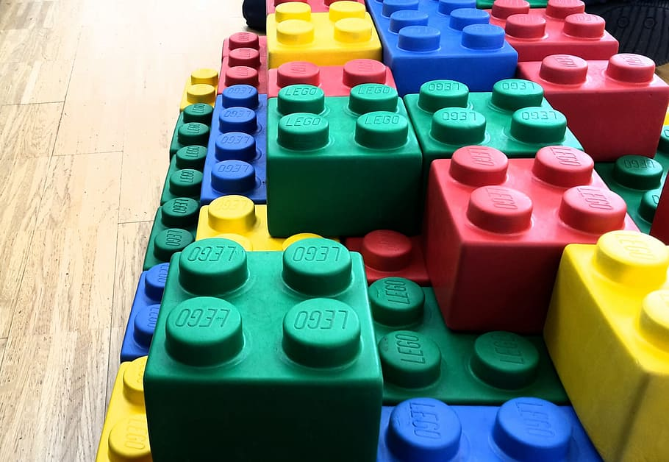
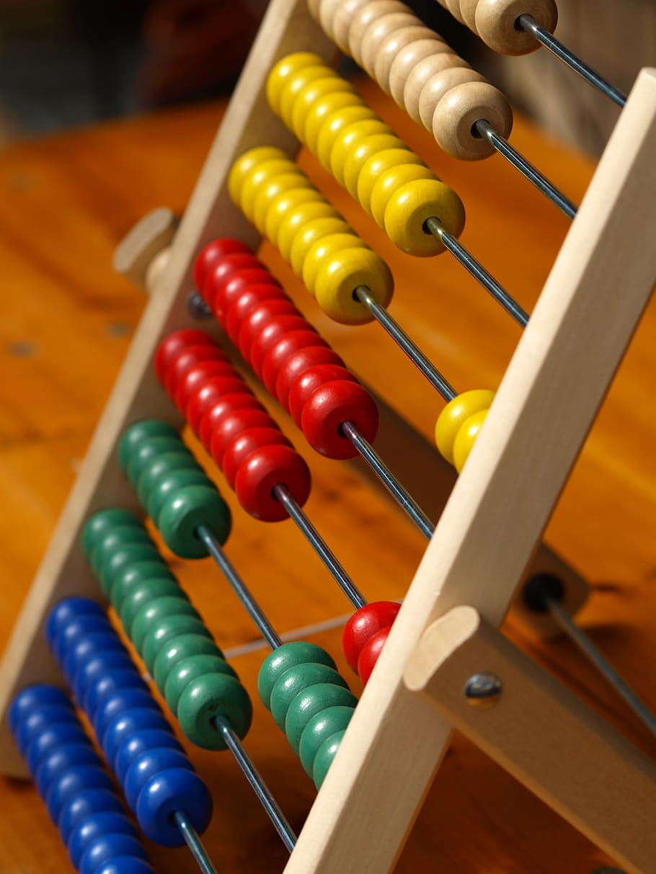


Problem
Lack of Support
The complexity of Braille codes in STEM subjects can be challenging and intimidating for blind individuals.
Diminishing market of blind tutors.
Family support is not enough for education.
Lack of necessary tools and supportive learning modules.
The current tools used for blind individuals to learn STEM subjects include:
Accessibility Barriers
Inaccessibility of STEM curriculum in blind schools.
Lack of opportunities.
Financial Barriers.
Expensive Blind Education
Expensive braille books.
Expensive tools for blind education.

Slide 4
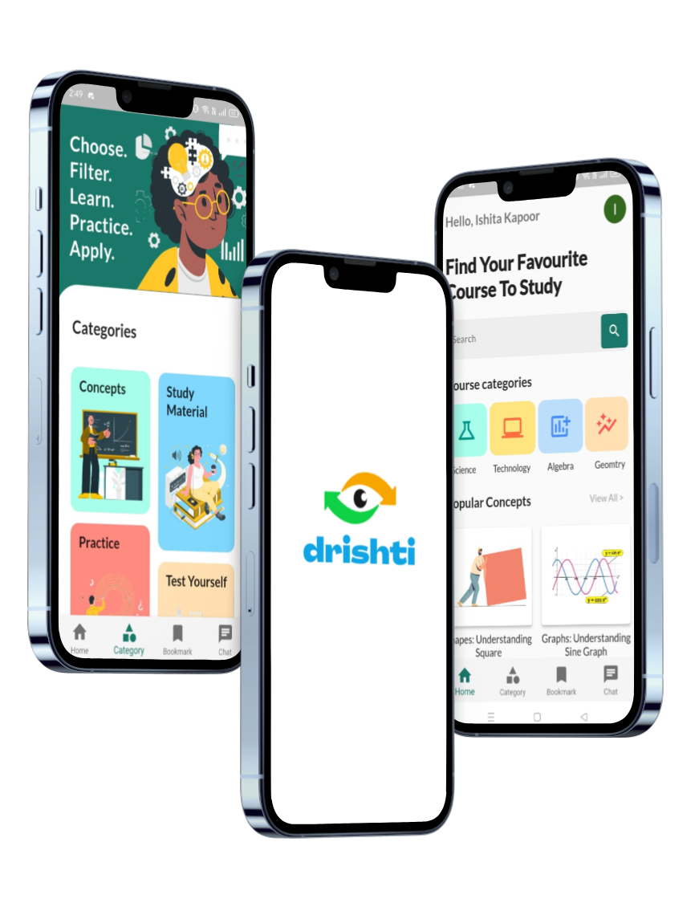





Solution
Enabling blind users to learn Science and Maths through embedded software.
24x7 Support from Blind Tutors.
Worldwide STEM resources accessible within a few clicks.
Affordable STEM Education.
Empowering independence with advanced voice-operated software.

Slide 5
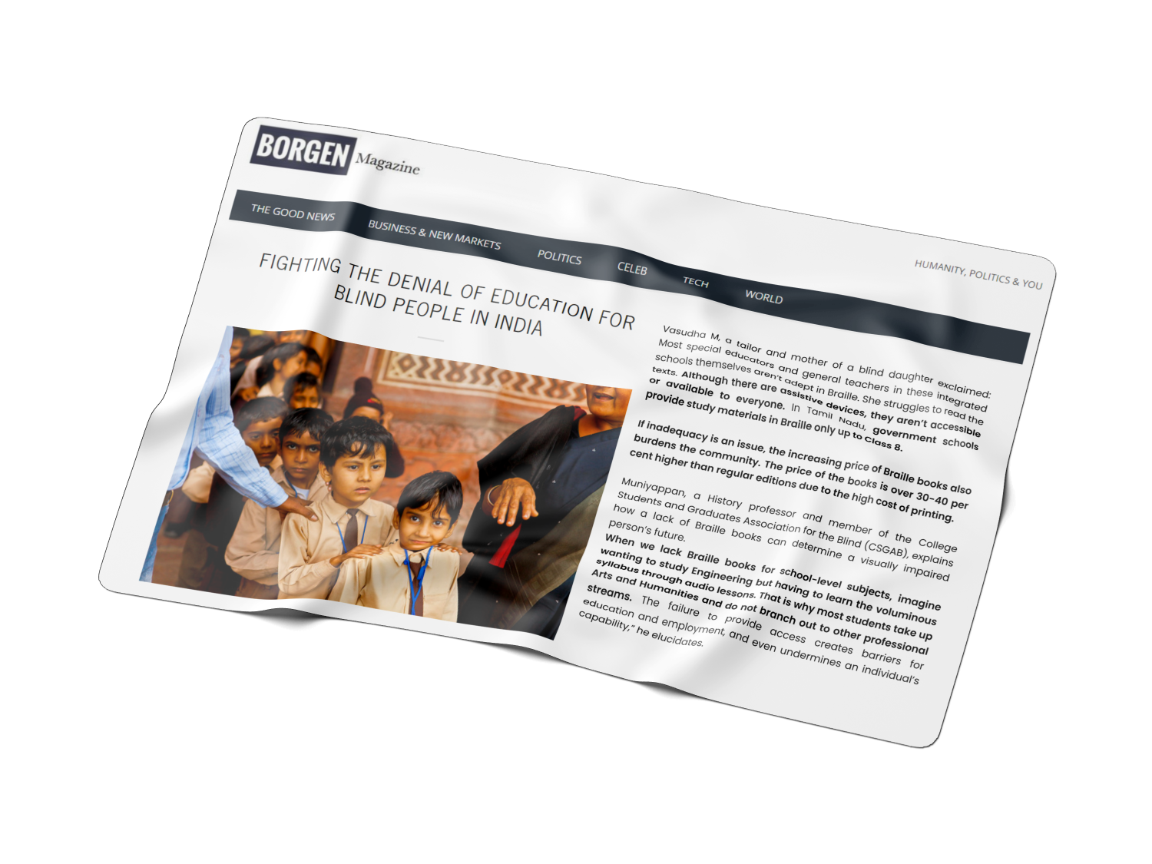
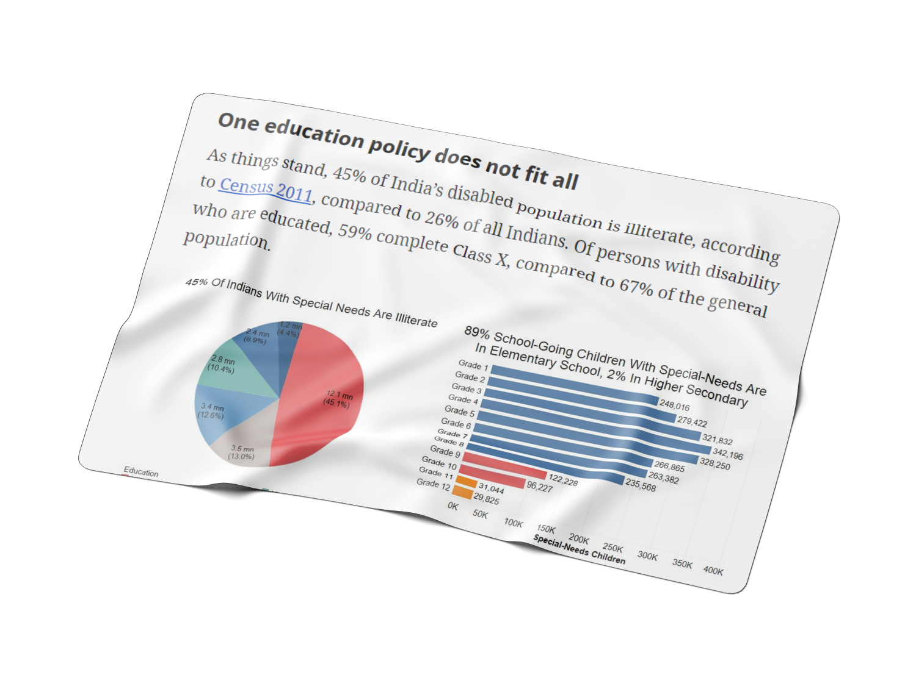
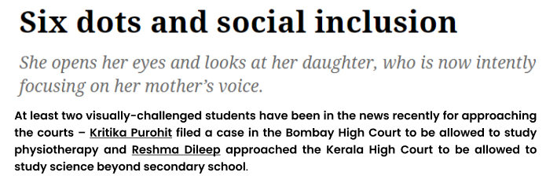

03
Market Validation

Slide 6
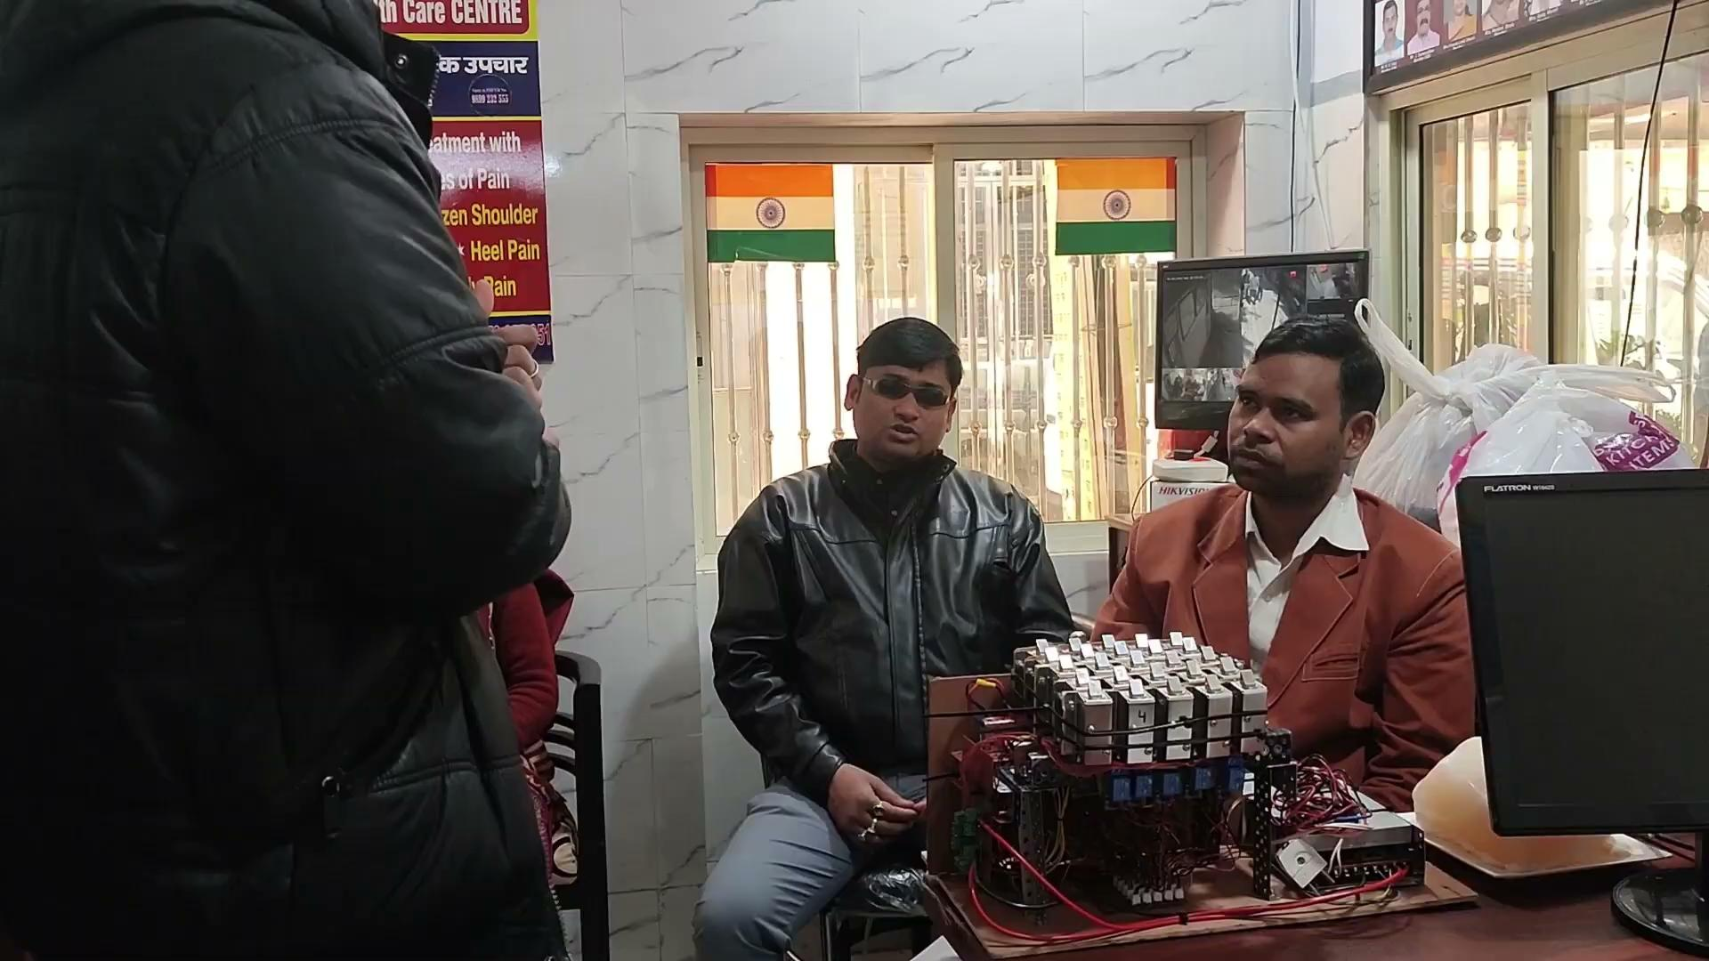
03
Market Validation

Slide 7
Market Size
$4.4+ Billion
Fully diluted market as of 2020-2027 estimation
$899+ Million
Visually impaired market
Size, including individuals and organisations
$14+ Million
Our initial market size

Slide 8
05
01
Product
TalkBack Controlled Android Application
The entire application can be operated using Talkback (voice read-aloud) feature, eliminating the need for assistance.
02
Hardware Device
Mobile application can be connected to hardware via bluetooth to practice geometry.

Slide 9
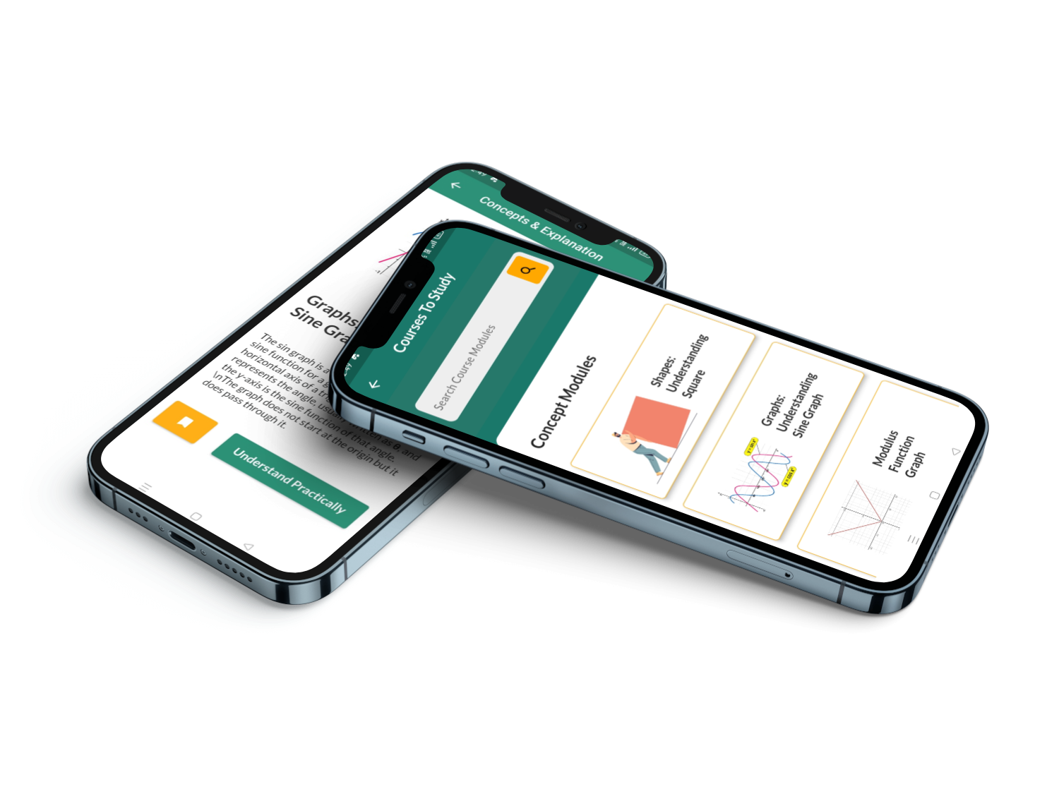
Explore and Learn various Maths and Science Concepts

Slide 10
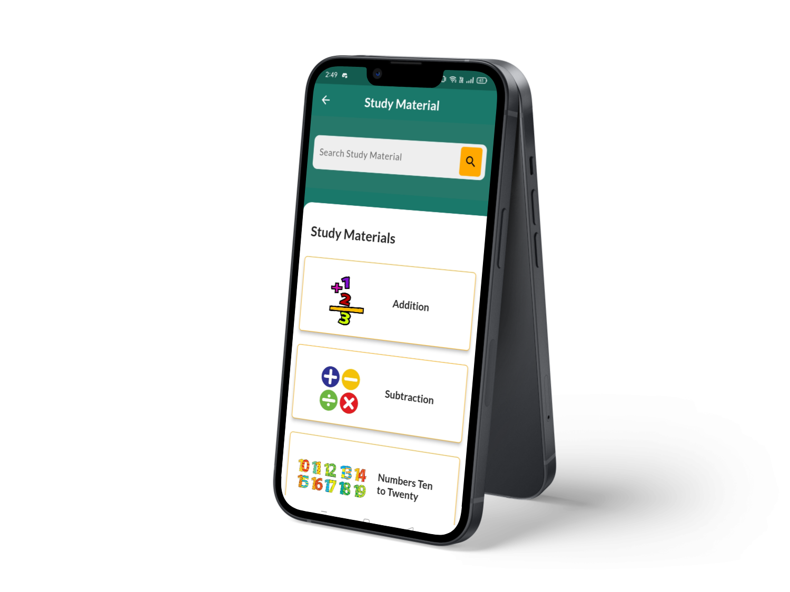
Get a single mobile app with a voice read-aloud feature, offering a diverse range of STEM study materials.

Slide 11
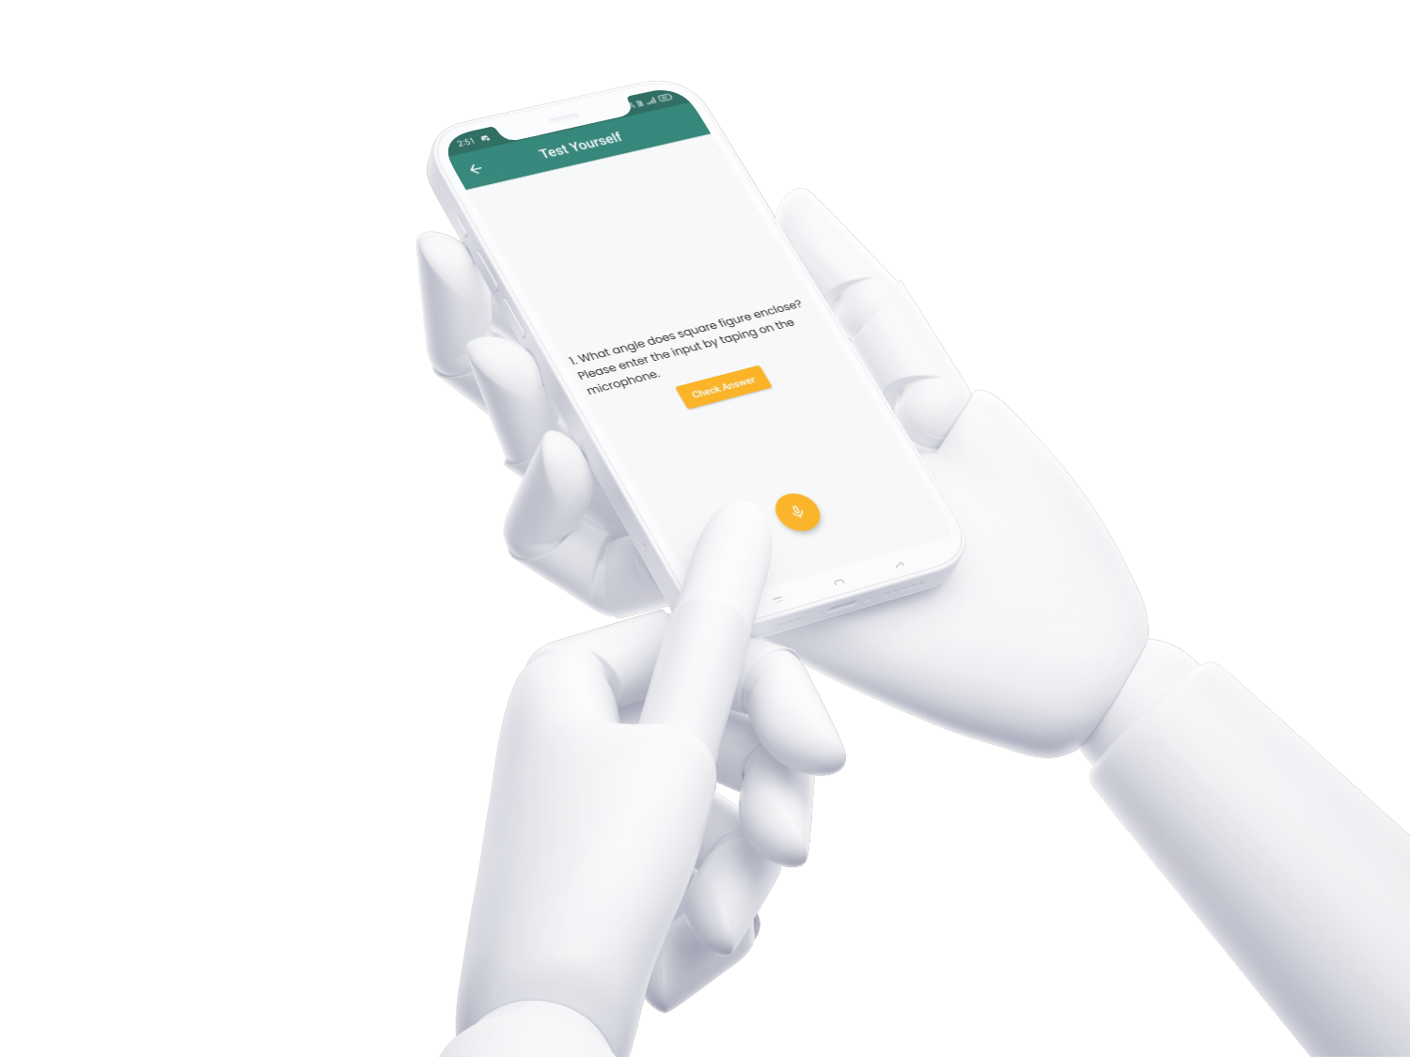
Assess your knowledge using real-time audio responses.

Slide 12
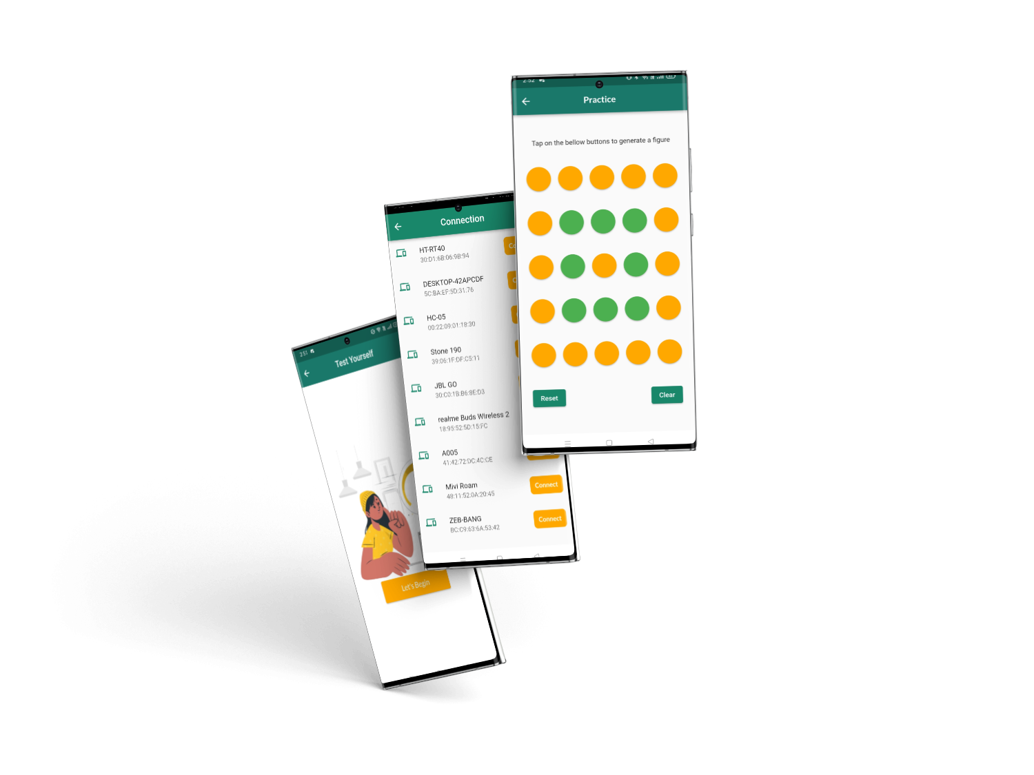
Use a Bluetooth-connected app and hardware to visually trace and comprehend figure geometry in real time.

Slide 13
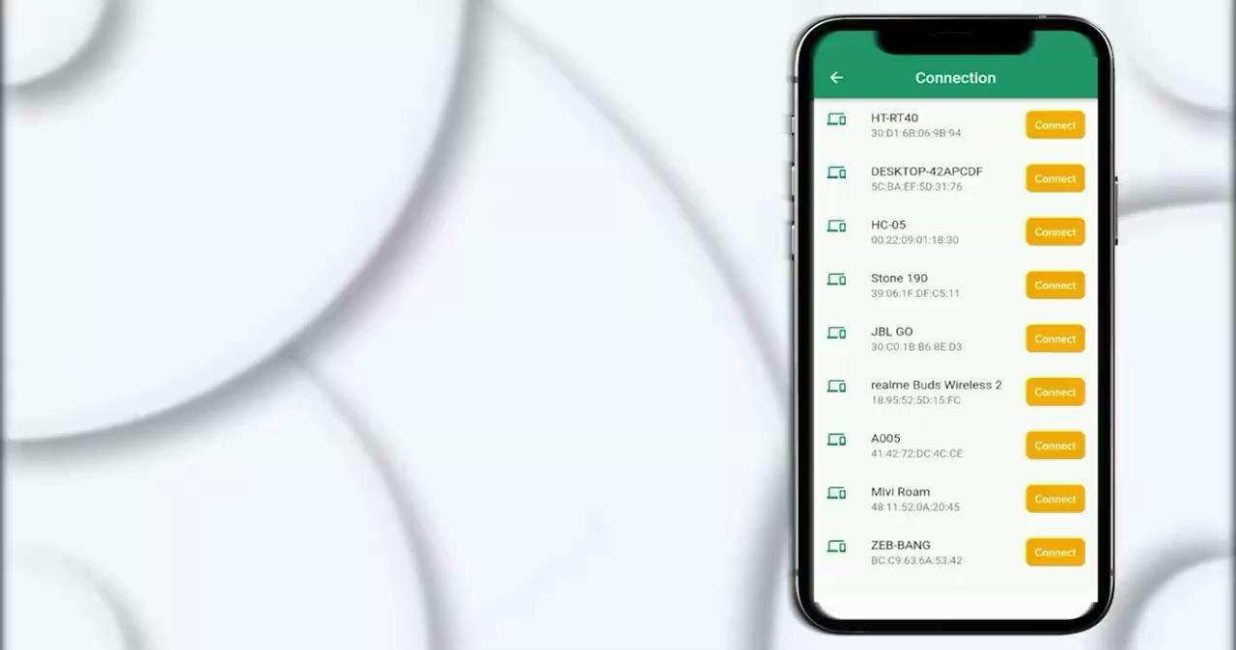
Use a Bluetooth-connected app and hardware to visually trace and comprehend figure geometry in real time.

Slide 14
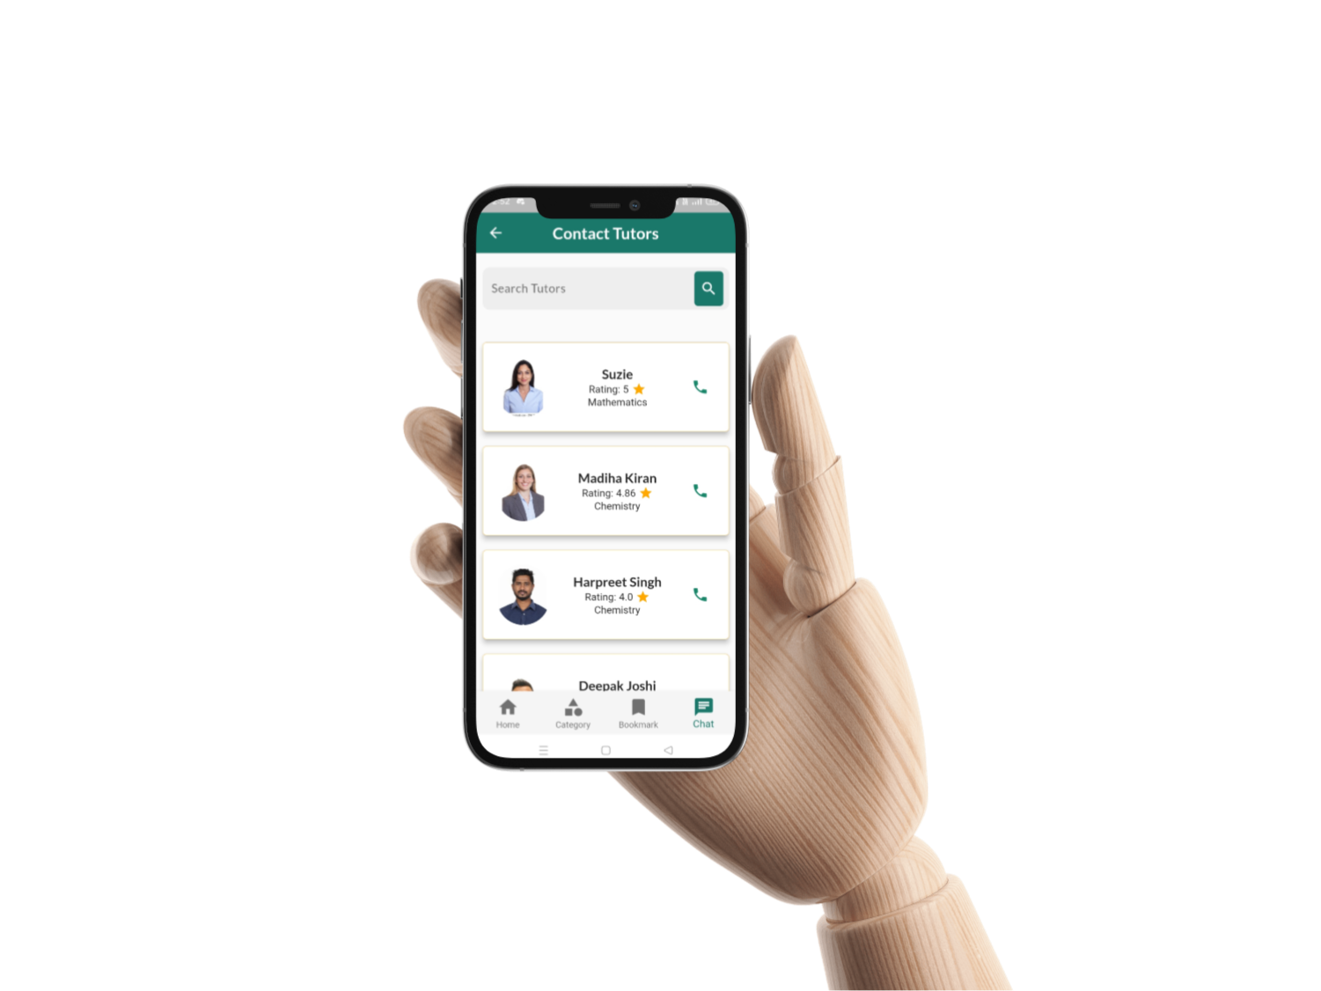
24X7 Round the Clock Tutor Support via call.

Slide 15

Business Model
We majorly generate our revenue from the software subscriptions.
$75 Million
Dollars
20% of our initial market
coverage.
$13
Dollars
Average software subscription costing per month.
One time hardware purchasing and free maintenance services @ INR 14,500.

Slide 16
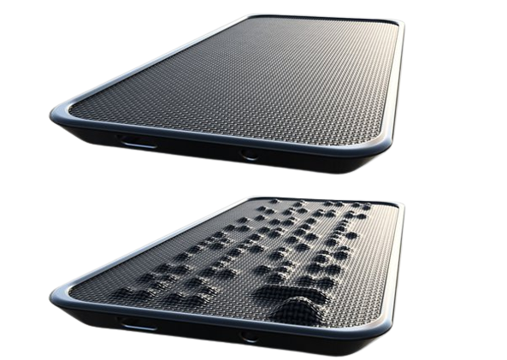
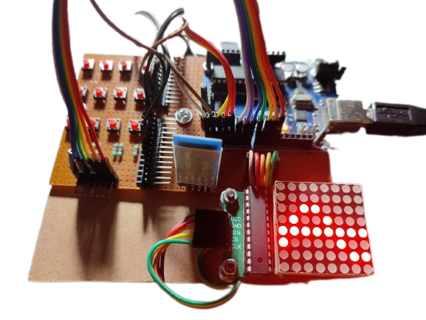
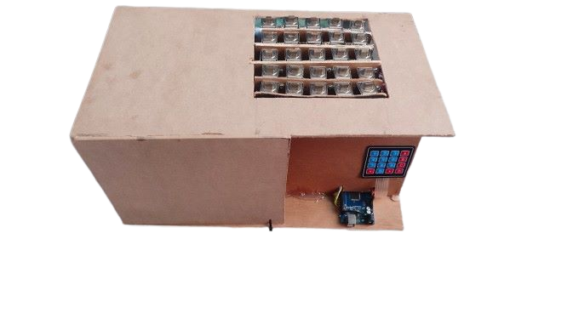
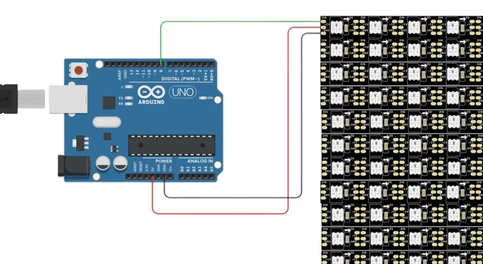
Evolution of Idea
This is still work in-progress.
Our team is working to achieve this hardware design appearance.
Improvised the user experience of the mobile application.
Built the fully-functional market ready hardware.
Developed a basic UI functional android application.
Implemented the feasibility model and built a functional LED prototype.
Researched the problem, its solution and market need.
Developed a concept feasibility model.

Slide 17
08
Competitor

Slide 18

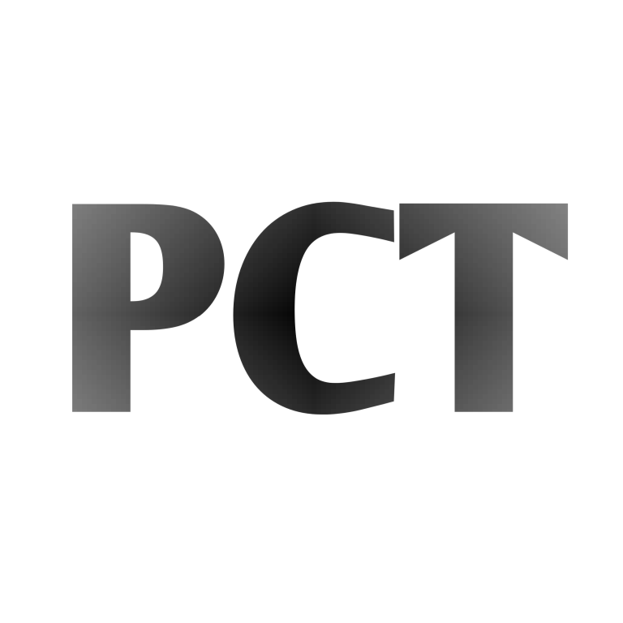

24X7 Tutor Support, Provides STEM education
 | All in one system for educational resources | Providing STEM education to visually impaired | Cost-effective
E-DRISHTI
BlindPad
Tactile Braille Pro by PCT
BlisCare
Non- Affordable
Affordable
BlisCare
BlindPad

Slide 19
Competitive Advantage
First to Market
To provide STEM education to visually impaired individuals.
All-In-One STEM education software embedded system
Covers all educational app features like quiz, study material, practice, etc.
24X7 support from Blind Tutors
Clarify doubts on call with round the clock tutor support.
Affordable
Eliminates the need of costly tools, braille books, interpreters, etc.
Easy to Use
Eliminates the use of complex braille for concept explanation. App can be operated using read-aloud Talkback feature.

Slide 20


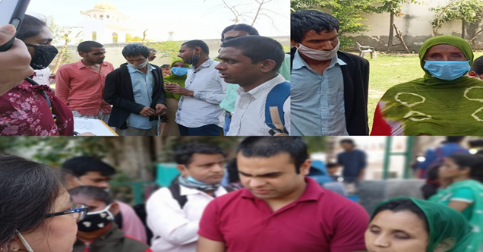
User Testimonials
“E-DRISHTI is introducing new educational and cost-effective techniques to teach visually impaired people. It has a huge market scope.”
~ Pranav Desai,
Founder of VOSAP
“E-DRISHTI is building a device for helping visually impaired people, thus, giving their life a new direction with lots of career opportunities.”
~ K.N. Shashi,
President of Sai Netrheen Sewa Sanstha
“It is easy to understand shapes and geometry using the device made by team E-DRISHTI than using braille for STEM and learning shapes.”
~ Dhaninjay,
Visually Impaired person at NGO

Slide 21


Achievements
Got the idea patented
Successfully published research paper and the idea was awarded “Best Research Paper Award 2023” by Scopus

Slide 22
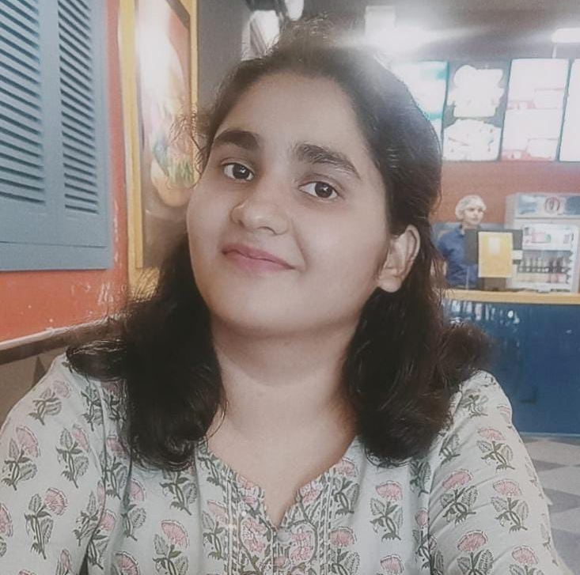
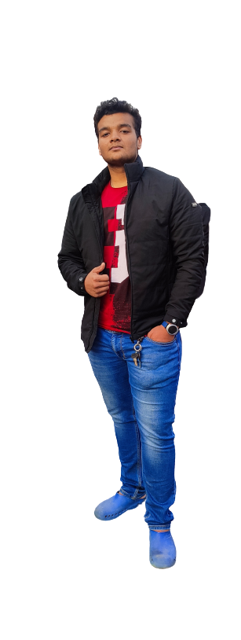
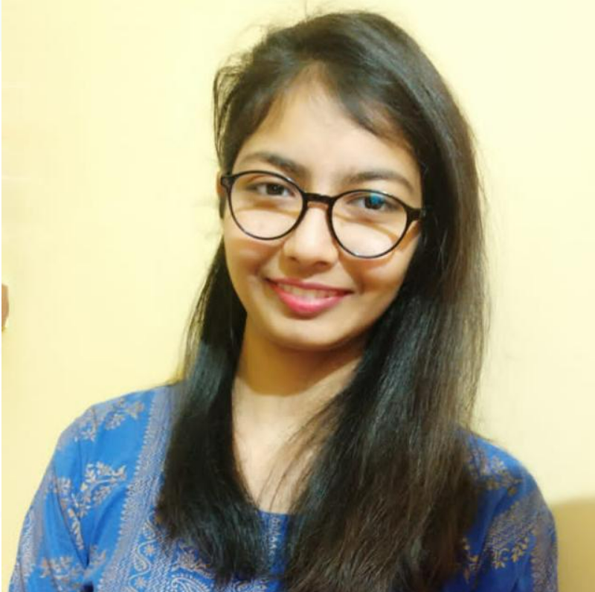
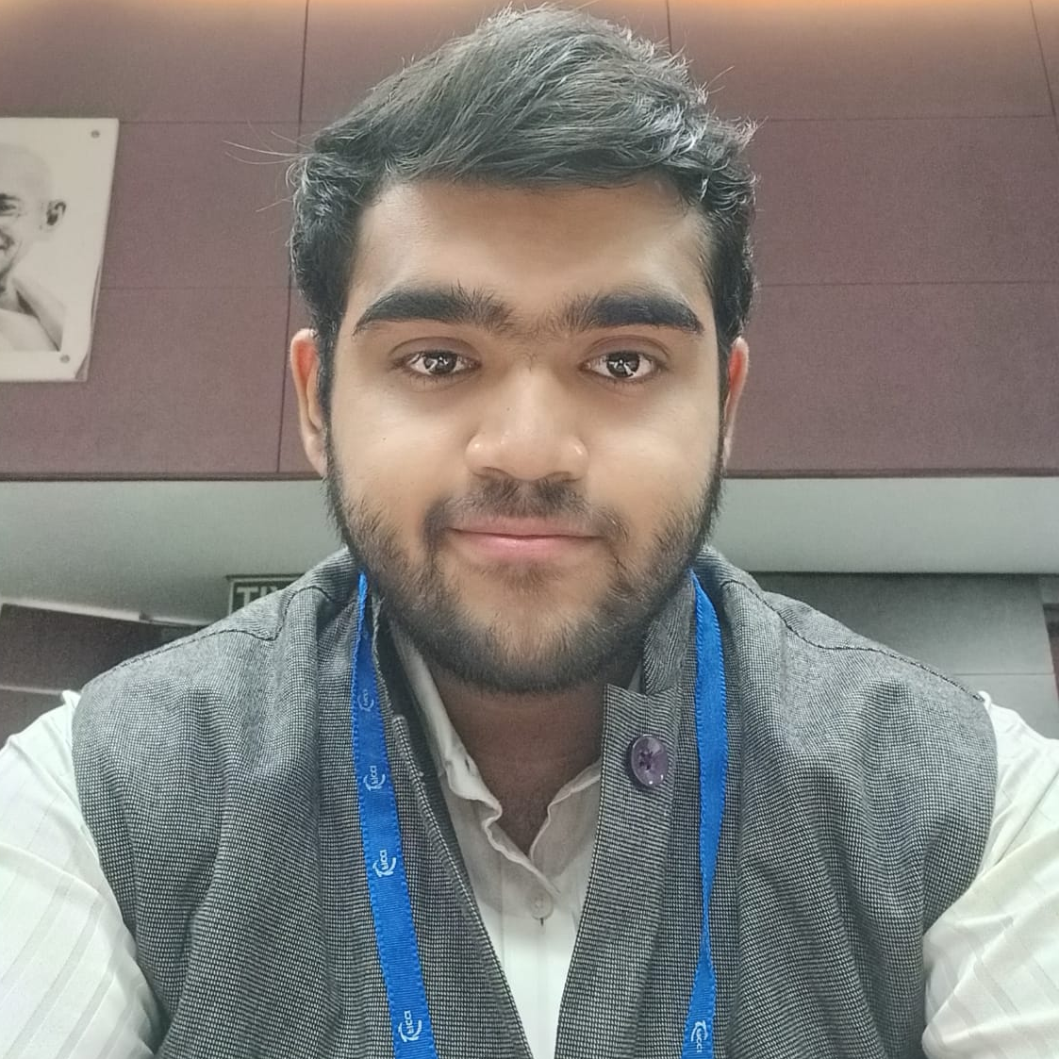
Team
Ishita Kapoor
Founder & CEO
Adarsh Goyal
Co-Founder & CTO
Ishika Punchariya
Designer Team Lead
Aabhaas Sikka
COO

Slide 23
THANK YOU

