Slide 1
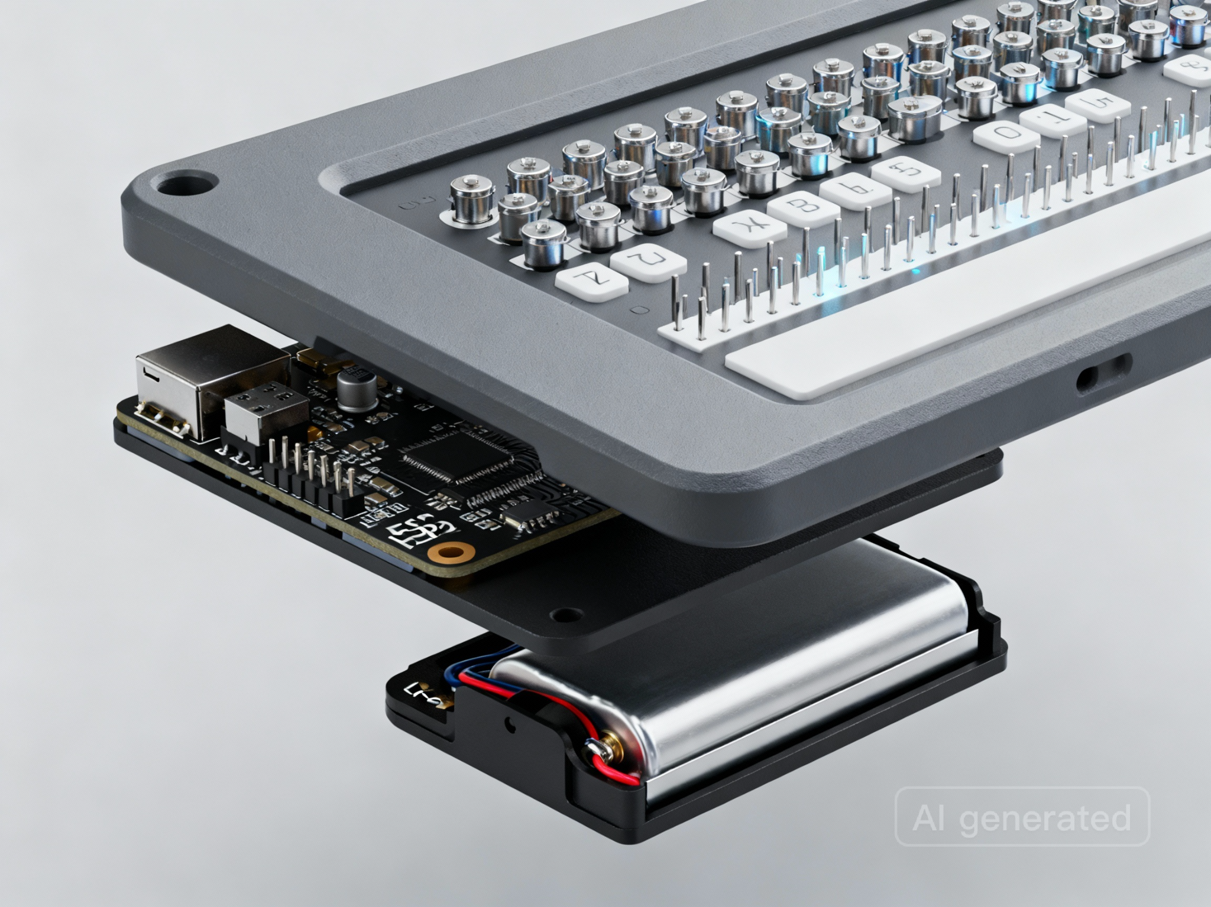
ViiSar
(Neenva)
Tactile refreshable display
+ accessible STEM learning suite
See Beyond. Step Ahead.
Pitch Deck

Slide 2
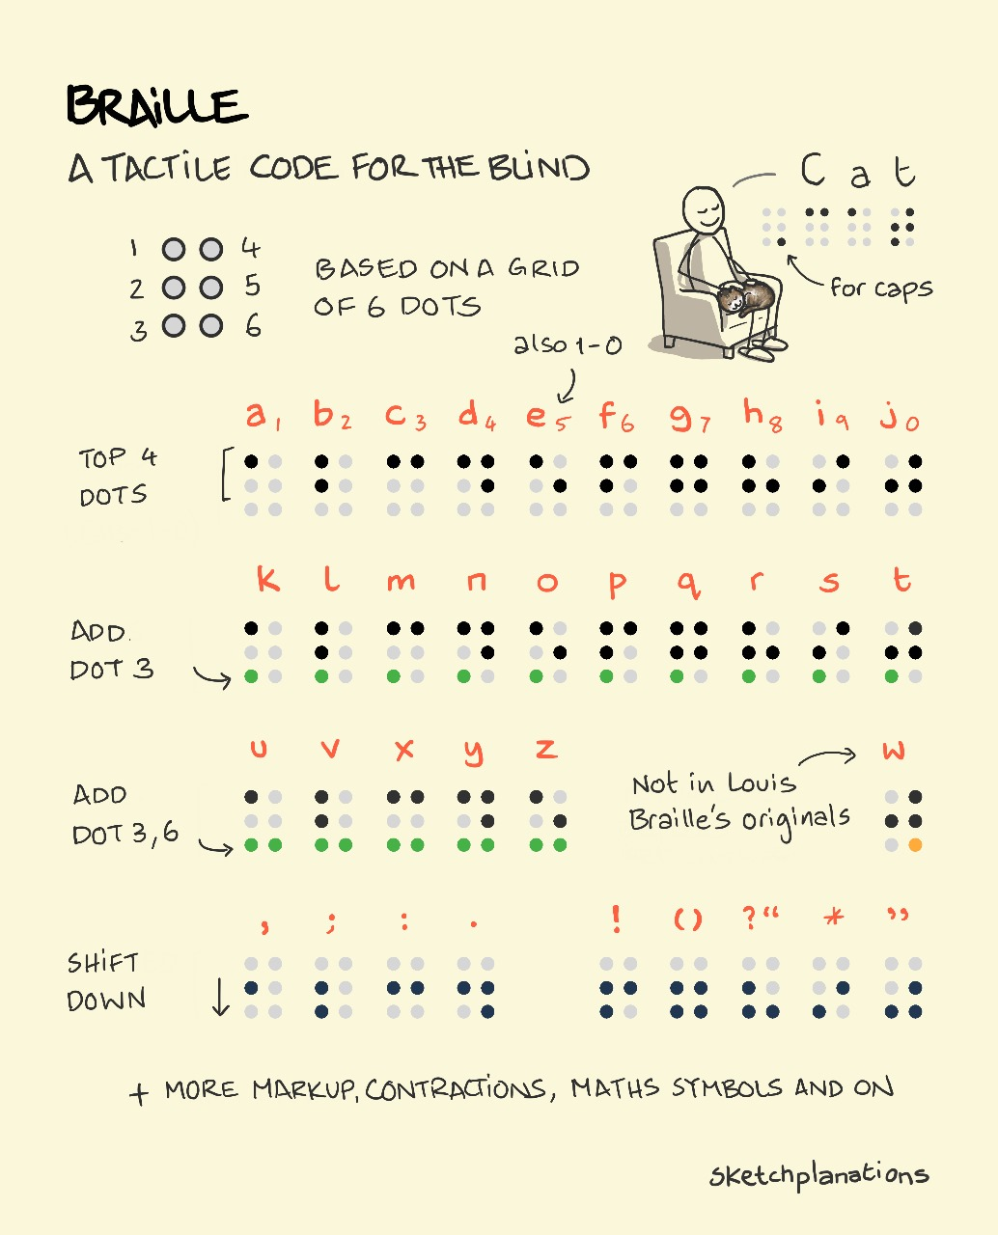
Problem
STEM is visual. Current access tools are not.
Visually impaired students lack an affordable, scalable way to understand the visual–spatial foundations of STEM (graphs, geometry, diagrams, equations).
Audio-only learning increases cognitive load and fails for spatial concepts.
Static Braille is slow to produce, expensive, and limited for diagrams/graphics.
Advanced refreshable tactile displays are often prohibitively expensive for most schools and families.
ViiSar (Neenva)

Slide 3
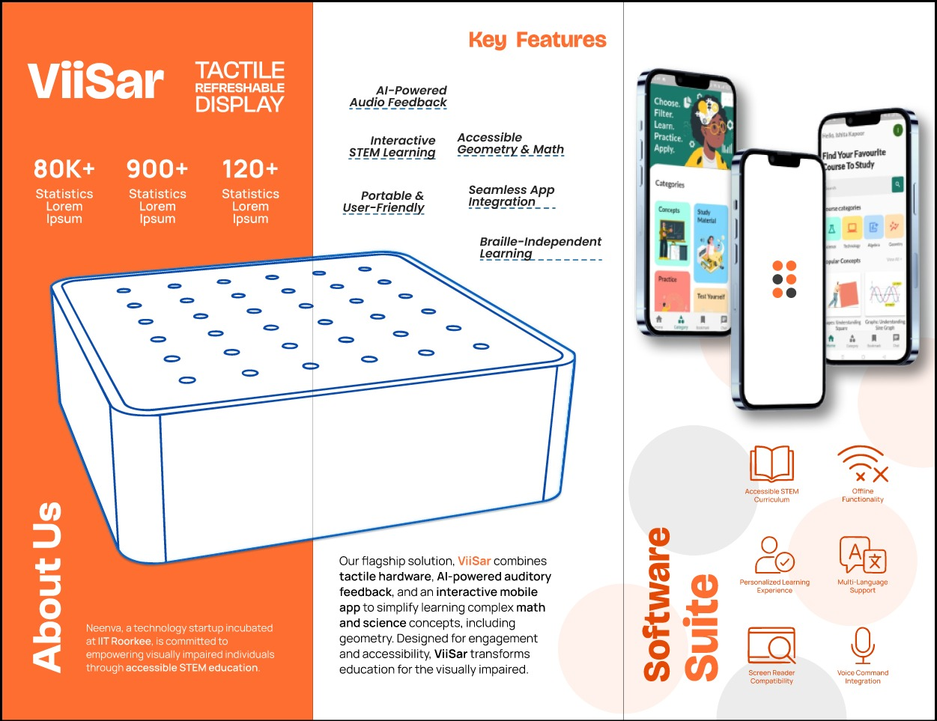
Why STEM is hard with Braille & audio-only
Braille is powerful for text—STEM needs spatial representation.
Braille cells encode characters linearly; graphs/geometry require a 2D tactile surface.
Math Braille (e.g., Nemeth) adds extra rules & formatting—hard to learn and teach at scale.
Audio tools cannot replace touch for shapes, diagrams, coordinate planes, and graphs.
ViiSar (Neenva)

Slide 4
Solution
ViiSar = Tactile hardware + accessible app + AI feedback
Tactile Refreshable Display
Accessible Mobile App
AI-powered Guidance
A refreshable pin-matrix surface that renders shapes, graphs, and geometry so students can “feel” STEM concepts.
TalkBack-first learning modules: concepts, study material, quizzes, and practice—designed for independent use.
Audio feedback and adaptive learning paths to reinforce understanding, reduce dependency, and improve outcomes.
Designed for Braille-optional STEM learning
Tactile graphics + guided audio + interactive practice, built for independent use in low-resource classrooms.
ViiSar (Neenva)

Slide 5
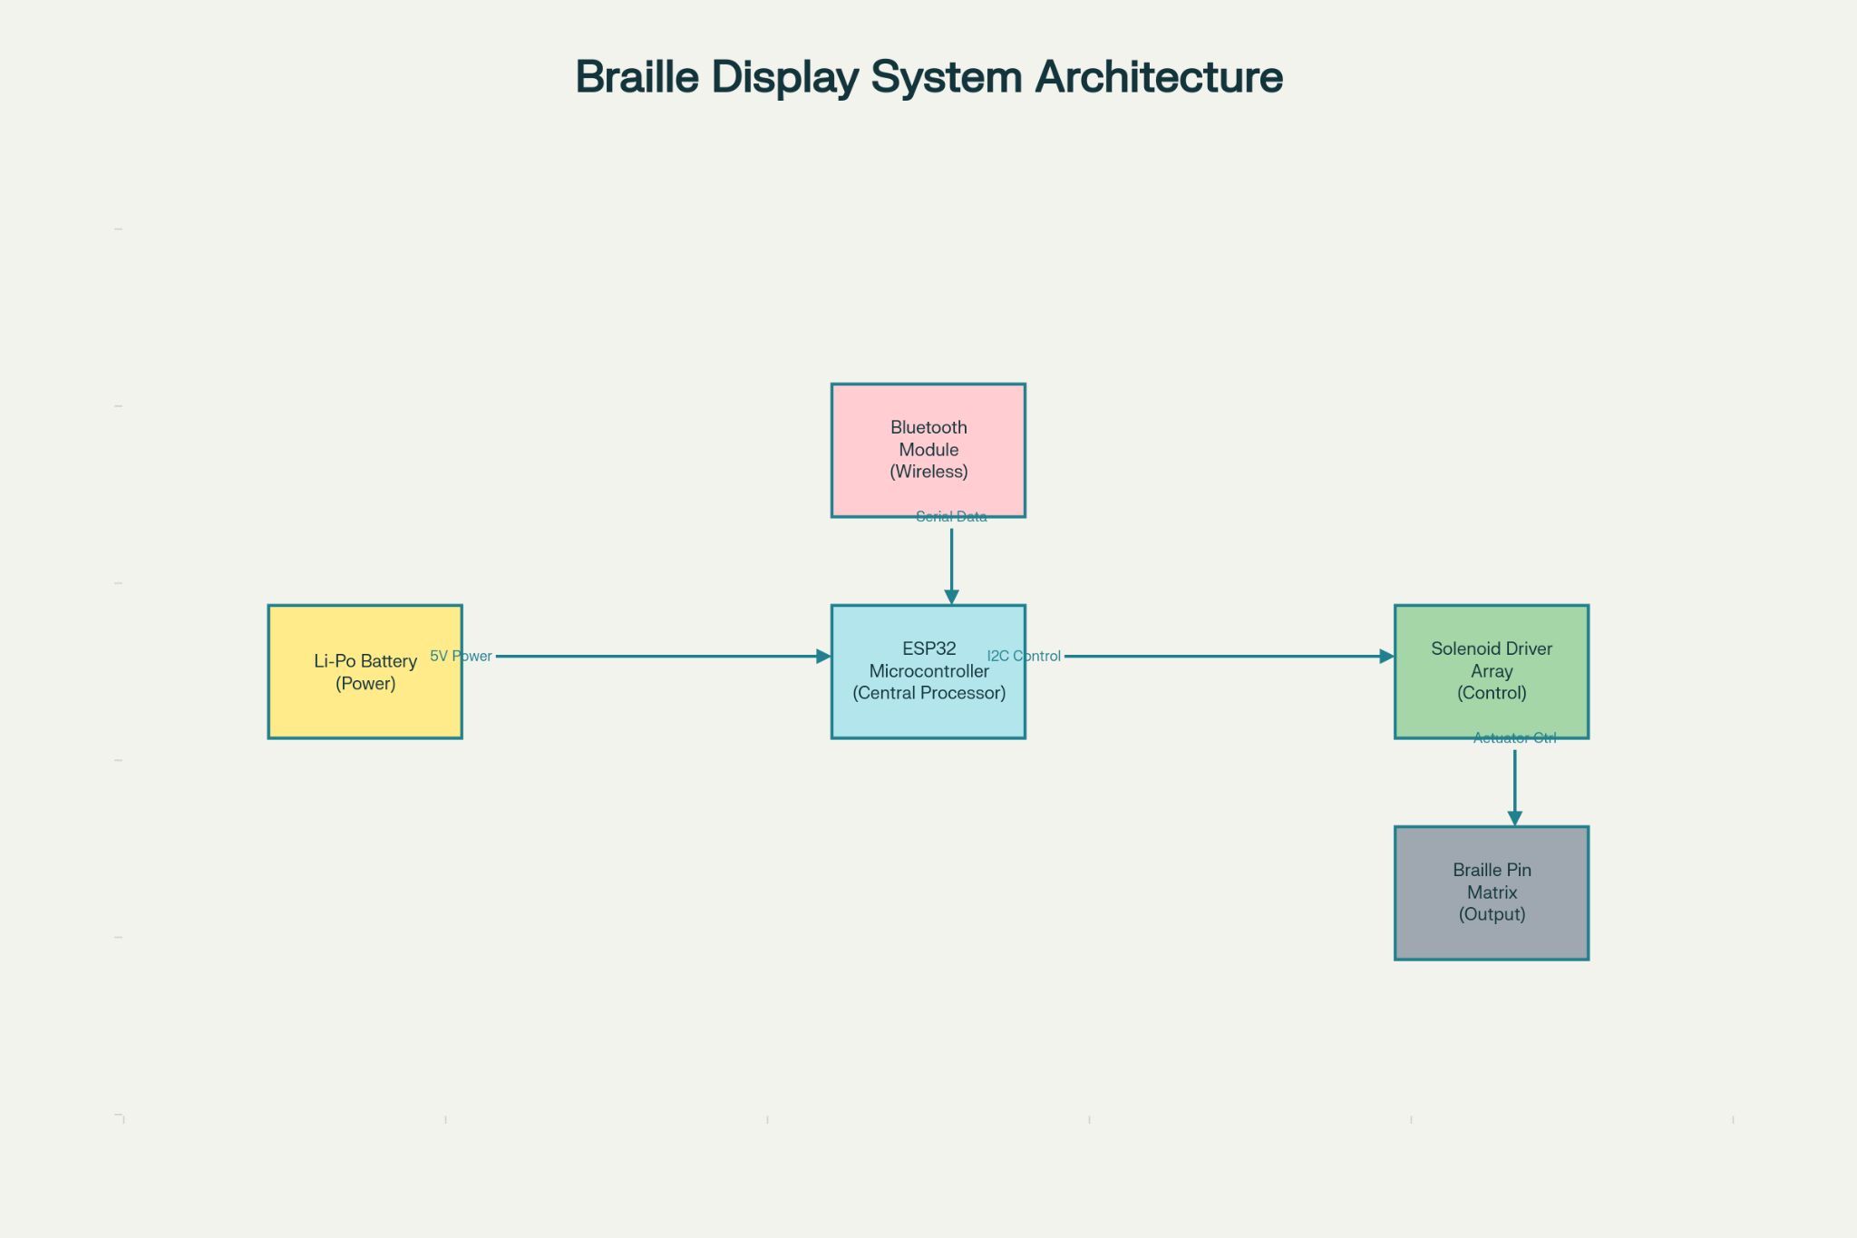
System Architecture
Bluetooth-connected app drives a tactile pin-matrix via ESP32 + solenoid drivers.
ViiSar (Neenva)

Slide 6
Hardware: Refreshable Tactile Display
Modular, battery-powered, scalable pin matrix for tactile graphics.
Design principles
Low-cost actuators for refreshable pins
ESP32 control + driver array scaling
Portable form factor with battery power
Repairable, modular, locally manufacturable
ViiSar (Neenva)

Slide 7
Software Suite (App)
Accessible by design: TalkBack-first, offline-friendly, multilingual.
Core capabilities
Interactive STEM modules (concepts + guided practice)
Accessible geometry & math with tactile tracing
AI-powered audio feedback & adaptive support
Screen-reader compatibility + voice navigation
Offline mode for low-connectivity schools
Multilingual support for broader adoption
ViiSar (Neenva)

Slide 8
User Journey & Outcomes
From explanation → tactile understanding → independent practice.
1
Learn
2
Feel
3
Practice
4
Improve
Listen to concept
via accessible app
Tactile pins render
shape/graph
Trace geometry &
solve problems
AI + feedback loop
reinforces learning
Outcomes
Independent understanding of geometry, graphs, and diagrams
Less dependence on interpreters and expensive tactile books
Better retention through touch + audio reinforcement
Improved confidence and readiness for higher education and STEM careers
ViiSar (Neenva)

Slide 9
Market & Business Model
Go-to-market: institutions first, then families.
Customer segments
Revenue model
Schools for the visually impaired
NGOs & associations
Inclusive education institutions
Students & working professionals (B2C)
Hardware: one-time device purchase (institutional & retail)
Software: freemium → subscription tiers
B2B deployment: bulk orders + training + support
Service: content partnerships and curriculum licensing
Goal: make tactile STEM access affordable and scalable through low-cost components + local manufacturing.

Slide 10
Roadmap & Ask
Phase 1
Phase 2
Phase 3
Pilot deployments
with partner NGOs/schools
Scale manufacturing
+ reduce device cost
Wider rollout
(B2B → B2C)
We are looking for:
Pilot partners (schools/NGOs) for scaled trials
Hardware manufacturing guidance + cost-down strategy
Funding & mentorship for productization and distribution
ViiSar (Neenva) — Accessible STEM, made tactile.

