Slide 1
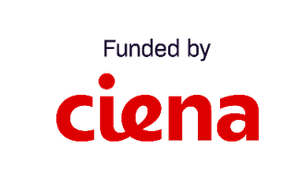
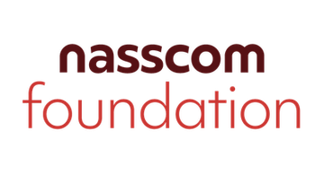
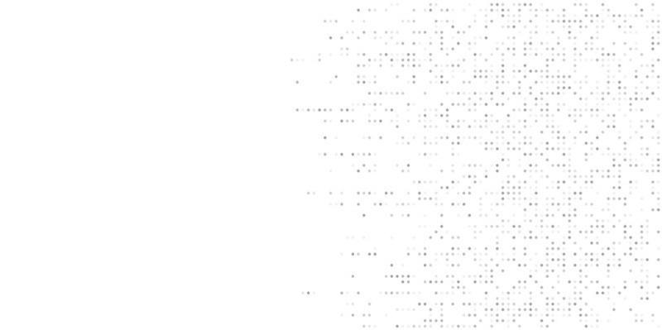
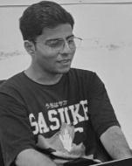
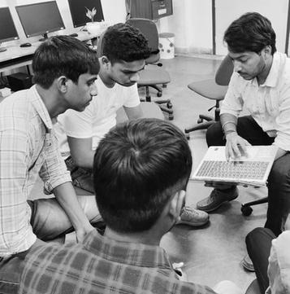
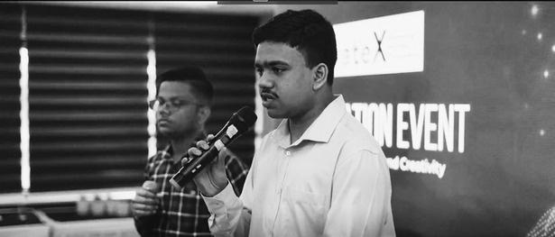
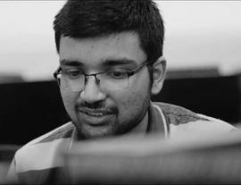
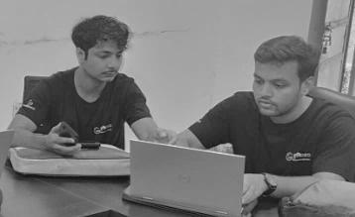
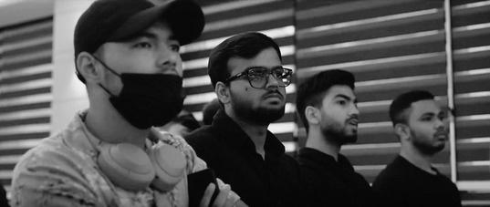
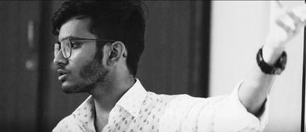
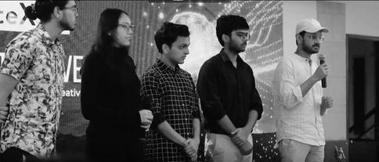
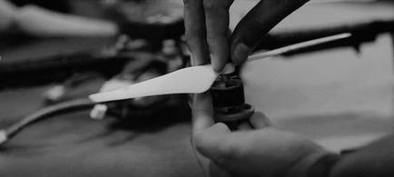
TechForChange
COHORT 4

Slide 2
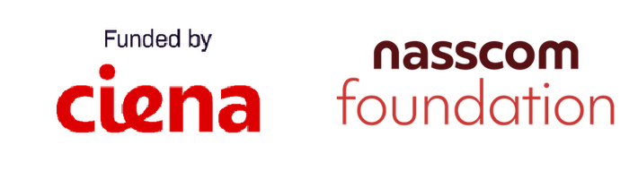
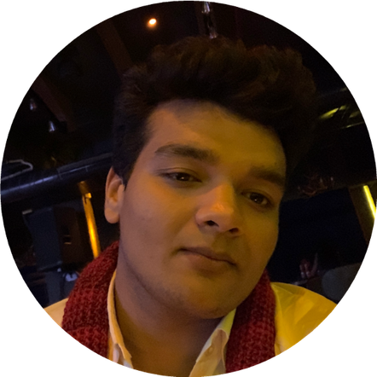

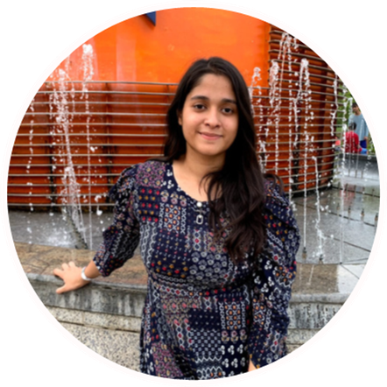
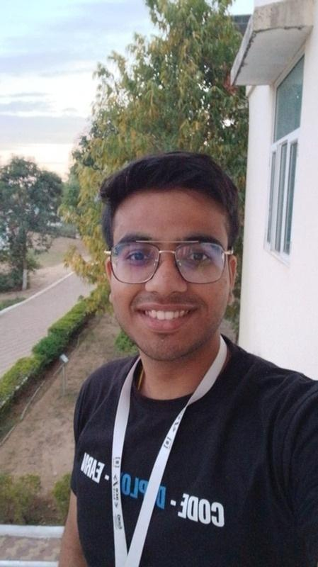
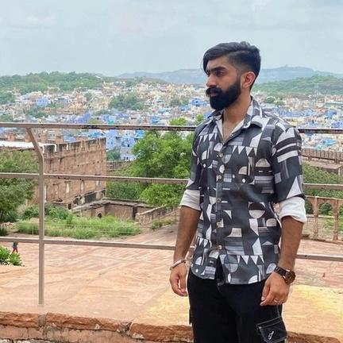
VIISAR
Turning STEM into Touch.
Adarsh Goyal
Founder & CEO
Sneha Gupta
Naman Dadhich
Sarthak Kakar
Co-Founder & COO
Web Developer
Web Designer

Slide 3
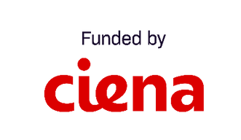
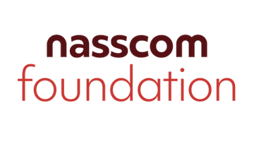





The Problem: STEM Is Still Visual-First
01.
02.
Graphs, geometry, circuits, and equations are hard to understand through Braille alone.
Current tactile tools and Braille books are bulky, heavy, and difficult to carry, making STEM learning less portable and less convenient.
03.
04.
Audio can describe a shape, but it cannot help students physically feel graphs or diagrams.
Existing tactile displays and specialized learning tools are unaffordable for most students and schools.

Slide 4
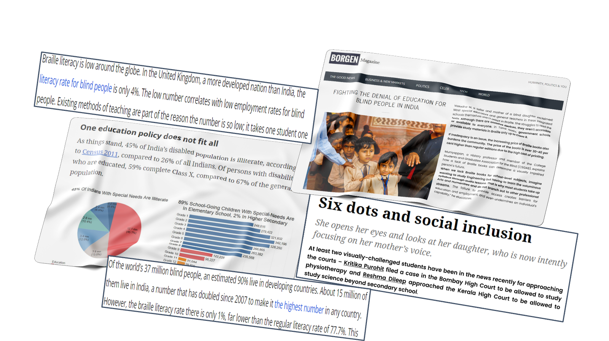

VIISAR
Research & Market Analysis

Slide 5
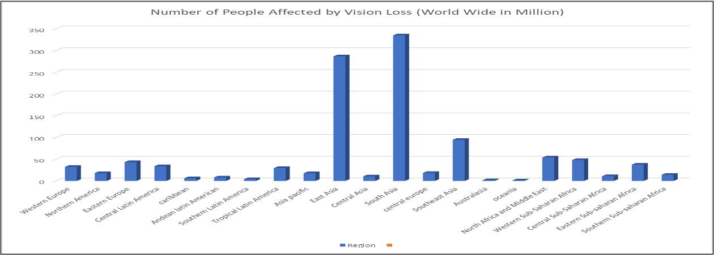
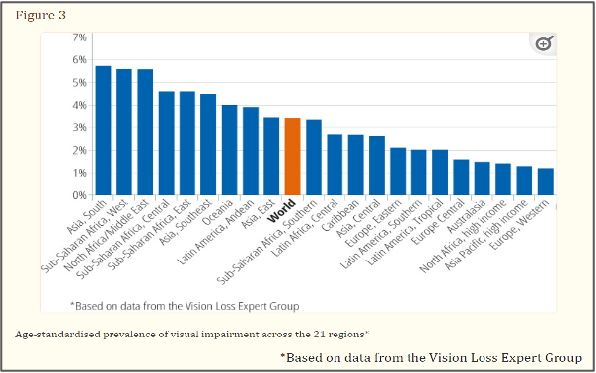
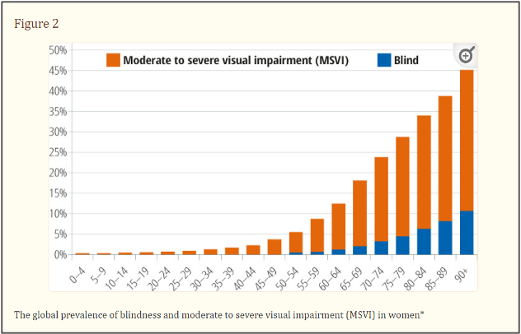
VIISAR
Research & Market Analysis

Slide 6
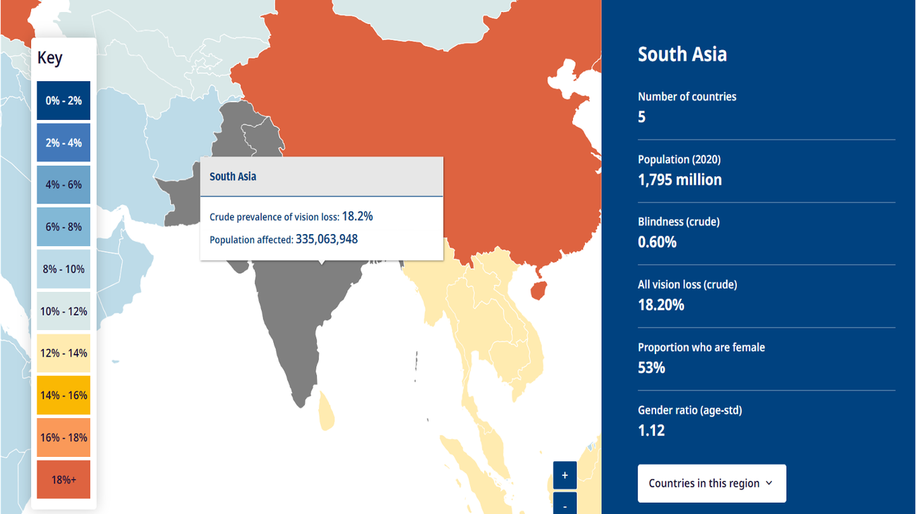
VIISAR
Research & Market Analysis
With 1.18M+ school-age visually impaired learners in India and 67M+ globally, Viisar addresses a large, underserved market with an affordable tactile STEM solution.
Age
India
Worldwide
Preschool age (0–6 years)
~0.42 million
~31.8 million
School-age (5–19 years)
~1.18 million
~67.4 million
India – College-age / young adults (20–24 years):
~0.39 million
~20.6million

Slide 7
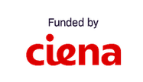
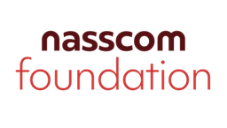
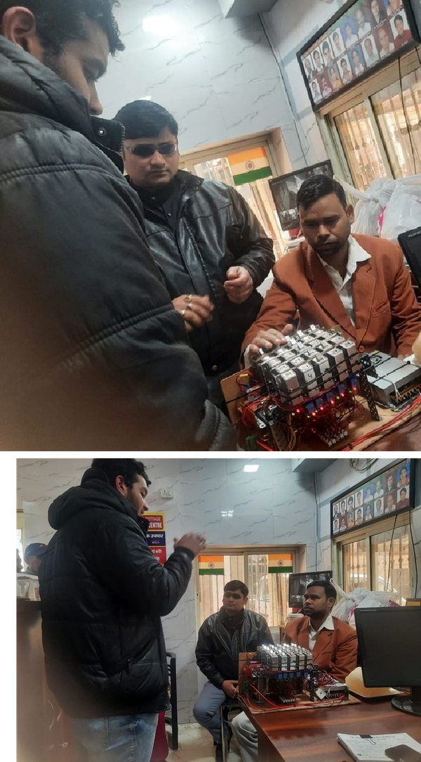
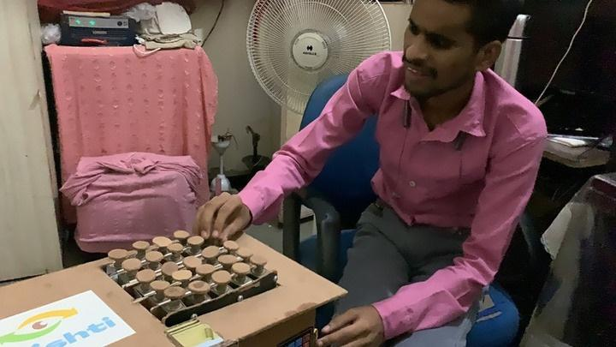
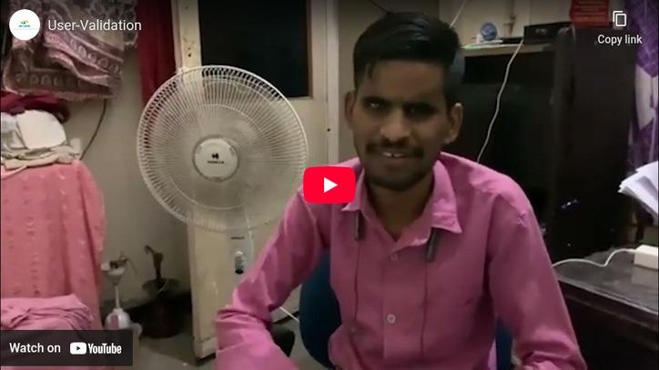
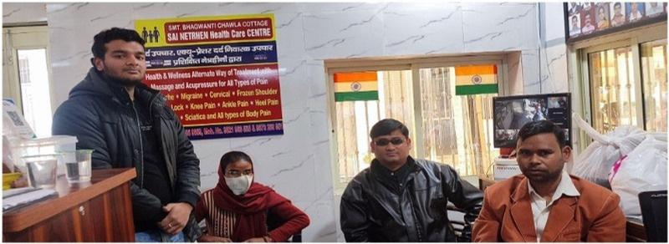
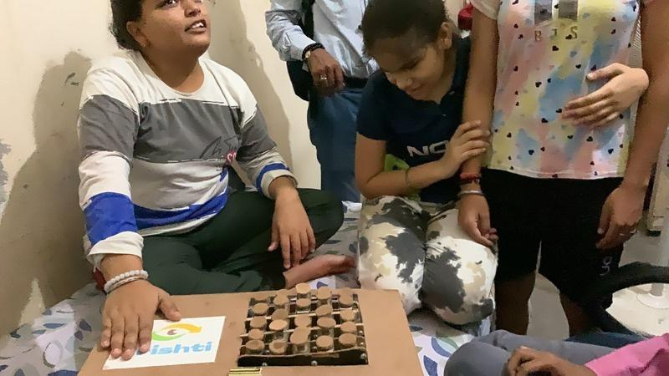
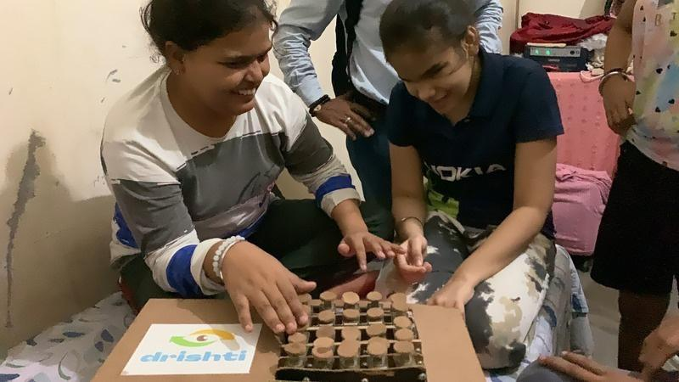
VIISAR
User interviews/survey insights
User-Validation (1080p, h264).mp4

Slide 8

VIISAR
Research Validation & Confirmation
Target Users:
We visited Shri Sai Nethraheen Sanstha and Blind Person Association in Uttam
Nagar and we tested our product on visually impaired individuals.
25+ Users Tested
Feedbacks Received Based on Interviews and Testing Sessions:
This product helps us imagine shapes in our mind. For ex- it helps us understand how A looks, how a triangle feels, or what other figures are like. For blind students, it is very helpful because it allows us to connect more with what we are studying. With this device, understanding shapes and figures becomes much easier.
Right now we mostly rely on audiobooks, but they don’t help us feel shapes. Geometry books and physical models are also heavy and hard to carry. Your device solves this problem because we can feel different shapes on a single device, and
it is much easier to carry.
The device feels a bit large right now. If the size could be reduced, it would be better because then we could feel the whole image using just our palm. That would make it more comfortable and easier to use.
Rajesh
Krishna
Rajesh

Slide 9
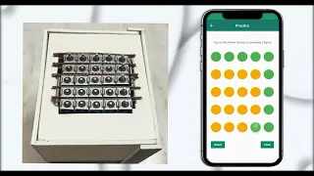
VIISAR
Video of the MVP
New Hardware - VIISAR(1080p, h264).mp4

Slide 10
VIISAR
Current Solutions vs Existing Gaps​
Factor
Graphiti
Dot Pad
BrailleMe
Cost accessibility
Low ( ~$20,000 USD)
Low ( ~$10,000 USD)
High (~ $1,000 USD)
Multi-line support
Yes
Yes
No, mainly 20-cell single-line
STEM suitability
Strong but expensive
Strong but expensive
Limited
Tactile graphics
Strong
Story
Weak / not primary
Portability
Medium
Medium; Dot Pad X is more tablet-like
High
Local manufacturing
Low
Low
Medium, India-origin product
Repairability
Low to medium
Low to medium
Medium
Open-source scalability
Limited
Limited
Limited
Best suited for
Premium institutions
Premium accessibility labs / institutions
Individual Braille readers

Slide 11

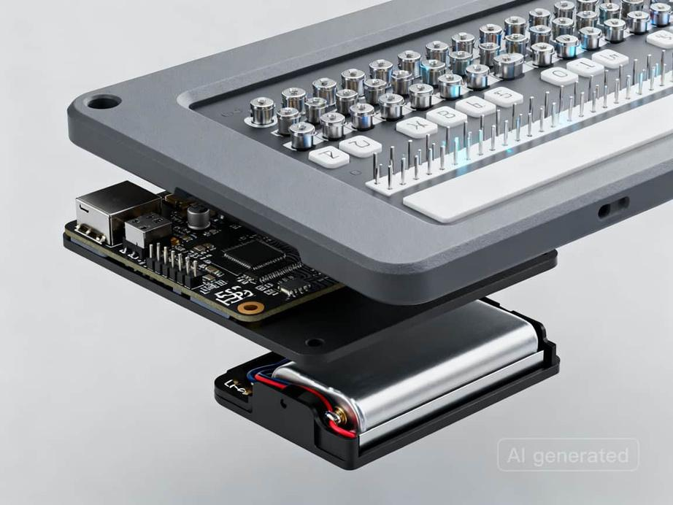

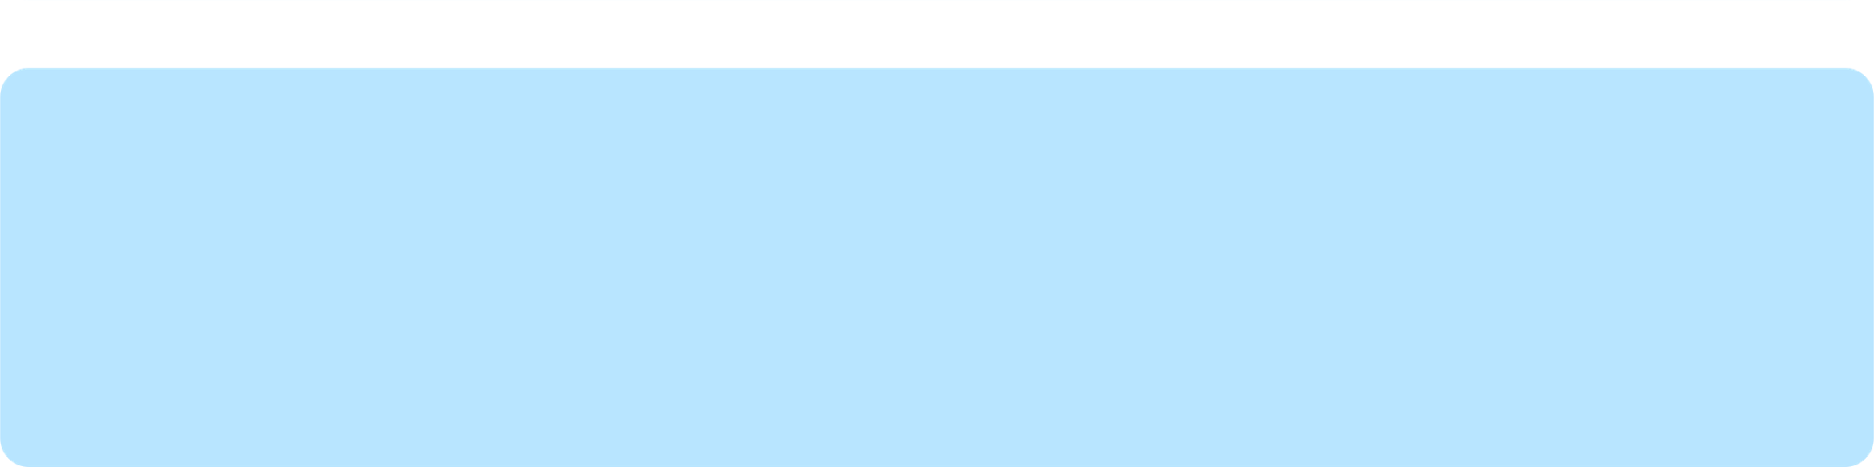

Introducing Viisar:
Affordable tactile STEM learning:
A lightweight, modular refreshable tactile display that converts graphs, geometry, and complex mathematical concepts into touch-based learning.
Built for accessibility and portability:
It directly solves the affordability, multi-line display, and portability gaps—making Braille and STEM content accessible to millions of visually impaired learners and professionals at a fraction of the cost.
Scalable and cost-effective:
Reduces the cost of tactile display technology from $10,000–$20,000 to $500–$1,500, while enabling local manufacturing, repair, and open-source scalability.

Slide 12
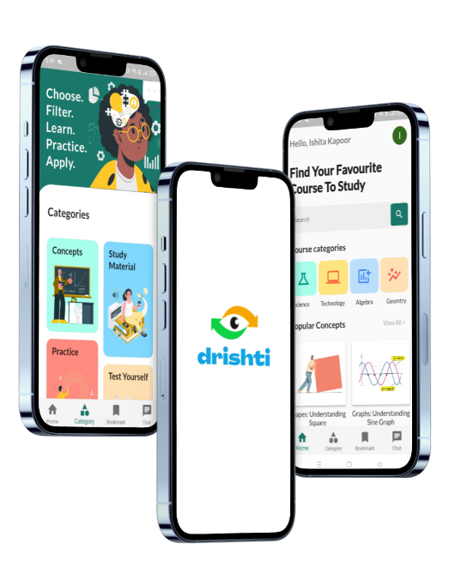
VIISAR
Product & Prototype Readiness
SOFTWARE SERVICES
Interactive Learning Modules AI-Powered Feedback System Portable Tactile-Compatible Interface Multilingual Support
VIISAR
Website Link:
https://viisar.vercel.app/

Slide 13


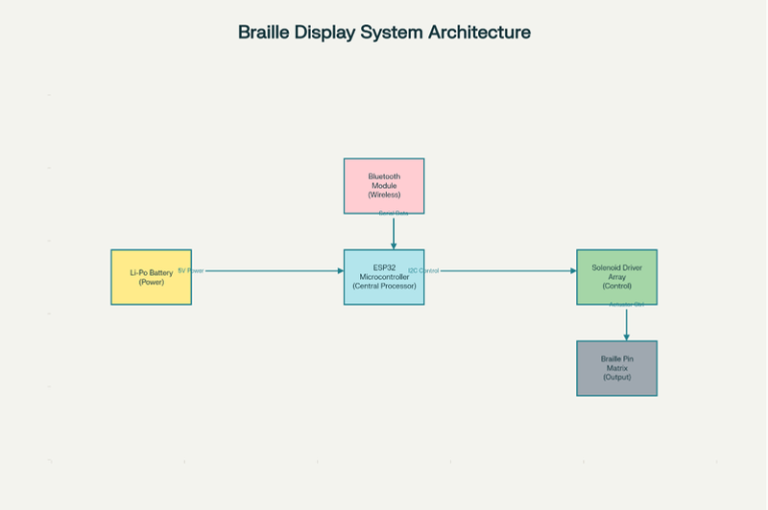
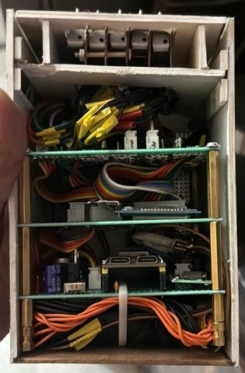
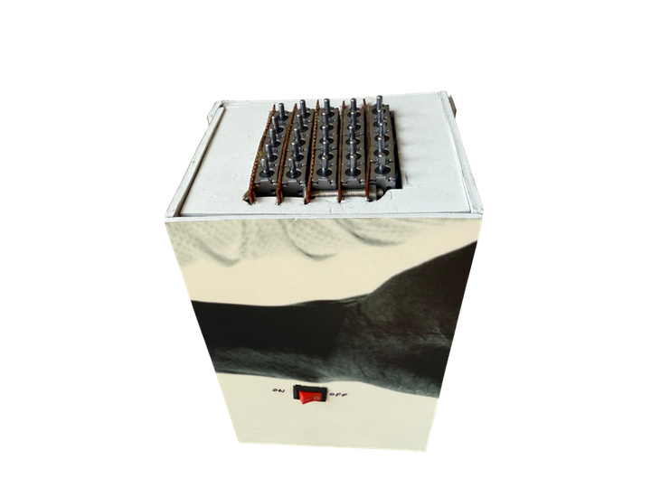
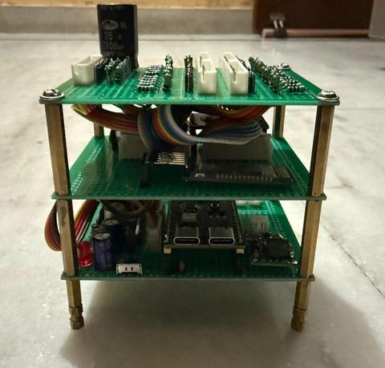
VIISAR
Product & Prototype Readiness
We help visually impaired students achieve confidence and inclusion in STEM through affordable, touch-based learning tools.
System Architecture
Hardware Prototype
Final Prototype
Internal Circuitry
Bluetooth-connected app drives a tactile pin-matrix via ESP32 + solenoid drivers.

Slide 14

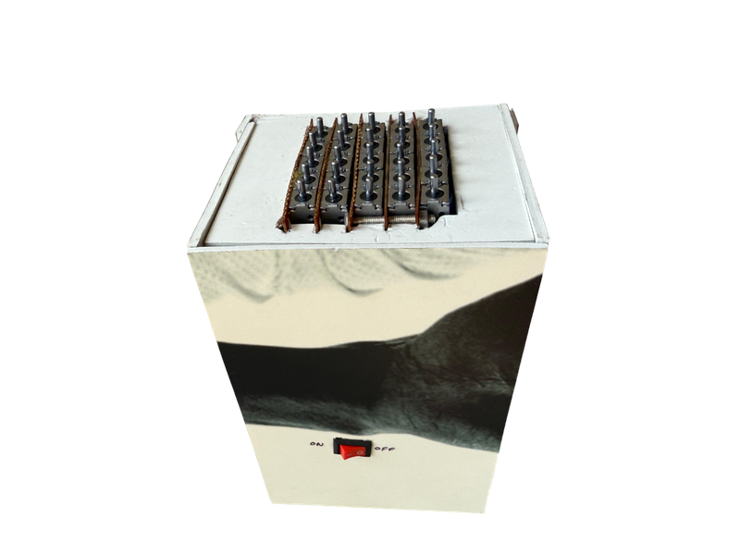
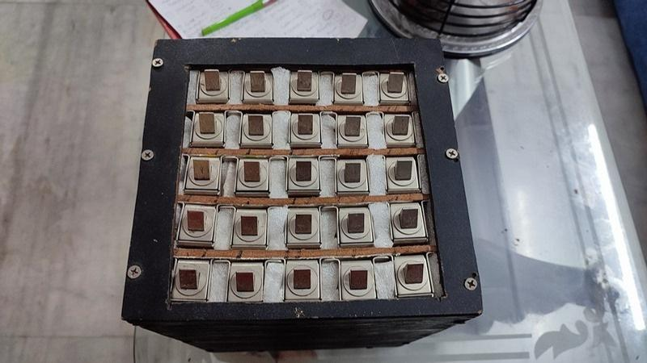
VIISAR
User Validation & Confirmation
Based on the feedback we received, we redesigned the hardware and made it smaller in size. This allows users to easily feel the images using their palm, and the device can now comfortably fit in the hand.
Before
After

Slide 15
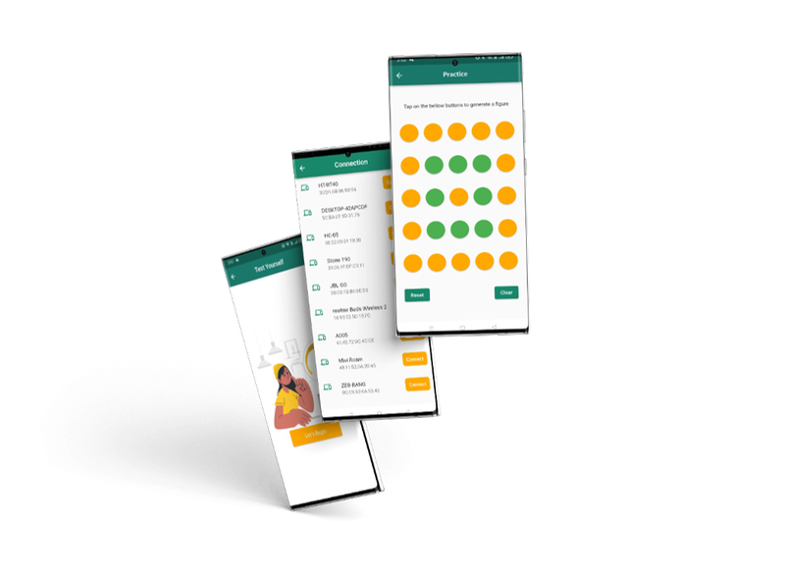
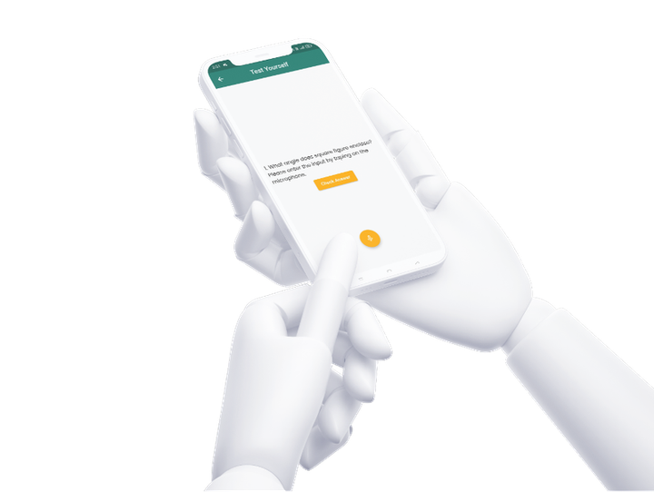
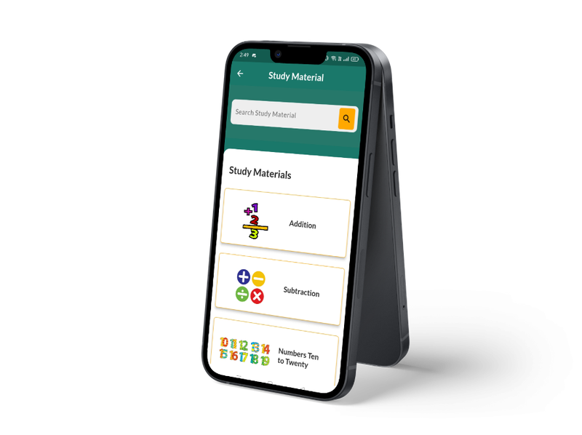
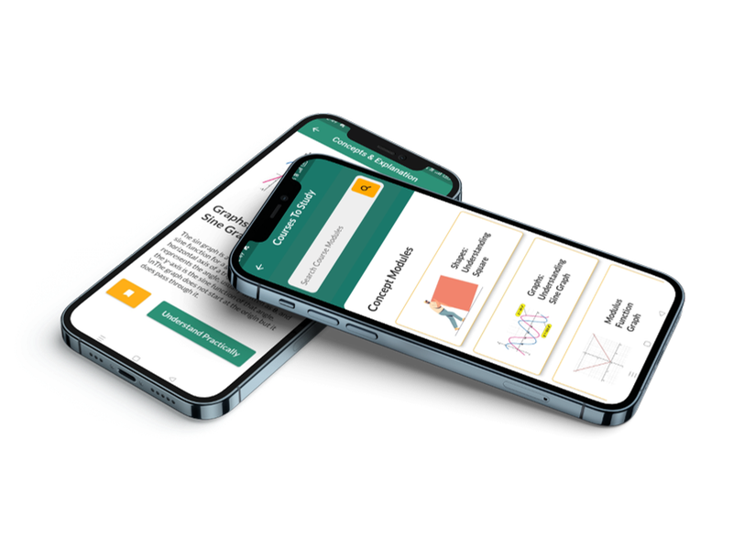
VIISAR
Product & Prototype Readiness
Use a Bluetooth-connected app and hardware to visually trace and comprehend figure geometry in real time
Assess your knowledge using real-time audio responses.
Key Features
Explore and Learn various Maths and Science Concepts
Mobile app with voice read-aloud feature offering a diverse range of STEM study materials.

Slide 16
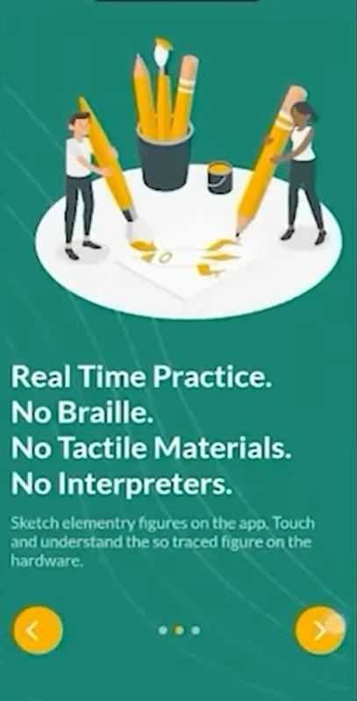
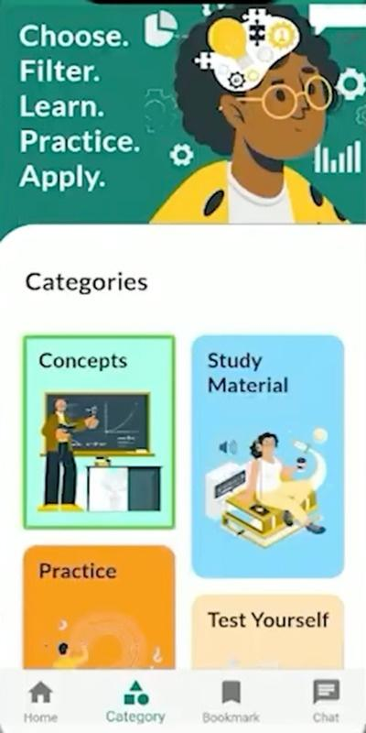
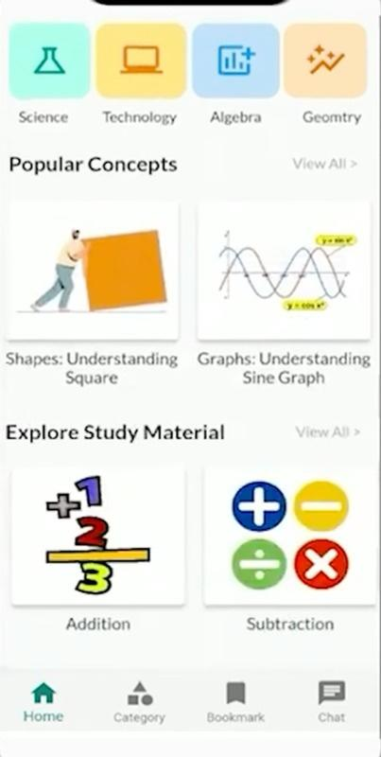
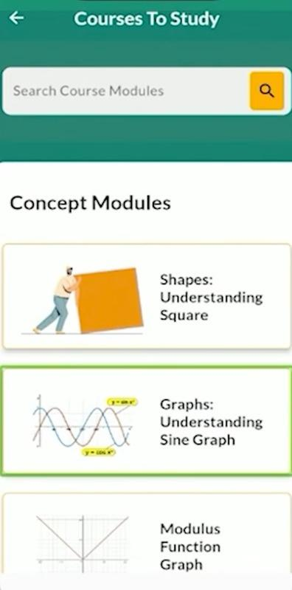

VIISAR
Product Journey Experience
Screens
Starting with the app
Available options to learn, practice and test
Offering a diverse range of STEM study materials.
Explore and Learn various Maths and Science Concepts

Slide 17



VIISAR
Product Journey Experience
Screens
Understanding Sine Graph
Bluetooth enable option for connecting to hardware
Hardware showing the practical representation of Sine Graph

Slide 18



VIISAR
Product Journey Experience
Screens
Connecting Bluetooth
Drawing square on app
Hardware showing square figure

Slide 19













VIISAR
Product Demo & Technology
Tech Stack:
Frontend
React Native
Fast API (AI Server)
NestJS (App Server)
Backend
Database
Clickhouse
Docker
MongoDB
Vercel
Deployment
CI/CD Pipeline
Hardware
Arduino IDE
Monitoring
Graphana
Mageai
Data Ingestion Pipelines

Slide 20





VIISAR
Innovation & Competitive Advantage
Portability
Cost-effective
Repairability
VIISAR
Graphiti
Dot Pad
BrailleMe
(Innovision Tech)

Slide 21

VIISAR
Market Opportunity: TAM, SAM & SOM
TAM
SAM
$20 Billion+
SOM
$200 Million+
Global visually impaired learners who need accessible STEM tools
$40 Million+
India + developing-market institutions reachable through schools, NGOs, CSR, and government
Realistic 3–5 year obtainable market through pilots, school partnerships, NGOs, and CSR-funded deployments.

Slide 22










KEY
ACTIVITIES
KEY
RESOURCES
Business Model Canvas
VIISAR
KEY
PARTNERS
VALUE
PROPOSITIONS
CUSTOMER
RELATIONSHIPS
CUSTOMER
SEGMENTS
STEM content creation
School onboarding / teacher training
Hardware manufacturing & assembly
Software Development
Sales & Marketing with after-sales support and repair
Converts visual STEM concepts into tactile learning
Enables blind students to feel graphs, shapes and diagrams
Combines tactile hardware + mobile app + audio guidance
Affordable compared to premium tactile display.
Portable, modular, and self repairable
Improves independent learning and classroom participation.
Demo-based onboarding
Training for teachers and institutions
Feedback-driven product improvement
Maintenance and repair support
Long-term institutional support plans
Blind educational institutions
Sai Netraheen Sewa Sanstha, New Delhi
National Blind School, New Delhi
CSR foundations
Assistive technology distributors
Government education departments
Special educators and curriculum experts
3D printing and PCB manufacturers
NGOs
GirlUpFoundation, NYC
Voice of Specially Abled People
Primary customer
Blind schools and inclusive schools
NGOs working in disability education
CSR foundations
Government inclusive education programs
Accessibility labs/ special education centers.
End users
Visually impaired students aged 8-24.
STEM teachers and special educators.
CHANNELS
Tactile hardware prototype
Mobile app & software platform
Team expertise in hardware, software, and accessibility.
User feedback data
STEM learning content
Direct sales to blind schools and inclusive schools.
School demos and teacher workshops
Assistive technology exhibitions
NGO and CSR partnerships
Government education tenders
COST STRUCTURE
REVENUE STREAMS
Hardware components
manufacturing/ 3D printing
Software platform development
Cloud hosting
Maintenance and repair
Sales, partnerships and demonstrations
Training and onboarding for schools
Average number of blind people using our software per year: 500
Average software subscriptions: INR 300 - 500 per month
Hardware sales (one-time): INR 40,000/ unit
Average number of hardware units sold: 500 units
Total income per year: 500*(500*12)+40000*500= 2.3 crores
After removing expenditure, estimated profit = INR 35-45 Lakhs per annum
Notes:
1.7.2013
‹#›

Slide 23








VIISAR
Social Impact & Schedule
Who is Benefited?
Primary -
Visually impaired / blind students (especially in under-resourced schools)
Secondary - Teachers, special educators, schools, parents/caregivers, NGOs
working in disability inclusion
Real World Use Case:
Teacher introduces topic (e.g., triangles / graphs / coordinate geometry)
Student uses the tool to feel the diagram (tactile output) + hear guidance (audio)
Student solves practice questions independently, gets feedback

Slide 24






VIISAR
Social Impact & Schedule
Direct Impact
Indirect Impact
Estimated Scale
SDGs
Accessible STEM via tactile + audio learning; improves concept understanding and confidence
Teacher enablement + curriculum integration for inclusive STEM classrooms and assessments.
Pilot target
(first deployment)
3–5 schools / 50–150
students
Post-pilot (after iteration)
10–20 schools / 300–800 students
STEM readiness → pathways to higher studies, skills development, and employability.
Long-term economic inclusion by reducing dependency and widening career opportunities.
Measurable outcomes
Learning gain: pre/post concept test improvement (%) Independence: % tasks completed without assistance Time efficiency: time to complete diagram-based
problems
Teacher adoption: weekly class sessions using tool
Retention rate: attendance or participation proxy
Cost proxy: reduction in material dependence per learner
Affordable assistive-tech learning infrastructure (device + app ecosystem) for learners.
Modular design supports scalable manufacturing, local repair, and sustainable deployment.
Cuts disability-based learning barriers; supports equal participation without constant assistance.
Scales access through schools/NGOs to underserved communities and low-income learners.

Slide 25


VIISAR
Why We Should Be Selected
Key reasons that make VIISAR the right choice
Proven Impact
1
Our solution directly addresses the learning gap for 39M+ visually impaired individuals, with measurable outcomes in pilot testing.
2
Scalable & Affordable
Modular hardware + mobile app architecture enables rapid deployment at <$1000/unit, making it accessible for NGOs and schools.
3
Strong Execution Team
Cross-functional team with deep expertise in assistive tech, embedded systems, and inclusive education design.
39M+
95%
<$1000
6 Month
Lives Impacted
Pilot Satisfaction
Per Unit Cost
To Deploy

Slide 26






VIISAR
Thank You

