Slide 1

Intermediate SQL
for Data Analysis

Slide 2
Agenda
Installing SQLiteStudio
Subqueries, Derived Tables, and Unions
Regular Expressions
Advanced Joins
Window Functions
Programming with SQL (Python, R and Java)

Slide 3
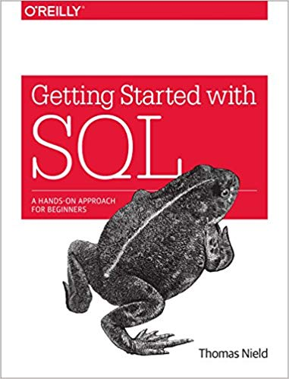


About the Instructor
Thomas Nield
Business Consultant for Southwest Airlines
Author of Getting Started with SQL by O'Reilly and Learning RxJava by Packt
My other online trainings at O'Reilly:
SQL Fundamentals for Data
Intermediate SQL for Data Analytics
Intro to Mathematical Optimization
Machine Learning from Scratch
thomasnield9727
https://github.com/thomasnield

Slide 4
Setting Up SQLite
SQLiteStudio or DB Browser for SQLite can be downloaded here:
https://sqlitestudio.pl/
https://sqlitebrowser.org/
You can install either of these platforms.
If you cannot install or download any software, you can use SQLiteOnline.com which is an online-only SQLite browser.

Slide 5
Getting Resource Files
The few resources needed for this class are available on GitHub:
https://github.com/thomasnield/oreilly_advanced_sql_for_data
Unzip the contents to a location of your choice, and note where you put them
Contents include:
A SQLite database file called thunderbird_manufacturing.db
Class notes with all examples (in three formats)
A customer_order.sql SQL script file to create a CUSTOMER_ORDER table

Slide 6
Section II Exercise
Bring in all fields from CUSTOMER_ORDER, but for each record show the total quantity ordered for that given CUSTOMER_ID and PRODUCT_ID.

Slide 7
Section III Exercise
Find all customers with an address ending in "Blvd" or "St"

Slide 8
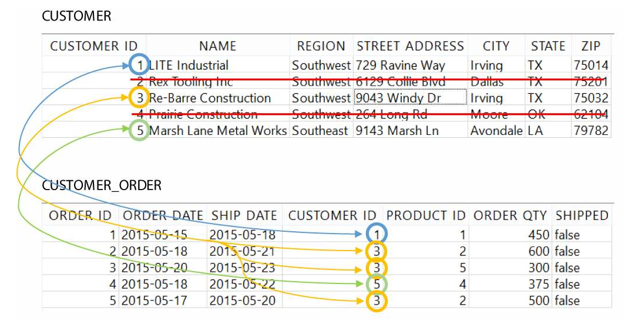
INNER JOIN

Slide 9
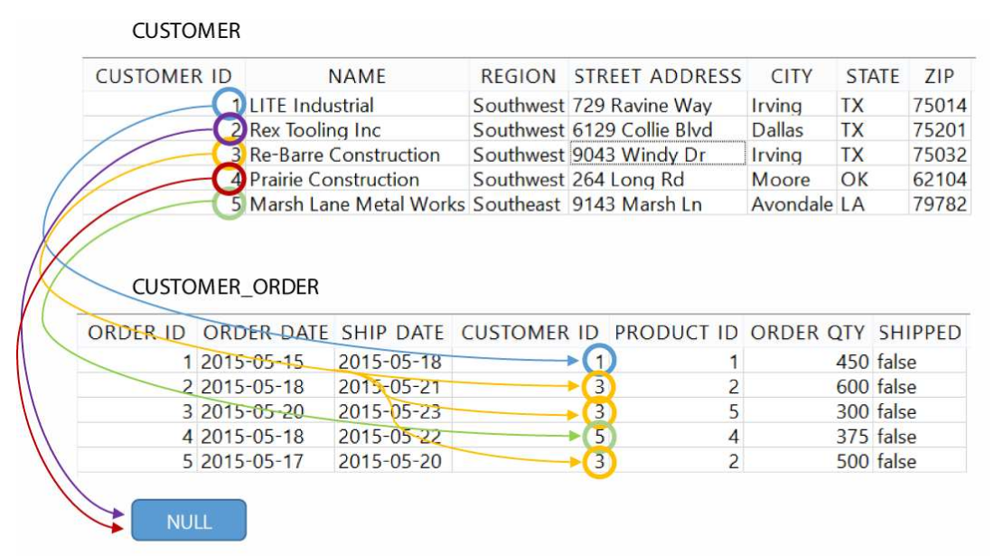
LEFT OUTER JOIN

Slide 10
Section VI Exercise
For every CALENDAR_DATE and CUSTOMER_ID, show the total QUANTITY ordered for the date range of 2017-01-01 to 2017-03-31:

Slide 11
Section V Exercise
For the month of March, bring in the rolling sum of QUANTITY ordered (to each ORDER_DATE) by CUSTOMER_ID and PRODUCT_ID.

Slide 12
Windowing Functions Support
Windowing functions are found on many database platforms, including:
Oracle
Teradata
PostgreSQL
SQL Server
Apache Spark SQL
MySQL (as of version 8)
SQLite (as of version 3.25.0)
These platforms notably do not have windowing functions:
MySQL (previous to version 8)
SQLite (previous version 3.25.0)
MariaDB

Slide 13
Mixing Programming with SQL
When using SQL with a programming platform like Python, Java, or R, you will constantly be making a decision where the onus of processing will happen.
Should the database engine do the computation work, or the programming platform?
You can simply pull in data and have your Python/Java/R codebase do the heavy-lifting.
You can also leverage more complex SQL against the database, and have Python/Java/R consume the results.
With a very large, expensive and calculated dataset you can save it to a temporary table and use it to support your Python/R/Java application.
A good rule of thumb: start with the simplest solution with minimal code/SQL that liberally hits the database as-needed, and gradually introduce caching strategies as performance starts to warrant it.
Never concatenate parameters, and use established SQL libraries to inject parameters safely to prevent SQL injection.

Slide 14

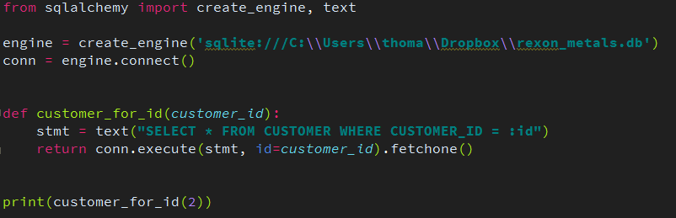
Preventing SQL Injection
To prevent SQL injection, never concatenate a SQL string with parameters
Instead, use the right tools and libraries to safely inject parameters for you
For Python, use SQLAlchemy
More info at:
http://www.sqlalchemy.org/

Slide 15
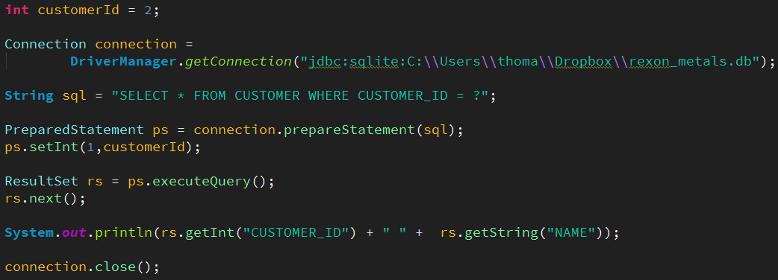
Preventing SQL Injection
For Java, Scala, Kotlin, and other JVM languages use JDBC’s PreparedStatement
More info at:
http://tutorials.jenkov.com/jdbc/index.html
http://www.marcobehler.com/make-it-so-java-db-connections-and-transactions

Slide 16

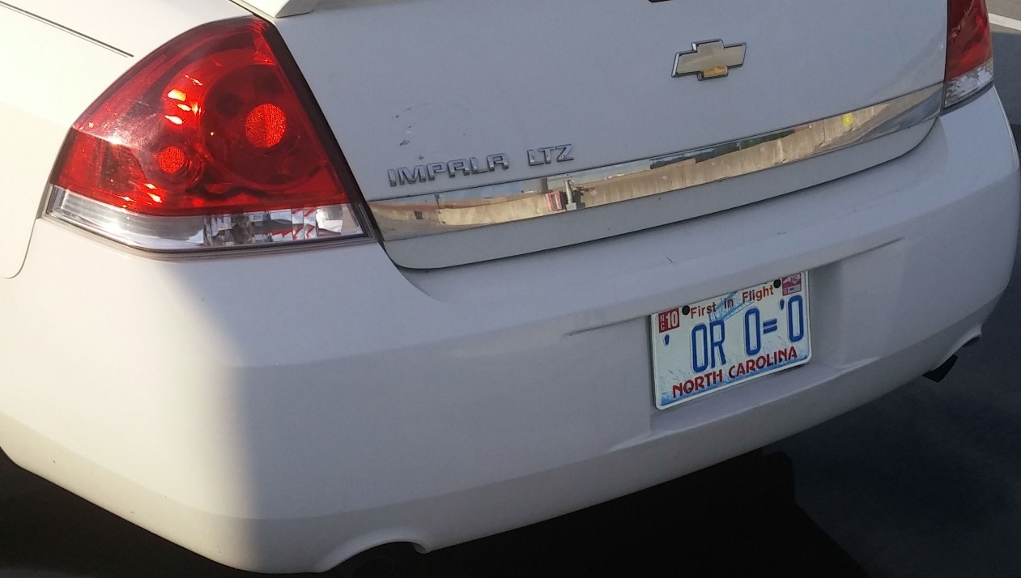
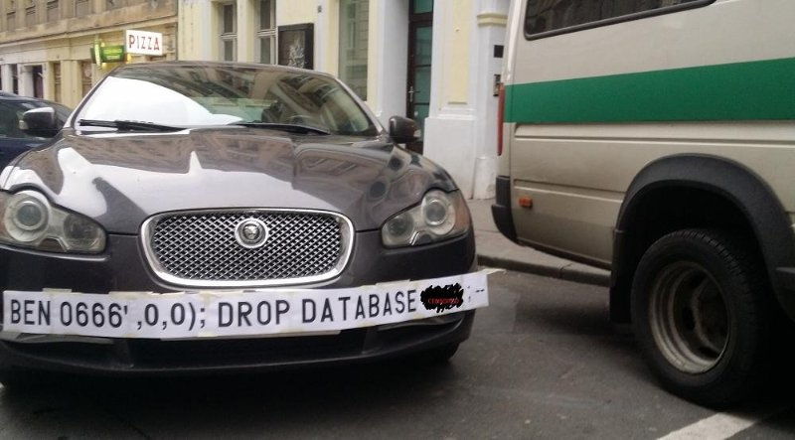

SQL Injection Humor

Slide 17
SQL Injection in the News
This couple cannot do the simplest things online because their last name is ‘Null’
https://thenextweb.com/insider/2016/03/27/last-name-null-is-tough-for-computers/
Catholic financial services hacked, 130K accounts exposed
http://www.twincities.com/2017/10/16/catholic-united-financial-data-breach-may-have-affected-nearly-130k-accounts/
South Africa’s massive data breach
https://www.moneyweb.co.za/news/tech/revealed-the-real-source-of-sas-massive-data-breach/
TalkTalk gets record £400K fine for failing to prevent October 2015 attack
https://ico.org.uk/about-the-ico/news-and-events/news-and-blogs/2016/10/talktalk-gets-record-400-000-fine-for-failing-to-prevent-october-2015-attack/

Slide 18
Other Online Trainings by Thomas Nield
SQL Fundamentals for Data
Intermediate SQL for Data Analytics
Intro to Mathematical Optimization
Machine Learning from Scratch

