Slide 1
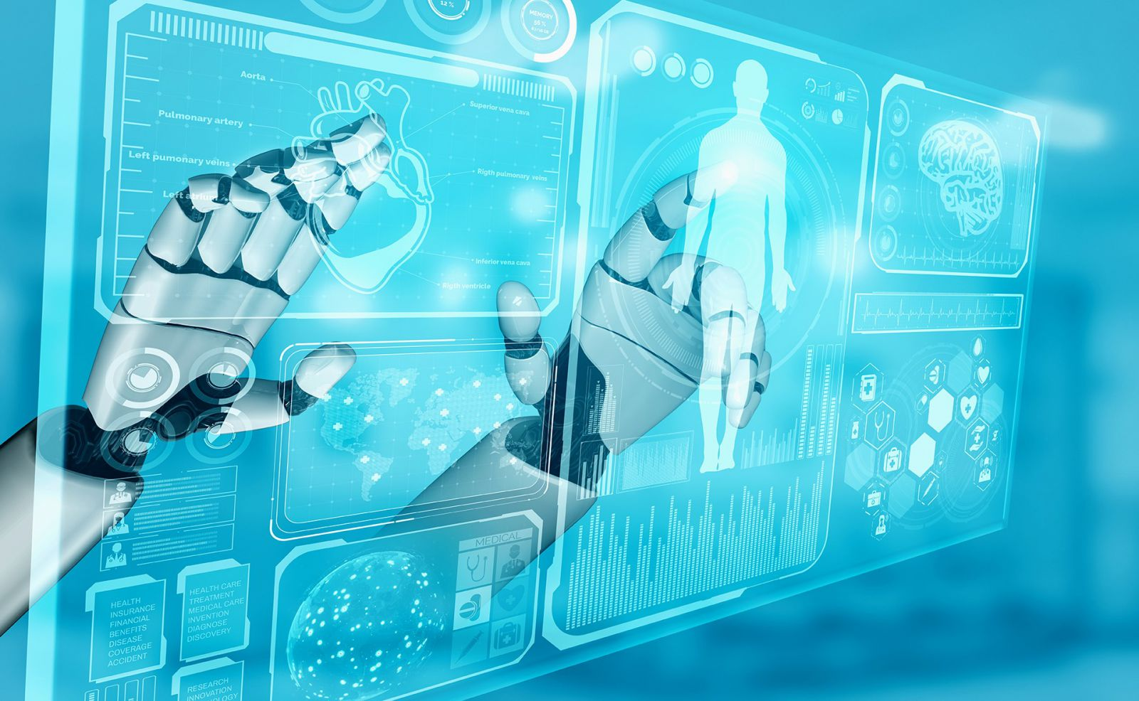
Signal Processing in Diagnostic Devices

Slide 2
Bio Medical Signal Processing:
Biomedical signal processing involves acquiring and preprocessing physiological signals and extracting meaningful information to identify patterns and trends within the signals.
Sources of biomedical signals include neural activity, cardiac rhythm, muscle movement, and other physiological activities. Signals such as electrocardiogram (ECG), electroencephalogram (EEG), electromyography (EMG) can be captured non-invasively and used for diagnosis and as indicators of overall health.

Slide 3
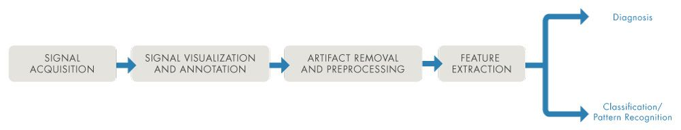
Bio Medical Signal Processing:
Continued…
The biomedical signal processing workflow involves:
Signal Acquisition
Signal Visualization and Annotation
Artifact Removal and Preprocessing
Feature Extraction
The extracted features are then fed into classification models or used directly for diagnosis.
Notes:
Image Reference: https://in.mathworks.com/discovery/biomedical-signal-processing.html

Slide 4
Signal Acquisition:
To measure the advances and efficiency of physical therapies, many sensors are required for recording biomedical signal data from the patients undergo these treatments in different situations at the same time, since performing the therapy procedure repeatedly can be stressful or expensive.
To collect the biomedical signal data, different sensors are required to be processed by a computer and then data are stored.
ECG: AD8232 sensor
EEG: CNT sensor (Carbon Nano Tube sensor)
Ultrasound: HC-SR04

Slide 5
Signal Visualization and Annotation:
Analyzing and visualizing signals in time, frequency, and time-frequency domains with or without writing any code.
These capabilities can help you in understanding which preprocessing techniques you can use to enhance the information contained within signals.
You can also annotate the biomedical signals and prepare them for downstream workflows such as machine learning and deep learning. (i.e. for designing predictive models like identifying cancerous and non-cancerous tumours, etc.)
Signals can be labeled manually or using algorithms like those that find peaks and transition points.

Slide 6
Artifact Removal and Signal Filtering:
Biomedical signals often contains noise or unwanted artifacts that can distort the analysis of the signals.
For instance, while measuring EKG signals, activities such as breathing and walking can add unwanted components.
One of the main challenges in preprocessing biomedical signals is to remove unwanted artifacts while preserving the sharp features within signals.
Most popular techniques for artifact removal are digital filtering, adaptive filtering, independent component analysis (ICA), and recursive least square.
A combination of preprocessing techniques may also be used to address the limitations of individual techniques.

Slide 7
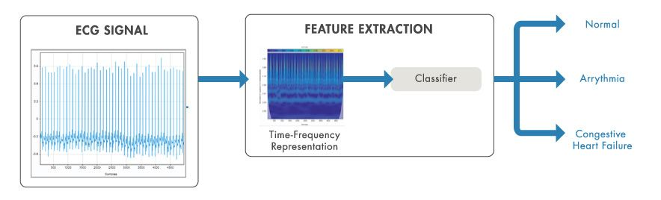
Feature Extraction:
Feature extraction can be accomplished manually or automatically.
Signal processing techniques like AR modeling, Fourier analysis, and spectral estimation can be used to manually compute key features from signals.
Time-frequency transformations, such as the short-time Fourier transform (STFT) can be used as signal representations for training data in machine learning and deep learning models.
Automatic feature extraction techniques like wavelet scattering can be used to reduce dimensionality and extract important features.
These features can be used directly for diagnosis or as input to machine learning and deep learning classifiers.
Notes:
Image Reference: https://in.mathworks.com/discovery/biomedical-signal-processing.html

