Slide 1
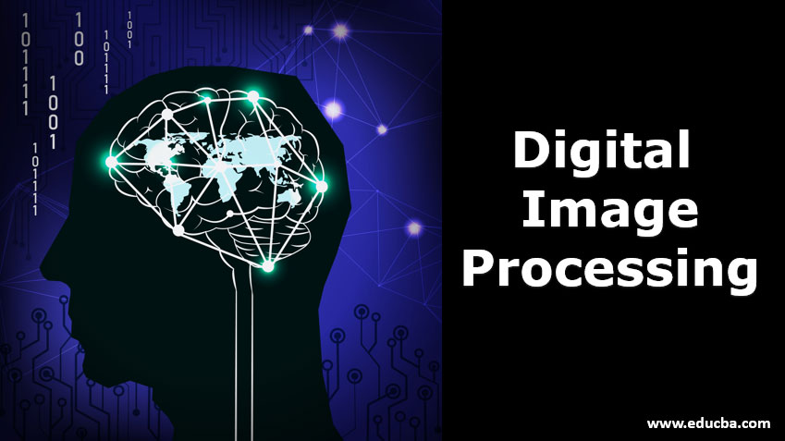

Slide 2
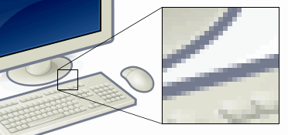
Pixel:
In digital imaging, a pixel (abbreviated px), pel, or picture element is the smallest addressable element in a raster image, or the smallest addressable element in a dot matrix display device.
In most digital display devices, pixels are the smallest element that can be manipulated through software.
Each pixel is a sample of an original or synthetic image; more samples typically provide more accurate representations of the original.
The intensity of each pixel is variable.
In color imaging systems, a color is typically represented by three or four component intensities such as red, green and blue, or cyan, magenta, yellow and black.
This example shows an image with a portion greatly enlarged so that individual pixels, rendered as small squares, can easily be seen.
Notes:
Image Refernce: https://en.wikipedia.org/wiki/Pixel#:~:text=Each%20pixel%20is%20made%20up,in%20a%20fixed%20native%20resolution.

Slide 3
Colour Spaces:
The colour spaces in image processing aim to facilitate the specifications of colours in some standard way.
Different types of colour models are used in multiple fields like in hardware, in multiple applications of creating animation, etc.
Let’s see each colour model and its application.
RGB
CMYK
HSV
YIQ

Slide 4
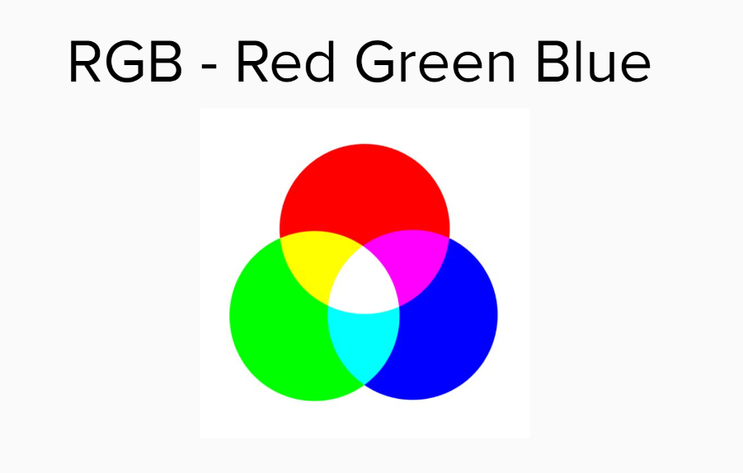
RGB:
The RGB colour model is the most common colour model used in Digital image processing and OpenCV.
The colour image consists of 3 channels. One channel each for one colour.
Red, Green and Blue are the main colour components of this model. All other colours are produced by the proportional ratio of these three colours only.
0 represents the black and as the value increases the colour intensity increases.
Properties:
This is an additive colour model. The colours are added to the black.
3 main channels: Red, Green and Blue.
Used in DIP, OpenCV and online logos.
Notes:
Image Reference: https://www.geeksforgeeks.org/difference-between-rgb-cmyk-hsv-and-yiq-color-models/

Slide 5
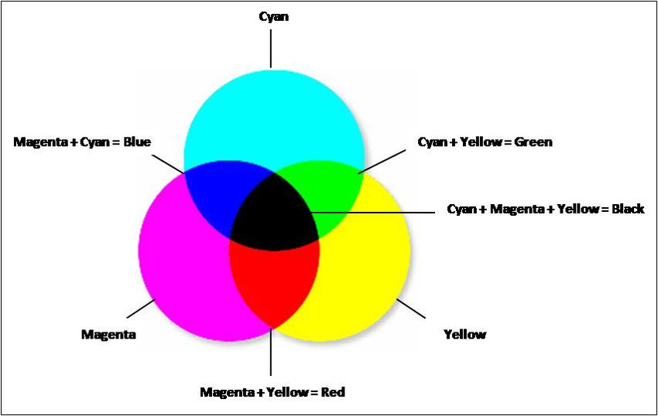
CMYK:
CMYK colour model is widely used in printers. It stands for Cyan, Magenta, Yellow and Black (key).
It is a subtractive colour model. 0 represents the primary colour and 1 represents the lightest colour.
In this model, point (1, 1, 1) represents black, and (0,0,0) represents white.
It is a subtractive model thus the value is subtracted from 1 to vary from least intense to a most intense colour value.
Notes:
Image Reference: https://www.geeksforgeeks.org/difference-between-rgb-cmyk-hsv-and-yiq-color-models/

Slide 6
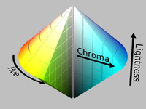
HSV:
The image consists of three channels.
Hue,
Saturation and
Value.
This colour model does not use primary colours directly.
It uses colour in the way humans perceive them.
HSV colour when is represented by a cone.
Hue is a colour component.
Notes:
Image Reference: https://www.geeksforgeeks.org/difference-between-rgb-cmyk-hsv-and-yiq-color-models/

Slide 7
HSV:
Continued…
Since the cone represents the HSV model, the hue represents different colours in different angle ranges.
Saturation as the name suggest describes the percentage of the colour.
0 being the grey and 1 being the primary colour.
Saturation describes the grey colour.
The value represents the intensity of the colour chosen.
Its value lies in percentage from 0 to 100.
0 is black and 100 is the brightest and reveals the colour.
HSV model is used in histogram equalization and converting grayscale images to RGB colour images.
Sometimes this value lies in the 0 to 1 range.

Slide 8
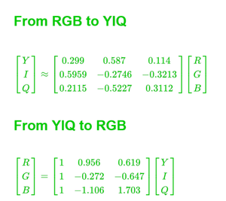
YIQ:
YIQ is the most widely colour model used in Television broadcasting.
Y stands for luminance part and IQ stands for chrominance part.
In the black and white television, only the luminance part (Y) was broadcast.
The y value is similar to the grayscale part.
The colour information is represented by the IQ part.
There exist a formula to convert RGB into YIQ and vice-versa.
YIQ model is used in the conversion of grayscale images to RGB colour images.
Notes:
Image Reference: https://www.geeksforgeeks.org/difference-between-rgb-cmyk-hsv-and-yiq-color-models/

Slide 9
Image File Formats:
Before you choose a file format, it’s important to understand the different image file types. There are several categories that define an image file’s capabilities:
Vector image files. These file types are ideal for resizing images, as they are endlessly scalable. The image proportions are calculated and automatically adjusted using line art equations, making it simple to modify your images without affecting file size or image clarity.
Raster image files. Rather than using algorithms, raster image files are based on pixels. The number of pixels and number of pixels per inch (PPI) or dots per inch (DPI) determines the image resolution. Raster images can be more difficult to scale without affecting the image quality.
High-resolution files. Images that have more PPI or DPI have a higher resolution, although this doesn’t always guarantee the image will appear crisp and clean. Depending on whether you need a web or print image, you’ll also need to pay attention to image dimensions and device requirements.
Low-resolution files. Images with fewer pixels or that are stretched will often appear blurry. If you need to enlarge a low-resolution image, you may need to use a program that can adjust the resolution while retaining the pixel quality.

Slide 10
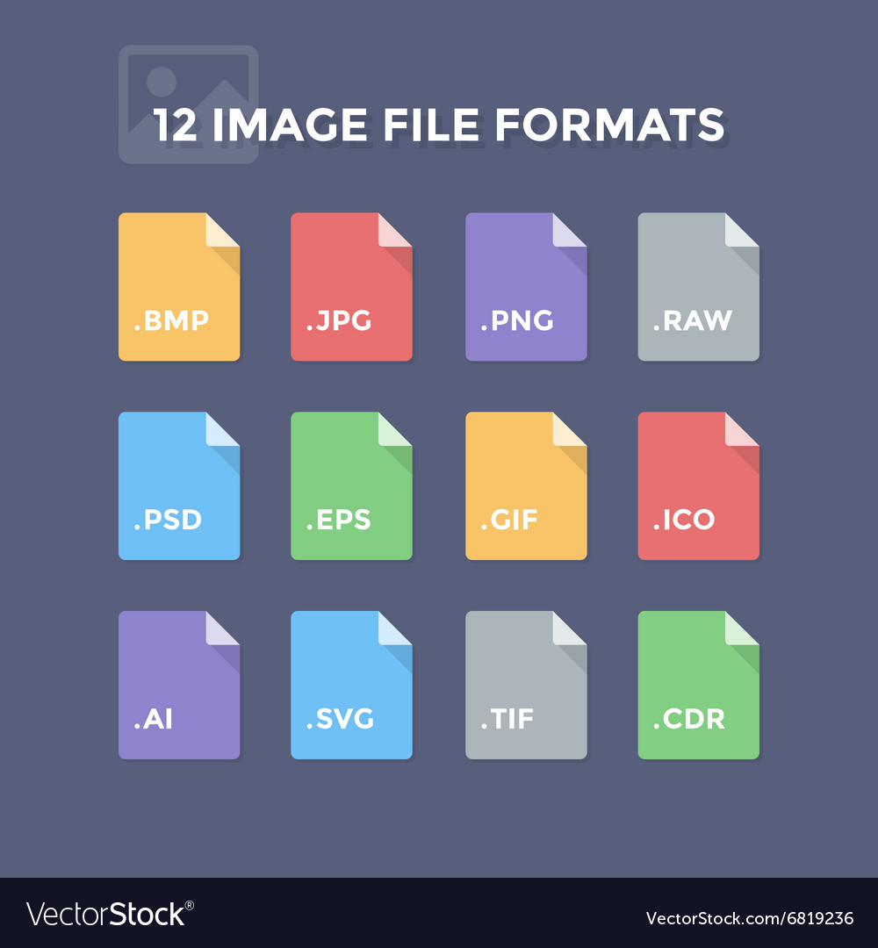
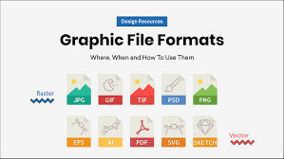
Image File Formats:
Continued…
The most common image file formats include
JPEG,
GIF,
PNG,
TIFF,
BMP and
PDF

Slide 11
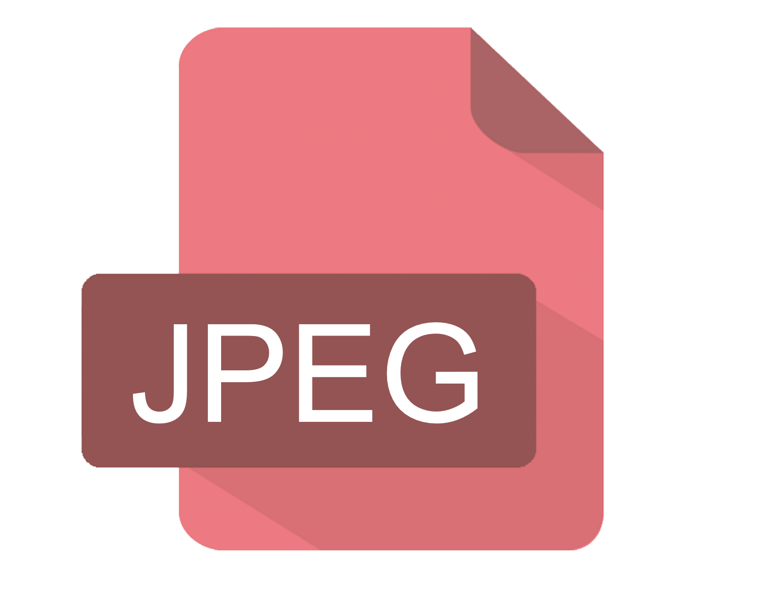
JPEG: Joint Photographic Experts Group
JPEG (or JPG) is a lossy image file format, meaning its quality decreases with the file size.
It’s the best choice for nearly all online images and for some printed photographs and artwork.
JPEG is your go-to option for adding images to websites and documents.

Slide 12
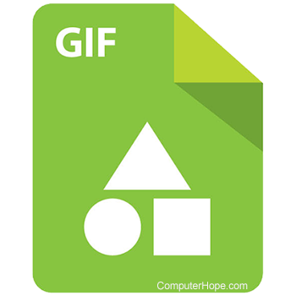
GIF: Graphics Interface Format
GIF is a lossless, lightweight image file format ideal for small graphics on websites and in emails.
It supports transparent elements and animated graphics.
If you see a small animated image on the web, you’re probably looking at a GIF.
However, GIFs are limited to 256 simultaneous colors, so they can’t achieve photographic quality.

Slide 13

PNG: Portable Network Graphics
You can think of PNG as the next-generation GIF.
It’s a lossless image file format that supports transparency and millions of colors.
It can also create animations, but few applications support this feature.
PNGs are ideal for colorful illustrations and graphics.

Slide 14

TIFF: Tagged Image File Format
TIFF is the workhorse format for high-resolution printing, including art photography and other fine artwork.
It’s a lossless image file format that retains extremely high photographic quality for scanning and printing.
However, TIFF file sizes are usually huge, making them difficult to share for general purposes.

Slide 15
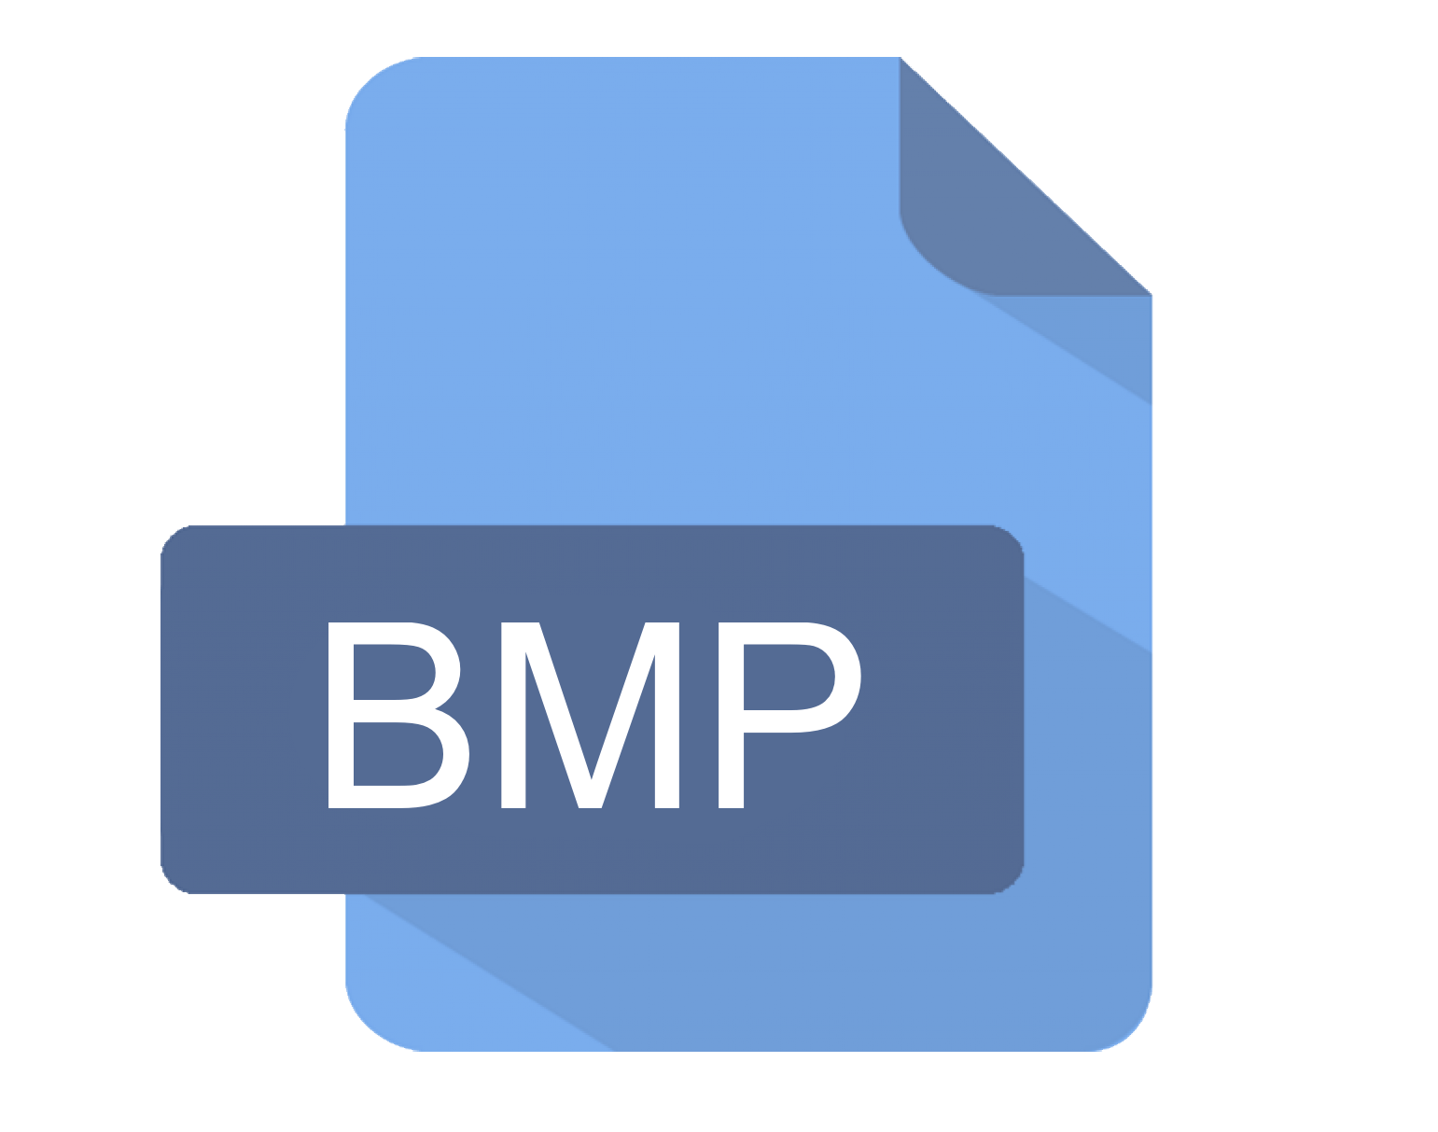
BMP: Bitmap
BMP is an uncompressed raster file format suited well for storing and displaying high-quality digital images.
While you don’t need to worry about losing data with BMP files, BMPs generally have larger file sizes than other formats and can be difficult to store.
BMPs are ideal for creating detailed scans or archival copies.
This file format was originally developed by Microsoft for Windows, but it’s compatible with many different operating systems.

Slide 16

PDF: Portable Document Format
PDF isn’t actually an image file format, but sometimes it can be a good idea to convert images to PDFs.
You can open PDFs on any device and compress them to smaller file sizes without significantly affecting image quality.
And, if you need to share multiple images at once, PDFs are a great option.
You can convert your images into a single PDF document with online tools like Adobe Acrobat online services.

