Slide 1
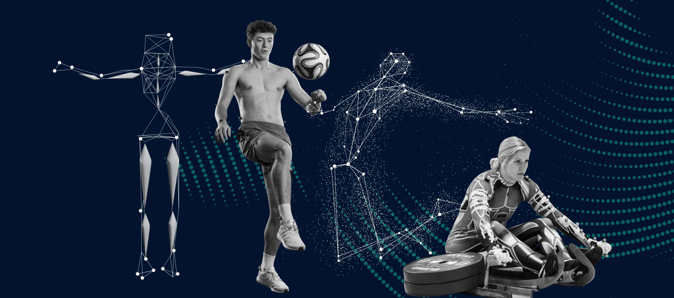
Techniques for analyzing motion in image sequences, including optical flow and motion tracking

Slide 2
What is Motion Analysis?
Motion Analysis refers to the processes of detecting, analyzing, and following the movement of objects or regions of interest within video or image sequences.
This field plays a crucial role in various applications, including surveillance, autonomous navigation, sports analysis, robotics, and more.

Slide 3
Overview:
Object Detection: Before tracking can begin, computer vision systems need to identify objects or regions of interest within a video stream or image sequence. Object detection algorithms, such as YOLO (You Only Look Once) or Faster R-CNN, are commonly used for this purpose.
Motion Estimation: Motion analysis starts with the estimation of how objects within the video sequence are moving over time. Various techniques are employed for this, including optical flow, which computes the movement of pixels between consecutive frames, and dense optical flow methods like Lucas-Kanade or Horn-Schunck.
Feature Tracking: Once objects or points of interest are detected, feature tracking algorithms help maintain correspondence between these features across frames. Common features include key points, corners, or unique textures. The Lucas-Kanade tracker is an example of a popular feature tracking technique.

Slide 4
Overview: continued…
4. Object Tracking: Object tracking involves following the entire object’s movement throughout the video sequence. This requires associating the detected object in one frame with the same object in subsequent frames. Various tracking algorithms are used for this, such as the Kalman filter, Particle filter, and Mean-Shift tracking.
5. Multiple Object Tracking: In scenarios where multiple objects are present, multiple object tracking algorithms must be used to keep track of each object individually and avoid confusion. Data association techniques are used to match objects between frames correctly.
6. Motion Analysis and Trajectory Prediction: After tracking objects, motion analysis can be performed to study object trajectories, speed, acceleration, and behavior patterns. This information can be crucial in applications like traffic monitoring, where predicting the future positions of vehicles is essential for safety and traffic management.

Slide 5
Application:
Object Detection: The system initially detects cars in the first frame using an object detection algorithm. It identifies the location and outlines of each car.
Feature Extraction: From the detected cars, the system extracts distinctive features, such as corners or key points, to track them more effectively.
Object Tracking: As the video continues, the system tracks the movement of each car by continuously updating the position of the extracted features in each frame.
Motion Estimation: By analyzing the changes in the position of the tracked features over time, the system can estimate the speed and direction of each car’s movement within the parking lot.

Slide 6
Advantages:
Object Detection and Localization: Motion analysis and tracking can help in detecting and localizing objects of interest in a scene, even when they are partially obscured or moving erratically.
Enhanced Understanding: They provide a richer understanding of the dynamic aspects of a scene, allowing for better decision-making in applications like autonomous vehicles or surveillance.
Behavior Analysis: Motion analysis enables the study of object behaviors over time, which is valuable in fields such as psychology, biology, and social sciences.
Real-Time Processing: Advances in hardware and algorithms have made real-time motion analysis and tracking feasible, which is crucial for applications requiring quick responses, like autonomous navigation and human-computer interaction.
Improves Object Tracking: In tracking applications, it can help maintain a target’s identity even when it briefly disappears from view, due to occlusion, for example.

Slide 7
Disadvantages:
Complexity: Developing effective motion analysis and tracking algorithms can be highly complex and resource-intensive, requiring significant computational power.
Sensitivity to Environmental Factors: Changes in lighting, weather, or other environmental conditions can affect the accuracy of motion analysis and tracking systems, making them less reliable.
Noise and False Positives: Noise in sensor data or image artifacts can lead to false positives, causing incorrect object detection or tracking.
Computational Load: Real-time tracking on resource-constrained devices can be challenging due to the computational load, potentially leading to delays or reduced performance.
Data Storage and Transmission: Continuous tracking generates a significant amount of data, which can be challenging to store and transmit, especially in remote or bandwidth-constrained environments.
Limited in Complex Scenes: In highly cluttered or crowded scenes with numerous moving objects, it can be challenging to accurately track specific objects or predict their future positions.

Slide 8
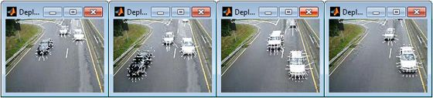
What is Optical Flow?
Optical flow is the distribution of the apparent velocities of objects in an image.
By estimating optical flow between video frames, you can measure the velocities of objects in the video.
In general, moving objects that are closer to the camera will display more apparent motion than distant objects that are moving at the same speed.
Optical flow estimation is used in computer vision to characterize and quantify the motion of objects in a video stream, often for motion-based object detection and tracking systems.
Moving object detection in a series of frames using optical flow.
Notes:
Image Reference: https://in.mathworks.com/discovery/optical-flow.html#:~:text=What%20Is%20Optical%20Flow%3F,of%20objects%20in%20the%20video.

Slide 9
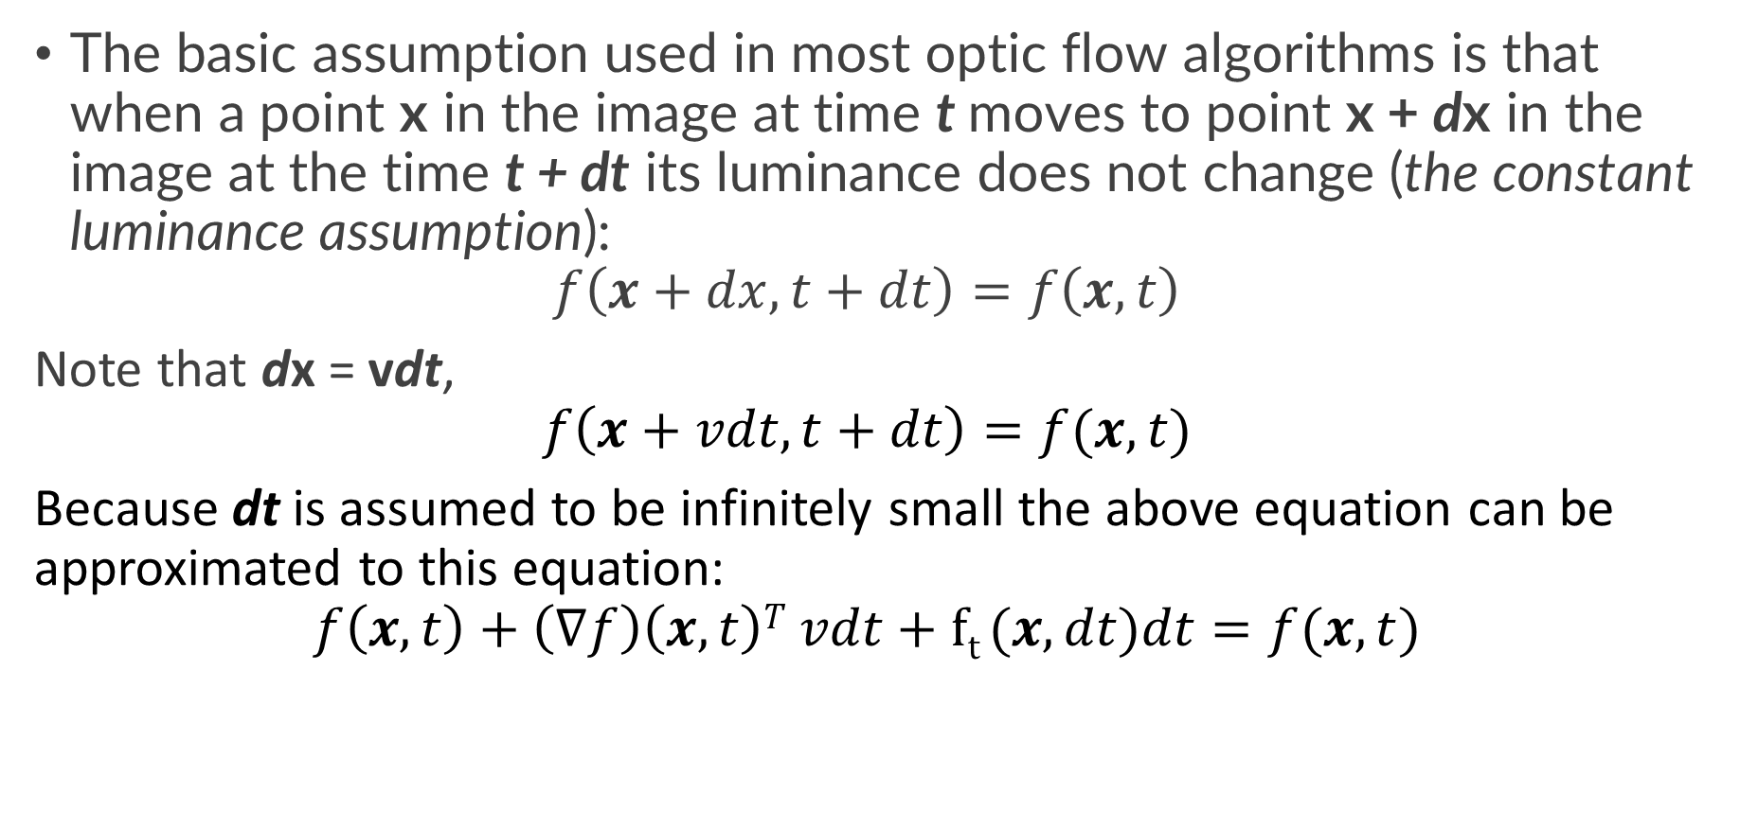
Math behind Optical Flow:
The basic assumption used in most optic flow algorithms is that when a point x in the image at time t moves to point x + dx in the image at the time t + dt its luminance does not change (the constant luminance assumption):
$$f\left(x+dx, t+dt\right)=f\left(x,t\right)$$
Note that dx = vdt,
$$f\left(x+vdt, t+dt\right)=f(x,t)$$
Because dt is assumed to be infinitely small the above equation can be approximated to this equation:
$$f\left(x,t\right)+\left(∇f\right)\left(x,t\right)T vdt+ft (x,dt)dt=f(x,t)$$
Notes:
Reference: https://staff.fnwi.uva.nl/r.vandenboomgaard/IPCV20162017/LectureNotes/CV/Motion/OpticFlow.html

