Slide 1
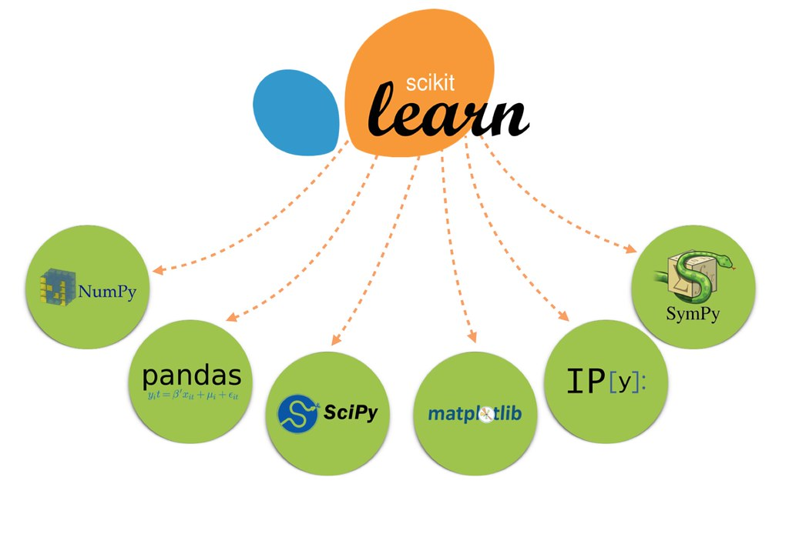

Introduction to scikit-learn
Machine learning library for the Python programming language

Slide 2
Introduction to scikit-learn
Overview:
Key Strengths:
Purpose:

Slide 3
Core Features of scikit-learn
Broad Range of Algorithms:
Tools for Model Selection:
Data Preprocessing:

Slide 4
Importance of scikit-learn in Machine Learning
Accessibility:
Community and Support:
Integration with Python Ecosystem:

Slide 5
scikit-learn's Key Components
Estimators:
Predictors:
Transformers:

Slide 6
Supervised Learning with scikit-learn
Overview:
Examples:

Slide 7
Unsupervised Learning with scikit-learn
Description:
Applications:

Slide 8
Model Selection and Evaluation
Tools:
Importance:

Slide 9
Data Preprocessing and Feature Engineering
Capabilities:
Impact:

Slide 10
Real-World Applications of scikit-learn
Industry Use-Cases:
Academic Research:

