Slide 1

Parallel Processing
Techniques for leveraging multi-core and GPU processing for accelerated image processing tasks

Slide 2
What is Parallel Processing?
Parallel processing is a computing technique when multiple streams of calculations or data processing tasks co-occur through numerous central processing units (CPUs) working concurrently.
In general, parallel processing refers to dividing a task between at least two microprocessors.
The idea is very straightforward: a computer scientist uses specialized software created for the task to break down a complex problem into its component elements.
Then, they designate a specific processor for each part. To complete the entire computing problem, each processor completes its portion.
The software reassembles the data to solve the complex initial challenge.

Slide 3
Parallel Processing in Image Processing:
Parallel image processing and analysis has been of interest at the Computer Vision Laboratory of the University of Maryland in College Park for many years.
Image processing and analysis are computationally intensive because of the complexity of the operations and the quantity of data that need to be processed.
Most images range in size from 256 x 256 to 1024 x 1024, so that up to three megabytes of data need to be processed for one color image.
Computational complexity is O(N² ) for an N x N image for simple operations such as point or local operations, and is even higher for more complex tasks such as image restoration and image compression.
In real-time video processing, tens of images must be processed every second.

Slide 4
Harris Corner Detection: An Overview
Harris Corner Detector is a corner detection operator that is commonly used in computer vision algorithms to extract corners and infer features of an image.
It was first introduced by Chris Harris and Mike Stephens in 1988 upon the improvement of Moravec’s corner detector.
Compared to the previous one, Harris’ corner detector takes the differential of the corner score into account with reference to direction directly, instead of using shifting patches for every 45-degree angles, and has been proved to be more accurate in distinguishing between edges and corners.
Since then, it has been improved and adopted in many algorithms to preprocess images for subsequent applications.

Slide 5
CPU vs. GPU: A Paradigm Shift
Today’s high-performance military computer systems rely increasingly on the graphics processing unit (GPU) to perform complex tasks.
GPUs have taken on many of the tasks traditionally entrusted to central processing units (CPUs), and their ability to handle and process large amounts of data has made them an important tool in the drive for increased networking and data-sharing, especially in the military domain.
They are also key enablers when it comes to the growth of areas such as artificial intelligence (AI).
CPUs are ideal at performing sequential tasks very quickly, but it struggles with parallel processing across a wide range of tasks. By contrast, the GPU comprises a large array of relatively slow processors, but they can work in parallel, in turn allowing the processing of huge amounts of data.

Slide 6
CUDA: The Enabler of Parallelism
NVIDIA's CUDA (Compute Unified Device Architecture), originally associated with the Plymouth Barracuda (CUDA), embodies the spirit of raw power, speed, elegance, and unrestrained innovation.
CUDA has enabled and redefined traditional HPC (high performance computing) capabilities and infrastructure, enabling both traditional and modern applications to utilize GPU computing infrastructures with extreme efficiency and power compared to traditional CPU-only based infrastructures of the past.
In 2003, a team of researchers led by Ian Buck unveiled Brook, the first widely adopted programming model to extend C with data-parallel constructs. Buck later joined NVIDIA and led the launch of CUDA in 2006, the first commercial solution for general purpose computing on GPUs.
CUDA allows software developers to use one or more (parallelized) NVIDIA GPUs (graphics processing units) for highly optimized, general-purpose processing.

Slide 7
Parallel Algorithms:
The need for a parallel algorithm model arises in order to understand the strategy that is used for the partitioning of data and the ways in which these data are being processed.
Therefore every model being used provides proper structuring based on two techniques. They are as follows:
1. Selection of proper partitioning and mapping techniques.
2. Proper use of strategy in order to reduce the interaction.

Slide 8
1. The Data-Parallel Model:
The data-parallel model algorithm is one of the simplest models of all other parallel algorithm models.
In this model, the tasks that need to be carried out are identified first and then mapped to the processes.
This mapping of tasks onto the processes is being done statically or semi-statically.
In this model, the task that is being performed by every process is the same or identical but the data on which these operations or tasks are performed is different.

Slide 9
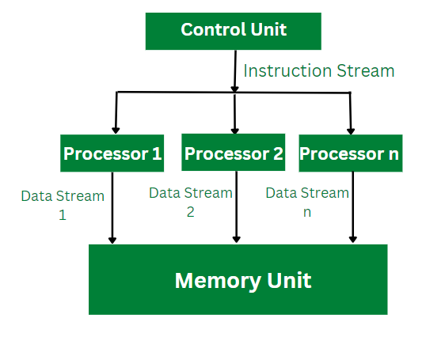
1. The Data-Parallel Model continued…
The problem to be solved is divided into a number of tasks on the basis of data partitioning.
Here data partitioning is being used because all the operations performed by each process are similar and proper uniform partitioning of data followed by static mapping assures the proper load balancing.
Example: Dense Matrix Multiplication

Slide 10
2. The Task Graph Model:
The task dependency graph is being used by the parallel algorithms for describing the computations it performs.
Therefore, the use of interrelationships among the tasks in the task dependency graph can be used for reducing the interaction costs.
This model can be used effectively for solving problems in which tasks are associated with a large amount of data as compared to that actual computation.
The parallelism that is described with the task dependency graph where each task is an independent task is known as task parallelism.

Slide 11
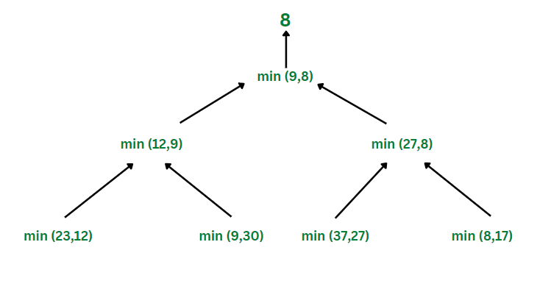
2. The Task Graph Model: continued…
The task graph model is majorly used for the implementation of parallel quick sort, a parallel algorithm based on divide and conquer.
Example: Finding the minimum number

Slide 12
3. Work Pool Model​:
The work pool model is also known as the task pool model. This model makes use of a dynamic mapping approach for task assignment in order to handle load balancing.
The size of some processes or tasks is small and requires less time. Whereas some tasks are of large size and therefore require more time for processing.
In order to avoid the inefficiency load balancing is required.
The pool of tasks is created.
These tasks are allocated to the processes that are idle in the runtime.

Slide 13
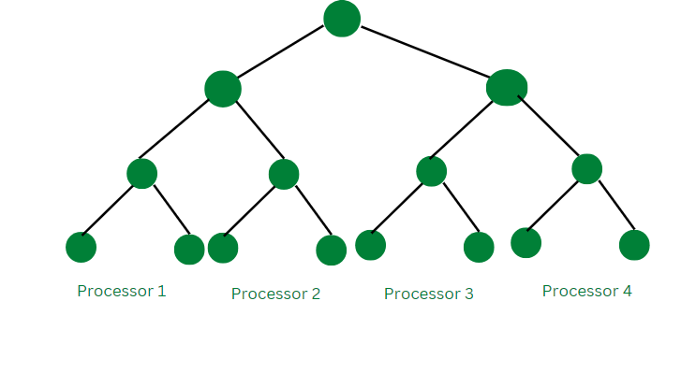
3. Work Pool Model​: continued…
This work pool model can be used in the message-passing approach where the data that is associated with the tasks is smaller than the computation required for that task.
In this model, the task is moved without causing more interaction overhead.
Example: Parallel tree search

Slide 14
4. Master-Slave Model:
Master Slave Model is also known as Manager-worker model.
The work is being divided among the process.
In this model, there are two different types of processes namely master process and slave process.
One or more process acts as a master and the remaining all other process acts as a slave.
Master allocates the tasks to the slave processes according to the requirements.
The allocation of tasks depends on the size of that task.
If the size of the task can be calculated on a prior basis the master allocates it to the required processes.

Slide 15
4. Master-Slave Model: continued…
If the size of the task cannot be calculated prior the master allocates some of the work to every process at different times.
The master-slave model works more efficiently when work has to be done in different phases where the master assigns different slaves to perform tasks at different phases.
In the master-slave model, the master is responsible for the allocation of tasks and synchronizing the activities of the slaves.
The master-slave model is generally efficient and used for shared address space and message-passing paradigms.
Example: Distribution of workload across multiple slave nodes by the master process

Slide 16
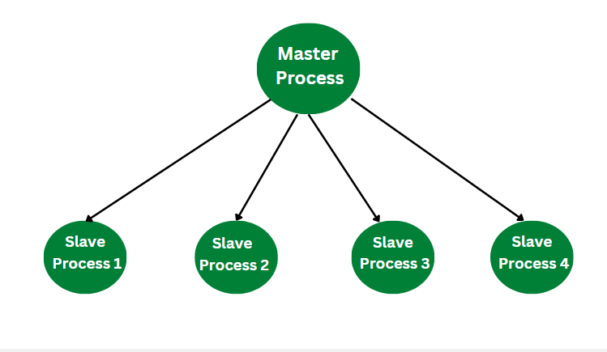
4. Master-Slave Model: continued…
As shown in the above example of the Master-Slave model, the distribution of workload is being done across multiple processes.
As shown in the above diagram, one node is the master process that allocates the workload to the other four slave processes.
In this way, each sub-computation is carried out by multiple slave processes.

Slide 17
5. The Pipeline Model:
The Pipeline Model is also known as the Producer-Consumer model.
This model is based on the passing of a data stream through the processes that are arranged in succession.
Here a single task goes through all the other processes.
They are then accessed by the required processes in a sequential manner.
Once the processing of one process is finished it goes to the next present process. In this model, the pipeline acts as a chain of producers and consumers.
This pipeline of producers and consumers can also be arranged in a directed graph-like fashion rather than a linear chain.

Slide 18
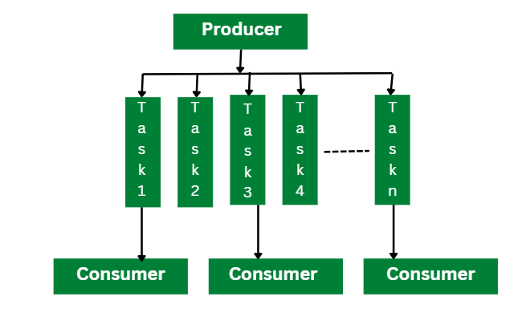
5. The Pipeline Model: continued…
The approach of Static mapping is being used for mapping of tasks onto the processes.
Example: Parallel LU factorization algorithm

Slide 19
5. The Pipeline Model: continued…
As shown in the above diagram, the Parallel LU factorization algorithm uses the pipeline model.
In this model, the producer reads the input matrix and generated the tasks that are required for computing the LU factorization as an output.
The producer divides this input matrix into a smaller size of multiple tasks and shares them into a shared task queue.
The consumers then retrieve these blocks and perform the LU factorization on each independent block.

Slide 20
6. Hybrid Model:
A hybrid model is the combination of more than one parallel model. This combination can be applied sequentially or hierarchically to the different phases of the parallel algorithm.
The model that can be efficient for performing the task is selected as a model for that particular phase.
Example: A combination of master-slave, work pool, and data graph model.
As shown in the above hybrid model where three different models are used at each phase master-slave model, the work pool model, and the data graph model.

Slide 21
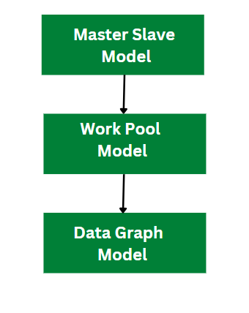
6. Hybrid Model: continued…
Consider the above example where the master-slave model is used for the data transformation task.
The master process distributes the task to multiple slave processes for parallel computation. In the second phase work pool model is used for data analysis and similarly data graph model is used for making the data visualization.
In this way, the operation is carried out in multiple phases and by using different parallel algorithm models at each phase.

