Slide 1
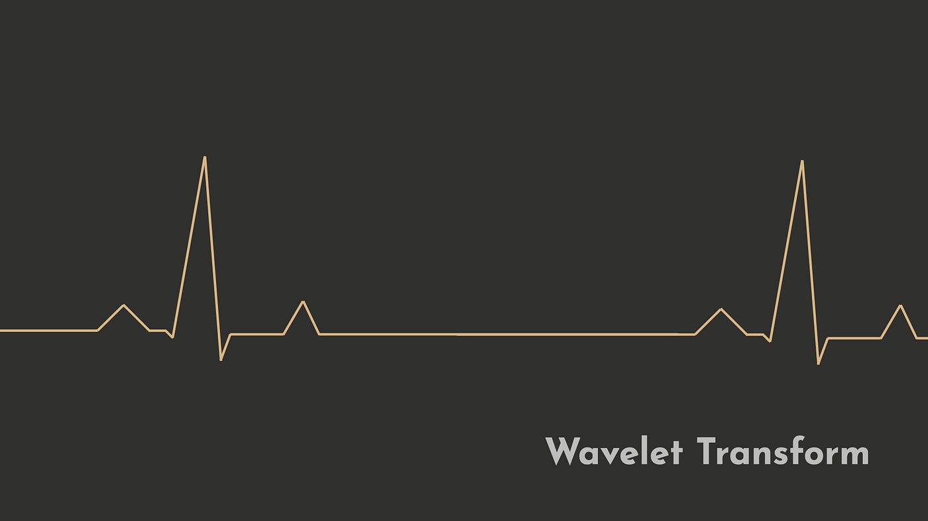
WAVELET ANALYSIS

Slide 2
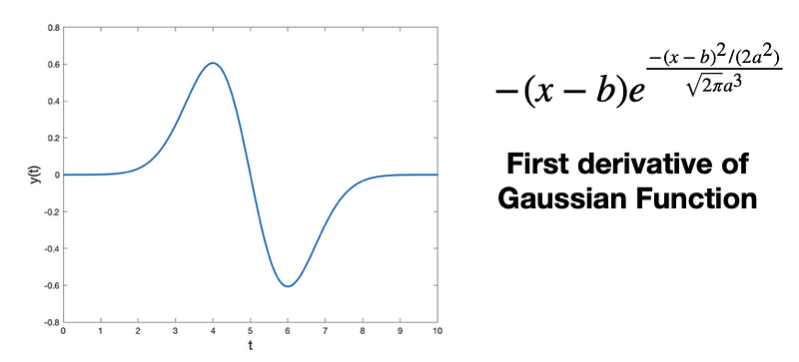
What is Wavelet?
A Wavelet is a wave-like oscillation that is localized in time, an example is given below.
Wavelets have two basic properties: scale and location.
Scale (or dilation) defines how “stretched” or “squished” a wavelet is.
This property is related to frequency as defined for waves.
Location defines where the wavelet is positioned in time (or space).
Notes:
Image Reference: https://cdn-images-1.readmedium.com/v2/resize:fit:800/1*Ioee_j_s29XVULQVUN_OmA.png

Slide 3
What is Wavelet Analysis?
Wavelet analysis is an alternative to windowed Fourier transforms that also yields a two-dimensional plot showing strengths of variations as a function of both period (or frequency) and time.
Unlike Fourier analysis, which characterizes similarities between time series and trigonometric functions of infinite extent, wavelet analysis addresses similarities, over limited portions of the time series, to waves of limited time extent called wavelets.
It is basically measure the amount of similarity between a wavelet with another continuous/discrete wave. (Inner Product)
It gives relation between Frequency and Time Domain with resistance to noise.

Slide 4
What is Wavelet Analysis?
According to Heisenberg uncertainty, frequency and amplitude cannot be measured at the same time. This implies to Wavelet Analysis as well.
At lower frequency, error in time is wide and in frequency is narrow.
At higher time, error in frequency is wide and in time is narrow.
This practically makes sense, because we need the exact time measure of higher frequency (especially for sounds) and lower frequency waves doesn’t matter at all and they can be present throughout audio wave (like noise).
Different types of wavelets are employed for various analysis like Daubechies for image analysis.

Slide 5
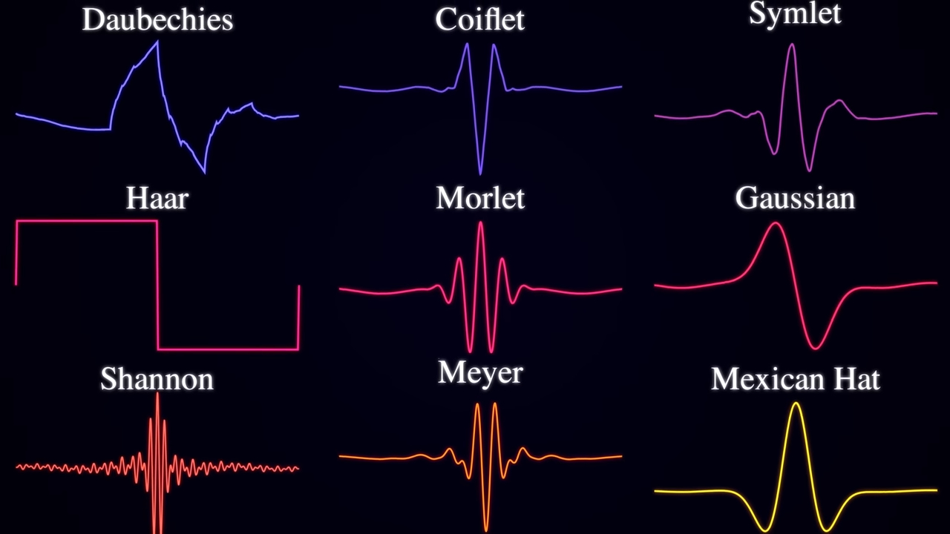
Types of Wavelets:
Notes:
Image Reference: https://www.youtube.com/watch?v=jnxqHcObNK4
Time stamp: 10:28

Slide 6
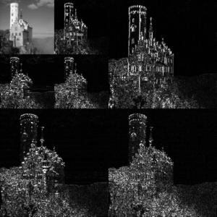
Discrete Wavelet Transform (DWT):
Discrete wavelet transform (DWT) is any wavelet transform for which the wavelets are discretely sampled.
As with other wavelet transforms, a key advantage it has over Fourier Transforms is temporal resolution: it captures both frequency and location information (location in time)
Notes:
Image Reference: https://en.wikipedia.org/wiki/File:Jpeg2000_2-level_wavelet_transform-lichtenstein.png

Slide 7
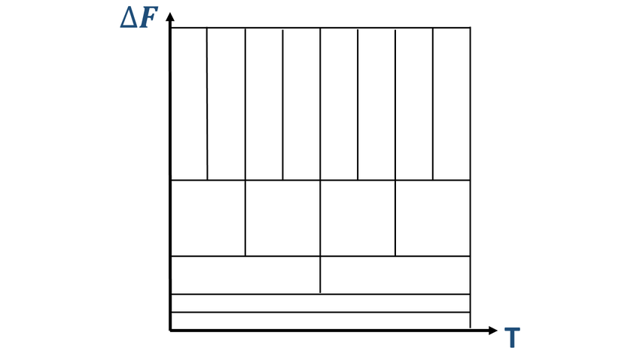
Applications of DWT:
The discrete wavelet transform has a huge number of applications in science, engineering, mathematics and computer science.
Most notably, it is used for signal coding, to represent a discrete signal in a more redundant form, often as a preconditioning for data compression.
Practical applications can also be found in signal processing of accelerations for gait analysis, image processing, in digital communications and many others.
It is shown that discrete wavelet transform (discrete in scale and shift, and continuous in time) is successfully implemented as analog filter bank in biomedical signal processing for design of low-power pacemakers and also in ultra-wideband (UWB) wireless communications.
Time-frequency plane associated to the wavelet packet transform.

Slide 8
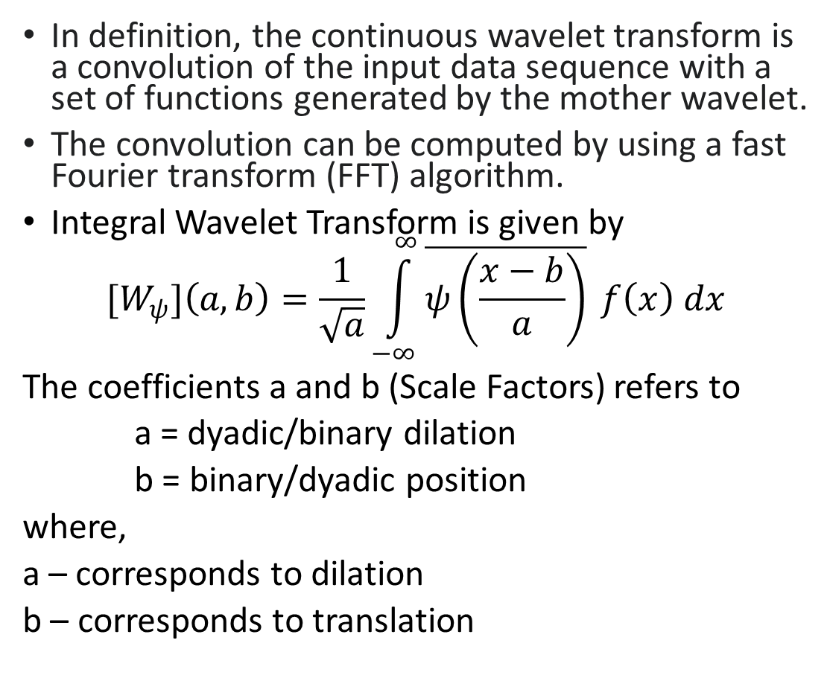
Continuous Wavelet Transform (CWT):
In definition, the continuous wavelet transform is a convolution of the input data sequence with a set of functions generated by the mother wavelet.
The convolution can be computed by using a fast Fourier transform (FFT) algorithm.
Integral Wavelet Transform is given by
$${[W}_{ψ}]\left(a,b\right)=\frac{1}{\sqrt{a}}\int_{−∞}^{∞}{\overline{ψ\left(\frac{x−b}{a}\right)}} f\left(x\right) dx$$
The coefficients a and b (Scale Factors) refers to
a = dyadic/binary dilation
b = binary/dyadic position
where,
a – corresponds to dilation
b – corresponds to translation
Notes:
Image Reference: https://upload.wikimedia.org/wikipedia/commons/thumb/9/95/Continuous_wavelet_transform.gif/450px-Continuous_wavelet_transform.gif

Slide 9
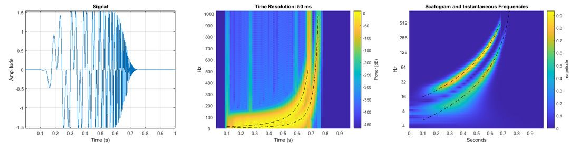
Applications of CWT:
Continuous Wavelet Transform (CWT) is very efficient in determining the damping ratio of oscillating signals
(e.g. identification of damping in dynamic systems).
CWT is also very resistant to the noise in the signal.
Analyzing a hyperbolic chirp signal (left) with two components that vary over time in MATLAB. The short-time Fourier transform (center) does not clearly distinguish the instantaneous frequencies, but the continuous wavelet transform (right) accurately captures them
Notes:
Image Reference: https://in.mathworks.com/discovery/wavelet-transforms.html

