Slide 1
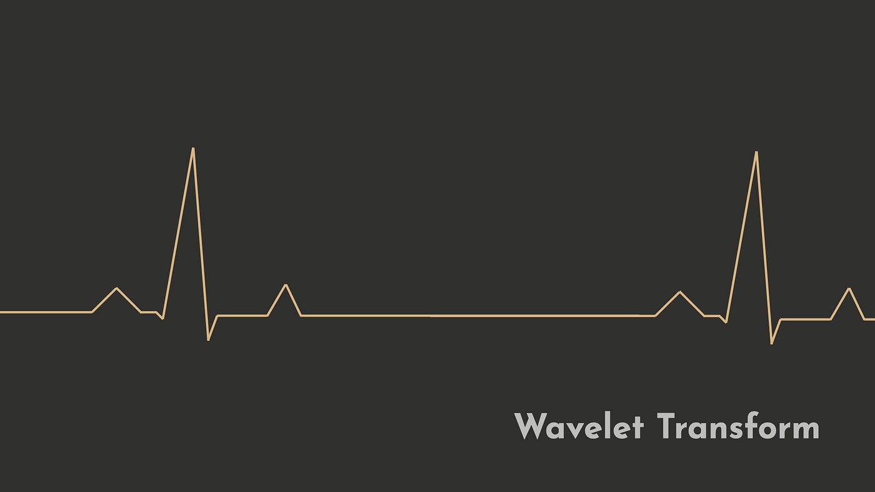
WAVELET ANALYSIS

Slide 2
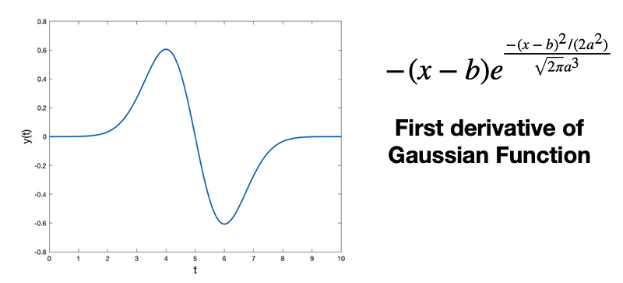
What is Wavelet?
A Wavelet is a wave-like oscillation that is localized in time, an example is given below.
Wavelets have two basic properties: scale and location.
Scale (or dilation) defines how “stretched” or “squished” a wavelet is.
This property is related to frequency as defined for waves.
Location defines where the wavelet is positioned in time (or space).
Notes:
Image Reference: https://cdn-images-1.readmedium.com/v2/resize:fit:800/1*Ioee_j_s29XVULQVUN_OmA.png

Slide 3
What is Wavelet Analysis?
It gives relation between Frequency and Time Domain.
According to Heisenberg uncertainty, frequency and amplitude cannot be measured at the same time.
This implies to Wavelet Analysis as well.
At lower frequency, error in time is wide and in frequency is narrow.
At higher time, error in frequency is wide and in time is narrow.
This practically makes sense, because we need the exact time measure of higher frequency (especially for sounds) and lower frequency waves doesn’t matter at all and they can be present throughout audio wave (like noise).

Slide 4
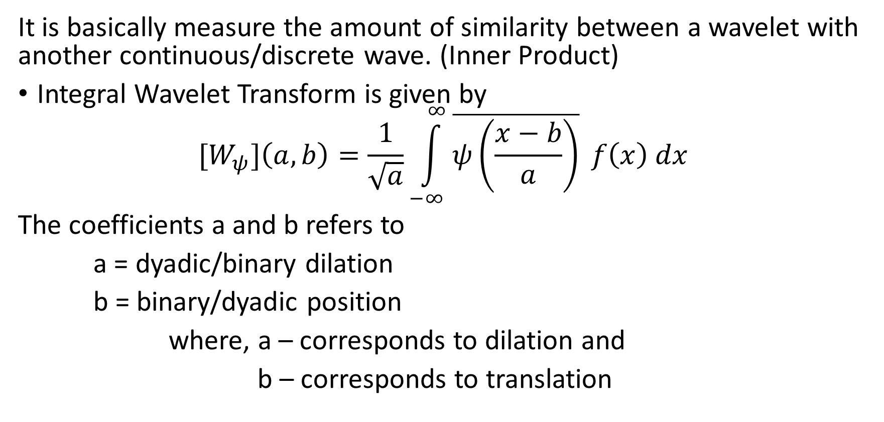
What is Wavelet Analysis?
Continued…
It is basically measure the amount of similarity between a wavelet with another continuous/discrete wave. (Inner Product)
Integral Wavelet Transform is given by
$${[W}_{ψ}]\left(a,b\right)=\frac{1}{\sqrt{a}}\int_{−∞}^{∞}{\overline{ψ\left(\frac{x−b}{a}\right)}} f\left(x\right) dx$$
The coefficients a and b refers to
a = dyadic/binary dilation
b = binary/dyadic position
where, a – corresponds to dilation and
b – corresponds to translation

Slide 5
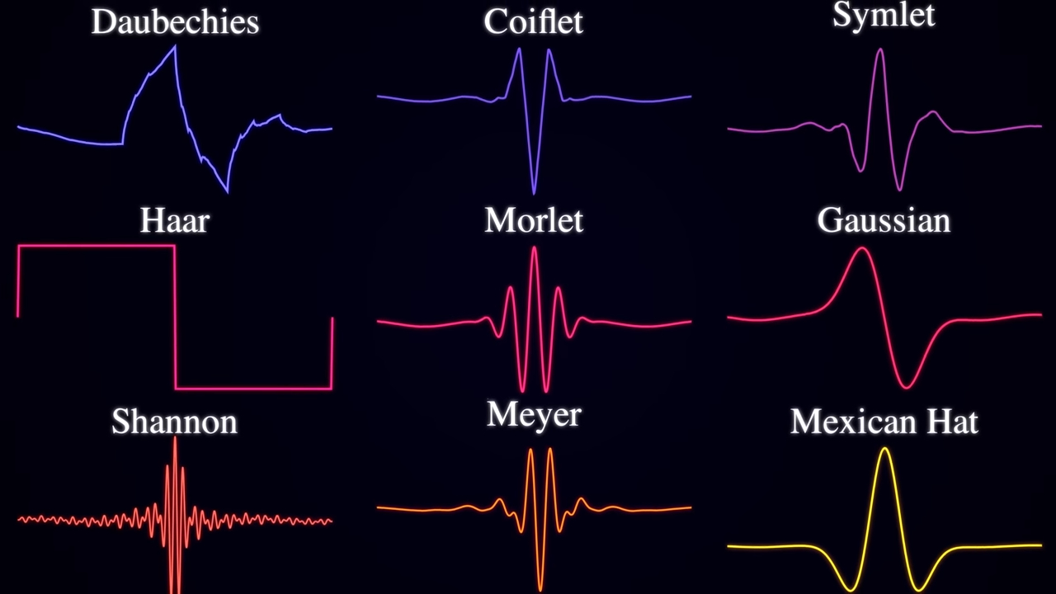
Types of Wavelets:
Notes:
Image Reference: https://www.youtube.com/watch?v=jnxqHcObNK4 10:28

