Slide 1
Allstate Purchase Prediction Challenge
Kevin Markham
May 19, 2014
Class Project: General Assembly Data Science DC

Slide 2
Agenda
What is the competition goal?
Why is this difficult?
What data do we have?
What can we learn from the data?
Can machine learning help?
What worked?
What did I learn?
Most importantly: Did I profit? ($25K prize!)

Slide 3
What is the competition goal?
Machine learning competition run by Kaggle
“Machine learning” = computers learning patterns from data
Sponsored by Allstate (insurance company)
Goal: Predict which car insurance options a customer will buy

Slide 4
Problem context
There are 7 car insurance options, each with 2 to 4 possible values
Values are identified by number (0, 1, 2, etc.)
A “quote” consists of a single combination of those 7 options
Customers review one or more quotes before making their purchase

Slide 5
Example
One customer’s quote history (in order):
What did they purchase?
 | A | B | C | D | E | F | G
Quote 1 | 0 | 0 | 1 | 1 | 0 | 0 | 2
Quote 2 | 1 | 0 | 3 | 3 | 1 | 0 | 1
Quote 3 | 1 | 0 | 1 | 1 | 1 | 0 | 1
Quote 4 | 2 | 0 | 1 | 1 | 1 | 0 | 1
Quote 5 | 2 | 0 | 1 | 1 | 1 | 0 | 1
Quote 6 | 2 | 0 | 1 | 1 | 1 | 0 | 1
Quote 7 | 2 | 0 | 1 | 1 | 1 | 0 | 2
Purchase | 2 | 0 | 1 | 1 | 1 | 0 | 2

Slide 6
Another example
This one should be easy:
What did they purchase?
 | A | B | C | D | E | F | G
Quote 1 | 1 | 1 | 3 | 3 | 0 | 2 | 2
Quote 2 | 1 | 1 | 4 | 3 | 0 | 2 | 2
Quote 3 | 1 | 1 | 4 | 3 | 0 | 2 | 2
Quote 4 | 1 | 1 | 4 | 3 | 0 | 2 | 2
Quote 5 | 1 | 1 | 4 | 3 | 0 | 2 | 2
Quote 6 | 1 | 1 | 4 | 3 | 0 | 2 | 2
Purchase | 2 | 1 | 4 | 3 | 0 | 1 | 2

Slide 7
How does the competition work?
“Training data”:
97,009 customers
Complete quote history plus purchase
“Test data”:
55,716 customers
Partial quote history
Goal is to predict the purchase
Evaluation metric is prediction accuracy

Slide 8
Why is this difficult?
2,304 possible combinations of options
Your prediction is only “correct” if you get all 7 options right!
No “partial credit”
No feedback given on which options were wrong
Options are not identified as to their meaning

Slide 9
Start with a naïve approach
For every customer, simply predict that they will purchase the last set of options they were quoted
Public leaderboard score: 0.53793
Good news: Works pretty well, and much better than random guessing (0.00043)
Bad news: Everyone figured out this strategy (46% of competitors have that identical score)

Slide 10
Data to the rescue!
Customer data
State, location ID, group size, homeowner?, married?, risk factor, oldest person covered, youngest person covered, years covered by previous issuer, previous C option
Car data
Age, value
Additional quote data
Day, time, cost

Slide 11
What can we learn from the data?
There are 2,304 possible option combinations, but perhaps only a small subset are ever actually purchased?
Nope:
1,878 unique combinations appear in training or test data
1,522 unique combinations are purchased in training data

Slide 12
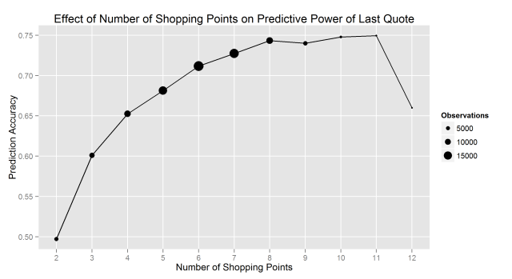
What can we learn from the data?
The more quotes you have for a customer, the better the naïve strategy will work.

Slide 13
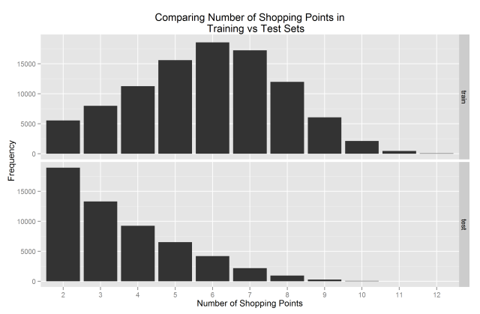
What can we learn from the data?
Test set has been significantly truncated

Slide 14
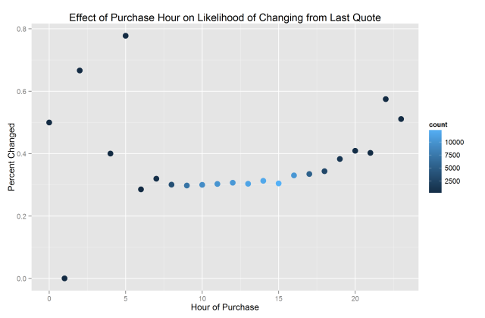
What can we learn from the data?
Behavior can vary based upon time of day

Slide 15
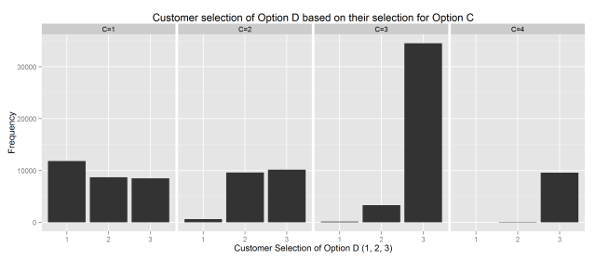
What can we learn from the data?
Option selections affect other options

Slide 16
Predict based on option interactions
Use the naïve approach to make the “baseline” predictions
Create a list of “rules” about pairs of options, and use these rules to “fix” the baseline predictions
Example: If C=3 or C=4, choose D=3
Result: Worse than naïve approach!

Slide 17
Why didn’t this approach work?
These “rules” are based on strong patterns in the data, but patterns are not always correct
You don’t know how many of the 7 options need to be changed from the baseline
Key insight: There is a huge risk when changing any baseline prediction:
There is a 53.793% chance you will “break” a prediction that is already correct.
Balance that against the 0.043% chance that you will change an incorrect prediction to be correct!

Slide 18
New strategy: Model stacking
It is very important to only change a baseline prediction if you’re sure it’s wrong.
Use a “stacked model” approach:
First, predict which customers are likely to change options after their final quote.
Then, fix the baseline predictions only for those customers.

Slide 19
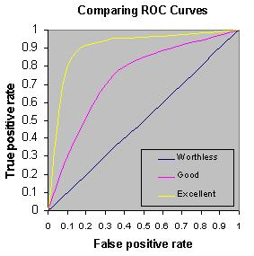
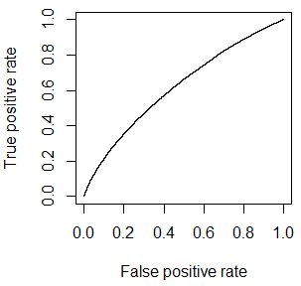
Step 1: Predict who will change
Model with logistic regression, random forests
Evaluate using ROC curve
Reference ROC curve (left) vs. my curve (right)

Slide 20
Feature engineering to the rescue!
Create new features by transforming or combining existing features
Perhaps less noisy than the raw features (and less likely to overfit the training data?)
Examples:
“family” (yes/no): married, group size > 2, youngest covered individual < 25 years old
“timeofday” (day/evening/night): 6am-3pm, 4pm-6pm, 7pm-5am

Slide 21
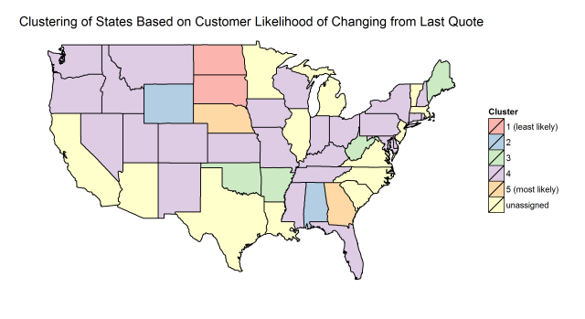
Feature engineering
Examples:
“stategroup”: cluster states based upon observed likelihood of changing from last quote

Slide 22
Feature engineering
Examples:
“stability”: calculation of how much a customer changed their plan options during the quoting process (low stability = more likely to change?)
“planfreq”: calculated frequency with which a given plan appears in the data (low planfreq = more likely to change?)

Slide 23
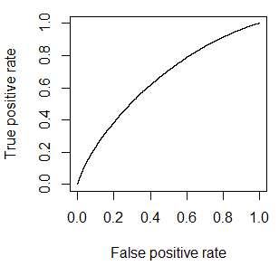
Step 1 (redux): Predict who will change
Redo model, except with new features!
Evaluate using ROC curve
My old curve (left) vs. my new curve (right)

Slide 24
New strategy: Precision not accuracy
Key insight: When predicting which customers will change, it’s much more important to optimize for precision than accuracy
Thus: minimize false positives by setting a high probability threshold
Example:
In test set, about 25,000 customers will change options after their final quote
Don’t try to find all 25,000; instead find 100 customers you are sure will change (and fix their baseline predictions)

Slide 25
Optimizing for precision
Created a cross-validation framework to predict the test set precision of my model
Tuned the probability threshold for predicting change to 0.85 (rather than 0.50)
Obtained 91% cross-validated precision on training set
Also validated (somewhat) on test set

Slide 26
Step 2: Predict new plans
Option 1: Build a single model to predict the entire combination of 7 options at once
Option 2: Build 7 models to predict each option one at a time, and then combine the results
Chose this option, and used random forests and single-hidden-layer neural networks

Slide 27
Poor prediction results
In order for the 7-model approach to produce a correct combination of options at least 50% of the time, each model needs to be at least 90% accurate (since 0.90^7 = 0.50)
Instead, models performed with 60-80% accuracy and thus rarely predicted a completely correct combination of options

Slide 28
Backup plan: Human learning!
Chose 9 customers in test set that had a very high probability of change
Revise option combinations by hand using my list of “rules” about unlikely combinations
Example: If C=3 or C=4, choose D=3
Completely non-scalable, but perhaps generates more nuanced predictions?
Result: No improvement over the baseline

Slide 29
New strategy: Locate unlikely plans
Based on a tip from the Kaggle forums:
Locate plans (combinations of all 7 options) that were “rarely” purchased
If those plans were predicted by the baseline approach, replace them with “more likely” alternatives
These are probably combinations of options that “don’t make sense” to most people
Note: This approach ignores all customer data!

Slide 30
Locating and replacing unlikely plans
Determine which plans are “unlikely”
Calculate view count and purchase likelihood for every plan and set threshold values
Determine the best replacement plan for each unlikely plan
Tally which plans were actually purchased by those who viewed them
Calculate replacement plan commonality and set threshold value

Slide 31
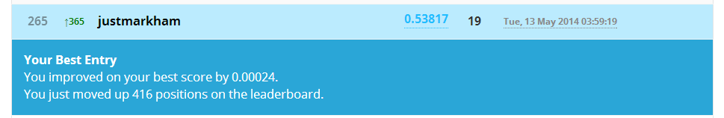
It worked!
Improved upon baseline approach
Tuned threshold values by submitting many different combinations to Kaggle
My best submission beat baseline by 0.06%
Top competitor beat baseline by only 0.78%

Slide 32
What does this approach look like?
Change the plans on the left to the plans on the right:
A | B | C | D | E | F | G
0 | 0 | 3 | 1 | 0 | 0 | 4
0 | 0 | 1 | 1 | 0 | 0 | 4
1 | 1 | 3 | 1 | 1 | 2 | 2
2 | 1 | 2 | 2 | 1 | 0 | 1
1 | 0 | 1 | 1 | 0 | 0 | 4
0 | 0 | 2 | 2 | 0 | 0 | 4
0 | 0 | 3 | 1 | 0 | 0 | 2
2 | 0 | 4 | 3 | 0 | 0 | 4
1 | 1 | 3 | 1 | 1 | 2 | 1
0 | 0 | 3 | 1 | 0 | 0 | 3
A | B | C | D | E | F | G
0 | 0 | 1 | 1 | 0 | 0 | 3
0 | 0 | 1 | 1 | 0 | 0 | 2
1 | 1 | 3 | 3 | 1 | 2 | 1
2 | 1 | 2 | 2 | 1 | 0 | 2
1 | 0 | 1 | 1 | 0 | 0 | 2
0 | 0 | 2 | 2 | 0 | 0 | 2
0 | 0 | 3 | 3 | 0 | 0 | 2
2 | 0 | 4 | 3 | 0 | 0 | 2
1 | 1 | 3 | 3 | 1 | 2 | 1
1 | 1 | 3 | 3 | 1 | 1 | 3

Slide 33
Improving this approach
Stack this approach with one of my models
Did not succeed in improving test set accuracy
Other ideas (didn’t have time to try them):
Don’t always replace an unlikely plan
Don’t always choose the same replacement plan for an unlikely plan
Top competitors are likely using an ensemble of models that incorporates this approach

Slide 34
Lessons Learned
Early in the competition, try many different approaches
Smarter strategies trump more modeling and more data
Real-world data is hard to work with
Algorithms and processes that allow for rapid iteration are priceless
Learn from others around you

Slide 35
Thank You!
GitHub repository with paper and code:
https://github.com/justmarkham/kaggle-allstate

