Slide 1

OPTIMISTIC – AMSGrad
(Optimistic Adaptive Acceleration For Optimization)
Presented by:-
Govardhan Chitrada (1923585)
Amurutham Vamshi Kumar (1920589)

Slide 2
INTRODUCTION
Implementing Optimistic Adaptive Acceleration For Optimization also known as Optimistic AMSGrad can be a challenge when working with large datasets such as CIFAR-100. The new variant assumes that mini-batch gradients in consecutive iterations have some underlying structure, which makes the gradients sequentially predictable. By exploiting the pre- dictability and some ideas from Optimistic Online learning, the algorithm can accelerate the convergence and also enjoys a tighter regret bound. The proposed algorithm not only adapts to the informative dimensions, exhibits momentum, but also exploits a good guess of the next gradient to facilitate acceleration. We conduct experiments and show that OPTIMISTIC-AMSGRAD improves AMSGRAD in terms of various measures.
Titolo Presentazione
Pagina <number>

Slide 3
IMPLEMENTATION
Basic idea behind this is algorithm is predicting the loss function before playing
action by optimistic online learning. Predicting gradients before hand will greatly
reduce the number of epochs to be trained. Combining Optimistic Online Learning
with adaptivity and the momentum to create OPTIMISTIC-AMSGrad is a good
idea. The implementation of algorithm show that OPTIMISTIC-AMSGRAD
improves AMSGRAD in terms of various measures:
Training loss
Testing loss
classification accuracy on training/testing data over epochs
Titolo Presentazione
Pagina <number>

Slide 4
CIFAR-10:
The CIFAR-10 dataset consists of 60000 32x32 color images in 10 classes, with 6000 images per class. There are 50000 training images and 10000 test images.
Classes:
('plane', 'car', 'bird', 'cat', 'deer', 'dog', 'frog', 'horse', 'ship', 'truck’)
ResNet18:
Deep residual learning framework for the image classification task. Which supports several architectural configurations, allowing to achieve a suitable ratio between the speed of work and quality.
Training Platform:
Google Colab with GPU acceleration and pytorch as the underlying framework.
Titolo Presentazione
Pagina <number>

Slide 5
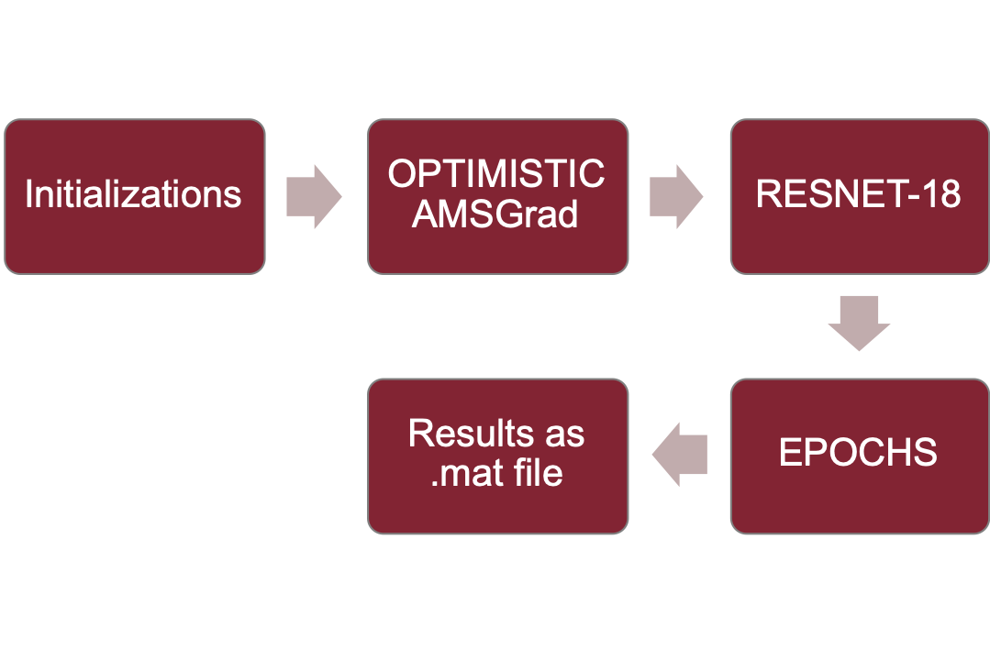
Diagram:
Titolo Presentazione
Pagina <number>

Slide 6
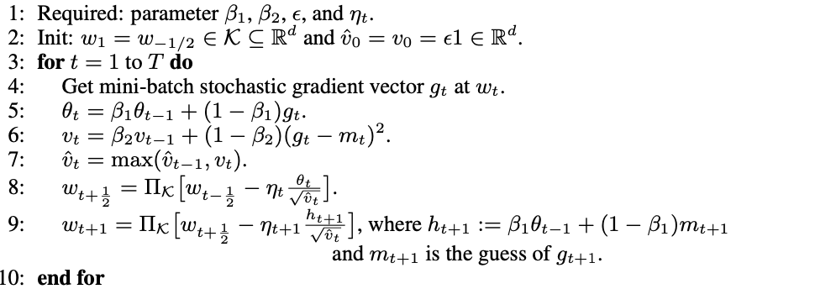
ALGORITHM(optimistic AMSGrad)
Titolo Presentazione
Pagina <number>

Slide 7
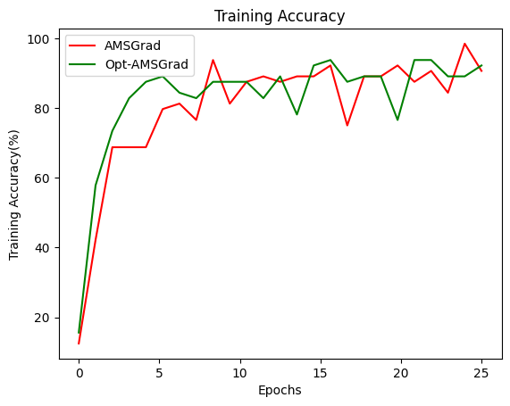
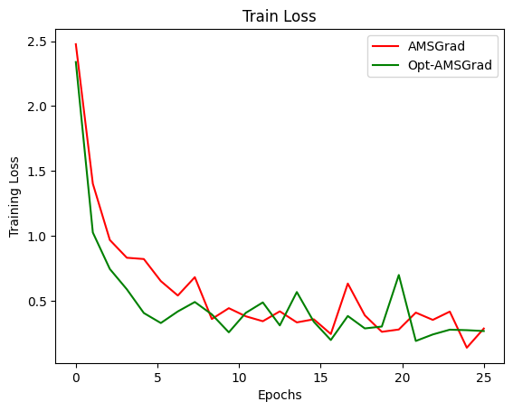
Result Graphs (Training):
Titolo Presentazione
Pagina <number>

Slide 8
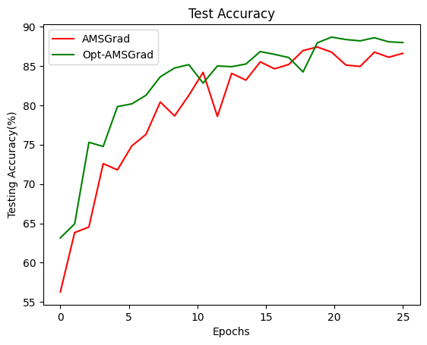
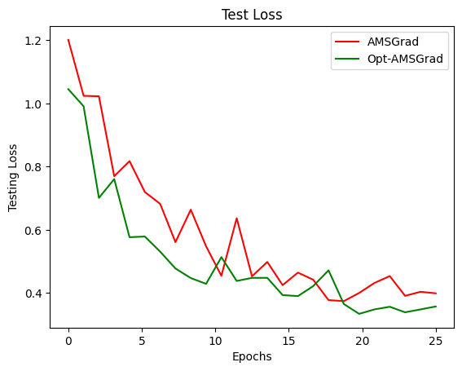
Result Graphs (Testing):
Titolo Presentazione
Pagina <number>

Slide 9
CONCLUSION
As it is an iteration of ADAM we cannot expect a large performance boost in accuracy and training time but significant improvement is observed with CIFAR-10 dataset. To be specific during the first few epochs, the algorithm has a better gradient prediction than that of AMSGrad. We have only trained 25 epochs because each epoch is talking approximately 40 mins to train in google colab. I doubt, even if we increase the number of epochs to 100 the difference will be the same. It is always ideal to use the best optimization algorithm available out there even if the performance difference is little.
Titolo Presentazione
Pagina <number>

